Slide 1
RSHE: helping your child to stay safe and thrive in the modern world
Insert school logo here
Notes:
Welcome families and introduce yourself
Confirm finish time for the session
Ask parents / carers to consider if there is anything they want to get from the session. Give them the chance to post it into an ask it basket- use Question Cards so parents can choose how it will be responded to.

Slide 2
Help keep this space as safe as possible
Respect and compassion
Share with care
Confidentiality
Notes:
Tell parents that in order for this to be as a safe a space as possible for you all to share your thoughts, opinions and experiences you need to set some ground rules. I use:
Please can everyone respect and value difference and diversity in all of its forms and aim to be compassionate even if there’s disagreement with what someone is saying
Think carefully how personal material and views might be used; share with care
And finally, learning can be taken out of the session but please don’t share any personal or identifying information, including online
Ask if there’s anything anyone would like to add.
Explain that RSHE, by its nature, deals with topics that some folk might find distressing or triggering. If they are affected by tonight’s content please practise self care, follow their usual support channels if they would like to follow anything up; how they can contact you using the usual; school channels.

Slide 3
The intentions of this session are to...
Understand some key points from DfE RSHE guidance
Recognise the importance of RSHE for our pupils
Familiarisation with school curriculum and policy
Develop consistent approaches to teaching RSHE within the school.
Notes:
Run through session aims:
Understand some key points from the DfE RSHE guidance
Recognise the importance of RSHE for our pupils
Familiarisation with school curriculum and policy
Develop consistent approaches to teaching RSHE within the school

Slide 4
RSHE Guidance; Secretary of State Foreword
“Today’s children are growing up in an increasingly complex world and living their lives seamlessly on and offline. This presents many positive and exciting opportunities, but also challenges and risks.
In this environment, children and young people need to know how to be safe and healthy, and how to manage their academic, personal and social lives in a positive way.”
Notes:
Either read aloud the foreword from the guidance, or allow parents / carers time to read themselves:
“Today’s children are growing up in an increasingly complex world and living their lives seamlessly on and offline. This presents many positive and exciting opportunities, but also challenges and risks. In this environment, children and young people need to know how to be safe and healthy, and how to manage their academic, personal and social lives in a positive way”.
Damien Hinds was the Education Minister at the time the guidance was publicly published. In his forward he talks about the world being complex, challenges and risks. Ask the parents and carers to consider how these relate to their child; what might they find complex, challenging and risky? Ask them to write these on Post It notes and stick them on a display board; ask them to have a look at other peoples’ and stick similar ones together.
Explain that his foreword also makes it clear that RSHE is about ensuring the safeguarding, health and happiness of young people and research has also linked high quality RSHE to improved attendance and attainment.
If anyone is keen to know more https://www.probonoeconomics.com/resources/pshe-association

Slide 5
What do our pupils say?
Insert an image from your school website picturing your pupils here
Notes:
Share with parents / carers your pupil voice work here; possibly framing it…“We conducted some pupil consultation to identify what knowledge they need to gain from RSHE and to ascertain that our own teaching is age and stage appropriate and relevant to their real lives. This is what we found out….”
Use the pupil voice insight you have gained
- hopefully you can share some positive comments on the quality, content, relevance and inclusiveness of the teaching
hopefully you can share some of the worries, challenges, risks the pupils have or face
Have this insight printed out and stick it to the board containing the Post It notes from the parents / carers.

Slide 6
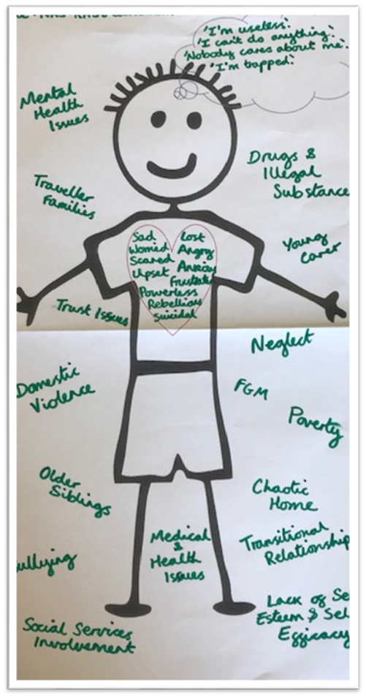
What are the challenges and risks for our young people?
Notes:
Share the local and national health and behaviour data and add a print out to the board with the pupil and family insight on it. Explain that this; underpinned by the DfE guidance for RSHE shapes what, as a school we aim our RSHE provision to provide the children with.

Slide 7
Our school vision for RSHE
Insert your vision statement here
Notes:
Share your school vision for RSHE, highlighting how this links to the school’s overarching mission statement.
Explain that RSHE will be centralised at the core of your school to ensure pupils are safe, happy and healthy. As well as ensuring pupils understand what RSHE is and why it is taught, this is shared with the whole school community. Framing it this way explains why Relationships, Sex Health Education must be taught in secondary school and should reduce the likelihood of resistance or requests for pupils to be excused from these subjects.
You cannot withdraw your child from Health Education or the Relationships Education element of Relationships and Sex Education, because it is important that all children receive this content, covering topics such as friendships and how to stay safe.
If you do not want your child to take part in some or all of the Sex Education lessons delivered at secondary, you can ask that they are withdrawn. The head teacher will consider this request and discuss it with you, and will grant this in all but exceptional circumstances, up until three school terms before your child turns 16. At this age, your child can choose to receive Sex Education if they would like to, and the school should arrange for your child to receive this teaching in one of those three terms (unless there are exceptional circumstances).
The science curriculum in all maintained schools also includes content on human development, including reproduction, which there is no right to withdraw from.
Explain the procedure in your school that should be followed if a parent / carer wishes to excuse their child from Sex Education.
Explain this is available in the RSHE policy and let parents / carers now how they can access this.

Slide 8
Curriculum- Relationships and Sex Education
Families​
Respectful relationships, including friendships​
​Online and media​
Being safe ​
Intimate and sexual relationships, including sexual health​
Notes:
So now parents / carers understand the school’s intention of RSHE, its time to turn their attention to how that’s going to be achieved and we are going to do this initially by sharing the statutory curriculum content, starting with relationships and sex education. It is worth highlighting that this used to be called SRE and is now called RSE, usefully highlighting that the guidance is mainly focused on relationships education and sex education is taught within the context of relationships.
The new guidance contains statutory curriculum content for relationships and sex education. The statutory curriculum includes:​
Families ​
Respectful relationships, including friendships​
Online and media​
Being safe​
Intimate and sexual relationships, including sexual health​
​
The guidance says:​
‘The aim of RSE is to give young people the information they need to help them develop healthy, nurturing relationships of all kinds. It should also cover contraception, developing intimate relationships and resisting pressure to have sex (and not applying pressure). It should teach what is acceptable and unacceptable behaviour in relationships. It should teach young people to understand human sexuality and to respect themselves and others’
Highlight that the school teaches much of this already, not just in RSHE but across the wider curriculum and throughout the school ethos and environment.
If time allows, it would be useful to Share any cross-curricular teaching of RSHE at this stage

Slide 9
Curriculum- Health
Mental wellbeing
Internet safety and harms
Physical health and fitness
Healthy eating
Drugs, alcohol and tobacco
Health and prevention
Basic first aid
Changing adolescent body.
Notes:
The new guidance contains statutory curriculum content for health education. The statutory curriculum includes:
Mental wellbeing
Internet safety and harms
Physical health and fitness
Healthy eating
Drugs, alcohol and tobacco
Health and prevention
Basic first aid
Changing adolescent body
The guidance says:
‘It is important that the starting point for health and wellbeing education should be a focus on enabling pupils to make well-informed, positive choices for themselves. They should know that there is a relationship between good physical health and good mental wellbeing and that this can also influence their ability to learn’.
Highlight that the school teaches much of this already, not just in RSHE but across the wider curriculum and throughout the school ethos and environment. If time allows, it would be useful to ask staff to capture any cross-curricular teaching of RSHE at this stage.
Parents can not withdraw their child from relationships education, health education; or sex education taught as part of the national curriculum for science.
They can withdraw their child from sex education taught as part of the RSHE curriculum until 3 terms before their child turns 16, when the child can decide for themselves
Discuss plans for parental engagement and school process for when a parent exercises their right to have child excused.

Slide 10
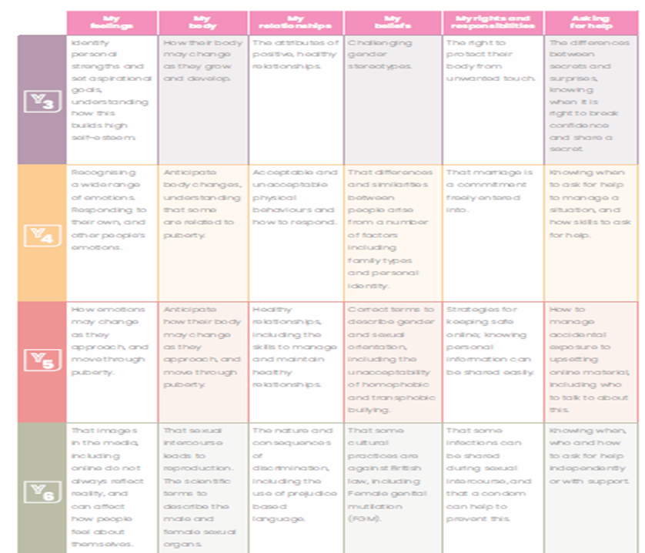
Curriculum
Notes:
So, now we have looked at what pupils will be taught, it’s time to look at how we are planning to teach the statutory curriculum in our school:
Read quotation from guidance:
‘Schools are free to determine how to deliver the content set out in this guidance, in the context of a broad and balanced curriculum. Effective teaching in these subjects will ensure that core knowledge is broken down into units of manageable size and communicated clearly to pupils, in a carefully sequenced way, within a planned programme or lessons’.
Introduce your school RSHE curriculum map. Highlight, using examples, how this is spiral and developmental, teaching acquisition of knowledge, values and interpersonal skills as required in the new guidance.
Explain how parents / carers can get information about curriculum content; what is shared on the website etc and what the school will put in place to ensure learning around RSHE can happen in partnership with families.

Slide 11
How we create a safe space for teaching and learning
Lessons are regular and follow a routine
Working agreement
Use of language
Asking and answering questions
Pupil voice that makes a difference
Adults are emotionally available
Belonging and connection
Distancing
Teachers have been trained to teach these lessons
All causes for concern raised will follow the school safeguarding policy
Notes:
Explain the importance of pupils feeling physically and emotionally safe in an RSHE; for their wellbeing and for effective learning to take place. Share these ways of creating a safe space for RSHE teaching. This list is not exhaustive, and it is important that pupils are consulted.
Teachers have been trained to teach these lessons; using high quality, inclusive resources and using an approach that is needs led; not intended to cause shock or distress
Lessons are regular and follow a routine
There will be a working agreement; clear ground rules can help when teaching about sensitive topics. They also support confidentiality and safeguarding of pupils and will make it clear that no pupil will be forced to join in an activity, or answer a question
We avoid embarrassment and protect pupils’ privacy by always depersonalising discussion, for example, using a case study to illustrate an issue or through the creation of fictional characters. Teachers are unlikely to, and pupils not be asked to, share personal experiences.
Use of language; we use scientific language rather than pet names
We enable pupils to ask and answer questions in a variety of ways so that all pupils can participate and we handling difficult questions sensitively, being mindful of safeguarding. Refer to the ‘ask-it basket’ and ‘question cards’ used at the start
Pupil voice that makes a difference
Adults are emotionally available; the school takes a trauma informed approach and there is a good knowledge of pupil need. Within our lessons on ‘Asking for help’ we encourage pupils to create a ‘helping hand’- 5 trusted grown ups; 2 of which should be in school.
All causes for concern raised as a result of the lessons will be dealt with according to the school safeguarding policy.
Belonging and connection; pupils feel welcome in the classroom and relationships are healthy, positive and respectful. At the heart of this is equality.

Slide 12
Scientific vocabulary
Anus: The private part of the body where poo comes out
Penis: The private part of a boy where wee comes out
Vulva: The private part of a girl that she wipes when she has had a wee
Notes:
Recognise that some parents / carers may find this initially uncomfortable, and it is important to role model not just use of the scientific term, but also confidence and comfort. Not talking about the terms communicates that this is something awkward and embarrassing. It is important that pupils know they can talk about those body parts if they need to discuss issues, including disclosure of abuse. We will share this content in advance and also when the content has been delivered so you can be prepared and support the learning at home.
Key point: It is important to develop a clear, common language so all pupils can effectively engage with the learning. Some preferred slang terms or pet names may be comfortable for some, but not for others.
Be clear that all staff will use scientific language, as opposed to any preferred slang terms, when talking about the private parts of the body and encourage pupils to do the same.
The terms and their descriptions, displayed here, are how pupils are first introduced to the private parts of the body, in primary school, so are hopefully familiar to you.
Anus: The private part of the body where poo comes out
Penis: The private part of a boy where wee comes out
Vulva: The private part of a girl that she wipes when she has had a wee

Slide 13
Some resources we will use…
Notes:
Suggestions for sharing (if you use them):
The RSE Solution resources
PSHE Association and Stonewall resources {highlight these are recommended by the DfE}
Resources that represent the protected characteristics, highlight the quote “Families can include for example, single parent families, LGBT parents, families headed by grandparents, adoptive parents, foster parents and carers amongst other structures.” and think about sharing some resources that show families might look different but that differences they should be respected that other children’s families are also characterised by love and care.

Slide 14
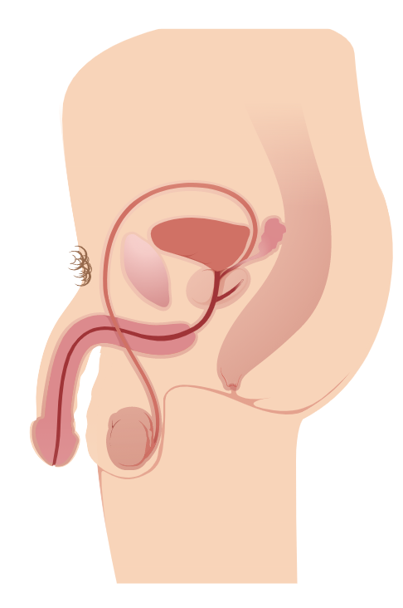
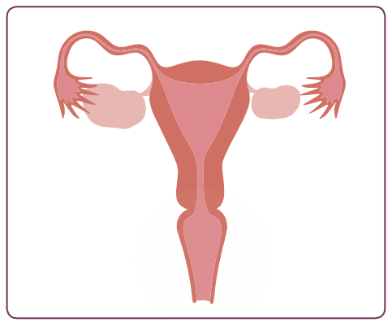
Activity 1; private parts
Notes:
Explain to parents / carers that we are now going to do an activity which teaches pupils to correctly name the main body parts including external genitalia using the scientific terms. Remind them that this work is the foundation needed for the work on the changing adolescent body, is part of staying safe.
Explain you are going to work through an activity usually delivered in the Yr 7 curriculum.
Conduct the session, as detailed in RSE Solution. YR7, Lesson 1. Activity 1.

Slide 15
Activity 2; Puberty
Notes:
You only need to include this slide if you are a school with KS2 pupils
Explain to parents / carers that we are now going to do an activity about puberty. Remind them that ‘Changing adolescent body’ is a topic within Health Education.
Ask parents, working in small groups, to draw a Venn Diagram (two overlapping circles). In one circle ask them to write every puberty experience they can think of that happens to girls only and in the other to boys only. Ask them to use the middle overlapping space to write every puberty experience that is common to all genders. Discuss what they notice? Key point: Many puberty experiences are common to all genders.
Explain you are going to work through an activity usually delivered in the Yr 7 curriculum.
Conduct the session, as detailed in RSE Solution. YR7, Lesson 1. Activity 2.
If time allows play the Puberty Pictionary game: RSE Solution. YR5, Lesson 2, extension activity.

Slide 16
Activity 3; Sex Education
Notes:
Tell parents / carers that it is recognised Sex Education may be a topic area that parents / carers are often anxious about discussing and that is a perfectly natural response. Tell parents / carers that just like Relationships and Health Education; secondary schools must teach Sex Education. It is recommended for primary schools and most pupils will have been taught Sex Education in Yr 6.
Explain you are going to work through an activity usually delivered in the Yr 7 curriculum.
Conduct the session, as detailed in RSE Solution. YR7, Lesson 1. Activity 3.

Slide 17
Activity 4; Inclusive approaches
Notes:
Read quotation from the legislation:
‘Schools should be alive to issues such as everyday sexism, misogyny, homophobia and gender stereotypes and take positive action to build a culture where these are not tolerated, and any occurrences are identified and tackled. Staff have an important role to play in modelling positive behaviours. Schools must ensure that they comply with the relevant provisions of the Equality Act 2010, (please see The Equality Act 2010 and schools: Departmental advice), under which sexual orientation and gender reassignment are amongst the protected characteristics’.
Remind staff that it is important that as a school we continue to prevent incidents of bullying linked to a young person’s actual (or perceived) gender and/or sexual orientation. Teaching should be fully inclusive and not assume a heteronormative approach. This is where it is assumed that relationships are between a man and a woman. Teaching should also challenge gender stereotypes as far as possible.
Recognise that as language can be fluid, some staff may feel anxious about the ‘right’ terms to use. Explain that we are now going to do an activity to help build confidence around this, ensuring as we scientific terms for describing the private parts of the body, that we also have a common language for talking about gender and sexuality.
Explain you are going to work through an activity usually delivered in the Yr 7 curriculum.
Conduct the session, as detailed in RSE Solution. YR7, Lesson 2. Activity 1.

Slide 18
Top tips for talking to your child…
✔ Start by talking about something that you both find comfortable, such as feelings and emotions
✔ Ask your child what they think their friends know/think about the topic
✔ Avoid ‘The Chat’
✔ Reading a picture book containing relevant content is a helpful way to stimulate discussion with your child
✔ Don’t leave it too late
✔ Be prepared to listen
✔ If your child asks you a question you are not sure how to answer, don’t panic!
✔ Try to listen calmly, even if what they say surprises or concerns you.
Notes:
Share these tips (send them home and make available on your website)
✔ Start by talking about something that you both find comfortable, such as feelings and emotions.
✔ Ask your child what they think their friends know/think about the topic, as this provides a way to talk about your child’s views indirectly.
✔ Avoid ‘The Chat’. Talk about these topics little and often over everyday events like playing, drawing, whilst driving in the car or watching TV. This can help to normalise the conversation, easing uncomfortable feelings.
✔ Reading a picture book containing relevant content is a helpful way to stimulate discussion with your child. Your school or the library should be able to suggest some titles.
✔ Don’t leave it too late. Start talking about relevant topics before you feel your child is approaching a level of curiosity about it, so you establish strong channels of communication in readiness.
✔ Be prepared to listen. Your child will want to have their voice heard without feeling judged. Feeling listened to will encourage your child to talk about issues in the future.
✔ If your child asks you a question you are not sure how to answer, don’t panic! Let them know that you will answer it at another time, making sure you remember to. Sometimes a simple answer can provide a sufficient response.
✔ Try to listen calmly, even if what they say surprises or concerns you. Remember that it is good that they are comfortable to discuss issues with you. They need to trust that you will not respond negatively.
Explain there is also a ‘Top tips for talking to your child about sex’

Slide 19
How else can we help you…
If you would like to discuss the RSHE provision further, please: Insert email/phone Staff member
Information, advice, guidance
Just One Number; 0300 300 0123
Childline.org.uk; 0800 1111
Kooth.com (11+)
Notes:
Explain that in school we signpost pupils to who they can talk to in school if they have any questions or concerns about what has been taught in the lesson and reputable sources of information and guidance. We aim to address all questions to minimise the risk of pupils finding themselves in an unsafe space via an Internet search.
Explain that you are also here to support families- share details
And share some reputable sources of information and guidance.

Slide 20
RSHE can make a difference!
“These subjects represent a huge opportunity to help our children and young people develop. The knowledge and attributes gained will support their own, and others’, well-being and attainment and help young people to become successful and happy adults who make a meaningful contribution to society.”
Notes:
Read final script from slide:
‘These subjects represent a huge opportunity to help our children and young people develop. The knowledge and attributes gained will support their own, and others’, wellbeing and attainment and help young people to become successful and happy adults who make a meaningful contribution to society’.
Reassure parents / carers that RSHE will have a positive impact of on the health, wellbeing and safeguarding of their children. However big the challenges they may face in parenting, it is not something anyone needs to do alone, and the school is here to support.
Thank parents / carers for their attendance and engagement with the session.
Remind parents / carers they can stay behind for specific concerns
Make sure that a member of staff is available at the end of the session to speak to any parents or carers who have specific questions.

