Slide 1

Norfolk & Waveney
CYPMH Transformation
School Forum Meeting – 12th March
Notes:
Expectation setting:
This isn’t capacity and demand (we haven’t been asked to work on that), nor a piece of work aimed at reducing the wait lists;
we don’t have the answers to reducing the burden on existing teams.
This is focused on how we improve the experience of young people by changing / creating the overall clinical model.
Overview:
Feedback from previous events and young people
The model paper which was already been agreed
What we have done to date now
What do we need to make it work – ask 3 questions to get feedback

Slide 2

The Integrated CYP MH Commissioning Team
The CYP Mental Health Integrated Commissioning team is currently a team of 4 with a WTE of 3.2 (although 2 more are joining soon!)
We are responsible for the commissioning of and ongoing transformation relating to all CYP MH service areas – in line with the NHS Long Term Plan we are moving to a model which views CYP from birth to the young persons 25th Birthday.
There are also significant overlaps with other areas of CYP commissioning and transformation and thus we are also involved in wider programmes relating to NDD, Safeguarding and SEND.
Across CYPMH services in Norfolk and Waveney we are adopting the ‘Thrive Framework’ which means every child across Norfolk and Waveney will have an offer of support for their emotional wellbeing and mental health needs across all 5 ‘needs based groupings’.
The portfolio for our team is significant. However headline priorities include:
Meeting National Standard in line with the Five Year Forward View and the Long Term Plan – Minimum access of 35% increasing year on year and the Eating Disorder Access and Waiting Time Standard, 1 Week to Treatment for Urgent and 1 Week to Treatment for Routine
Multiple transformation programmes; including Core CAMHS Commissioning (Early Intervention and NSFT Core Offer), Eating Disorders, Crisis Presentations and Inpatient admissions, Self Harm and Suicide Prevention, Improving Transitions (particularly 18-25 years), Perinatal and Maternal Mental Health, LAC, Thriving and Universal (including the MH Offer to Schools) and Digital e.g. digital solutions to case management and the online offer of support.
Ensuring Easy Access to CYPMHS and appropriate support regardless of presentation or severity of need (improving external referral forms, scoping an integrated front door, improving communications and access to advice and guidance, mobilising a shared case management system, and coproduced triage and assessment forms)
Reducing Waiting Times to access CYPMHS Therapeutic Teams (and promoting alternative support sources)
Improved Integration with wider statutory partners on ongoing transformation including Childrens Services (ECFS, Social Care, LAAC, Exploitation) and Education.
Developing and growing the CYP MH workforce (we very much see education staff as part of this growing workforce!)
Ensuring CYP and their families are involved in the ongoing development and improvement of CYPMHS (Participation and Engagement Model)
Service gaps; Trauma (particularly linked to NDD agenda), Family Focussed Therapeutic Services, All-age eating disorder, crisis and self harm/suicide prevention strategies and pathways,
Vast CYP programme of contract and performance management and short term projects e.g. improving discharge and reducing admissions, MHIS, Recruit to Train Posts
Managing the operational implications and complications of COVID19 and its wider impact on the Mental Health support available to CYP and families

Slide 3
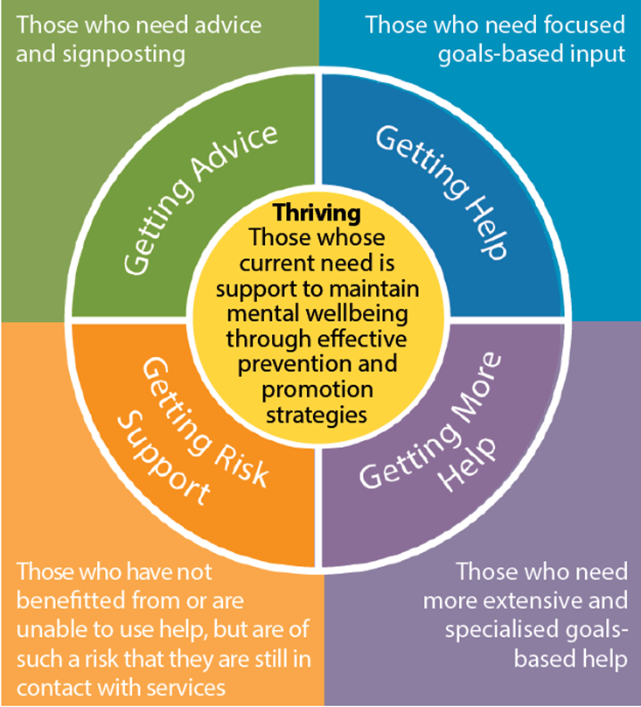
THRIVE Framework
We want to create a system based on the THRIVE framework, a nationally recognised best practice approach cited in the Government’s recent Green Paper.
Instead of a tiered system that creates gaps and exacerbates waiting times, a THRIVE-based system focuses on the needs of individual children, young people and young adults.
All 0—25 year olds are considered to be ‘in’ the THRIVE framework. The majority of CYP will be ‘Thriving’. 1 in 6 are likely to need some kind of help (above traditional promotion of wellbeing across schools, community groups etc), with the majority having needs met through ‘Getting Advice’.
Education establishments have a vital role to play in not only educating on mental health and emotional wellbeing but creating a school culture that promotes good mental wellbeing and resilience.

Slide 4
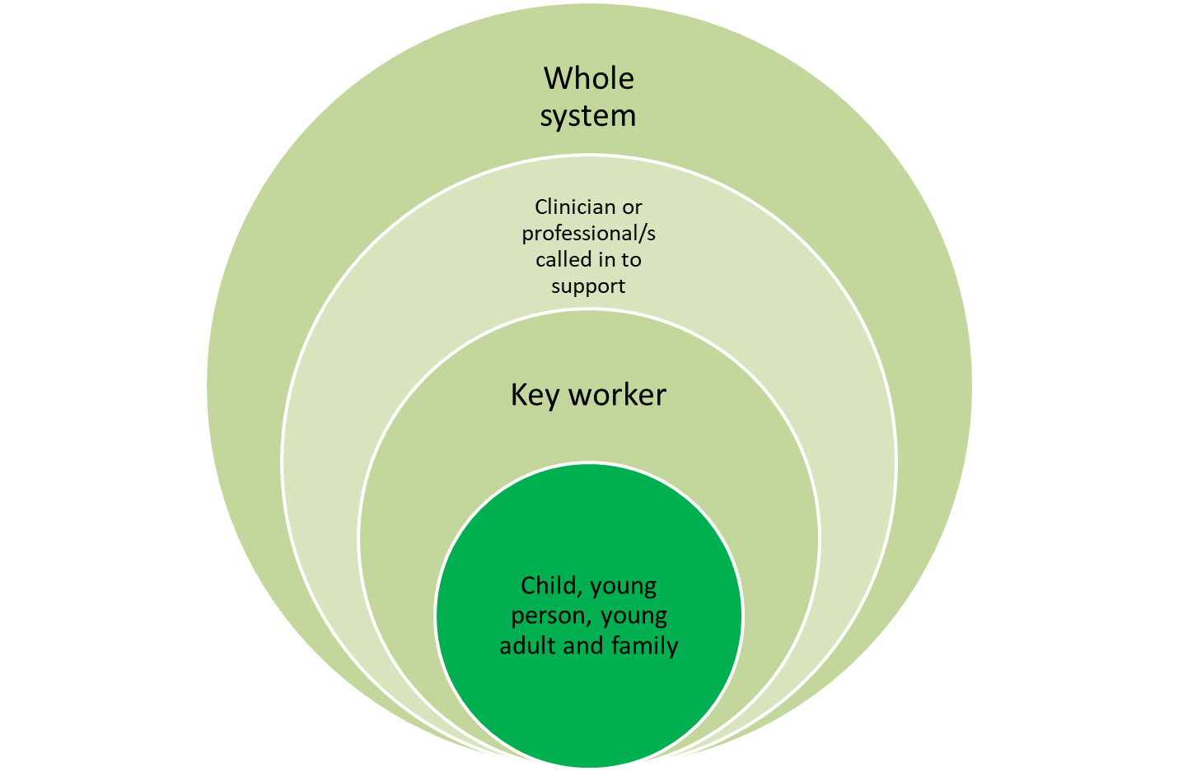
Moving the system around the child or young person
Instead of moving a child or young person around the system, we will move the system around the child or young person. Our new model will embrace some core principles:
0—25 yrs: any child, young person or young adult up to their 25th birthday will be served by this model.
Relationship focused: reducing ‘hand offs’ and reducing the amount of times children and young people need to tell their story.
Clear access routes for children, young people, young adults and professionals.
A focus on Thriving: investing in early prevention and aiming to return those with difficulties to a Thriving state.
Community Based: serving local communities and building community capacity.
Working as a single system, with shared case management, performance management and assessments across providers.
Multi-agency multi disciplinary teams that provide support to families, professionals, and universal settings (especially schools).
Goal-Focused & Episodic Interventions: involving children, young people and young adults in setting goals and making choices.
Could absolutely be a teacher, teaching assistant, pastoral lead or school nurse

Slide 5
Benefits
Supporting children and young people to have good mental health and wellbeing | Improved mental health and wellbeing CYPF are enabled to look after their own mental health and wellbeing CYPF feel supported to recognise mental health issues and know where to go for help Increased number of CYPF are appropriately supported by the right services at the right time Increased knowledge and awareness within communities to support health and wellbeing
Educational establishments are in a unique position in that they see, and importantly, develop a relationship with a young person more than any other professional
By ensuring that schools adopt ‘whole school approaches’ to MH and EWB, CYP will be able to recognise MH issues and know who to go to for support
Reducing the negative effects of emotional and mental health difficulties | Improved functioning (social, educational) for CYP experiencing mental and emotional health difficulties Reduced need for emergency, crisis and social care interventions Timely access to and progress through interventions Improved physical health Reduced inequality gap for key developmental milestones Duration of help-seeking is reduced Parents/carers, CYP and professionals are aware of available help and how to access it CYP are able to remain at home in safe, stable, nurturing environments
We know if CYP’s emotional health needs are met that improves social and educational functioning (it also improves staff wellbeing)
Good MH and resilience is a vital predictor of attendance, attainment and positive social relationships
If a CYP’s MH needs are addressed at an earlier opportunity the duration of help seeking is reduced, and the likelihood of escalation is far lower (reducing the demand on therapeutic/secondary MH services)
Improving transitions into and experiences of adulthood | Improved engagement with universal services including school/college/university and apprenticeships Improved achievement of educational milestones More YP accessing training and skills development opportunities YP are confident in developing their independence YP report greater agency and autonomy and have sufficient understanding and skills to take a leading role in their own recovery
50% of MH presentations occur before a child's 14th Birthday, and 75% before they turn 24.
Creating a culture, embedding learning around wellbeing and the importance of resilience and equipping CYP with core life skills within education settings, has the potential to impact a young person through their entire life.

Slide 6
So what is the education offer currently…

Slide 7

Healthy Child Programme
Our Healthy Child Programme team can help you by providing health advice and information about a child or young person (or help the young person, and their family directly).
‘Just One’ Number
They are able to support you over the telephone (whether you are a parent, young person or professional). Just call 0300 300 0123 or text 07520 631590 with any questions
This service is available from Monday – Friday 8am to 6pm and 9am to 1pm on Saturdays.
Chat Health
ChatHealth is a secure NHS approved text messaging service for 11- 19 year olds.
All the CYP needs to do is text 07480 635060 to start a conversation about anything that is worrying them and a health practitioner will respond as soon as they can
Health Passport App
The Just1Norfolk Health Passport has been developed to support Norfolk 16-19 year olds make the transition into adulthood and to help young people become more independent with their own health needs.
The app provides general health information and advice on a variety of topics
Emotional Health Pathway and Resilience Practitioners
Referrals for this offer come through school nurses (already working with a CYP) or through the Just One Number phone line.
When a referral is made (either by a parent, school, family) they are called back and a full assessment of need completed.
A short intervention (6-8 sessions) from a Resilience and Emotional Health Practitioner may be appropriate.

Slide 8

‘The LINK’ Programme
The Link is designed to maximise the impact of our ‘Early Intervention’ therapeutic service. It does so by providing advice, support and training to adults who work with children and young people across Norfolk and Waveney.
The Link project:
  Identifies, trains, develops and supports ‘mental health champions’ to discuss concerns about children and make educated referrals to targeted and specialist Child Adult and Mental Health Service (CAMHS) teams
  Supports mental health champions in delivering the information they have learned to other staff within their workplace
  Runs a rolling programme of training events and consultations
  Delivers an area specific termly newsletter and update
  Builds community connections between professionals
Across Norfolk & Waveney, 228 schools have a trained Mental Health Champion. Of those schools, 111 have at least one member of the Senior Leadership Team (SLT) trained as a Mental Health Champion.
If you do not yet have a MH Champion within your school and would like one, or if you would like to increase the number of champions you already have, please contact: linkwork-point1@ormistonfamilies.org.uk

Slide 9
Mental Health Support Teams (MHSTs)
In 2017, the Government published its Green Paper for Transforming children and young people’s mental health, which detailed proposals for expanding access to mental health care for children and young people, building on the national NHS transformation programme which is already underway.
MHSTs are intended to provide ADDITIONAL RESOURCE around early intervention within a school environment on some mental health and emotional wellbeing issues, such as mild to moderate anxiety, as well as helping staff within a school or college setting to provide a ‘whole school approach’ to mental health and wellbeing.
Each MHST is allocated to a geographical area and supports approx. 20 primary, secondary, or special schools (around 8000 pupils).
Each MHST has a ‘suggested structure’ which includes 4FTE Education Mental Health Practitioners (in training for 12 months), 2FTE Band 6 Senior Practitioners (who should be clinical), 1 x Band 7 (Team Lead – ideally clinical) and a 0.5FTE Band 8a to supervise the clinical staff…plus 0.5FTE admin support
In Norfolk and Waveney we have 2 MHSTs that have just mobilised (in North Norfolk and Kings Lynn and West Norfolk) and we have a further 2 MHSTs currently in their training year (for Lowestoft and South Norfolk).
Over the next 3 years (national funding committed until 2025) there is an ambition to have another 6-9 MHSTs across the N&W landscape…representing around 50-60% coverage of all schools in our area…there may be a MHST allocated to your school area in the next few years so please keep an eye out and engage with our recruitment efforts!

Slide 10

‘Nurturing Resilience’ Programme
Fully funded (by DfE and DfHSC) project to support schools around emotional wellbeing and embedding whole school approaches to mental health in light of the pandemic
Phase 1 (delivered Sep-Dec 2020)
2 part webinar and evidence based resources available to access for all schools to promote Whole School Approaches to Emotional Health
Whole school approach to EHWB; A Toolkit
All resources accessible for any education setting: https://www.schools.norfolk.gov.uk/teaching-and-learning/wellbeing-in-education/wellbeing-introduction
Phase 2 (March-July 2021)
Webinars on identified areas of concern focussing on NQTs, SENCOs, DSLs – focus on Trauma informed practice.
Nurturing Wellbeing Webinars aimed at both Primary and Secondary Age pupils – all schools – Part 1 has happened (and will be available online soon) to book part 2:
  Primary https://s4s.norfolk.gov.uk/Event/135201
  Secondary https://s4s.norfolk.gov.uk/Event/135203
Targeted offer for some schools to develop their own ‘Whole School Approach’ (supported by an advisor) – EOI Closed
Further targeted offer to schools who will be additionally supported to mobilise their approaches to EHWB – EOI Closed
For further information please contact the Inclusion and Opportunity Team in Norfolk County Council: josie.rayner-wells@norfolk.gov.uk and victoria.groom@norfolk.gov.uk

Slide 11
Key Calls to Action/Things to Consider…
How many of our schools do not have any Mental Health Champions (how many schools have only one and should have more)? How do we promote this?
How consistent are policies and procedures around supporting CYP with EWB and MH (and behavioural) needs across Norfolk schools? How frequently are these reviewed and revised?
How are we promoting Kooth within the Education sector – could we be doing more to utilise this resource?
How can we as a system ‘give pupils a voice’…what do CYP want to see schools do to support their mental health and wellbeing – could this be through school council groups, or regular engagement as part of the tutor time? How do we ensure these suggestions are properly considered/implemented?
How do we embed wellbeing and resilience building ‘activities’ into the school curriculum/day e.g. Mindfulness Monday, Time to Talk Tuesday – so wellbeing is not just considered during RSHE time?
How is staff wellbeing considered? Are there places/people school staff can go to if they have just had a really difficult conversation? How can a culture around promoting wellbeing and resilience be modelled across the entire school landscape (as opposed to prioritising discussion around mental illness)?
What more could we do to support parents?

Slide 12
Any questions?
Please email Kelly.semper@nhs.net if you need further information

