Slide 1
RSHE Pupil Voice Activity Primary
Part of the RSHE whole-school approach toolkit
inclusionandsend@norfolk.gov.uk

Slide 2
RSHE - what do you think?
Insert school logo here
Notes:
Notes:
Today we are going to be thinking about RSHE. RSHE helps children and young people to be safe, healthy and prepared for life's opportunities. Re-cap with pupils the different topics that are covered in RSHE and remind them about previous work they may have done on friendship, different kinds of families, taking care of their bodies, growing and changing, feelings, different communities, asking for help etc

Slide 3
We are going to explore:
What RSHE is and why we do it
How we can improve RSHE
What you want to learn in RSHE
Notes:
Notes:
We are going to explore what RSHE is, why it is so important to do in school and what we can do to make it as good as it can be for you.
We are looking forward to learning from you.

Slide 4
Warming up
Notes:
Sit on the floor in a circle. Someone (we suggest a leader) starts in the middle and says "The sun shines on people who (choose an attribute that more than one person, including the person saying it, in the room has, e.g. have blue eyes; are wearing red; have a sibling etc).
All the people who share that attribute must swap places and the person from the middle must try to take one of their places, leaving a new person in the middle to say the next "The sun shines on.." thing.
Continue until everyone is exhausted (or has had a go!).
Emphasise that we all have different experience/views etc and that it is OK to have different ideas to each other as we go through today’s activities

Slide 5
RSHE helps you to be healthy, happy and safe
Families
Friendships
Being safe online
And more!
Growing up
First Aid
Feelings
Notes:
Notes:
RSHE stands for relationships education, sex education and health education.
Each school teaches RSHE differently because each school and the pupils, their families and teachers are different.
It’s really important that schools are teaching pupils what they need to know to stay healthy, happy and safe.
We think we know what that is but it makes RSHE even better when you tell us what you want to learn, what you need to learn and how you want to learn it.
There are lots of ways you can tell us and we really value what you tell us.

Slide 6
A class contract
Notes:
Notes:
A class contract can help everyone feel safe to join in with RSHE as it sets out rules; things that are okay and things that are not okay. It’s a way for your class to agree some behaviours for the RSHE lessons.
What would you like to see included on the class contract?

Slide 7
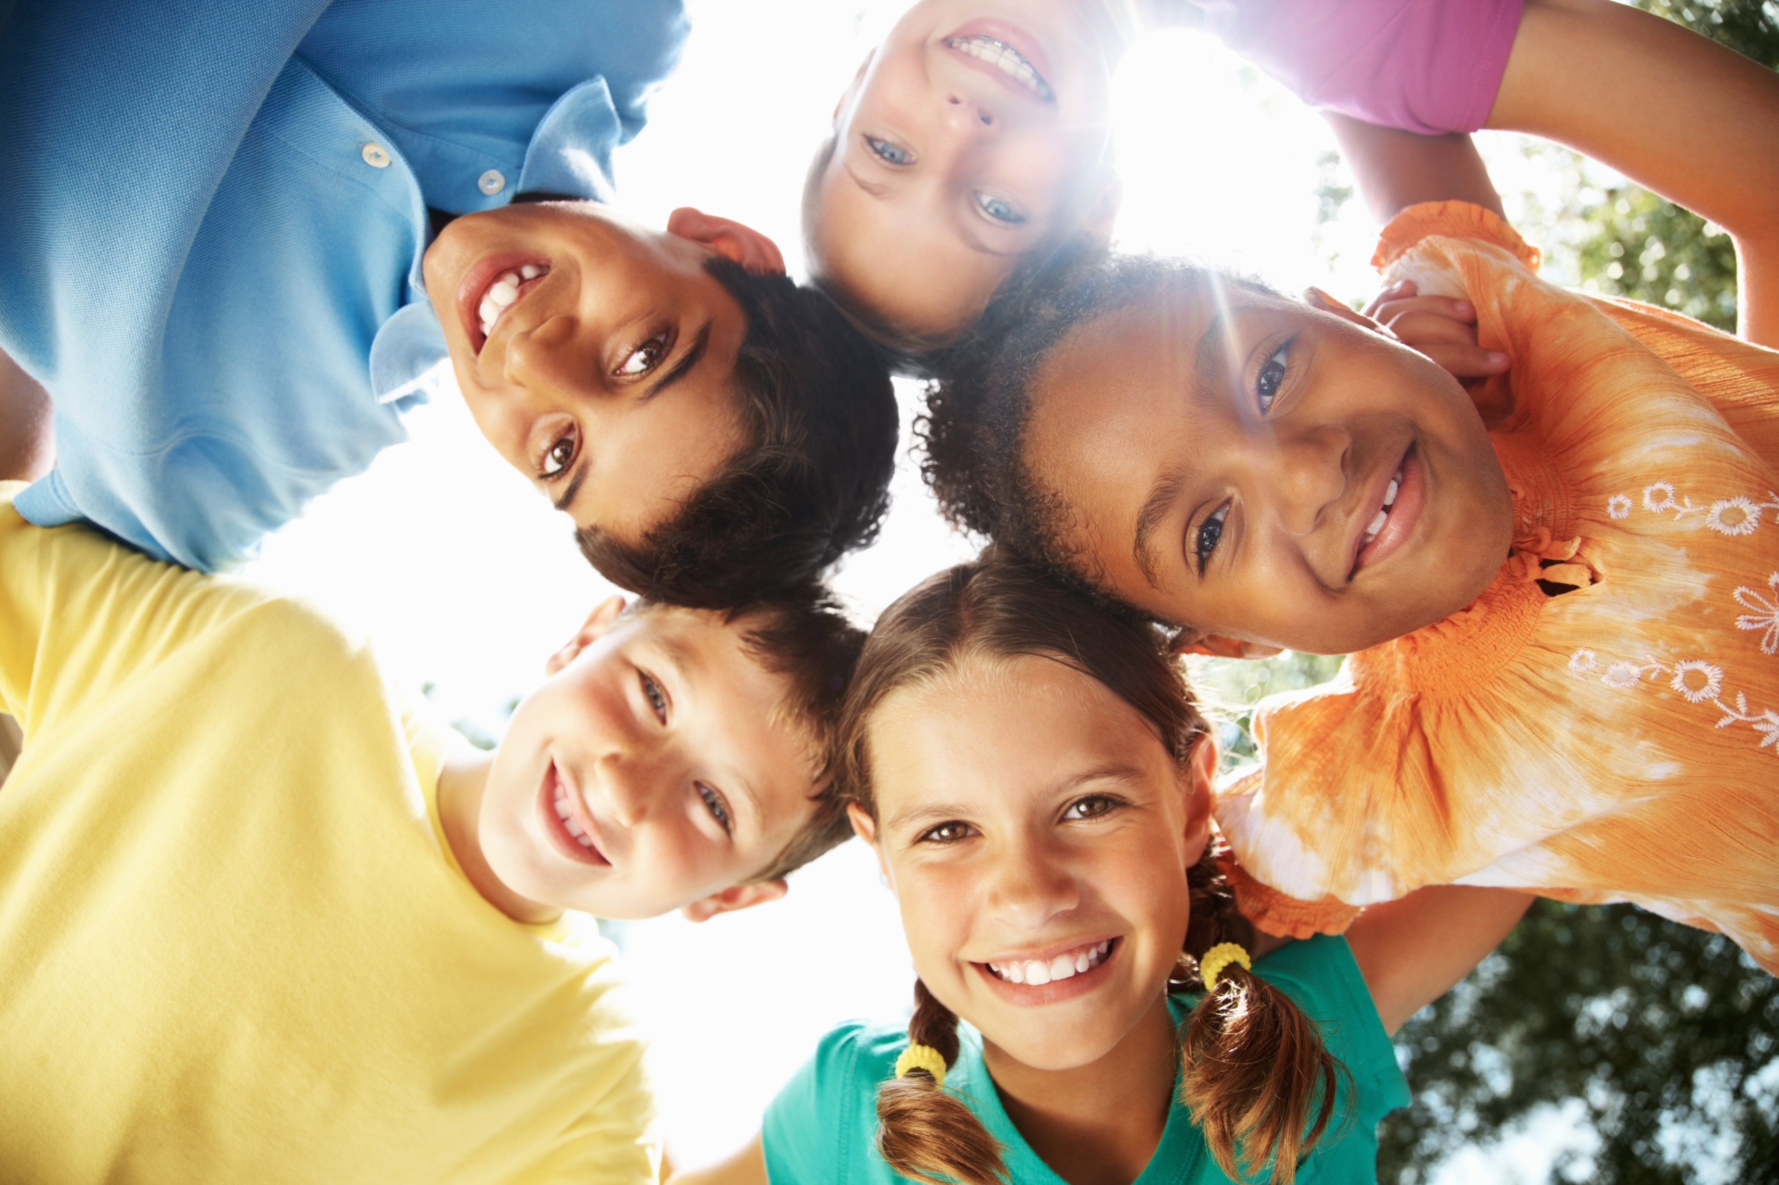
What’s in a name?
Notes:
Notes:
‘RSHE’ can be hard to remember and might not be the most fun name. Thinking about the different things you learn in RSHE, what do you think would be a better name?
We can always come back to this later once we have explored RSHE a bit more.

Slide 8
How is stick pupil doing?
What worries does stick pupil have?
How does stick pupil feel?
What is stick pupil thinking?
How might stick pupil behave because of their problems, thoughts and feelings?
Who does stick pupil go to with their worries?
Notes:
Notes:
Imagine a pupil of the year above you at school. What problems, thoughts and feelings do you think they may experience?
Draw a stick pupil
Write all the problems around the outside of them
Draw a heart and write their feelings inside
Draw a thought bubble and write their thoughts inside
Around the edge of the paper, to make a frame, write how they might behave because of their problems, thoughts and feelings.

Slide 9
What does stick pupil need to be happier, healthier and safer?
What does stick pupil need to know?
What does stick pupil need to be able to do?
What does stick pupil need to understand?
Notes:
Notes:

Slide 10
Some of the things we learn in RSHE
Coping with change
Healthy bodies, healthy minds
Families
Caring and responsibility
Similarities and differences
Healthy and happy friendships
Notes:
Notes:
These are some of the things we learn about in RSHE; I have put pictures of them around the classroom.
Have a think and go and stand next to…
The one you know most about
The one you want to know more about
The one you think our class is really good at
The one you think our class need to get better at

Slide 11
We would love to hear more!
‘Ask it’ basket
Notes:
“Are there any other things you are interested in learning about in RSHE? Is there anything you would like us to know that would help us create RSHE lessons that help you to be as happy, healthy and safe as possible?”
Create the ‘basket’ and put it in an accessible place, tell pupils when it will be checked and how entries will be responded to. They can add their name if they want but usually entries would be anonymous.

Slide 12
How does stick pupil like to learn?
What makes learning fun?
How do we know if we are learning?
How can we ask for help?
Notes:
Notes:

Slide 13
What does stick pupil need to learn?
What knowledge does stick pupil need?
What skills does stick pupil need?
What does stick pupil need to understand?

Slide 14
Design a teacher!
What makes a good RSHE teacher?
What would they look like?
What would they have?
What would they do?
What would they say?
What would they be like?
Notes:
Notes:

Slide 15
Affirmations
I am powerful
I am free to be myself
My feelings matter
I can make a difference
I choose to be happy
I am important
Notes:
Notes
Thank pupils for their contributions, highlighting any common or key points that have been made.
Explain that their work today will make a difference to how RSHE is taught and that it is important to remember that they do make a difference.
Spend a minute reading through the affirmations and if the children like them, think about displaying them in the classroom or beyond.

Slide 16
Thank you
Thank you!
Notes:
Notes:
If you have any other ideas, share these with your class teacher, draw or write them and pop them in the ask it basket.

