Slide 1
Norfolk Autism Acceptance Week
‘In a world where you can be anything, be accepting.’
Notes:
Schools all over Norfolk are working together throughout World Autism Acceptance Week, to learn more about autism acceptance and what this means.
Link to school ethos/’motto’ where relevant .

Slide 2
What do you think your school would be like if everyone was the same?
If all the teachers were the same…
If all the children were the same…
Notes:
Structured Questioning :
Would this be fun or boring?
How would we learn different things in different ways?
How would we have different ideas to help us work together?

Slide 3
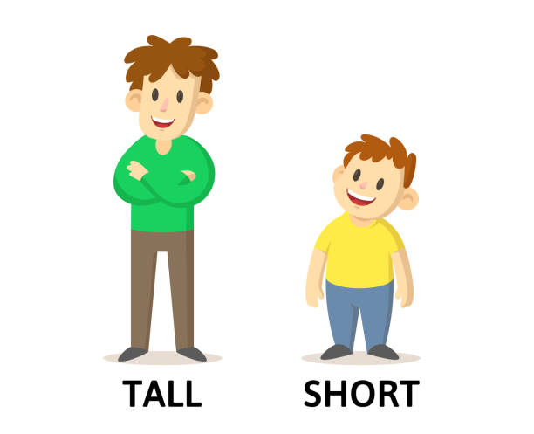
What makes us different? The way we look…
The colour of our eyes.
Our height.
How we like to wear our hair.
Notes:
Encourage pupils to contribute to other ideas for what make us all different.

Slide 4
What makes us different? The things we like to do…
Notes:
Encourage contributions – does anyone like to do something that other people might not know much about, could they share this?

Slide 5
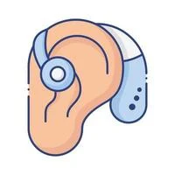
What makes us different? The things we need to help us learn
Notes:
Glasses to help us see important information.
Coloured overlays to help us read and understand.
Hearing aids and hearing loops.
Pencil grips to help us with our handwriting.
Our own table or work space to help us focus on our work.
Time to take a movement break or to go outside when we need to help us concentrate on our learning.

Slide 6
Amazing things happen…
Notes:
National Autistic Society
Professional category finalist
Alexander Amelines (2017)
Alexander’s film gives an uplifting introduction to autism for young non-autistic audiences, aiming to raise awareness, understanding and tolerance in future generations.
Show video

Slide 7
Some people you know might have autism. This means they might learn in different ways and need different things to help them at school and at work…..

Slide 8
Here at our school we are learning to be accepting and that’s why we are taking part in:
Notes:
Schools all over Norfolk are working together throughout National Autism Acceptance Week, to learn more about autism acceptance and what this means.
Link to school ethos/’motto’ where relevant .

