Slide 1
Relationships, Sex and Health Education CPD Inset
Insert school logo here
Notes:
Welcome staff and introduce yourself
Confirm finish time for the session- you might choose to break this into x2 1hr sessions
Select from either of the below activities:
One word – Ask staff to take tuns in saying how they feel about teaching RSHE. Reassure staff that all feelings are OK, some people will feel comfortable and others less so. Highlight the spectrum of different feelings and any common feelings.
Worry wall – Provide all staff with a post-it note. Ask them to write down their biggest concern about teaching RSHE. Collect in the post-it notes and stick to a wall, collating in groups of common themes to make a ‘worry wall’. The responses can remain anonymous as you share key reflections/staff view.

Slide 2
Help keep this space as safe as possible
Respect and compassion
Share with care
Confidentiality
Notes:
In order for this to be as a safe a space as possible for you all to share your thoughts, opinions and experiences you need to set some ground rules. I use:
Please can everyone respect and value difference and diversity in all of its forms and aim to be compassionate even if there’s disagreement with what someone is saying
Think carefully how personal material and views are used; share with care
And finally, learning can be taken out of the session but please don’t share any personal or identifying information
Ask if there’s anything anyone would like to add.
RSHE by its nature, deals with topics that some folk might find distressing or triggering. If you are affected by tonight’s content please practise self care, follow your usual support channels if you would like to follow anything up; contact me.

Slide 3
The intentions of this session are to...
Understand some key points from DfE RSHE guidance
Recognise the importance of RSHE for our pupils
Familiarisation with school curriculum and policy
Develop consistent approaches to teaching RSHE within the school.
Notes:
Run through session aims:
Understand some key points from the DfE RSHE guidance
Recognise the importance of RSHE for our pupils
Familiarisation with school curriculum and policy
Develop consistent approaches to teaching RSHE within the school
Ask colleagues to consider if there is anything they want to get from the session not covered in the aims. Give them the chance to share it on a whiteboard or a Post It during the upcoming activity.

Slide 4
Changing the tone of the room
1. Worked with a child who is looked after or previously looked after | 2. Has had any training to teach RSHE | 3. Feels nervous about teaching sex ed
4. Has been asked where babies come from | 5. Knows what the term cisgender means | 6. Had a teacher they could trust
7. Has taught sex education before | 8. Has watched Sex Education | 9. Knows how many people are born intersex
Notes:
Introduce this as an ice breaker activity.
Explain this is human bingo; they are going to be collecting signatures; and sharing experiences.
Ask them to move round the room trying to find someone who can answer yes to the statements on the grid. If they can, ask them to sign next to the name. A person can only answer one question per sheet.
Wait and see if anyone asks you; if they do, make a point of saying it’s nice to be included. If you’re not invited offer an answer to someone; possible the intersex question which I have more information about in a minute.
If anyone has any questions about RSHE they want answered; now is a good time for them to share them on a whiteboard or post it.
The winner is the first person with a full house of signatures. You might want to reflect on why these statements were included as a group- there is no right or wrong answer.
How many people are born intersex?
People often assume that the world is divided neatly into two groups of people, male and female, and that everyone’s biological and genetic characteristics fit into one of these two categories.
But this is not always the case. There are millions of people around the world who have sexual characteristics that do not fit typical binary notions of male or female bodies. Many, though not all, of these people identify as intersex.
Intersex is an umbrella term used to describe a wide range of natural variations that affect genitals, gonads, hormones, chromosomes or reproductive organs. Sometimes these characteristics are visible at birth, sometimes they appear at puberty, and sometimes they are not physically apparent at all.
According to experts, around 1.7% of the population is born with intersex traits – comparable to the number of people born with red hair.

Slide 5
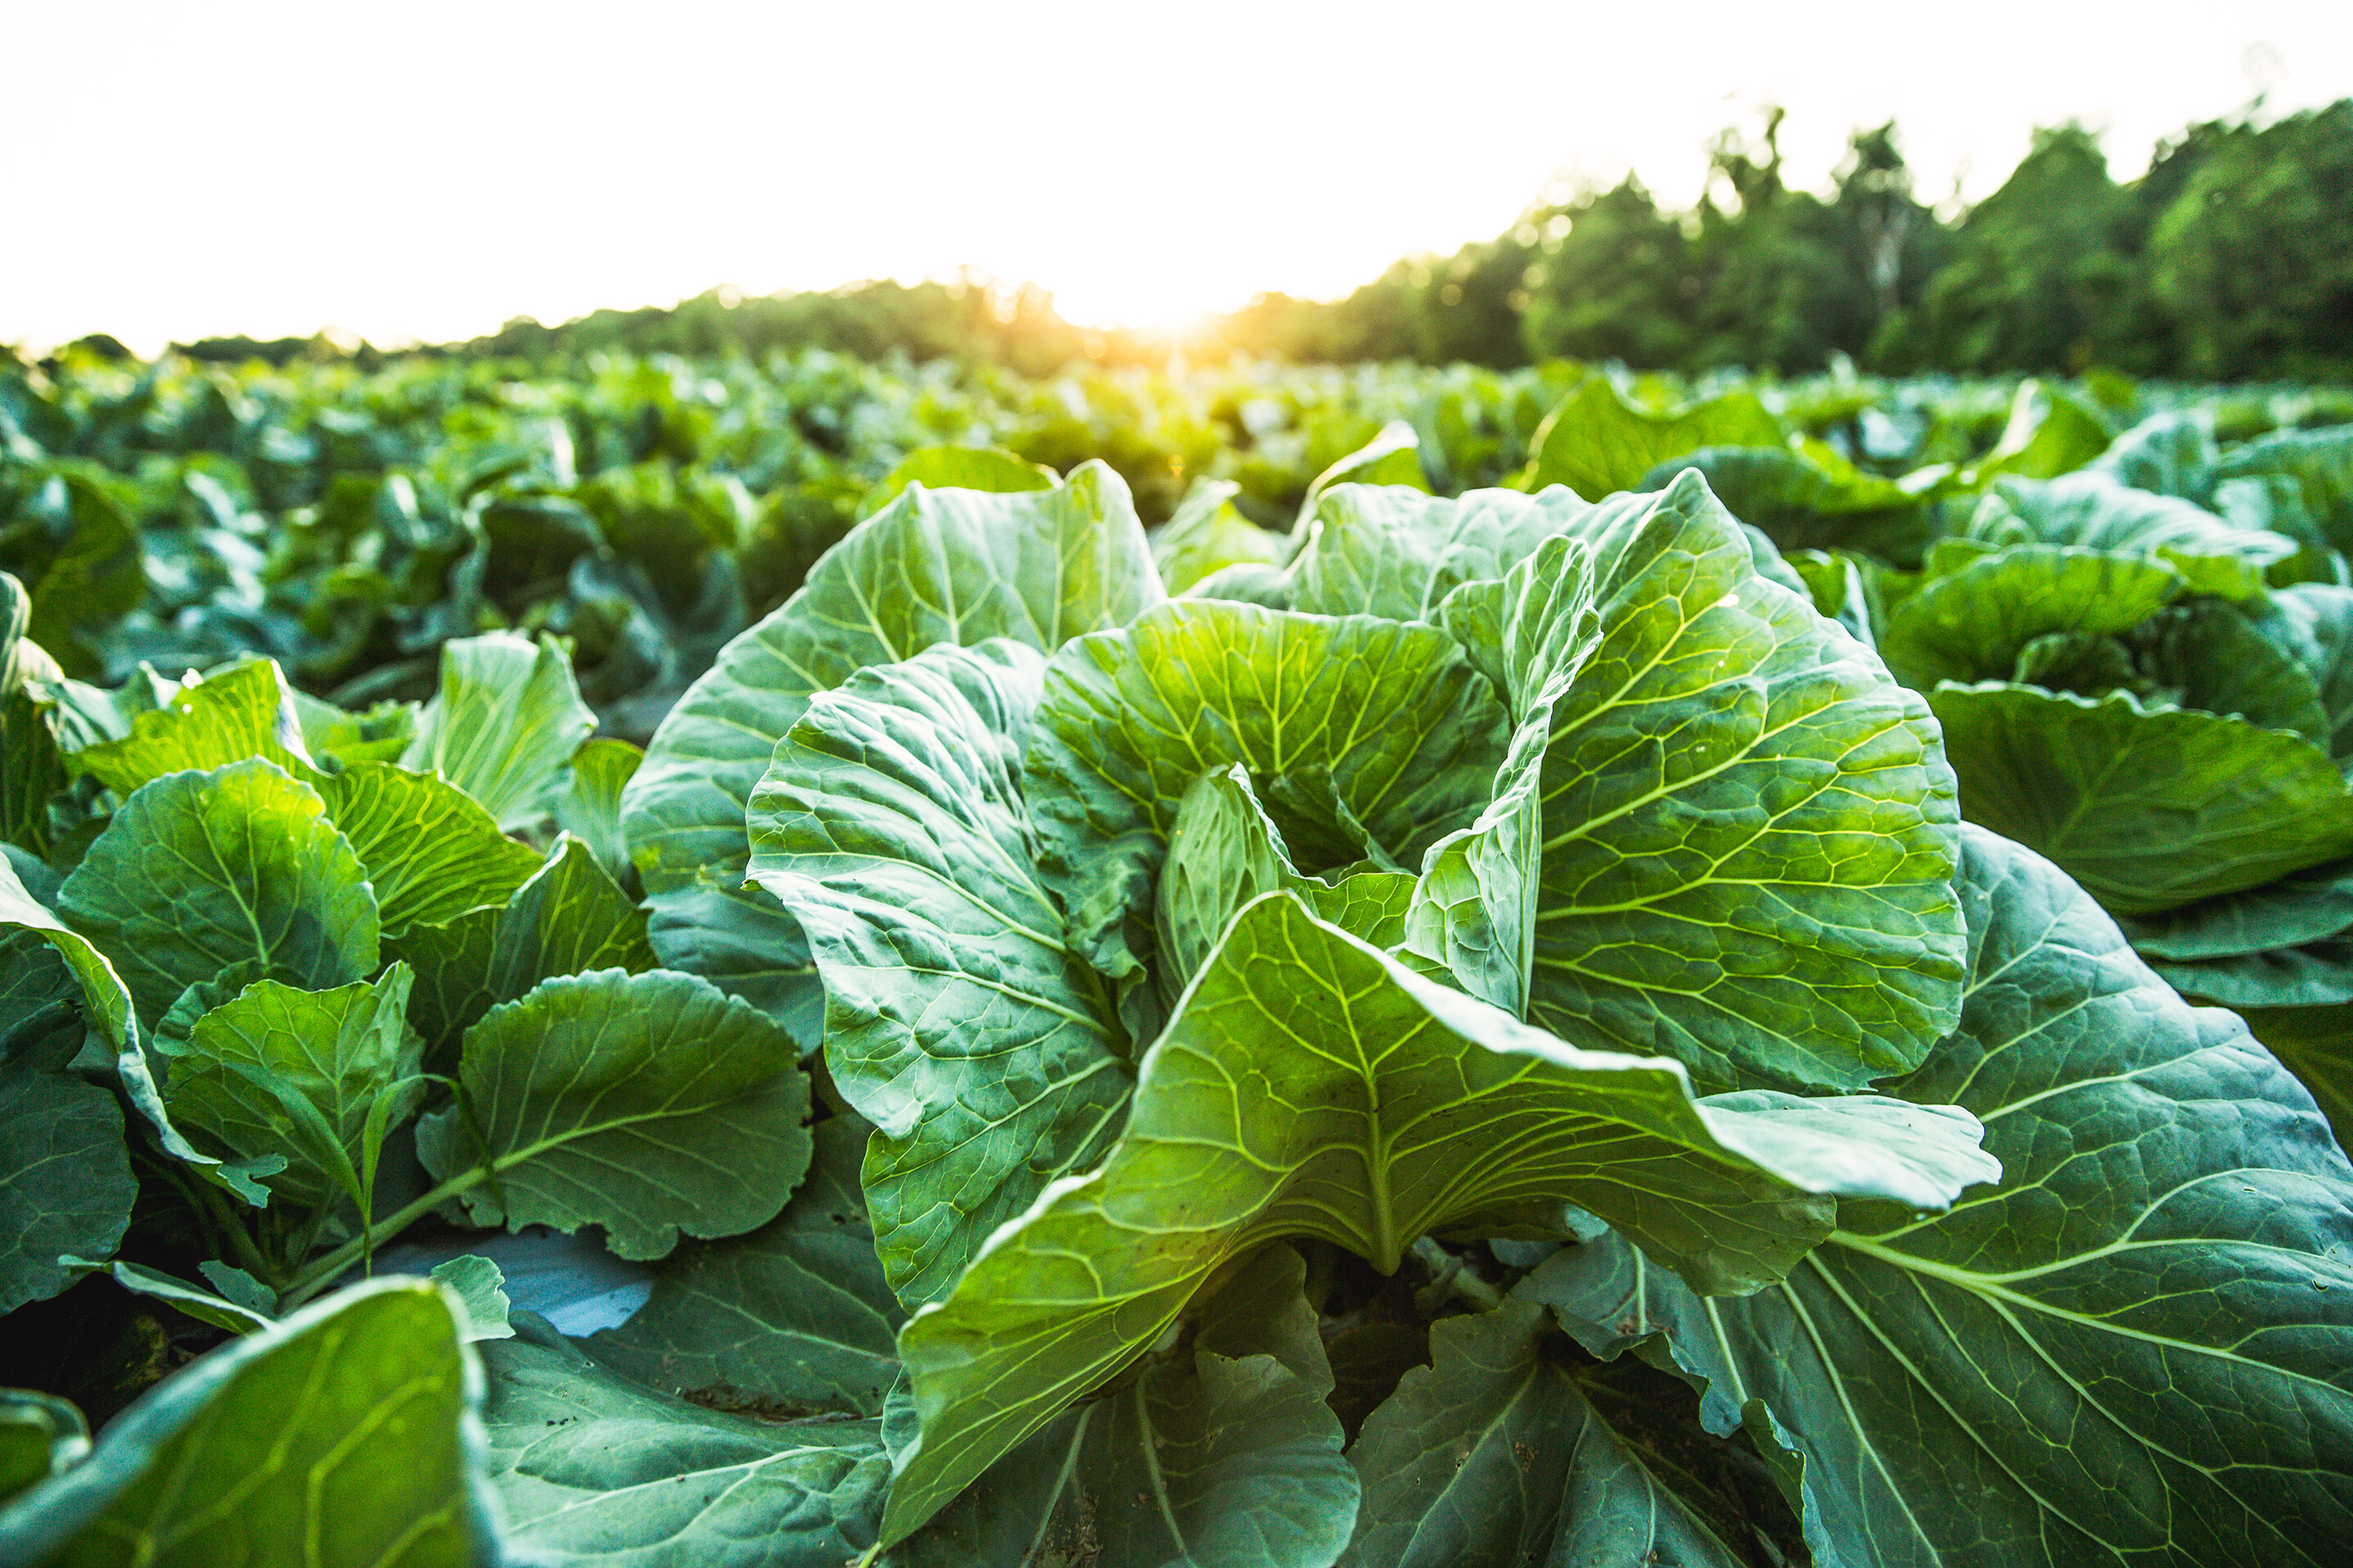
What do you remember about your own sex education?
Notes:
Activity: Ask colleagues to spend a few minutes discussing what they remember about their own sex education taught in school as pairs/small groups. Invite anyone to share if they feel comfortable to.
Key point: The general consensus it that it wasn’t good enough. Attendees’ memories usually echo national research: Too little, too late and too biological. (These concepts have been highlighted by Ofsted in national PSHE inspections)
The good news is we have moved on; we have statutory guidance; excellent resources and your school has prioritised RSHE as an area for staff development.

Slide 6
What would our pupils say?
Insert an image from your school website picturing your pupils here
Notes:
Now you have reflected your own experiences of one aspect of RSHE, it’s time to reflect on what you feel your pupils would say about the RSHE you provide at your school.
Discuss: Ask staff to discuss in small groups, what they believe pupils of your school would say about the RSHE provided to them through your school. Ask staff to consider the quality, content, relevance and inclusiveness of the teaching.
Invite groups to feedback, reflecting any differences of opinion and common trends. Consider what causes this. For example, is it year group depending etc?

Slide 7
RSHE Guidance
“Todays children are growing up in an increasingly complex world and living their lives seamlessly on and offline. This presents many positive and exciting opportunities, but also challenges and risks. In this environment, children and young people need to know how to be safe and healthy, and how to manage their academic, personal and social lives in a positive way.”
Notes:
Either read aloud the foreword from the guidance, or allow colleagues time to read themselves:
“Todays children are growing up in an increasingly complex world and living their lives seamlessly on and offline. This presents many positive and exciting opportunities, but also challenges and risks. In this environment, children and young people need to know how to be safe and healthy, and how to manage their academic, personal and social lives in a positive way”.
Damien Hinds was the Education Minister at the time the guidance was publicly published. His foreword makes it clear that RSHE is about ensuring the safeguarding, health and happiness of young people.
Research has also linked high quality RSHE to improved attendance and attainment; if anyone is keen to know more https://www.probonoeconomics.com/resources/pshe-association

Slide 8
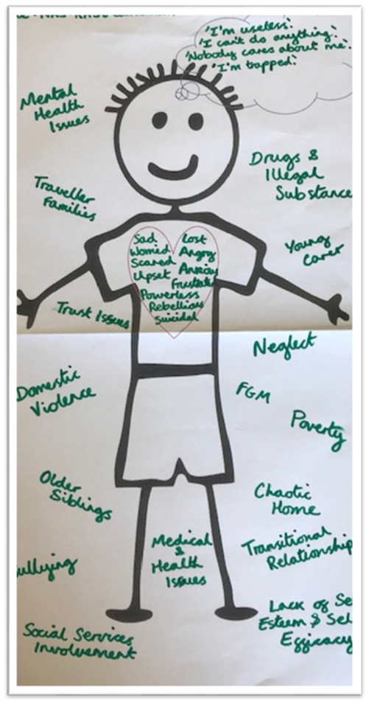
What are the challenges and risks for our pupils?
Notes:
In his foreword, Damian Hinds references the challenges and risks young people face. Let’s look at these now.
Activity: Ask staff to work in small groups and draw a stick pupil. Around the outside write all the challenges, issues, risks etc that they know their pupils face, before drawing a heart and writing inside how these may cause pupils to feel, then in a speech bubble how these may cause a pupil to think before writing around the edge to make a picture border how these experiences, thoughts and feelings may cause a pupil to behave. Invite groups to share. Reflect and feedback any common areas and differences.
Share with staff your own pupil voice work here; possibly framing it…“We conducted some pupil consultation to identify knowledge they have gained from RSHE and to ascertain that our own teaching is age and stage appropriate and relevant to their real lives. This is what we found out….”
Summarise by reiterating the important and pivotal role RSHE plays in supporting pupils to be as safe, happy and healthy as possible.

Slide 9
Our school vision for RSHE
Insert your vision statement here
Notes:
Share your school vision for RSHE, highlighting how this links to the schools overarching mission statement.
Explain that RSHE will be centralised at the core of your school to ensure pupils are safe, happy and healthy. As well as ensuring pupils understand what RSHE is and why it is taught, this is shared with families. Framing it this way explains why Relationships and Health Education is statutory and Sex Education recommended for primary age children and should reduce the likelihood of resistance or requests for pupils to be excused from these subjects.

Slide 10
Curriculum- Relationships
Families and people who care for me
Caring friendships
Respectful relationships
Online relationships
Being safe.
Notes:
So now your staff understand the importance of RSHE, it’s time to turn their attention to how that’s going to be achieved. We are going to do this initially by sharing the statutory curriculum content, starting with relationships education. It is worth highlighting that when taught with Sex Education this used to be called SRE. It is now called RSE when combined, usefully highlighting that the guidance is mainly focused on relationships education and sex education is taught within the context of relationships.
The guidance contains statutory curriculum content for relationships education. The statutory curriculum includes:
Families and people who care for me
Caring friendships
Respectful relationships
Online relationships
Being safe
The guidance says:​
‘The focus in primary school should be on teaching the fundamental building blocks and characteristics of positive relationships, with particular reference to friendships, family relationships, and relationships with other children and with adults. This starts with pupils being taught about what a relationship is, what friendship is, what family means and who the people are who can support them. From the beginning of primary school, building on early education, pupils should be taught how to take turns, how to treat each other with kindness, consideration and respect, the importance of honesty and truthfulness, permission seeking and giving, and the concept of personal privacy. Establishing personal space and boundaries, showing respect and understanding the differences between appropriate and inappropriate or unsafe physical, and other, contact – these are the forerunners of teaching about consent, which takes place at secondary.​
Highlight that the school teaches much of this already, not just in RSHE but across the wider curriculum and throughout the school ethos and environment.

Slide 11
Curriculum- Health
Mental wellbeing
Internet safety and harms
Physical health and fitness
Healthy eating
Drugs, alcohol and tobacco
Health and prevention
Basic first aid
Changing adolescent body.
Notes:
The new guidance contains statutory curriculum content for health education. The statutory curriculum includes:
Mental wellbeing
Internet safety and harms
Physical health and fitness
Healthy eating
Drugs, alcohol and tobacco
Health and prevention
Basic first aid
Changing adolescent body
The guidance says:
‘It is important that the starting point for health and wellbeing education should be a focus on enabling pupils to make well-informed, positive choices for themselves. They should know that there is a relationship between good physical health and good mental wellbeing and that this can also influence their ability to learn’.
Highlight that the school teaches much of this already, not just in RSHE but across the wider curriculum and throughout the school ethos and environment. If time allows, it would be useful to ask staff to capture any cross-curricular teaching of RSHE at this stage.
Parents can not withdraw their child from relationships education, health education; or sex education taught as part of the national curriculum for science.
They can withdraw their child from sex education taught as part of the RSHE curriculum until 3 terms before their child turns 16, when the child can decide for themselves
Discuss plans for parental engagement and school process for when a parent exercises their right to have child excused.

Slide 12
Curriculum- Sex
“The Department continues to recommend that all primary schools should have a sex education programme tailored to the age and the physical and emotional maturity of the pupils. It should ensure that both boys and girls are prepared for the changes adolescence brings and – drawing on knowledge of the human life cycle set out in the national curriculum for science - how a baby is conceived and born.”
Notes:
Explain that
“The Department continues to recommend that all primary schools should have a sex education programme tailored to the age and the physical and emotional maturity of the pupils. It should ensure that both boys and girls are prepared for the changes adolescence brings and – drawing on knowledge of the human life cycle set out in the national curriculum for science - how a baby is conceived and born”
In primary aged schools , sex education is not statutory so your school will have decided whether to teach it or not. Share what was decided; including the relevant part of the policy which sets out what is covered, if sex education is taught.

Slide 13
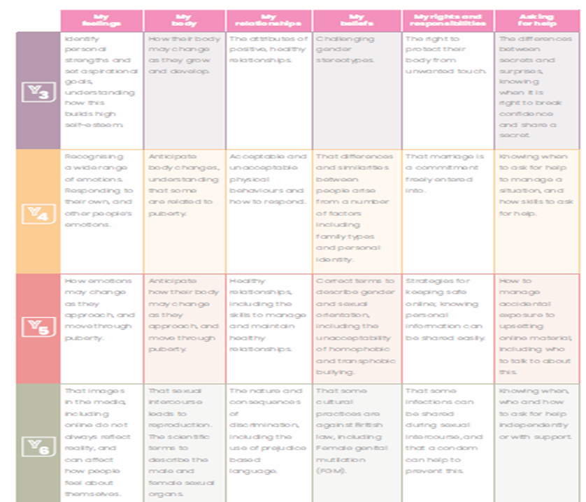
Curriculum
Notes:
So, now we have looked at what we have to teach, it’s time to look at how we are planning to teach the statutory curriculum in our school:
Read quotation from guidance:
‘Schools are free to determine how to deliver the content set out in this guidance, in the context of a broad and balanced curriculum. Effective teaching in these subjects will ensure that core knowledge is broken down into units of manageable size and communicated clearly to pupils, in a carefully sequenced way, within a planned programme or lessons’.
Introduce your school RSHE curriculum map. Highlight, using examples, how this is spiral and developmental, teaching acquisition of knowledge, values and interpersonal skills as required in the new guidance.
Explain where the resources are stored; including electronic resources and provide time for staff to review and familiarise themselves with the curriculum map and other resources.

Slide 14
Teaching
Notes:
Read quotation from legislation:
‘High quality, evidence-based and age-appropriate teaching of these subjects can help prepare pupils for the opportunities, responsibilities and experiences of adult life.’
Emphasise the importance of teachers being positioned to deliver high-quality, impactful teaching in RSHE.
Activity: Ask staff to:
Stand up if you have ever taught an RSHE lesson.
Stay standing if you feel confident to teach an RSHE lesson.
Stay standing if you have ever had any formal training to teach RSHE, either as part of your teacher training or since.
Stay standing if this was in the last 3 years.
Reflect on the number of staff that remain standing. Reassure staff that nationally only 6% of teacher received RSE or RSHE training as part of their initial teacher training, 29% have never had any training and only 46% say their training was adequate. Ref: https://www.sexeducationforum.org.uk/resources/evidence/statutory-rse-are-teachers-england-prepared
Highlight the importance and commitment of your school to training, practice sharing through team teaching/shadowing etc.
Tell staff that it is important to identify the areas of the curriculum that you may need additional support/training to confidently teach.
Activity: Take 3x a post-it notes each. Having reviewed topics on RSHE curriculum, write down 3 areas that you may require CPD support to teach. One per post-it note.

Slide 15
DfE teacher training modules
Primary and secondary
Basic first aid
Being safe
Changing adolescent body
Drugs, alcohol and tobacco
Families
Health and prevention
Healthy eating
Mental wellbeing
Physical health and fitness
Respectful relationships, including friendships.
Primary only
Online relationships.
Secondary only
Internet safety and harms
Intimate and sexual relationships, including sexual health
Online and media.
Notes:
Share that the DfE have created some RSHE teacher training modules so subject leads or other staff members can train groups of teachers in a variety of ways.
Each module contains:
key knowledge and facts to help teach the statutory guidance
activities and templates to help run a training session
guidance to help teachers tackle difficult questions
The training modules have been split into different topics within the curriculum. You should adapt the slides and activities to fit your school.
There is also a wide range of RSHE CPD available, so much that it is likely you will need to prioritise according to the needs of your pupils and staff. The toolkit has a menu of recommended CPD and there is our local offer of RSHE training and networking that aims to be responsive to need.
Ask colleagues to have a look at their Post Its and share any areas not covered by the DfE training modules. These may be covered by the content from the RSHE toolkit so you can signpost colleagues to these. If not; you are welcome to contact me for advice.

Slide 16
Creating a safe learning space
Lessons are regular and follow a routine
Working agreement
Use of language
Asking and answering questions
Pupil voice that makes a difference
Adults are emotionally available
Belonging and connection
Distancing
Notes:
Explain the importance of pupils feeling physically and emotionally safe in an RSHE; for their wellbeing and for effective learning to take place. Share these ways of creating a safe space for RSHE teaching. This list is not exhaustive, and it is important that pupils are consulted.
Lessons are regular and follow a routine
There will be a working agreement; clear ground rules can help when teaching about sensitive topics. They also support confidentiality and safeguarding of pupils.
Distancing- You can avoid embarrassment and protect pupils’ privacy by always depersonalising discussion, for example, using a case study to illustrate an issue or through the creation of fictional characters.
Use of language
Asking and answering questions; doing so in a variety of ways so that all pupils can participate and handling difficult questions sensitively and being mindful of safeguarding
Pupil voice that makes a difference
Adults are emotionally available; the school takes a trauma informed approach and there is a good knowledge of pupil need
Belonging and connection; pupils feel welcome in the classroom and relationships are healthy, positive and respectful. At the heart of this is equality.
Many of these aspects require more exploration than you have time for in this session. It is worth gauging from colleagues if they understand that this approach goes beyond RSHE and if it seems there’s a need for more development in areas such as pupil voice, emotional availability, use of language and belonging and connection.

Slide 17
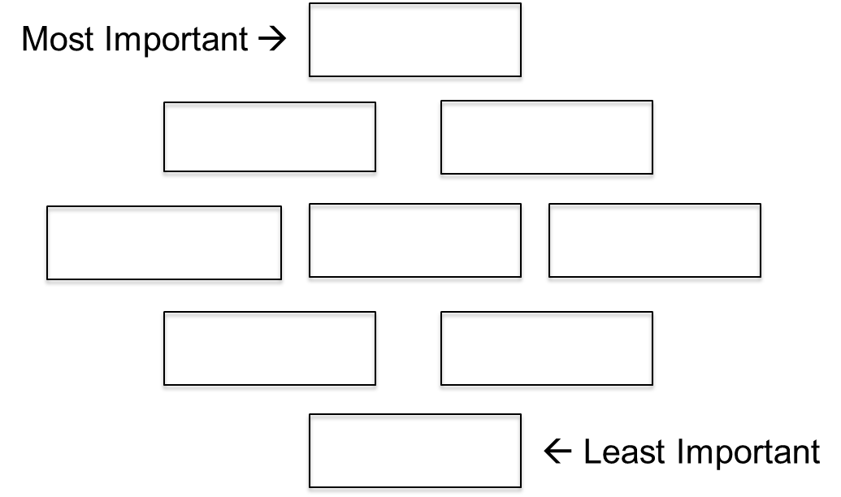
Working agreement
Notes:
Explain to staff that we are now going to look at some areas that will require consistency of approach across the school starting with establishing the classroom environment.
Discuss the importance of creating safe, inclusive classroom spaces. Invite staff to make suggestions as to how this can be achieved.
Importance of warmly welcoming pupils into lessons
Considering group formation – allowing pupils to sit with peers
Allowing sufficient time for pupils to transition and settle into lessons (physically and emotionally)
Activity:
As a group, take 9 post-it notes and using a diamond 9 principle create a pupil-friendly working agreement. Ask each group to share what is positioned at the top. Reflect any similarities/differences.
Remind staff of the importance of creating your own with each class, using these elements expressed in their own simple, positive language.
Signpost colleagues to the RSE Solution resource which contains: Creating a working agreement.

Slide 18
Scientific vocabulary
Anus: The private part of the body where poo comes out
Penis: The private part of a boy where wee comes out
Vulva: The private part of a girl that she wipes when she has had a wee
Notes:
Key point: It is important to develop a clear, common language so all pupils can effectively engage with the learning. Some preferred slang terms or pet names may be comfortable for some, but not for others.
Be clear that all staff are required to use scientific language, as opposed to any preferred slang terms, when talking about the private parts of the body.
The terms and their descriptions, displayed here, are how we will be describing the private parts of the body.
Anus: The private part of the body where poo comes out
Penis: The private part of a boy where wee comes out
Vulva: The private part of a girl that she wipes when she has had a wee
Recognise that some staff may find this initially uncomfortable, and it is important to role model not just use of the scientific term, but also confidence and comfort. Not talking about the terms communicates that this is something awkward and embarrassing. It is important that pupils see you as someone they can approach if they need to discuss issues, including disclosure of abuse. It is also vital that parents and care givers are given about this content in advance but also when the content has been delivered, as reminder, so they can be prepared and support the learning at home. This will strengthen home / school relationships.

Slide 19
Puberty
Notes:
You only need to include this slide if you are a school with KS2 pupils
Explain to staff that we are now going to consider a baseline assessment strategy, and apply this to teaching about puberty.
Ask staff, working in small groups, to draw a Venn Diagram (two overlapping circles). In one circle ask them to write every puberty experience they can think of that happens to girls only and in the other to boys only. Ask them to use the middle overlapping space to write every puberty experience that is common to all genders. Discuss what they notice? Key point: Many puberty experiences are common to all genders.
If time allows play the puberty Pictionary game: RSE Solution. YR5, Lesson 2, extension activity. Highlight how this is a useful summative assessment activity.

Slide 20
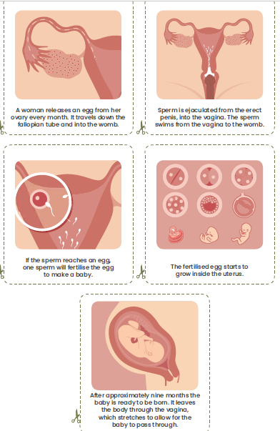
Sex Education
Notes:
You only need to include this slide if you are a school with KS2 pupils
Tell staff that it is recognised sex education may be the topic area people are most anxious to teach and as such. We recommend you work through the activity as set out in the RSE Solution. Explain to staff that even if they do not teach Year 6, it is helpful to understand how this will be taught in case pupils talk about it after their lessons.
Conduct the session, as detailed in RSE Solution. YR6, Lesson 2. Activity 2 and Activity 3.

Slide 21
Inclusive approaches
Notes:
Read quotation from the legislation:
‘Schools should be alive to issues such as everyday sexism, misogyny, homophobia and gender stereotypes and take positive action to build a culture where these are not tolerated, and any occurrences are identified and tackled. Staff have an important role to play in modelling positive behaviours. Schools must ensure that they comply with the relevant provisions of the Equality Act 2010, (please see The Equality Act 2010 and schools: Departmental advice), under which sexual orientation and gender reassignment are amongst the protected characteristics’.
Remind staff that it is important that as a school we continue to prevent incidents of bullying linked to a young person’s actual (or perceived) gender and/or sexual orientation. Teaching should be fully inclusive and not assume a heteronormative approach. This is where it is assumed that relationships are between a man and a woman. Teaching should also challenge gender stereotypes as far as possible.
Recognise that as language can be fluid, some staff may feel anxious about the ‘right’ terms to use. Explain that we are now going to do an activity to help build confidence around this, ensuring as we scientific terms for describing the private parts of the body, that we also have a common language for talking about gender and sexuality.
Activity: RSE Solution YR4, Lesson 4, Activity 1. Complete the activity as detailed, although you may wish to adapt to a table top activity as opposed to moving around the room.

Slide 22
Ending the lesson
Safeguarding / self care
Assessment
Questions
Signposting
Notes:
At the end of the session, it is important you assess the learning that has taken place.
There are assessment opportunities woven through the RSE Solution resource. Explain to staff that they need to:
provide pupils with an opportunity to ask questions and facilitate different ways they can ask questions.
congratulate pupils on their positive behaviour throughout the lesson if appropriate. reassure pupils that they do not need to feel embarrassed or uncomfortable to discuss the content of RSHE , but if they do that is okay.
remind them they might need to draw of their wellbeing strategies; how important self care is.
signpost pupils to who they can talk to in school if they have any questions or concerns about what has been taught in the lesson.

Slide 23
Questions
How old were you when you had sex?
“Primary-aged pupils will often ask their teachers or other adults questions pertaining to sex or sexuality which go beyond what is set out for Relationships Education. The school’s policy should cover how the school handles such questions.
Given ease of access to the internet, children whose questions go unanswered may turn to inappropriate sources of information’.”
Is a baby made every time people have sex?
How do two men have sex?
Notes:
“Primary-aged pupils will often ask their teachers or other adults questions pertaining to sex or sexuality which go beyond what is set out for Relationships Education. The school’s policy should cover how the school handles such questions.
We recognise that some staff are anxious about the questions pupils may ask. Remind staff that they do not have to know the answer to every question or answer any personal questions such as how old were you when you had sex; this should be explained to the pupils in the introductory RSHE lessons that set the ground rules to create the safe space. There might be questions that you are able to answer but need more time and to check school policy on the subject such as is a baby made every time people have sex. Then there are questions that are age and stage inappropriate and pupils need to ask their family such as how do two men have sex.
Given ease of access to the internet, children whose questions go unanswered may turn to inappropriate sources of information’.” It is important we provide an opportunity for pupils’ questions to be addressed.
An ask-it basket provides a method for pupils to share thoughts, questions and experiences in an anonymous way. It gives some thinking time to decide how to proceed and to consider if this question is asking about other information that is okay to share such as the age of consent for question 1.
Signpost: RSE Solution, Getting Started, Preparing to answer questions.
You will be provided with example ‘talk cards’. Share examples now. Emphasise that these include tick boxes so that pupils are in control of how their question is responded to.
It is important that all pupils put their talk cards into the ask it basket, to protect the anonymity of pupils that have asked questions.
Questions are an excellent opportunity to assess current level of knowledge/if what has been taught has been learned. It may also help with future curriculum planning. For example, when analysing a question you might like to consider:
What is the key concern?
What type of information do they need?
What would they need to know and understand to be able to make use of that information?
For that information to be practically useful, what skills and attributes would they need?

Slide 24
Assessment
Notes:
Read the below quote from the guidance:
‘Schools should have the same high expectations of the quality of pupils’ work in these subjects as for other curriculum areas. Teaching should be assessed and assessments used to identify where pupils need extra support or intervention’.
Highlight to staff that assessment is inbuilt into the lesson plans/topics and will be formed of both pupil and teacher assessments, to ensure it cover acquisition of knowledge alongside development of skills and attitudes.
Share the agreed school assessment strategy for RSHE; how you have decided assessment, recording and reporting should be carried out.

Slide 25
Safeguarding
Insert safeguarding process flow chart here
Notes:
Read quotation from the guidance:
‘Teachers should be aware of common ‘adverse childhood experiences’ (such as family breakdown, bereavement and exposure to domestic violence) and when and how these may be affecting any of their pupils and so may be influencing how they experience these subjects’.
Make staff aware that they need to signpost pupils to specialist information, advice and guidance from trusted sources of support as relevant to the topic being taught. Additionally reminding pupils of who they can speak to in school including their right to confidentiality.
Remind staff that RSHE can prompt safeguarding disclosures. This is because RSHE, taught effectively, teaching the information, vocabulary, emotional literacy and interpersonal skills to identify, respond to and report abuse.
Remind staff the school’s safeguarding procedure and how RSHE sits within this.

Slide 26
Policy
Insert a summary of key changes to your school RSHE policy here
Notes:
Share the newly updated school RSHE policy. (it may be PSHE and it may be RHE if you are not delivering Sex Education)
Highlight how this has been informed by pupil/parent and staff consultation.
Reference any key changes or points to note
Inform staff of where this can be accessed internally, and publicly so they can reference it themselves and signpost parents/external visitors to it.

Slide 27
RSHE can make a difference!
“These subjects represent a huge opportunity to help our children and young people develop. The knowledge and attributes gained will support their own, and others’, well-being and attainment and help young people to become successful and happy adults who make a meaningful contribution to society.”
Notes:
Read final script from slide:
‘These subjects represent a huge opportunity to help our children and young people develop. The knowledge and attributes gained will support their own, and others’, wellbeing and attainment and help young people to become successful and happy adults who make a meaningful contribution to society’.
Reassure staff that however big the challenges you may face in embedding RSHE within your schools, the opportunities to positively impact on the health, wellbeing and safeguarding of our pupils will ensure that our efforts are well invested, and it is not something anyone needs to do alone. Thank colleagues for their attendance and engagement with the session.
Signpost colleagues to who and how they can raise any future queries relating to RSHE and the staff wellbeing strategy; how they can seek support if they need it following this workshop.

