Slide 1





Trauma and Attachment Aware Practice
Training Offer
September 2023 – July 2024
    Contact Us – virtual.schoolscwsw@norfolk.gov.uk

Slide 2

It’s a way of being…
“Trauma Informed Practice is a lens, a way of being, the way we show up in the world and the way we understand each other. It is not a folder, a box to be ticked off or a set of instructions. It is an ongoing reflective practice that centralises and contextualises the ways in which humans experience and heal from trauma and adversity "
Lisa Cherry

Slide 3






How have we supported settings so far?
54 practitioners across Norfolk have accessed the 11 day Trauma Informed Schools UK Diploma in Trauma and Mental Health-Informed Schools and Communities.
The Trauma Informed Practice in Education Network ran termly with Luke Rodgers from The Care Leaders delivering a keynote as well as promoting trauma informed practice seen by our TIS UK Practitioners.
269 views of our Trauma Informed Schools UK Webinar.
50 Level 2 school based Desty Mentors and 30 Level 1 Practitioners in Social Care.
45 Schools received direct support and advice through online consultations and visits.

Slide 4

Trauma and Attachment Aware Practice Training Offer
Bespoke
Targeted
Universal

Slide 5



Universal Offer
Available to all education and social care professionals.
Universal
Bespoke
Targeted
Self-directed Learning Padlet
Touchbase Attachment Aware School Series Webinars (available from October 2023)
Attachment and Research Community (ARC) membership opportunity for all settings across Norfolk from Early Years to Post-16. (Education opportunity only)
Trauma and Attachment Aware Practice in Education Termly Network
RISE Up Early Intervention Wellbeing Programme provided by Future Action for all Secondary and Specialist Settings across Norfolk (Education opportunity only)

Slide 6
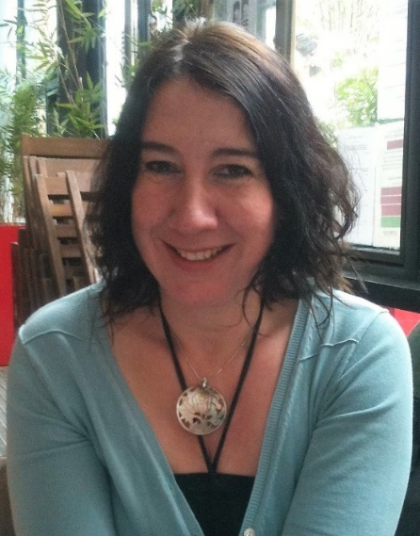
Trauma and Attachment Aware Practice in Education Network
Louise Michelle Bombèr – Founding Director, Teacher & Therapist
Louise Michelle Bombèr is qualified as both a specialist teacher, a therapist and a DDP certified practitioner. She is the Founding Director of TouchBase Centre CiC in Brighton. The aims of TouchBase are to support those who have experienced adverse childhood experiences to function well at home, in their schools and out in community. www.touchbase.org.uk
To be added to the network mailing list please email: virtual.schoolscwsw@norfolk.gov.uk
Termly Network Date (Online)
Each network will feature a 90-minute keynote presentation from Louise.
Autumn Wednesday 6th December 2023
Spring Wednesday 27th March 2024
Summer Wednesday 19th June 2024

Slide 7
Trauma and Attachment Aware Practice in Education Network
Louise Michelle Bombèr – Founding Director, Teacher & Therapist
Louise has a wealth of lived experience as both an adoptive parent and as a professional. Louise authored the very popular book ‘Inside I’m Hurting’. She also wrote ‘What About Me?’. Louise contributed to the book ‘Teenagers & Attachment’. She has co-authored ‘Settling Troubled Pupils to Learn: Why Relationships Matter in School’ together with Dan Hughes. Louise contributed to a specialist family law book ‘Capacity to Change’ outlining what needs to be considered for traumatized children and their lives in school. More recently Louise has written the ‘Attachment Aware Schools Series – Bridging the gap for troubled pupils’ to support schools to create effective small teams around pupils – Team Pupil. Her most recent books are ‘Know Me to Teach Me’, a book that advocates for differentiated discipline in schools using the latest findings in child development and neuroscience. We are looking forward to welcoming Louise to our termly network.
Termly Network Date (Online)
Each network will feature a 90-minute keynote presentation from Louise.
Autumn Wednesday 6th December 2023
Spring Wednesday 27th March 2024
Summer Wednesday 19th June 2024

Slide 8
Targeted Offer
Open to education and social care professionals supporting work with children in care, previously in care or children with a social worker.
Universal
Bespoke
Targeted
Termly AC Education Webinar offer (Limited Spaces available)
Trauma and Attachment Aware Practice Training Grant application
Advisers within the Virtual School will work with settings in their localities to provide information on trauma and attachment aware training opportunities and interventions that can be funded through application to the grant. Impact will be measured through a case study from the school.

Slide 9
Bespoke Offer
Partnership opportunities to work with the Virtual School
Universal
Bespoke
Targeted
Project opportunities in collaboration with partners from education and social care working to support children in care, previously in care or children with a social worker.
This may look like a one-off piece of training for an INSET or series of twilights to support staff. Alternatively, this may be a support project across a group of schools or within a trust.
To discuss this with us, please email virtual.schoolscwsw@norfolk.gov.uk

