Slide 1
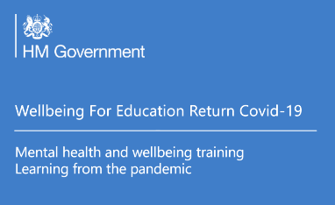

Nurturing wellbeing: practical support for developing wellbeing for pupils and families
Primary
16/03/21
Alice.Ndiaye@norfolk.gov.uk
Notes:
Welcome to the second of our webinars focussing on nurturing wellbeing. This first session was an introduction to social and emotional learning as a whole school approach. This session I want us to think about how we can create belonging, and connection in our classrooms and beyond.

Slide 2
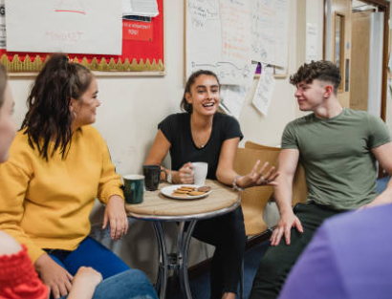

Introduction
By the end of the session you will hopefully -
Understand the importance of equipping pupils with the information that they need to make good decisions about their own health and wellbeing.
Understand the importance of providing clear, planned curriculum opportunities to promote resilience, support social and emotional learning and opportunities for pupils to participate in activities to build their confidence and self-esteem
Understand that we all have mental health but when issues arise pupils know to seek support as early as possible from appropriate sources
After this session you will have
complete and fully editable timetables for daily wellbeing sessions
complete and editable resources for screen free learning sessions
a resource bank of suggested sessions for use at home or in school to support wellbeing
a narrated PPT adaptation of the session to share with colleagues
Notes:
Here are my session aims which focus on the need to teach about and provide information on emotional wellbeing and mental health.
There are a number of resources that go with this presentation which you can access along with last week’s part one session and accompanying resources.

Slide 3
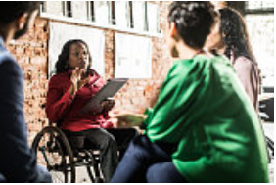

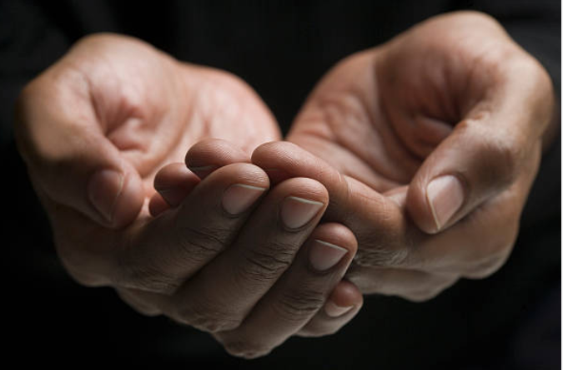
Group Agreement:
Group Agreement:
Use of personal material/views – share with care (including the webinar chat function)
Confidentiality – you can take the learning out of the session but don’t take or record any personal-identifying information out of the session
In order for this to be a safe space for us all to share our thoughts, opinions and experiences, it is important for us to respect and value difference and diversity in all of its forms
Notes:
We want this to be a safe space for people so here is a group agreement.
There are some points for reflection.
This was delivered in been a tough week in an already tough year and we talk about sensitive yet important issues. There will be points where we pause to hold space.
“Holding space” means being physically, mentally, and emotionally present for someone. It means putting your focus on someone to support them as they process their feelings.
This is important for all our wellbeing.
CHECK CHAT.

Slide 4
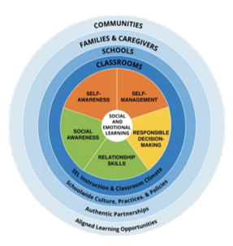
Social and Emotional Learning- SEL
Social and Emotional Learning- SEL
Understand how you are feeling, how others might be feeling
Putting feelings into words
The ability to calm oneself down when feeling highly emotionally aroused
Planning ahead and considering the effects of your behaviour on others
Developing greater empathy/compassion for others
“Treat Others the Way you Want to Be Treated”
Notes:
So, to recap we are advocating schools adopt Social and Emotional Learning as a tool to improve the emotional wellbeing and mental health of pupils and the whole school community. This means delivering lessons explicitly around mental health; ensuring pupils feel safe, having good role models and extending this from the classroom throughout the school, the family and the community.
The ultimate goal of SEL is to support the growth of empathy and compassion. We need to; understand ours and others’ feelings, be able to talk about feelings and identify when the way we are feeling is not conducive to doing what we want; when our wellbeing is compromised. We need the tools to self regulate; calm down or energise and to effectively problem solve and make plans.
The SEL curriculum is based on the 5 competencies; ● Self-awareness ● Self-management ● Social awareness ● Relationship skills ● Responsible decision-making
Norfolk has supported primary schools to deliver SEL using the ‘PATHS’ programme and the programme is underpinned by the Golden Rule, “Treat Others the Way you Want to Be Treated”

Slide 5
Whole school approach
Whole School Approach to Nurturing Wellbeing in Norfolk Schools and other settings
Ethos and environment
Enable student voice to influence decisions
Identify need, targeted support
Supports wellbeing and provides appropriate CPD
Curriculum, teaching and learning to promote and support wellbeing
Leadership and Management
Engagement and partnership with families and local communities
Whole school approach
Notes:
the SEL framework is most effective when delivered as a whole school approach – and in the UK we tend to look at these 7 elements as being the component parts of a Whole School Approach
Leadership and Management
Ethos and environment
Curriculum, teaching and learning
Identified need and targeted support
Staff wellbeing supported and appropriate CPD provided
student voice Enabled and evidenced to influence decisions
Engagement and partnership with families and local communities
The whole school approach is a tried and tested method of school improvement and is not a quick fix. We know that any work that will create long term cultural change needs to be top down and bottom up; addressing leadership and management alongside teaching and learning.

Slide 6
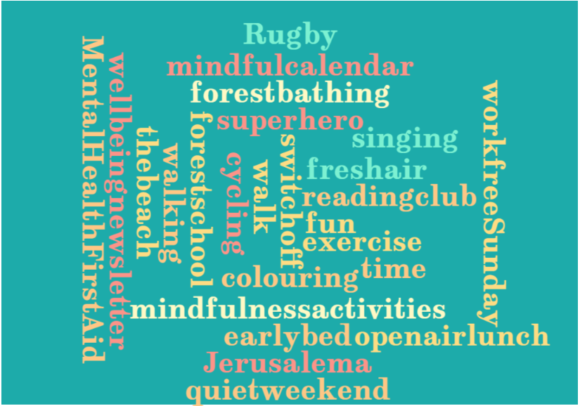

What were your wellbeing wins?
What were your wellbeing wins?
Notes:
At the end of last week’s session we asked attendees to make a wellbeing pledge to action within the week. Here are the wellbeing wins shared by the group.

Slide 7
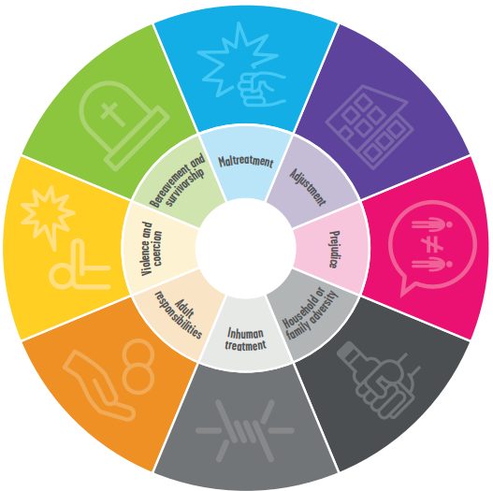
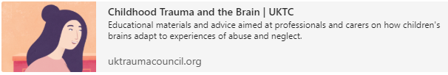
Childhood trauma and the brain
Household and family adversity
Inhuman treatment
Adult responsibilities
Violence and coercion
Bereavement and survivorship
Maltreatment
Adjustment
Prejudice
Notes:
Last session we talked about the need for a trauma aware approach and a wellbeing win for us last week was this video produced by the UKTC and shared by the Anna Freud team. The link will be embedded in today’s PDF and it explains very well the effect of ACEs on brain development which potentially threatens wellbeing outcomes
Click on the face to play the video

Slide 8
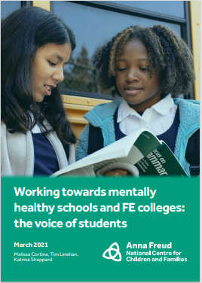
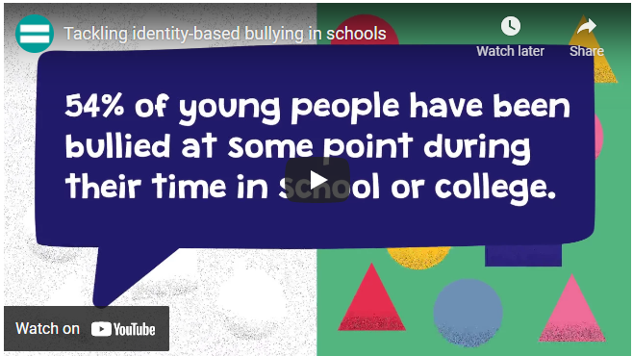

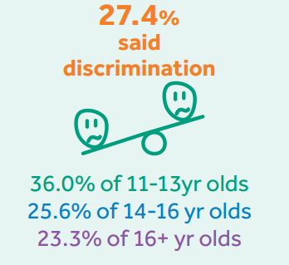
As educators our duty
As educators it is our duty to ensure our schools are places where no one experiences prejudice
How can we stop prejudice-based bullying in schools? | Equality and Human Rights Commission (equalityhumanrights.com)
Notes:
Experiencing prejudice is an adverse childhood experience and can have short and long term effects of mental and physical health. The results of a survey around being a mentally healthy school was published by the Anna Freud team last week. Between November 2020 and January 2021, the Anna Freud Centre surveyed just over 3 thousand young people aged between 11 and 19, asking them about factors relating to their mental health and wellbeing. Here are the results; over a quarter saying discrimination negatively affects them. I haven’t seen similar data for primary school children and would be curious to know what figure we would get for under 11s.
As educators it is our duty to ensure our schools are places where no one experiences prejudice and the equality and human rights commission have some useful resources such as this video. Links to the research and the equality and human rights videos are embedded.
It is important to remember that schools have statutory duties to prevent and challenge prejudice based behaviour
Education and Inspections Act 2006
the Equality Act 2010
Ofsted framework
Keeping Children Safe In Education
Statutory RSHE

Slide 9


Be where we are celebrated not tolerated
Notes:
One positive of the past year is the solidarity and generosity that some folk have shown and education is no exception. A huge amount of free content has been shared with the hope that it helps teachers who have had a tough year. I am very grateful to all those whose resources I am able to share and hope that I have remembered to credit everyone.
An excellent place to learn about what it means to have a school that is equitable, diverse and inclusive is from DiversEd. And their ambition is that all schools are where everyone is celebrated, not tolerated. We don’t want inclusive to mean homogenous; it’s not about not seeing colour. Let’s hold space for a minute and reflect on that.

Slide 10
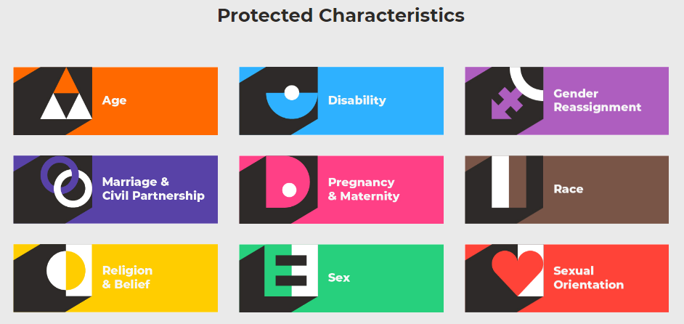
Protected characteristics
The Equality Act 2010 makes sure that people with particular characteristics are protected from discrimination. It is your right that you should not be treated differently based on a protected characteristic.
Discrimination means unfair treatment of somebody based on a particular characteristic
Your rights are things you are born with that belong to you that nobody can take away
While attending school there is no protection against age discrimination (unless you are in a 6th form, FE college or University) or marriage or civil partnerships discrimination
Notes:
I am very sure this is familiar to all but let’s remind ourselves. There are 9 protected characteristics; age, disability, gender reassignment, marriage and civil partnership, pregnancy and maternity, race, religion and belief, sex and sexual orientation.
The Equality Act 2010 makes sure that people with particular characteristics are protected from discrimination. It is your right that you should not be treated differently based on a protected characteristic.
Discrimination means unfair treatment of somebody based on a particular characteristic
Rights are things you are born with that belong to you that nobody can take away
While attending school there is no protection against age discrimination (unless in a 6th form, FE college or University) or marriage or civil partnerships discrimination

Slide 11
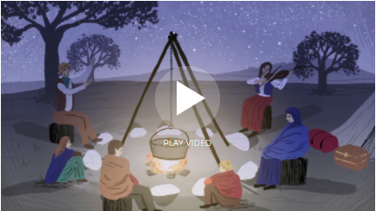
BAME and PoC
GRT
BAME and PoC
GRT- Roads from the Past: A Short History of Britain's Gypsies, Roma and Travellers | Travellers Times
Race and ethnicity
Disabled and people with disabilities
LGBT(QIA)+
Neurodiverse and neurotypical
‘No one today is purely one thing. Labels like Indian or woman or
Muslim or American are not more than starting points, which if followed
into actual experience for only a moment are quickly left behind’
Said, 1993:433
Notes:
To fully explore EDI you need a full day and an expert you have a few minutes and me, but I will do my best to explore some of the characteristics in more depth.
BAME stands for black, Asian, minority ethnic and right now is the most widely used acronym for ethnicity in the UK..
PoC stands for people of colour and is more internationally used.
We must appreciate neither term comes without criticism but it’s important to note these are widely accepted terms.
As teachers it is imperative we understand the difference between ‘race’ and ‘ethnicity’. Race historically describes a set of biological markers however this has been replaced with the idea that race is a social construct. Ethnicity is seen to identify culture, traditions and social identity. It’s learnable and less fixed.
Terminology around disability has changed; handicapped is no longer an acceptable term. Language around disability is often self determined (as with other PCs) some people choose to have the person first; others do not
When describing sexuality, terminology is as varied as the spectrum of sexuality itself. Terminology is rapidly changing. Homosexual is problematic due to its pathological history.
It is pleasing to see that diversity of neurological processing in schools is being recognised. The umbrella term is autism. It is widely accepted that ASC (autistic spectrum condition) is preferable to ASD as condition is preferable to disorder. Another term gaining traction is ‘neurodiverse’ and ‘neurotypical’ to reduce the use of the heavily loaded ‘normal’.
It is useful to keep up with what terms are used and if you are not sure what someone wants to be called; just ask. It is a good idea to have regular training around diversity.
I have shared a link to a short movie about the gypsy roma traveller (GRT) community narrated by teacher and stortyteller Richard O’Neill- Roads from the Past: A Short History of Britain's Gypsies, Roma and Travellers | Travellers Times
I began by acknowledging that last week was tough in a year that has been tough especially on those with one or more protected characteristic and their loved ones. We have seen stories in the news surrounding all of these communities so again; lets hold space to reflect. We need to think how world events impact the lives of the children we teach and their families. They may not be feeling safe, may not be feeling welcome.

Slide 12
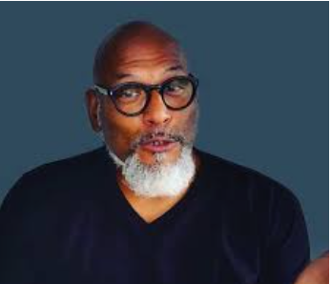
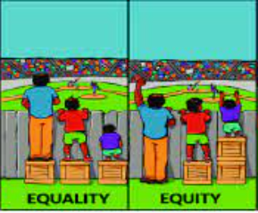


caution about cultural competence
Not racist v antiracist
Cultural competency v antiracism
Equality and equity
Notes:
I want to spend time looking at a few words and phrases that have been talked about a lot this year in response to George Floyd’s murder.
As a local authority we have made a pledge to be antiracist. Angela Davis made the famous quote, ‘It’s not enough to be non racist. We must be anti-racist’ and you can click on John Amaechi to hear him expand on this.
Just want to raise a note of caution about cultural competence
Sometimes the terms cultural competence and anti-racism are used interchangeably in the UK.
Cultural competence, broadly speaking, is the ability to work in culturally appropriate ways with people of various cultural backgrounds and in ways that are respectful of various values, worldviews, belief systems and cultural practices. Cultural competence is very important; especially in settings where it appears there is less diversity, but it is not antiracism; it doesn’t seek to reform structures or society.
Lastly I thought it would be helpful to explore the difference between equality and equity which I think this diagram does really well.
On the left, the fans have been given equal support in the form of boxes but due to their height differences one now has a great view due to his existing height, the fan of average height has an okay view but the fan with the height disadvantage still can’t see.
On the right the fans have been given the support they need so they have an equal opportunity to enjoy watching the match.
Now, I cropped out two images; reality and liberation. Have a think how they might look

Slide 13
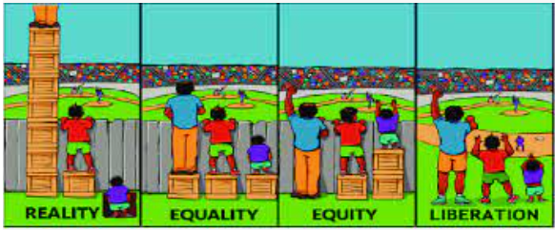
barriers to achievement
Notes:
Here’s the full diagram.
The reality being that some people easily excel, many just about cope and some do not achieve what they want and need to. We have different amounts of privilege.
The ideal is that barriers to achievement are removed and there is no need for support.

Slide 14
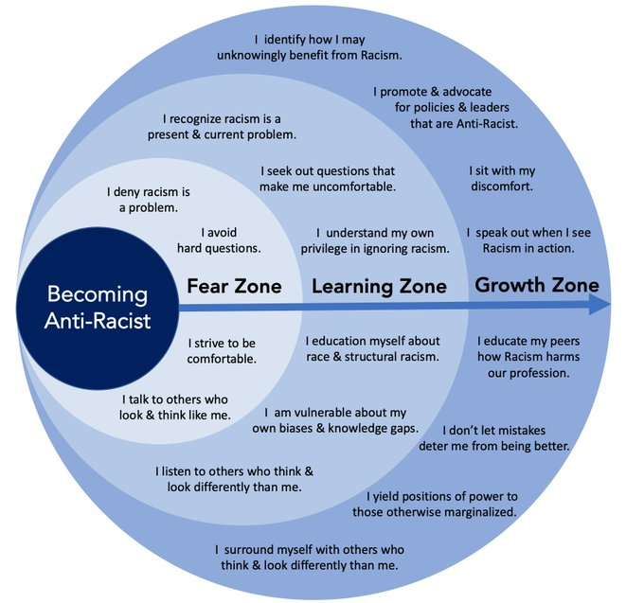
diagram created to support antiracism in social work
Socialwork.career
Notes:
I am very aware that this is an emotive topic so again want to hold space for you to process. You might want to use this diagram created to support antiracism in social work to identify where you sit.

Slide 15

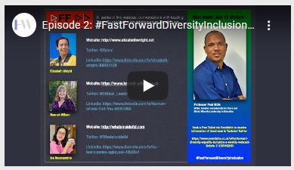
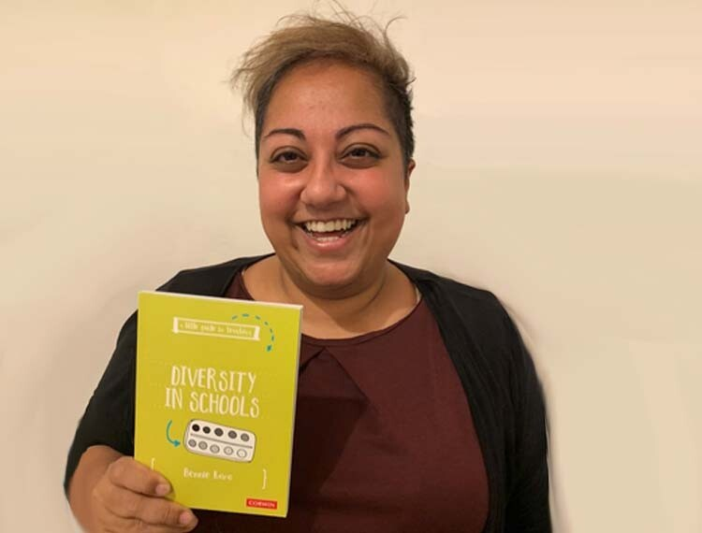
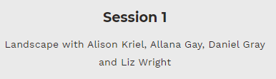
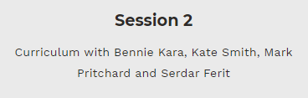
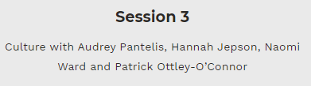
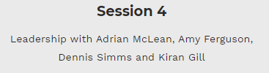

lots of excellent and accessible CPD and resources out there
Liz Wright
Dr Paul Miller
Iqra Iqbal
Andrew Moffat
Notes:
The great news is that if you and your school do want to do the work that is needed; there is lots of excellent and accessible CPD and resources out there. Diverse ED have recorded all their live sessions and the link is embedded. BAMED have a wealth of useful stuff; How to be an Ally by Dr Muna Abdi is highly recommended. A clear, concise and realistic read is Bennie Kara’s Diversity in schools which I finished in an hour.

Slide 16









Books
Notes:
More good news is there’s been a huge increase in the numbers of books by diverse authors and which include positive representation of the protected characteristics. What makes a baby is excellent as it is inclusive of different families and different ways families are made.

Slide 17
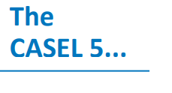
The Casel 5
● Integrating personal and social identities
● Identifying personal, cultural, and linguistic assets
● Examining prejudices and biases
● Taking others’ perspectives
● Recognising strengths in others
● Demonstrating empathy and compassion
● Identifying diverse social norms, including unjust ones
● Communicating effectively
● Demonstrating cultural competency
● Resolving conflicts constructively
● Resisting negative social pressure
● Seeking or offering support and help when needed
● Standing up for the rights of others
● Demonstrating curiosity and open-mindedness
● Identifying solutions for personal and social problems
● Anticipating and evaluating the consequences of one’s actions
● Reflecting on one’s role to promote personal, family, and
community well-being
● Evaluating personal, interpersonal, community, and institutional impacts
Notes:
Within the SEL framework there are many ways to teach about equity, diversity and inclusion- these are taken from the slides shared last session

Slide 18
whole school approach
Whole School Approach to belonging and connection in Norfolk Schools and other settings
Ethos and environment
Enable student voice to influence decisions
Identify need, targeted support
Supports wellbeing and provides appropriate CPD
Curriculum, teaching and learning to promote and support wellbeing
Leadership and Management
Engagement and partnership with families and local communities
Notes:
As with all systemic changes; equality, diversity and inclusion need a whole school approach to be effective. I have curated some wellbeing resources which support this but I want to briefly mention the idea of decolonising the curriculum as you may have heard this term recently.
Again this is something that needs further explanation to do it justice but it based around the idea that people of colour (and this can be expanded to the other protected characteristics are not accurately represented in the curriculum. It is only recently we are seeing the inclusion of African and Asia soldiers on Poppy Day.
It is important the representation is intersectional eg; a person might have more that one protected characteristic and that the representation is broad.
I asked the audience; can you name any black British musicians?
Then; can you name any black British sportspeople? can you name any black British academics?
Were any categories easier? Why is that?

Slide 19
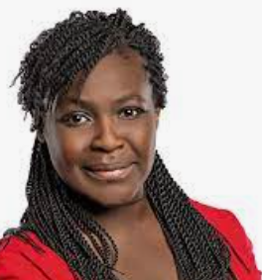
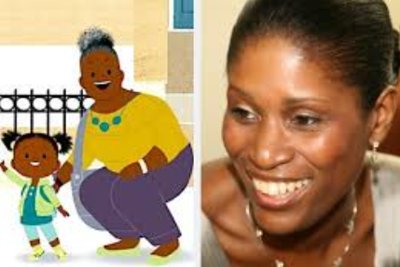
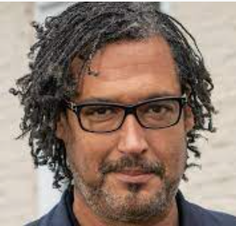
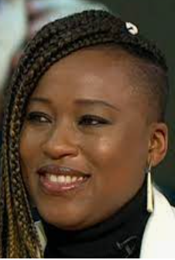
All have written books and most are activists
Notes:
Hold space on that for a minute.
I was asked this in a webinar I attended last week and I thought of
Dr Maggie Aderin-Pocock- space scientist (she’s a PATHS role model and did Cbeebies Stargazing)
Dr David Olusoga- historian (just published a children’s version of Black and British)
Dr Shola Mos Shogbamimu- lawyer (you might have seen her on GMB a few weeks ago)
Laura Henry Allain- Educator and creator of JoJo and Gran Gran, the first animated series to centre on a Black British family.
All have written books and most are activists

Slide 20

Link to video
New Bedtime Stories on CBeebies & BBC iPlayer - YouTube
Notes:
I am going to stop talking for a minute before I go through some resources to support wellbeing. I saw this at the weekend and thought it was too good not to share; for those of you that don’t know Cbeebies do a bedtime story, much like oldies such as myself watched as children. They are available on catch up and really do choose excellent books and have some great readers. Click on the link to watch it.
SHARE VIDEO

Slide 21
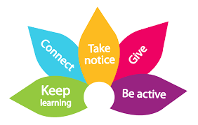
5 Ways to Wellbeing
5 Ways to Wellbeing
SMILE
Socialise
Move
Interest
Learn
Engage
Notes:
Last session we talked about the 5 ways of wellbeing which is the Public Health model that has been adopted by Norfolk and promoted to children, young people and families.
Smile is a child friendly version of this.
Socialise (connect),
Move (Be active)
Interest (Take notice),
Learn,
Engage (Give)
Our suggested SEL curriculum is based around the SMILE model

Slide 22
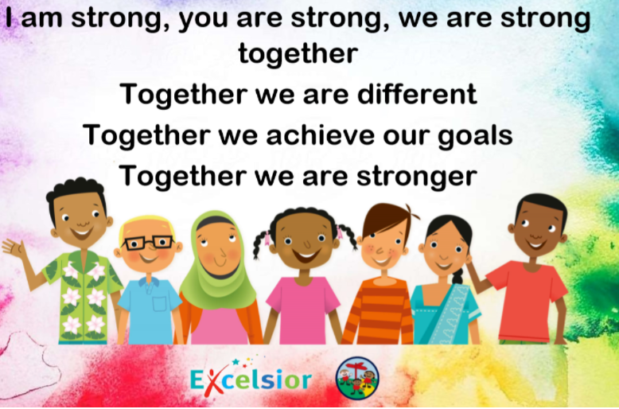




SMILE sessions- socialise (connect)
SMILE sessions- socialise (connect)
There is strong evidence that indicates that feeling close to, and valued by, other people is a fundamental human need and one that contributes to functioning well in the world.
No Outsiders session
Pro social game
Thanks to Andrew Moffat MBE, Puffin Books and Tata’s Storytime
Notes:
So what I would like you to do; if you haven’t already is to dedicate 15/20 minutes a day to a SMILE session. Ideally the first part of the day. I have designed this being mindful that not all children might be in school so I hope they would work remotely and could be delivered by a parent or carer. I have chosen activities to form a social therapy type curriculum; what we might call self care when practised as adults.
There’s 5 sessions a week. One is socialise which is based on Andrew Moffat’s ‘No Outsiders’ programme where picture books and circle time type discussions around RSE themes are had. I have chosen books that follow the SEL theme and order and with them is a drawing activity. This could easily be done at a different part of the day. I have also included a resources that has linked screen free activities; the socialise screen free games come from our friends who deliver PATHS for Barnardos . When I started these resources not all pupils were back and as I had started I finished. The activity in the purple is the screen free one.

Slide 23

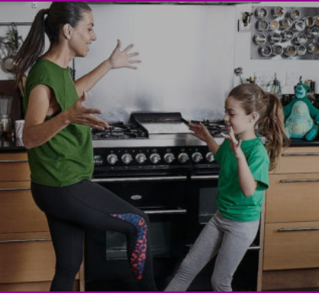

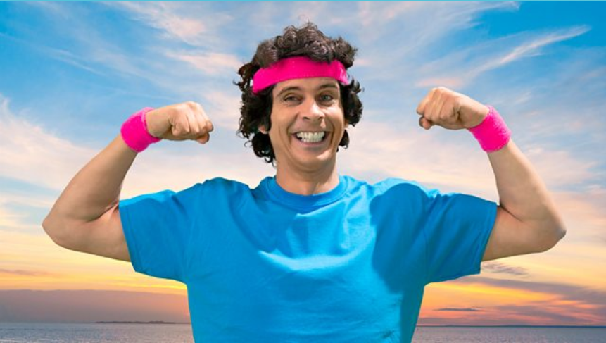

SMILE sessions- move (be active)
SMILE sessions- move (be active)
Physical activity has a huge potential to enhance our wellbeing. Even a short burst of 10 minutes' brisk walking increases our mental alertness, energy and positive mood. Participation in regular physical activity can increase our self-esteem and can reduce stress and anxiety
Dance / workout
Playground games
Thanks to: Kidz Bop, MissWilliams29, Tiny Toes Ballet,
CBeebies
Notes:
The next is move which is a collection of different dance activities I hope the children and you will enjoy. I have included move activities for differentiation from Cbeebies and Tiny Toes Ballet.
The move screen free games come from Miss Williams 29 who kindly shared her resource of games that could be played socially distanced if needed.

Slide 24


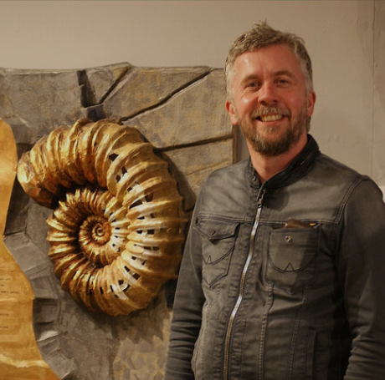

SMILE sessions- interest (take notice)
SMILE sessions- interest (take notice)
Reminding yourself to ‘take notice’ can strengthen and broaden awareness.
Studies have shown that being aware of what is taking place in the present directly enhances your well-being and savouring ‘the moment’ can help to reaffirm your life priorities.
Heightened awareness also enhances your self-understanding and allows you to make positive choices based on your own values and motivations.
Artwork of the week
Art Jumpstart
Thanks to Emma Cate and Darren Wakelam
Notes:
I thought we’d raise our cultural capital for interest and it’s focusing on art. I have found a lovely resource Kindly shared by Emma Cate so there’s a work of art a week linked to the SEL theme from Learn. You have the picture and some questions linked to it from Emma. The screen free content comes from they hugely talented Darrell Wakelam. He’s got some great ideas for junk modelling and I have selected ones linked to the books used in Socialise.

Slide 25

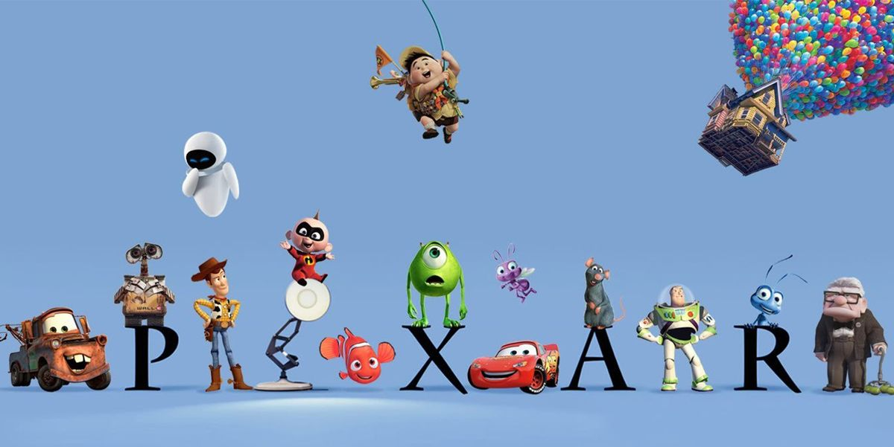
SMILE sessions- learn
SMILE sessions- learn
Learning throughout life enhances self-esteem and encourages social interaction and a more active life.
Anecdotal evidence suggests that the opportunity to engage in work or educational activities can help to lift people out of depression.
The practice of setting achievable and self set goals has been strongly associated with higher levels of wellbeing
Explicit SEL session inspired by an animated short movie
Learn your squad dance
SEL mindfulness
Thanks to Pixar, Netflix, Barnardos
Notes:
Learn uses animated short movies which demonstrate the themes from the SEL framework. You watch the move then discuss it. The learn screen free mindfulness drawing comes from our friends who deliver PATHS for Barnardos. Each one corresponds with the SEL theme. We also think it would be lovely if your class chooses a dance to perfect; practicing it each week or more if possible. I will explain more at the end.

Slide 26

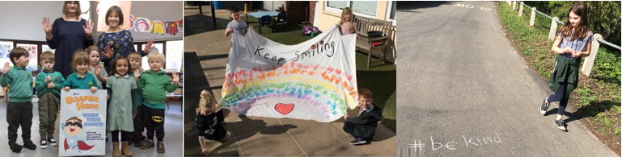
Social and Emotional Learning support for families
Social and Emotional Learning support for families
Guidance to support emotional wellbeing and mental health using principals, strategies and resources from PATHS® practitioners across the world, curated by the Norfolk Team.
Notes:
If you want explore into the 5 learn elements further this slide deck might be useful. I created this resource for PATHS schools to share with families last year to support SEL remotely. For schools that don’t do PATHS this may be useful for Parent Support Advisors or pastoral leads.

Slide 27


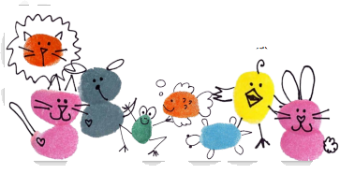
SMILE sessions- engage (give)
SMILE sessions- engage (give)
Participation in social and community life has attracted a lot of attention in the field of wellbeing research.
Individuals who report a greater interest in helping others are more likely to rate themselves as happy.
Research into actions for promoting happiness has shown that committing an act of kindness once a week over a six-week period is associated with an increase in wellbeing.
Thankful role model
Gratitude journal
Thanks to Charlotte and Aaron; the Individed team
Notes:
On a Friday we’d like you to end the week engaging; giving thanks. We would like the children to hear others giving thanks; their HT, someone from the community, maybe we can get some local celebrities to share theirs. Just a couple of minutes. Then there’s a chance for the children to reflect on what they are grateful for as part of a gratitude journal. Different weeks will have a different theme; linked to the SEL theme.

Slide 28

SMILE sessions- Primary; recommended order Learn, Move, Socialise, Interest, Engage
SMILE sessions- Primary; recommended order Learn, Move, Socialise, Interest, Engage
 | Week 1 | Week 2 | Week 3 | Week 4 | Week 5
Socialise Read and draw along | Don’t mess with a princess- Rachel Valentine & Rebecca Bagley | How to be a Lion- Ed Vere | Look Up- Nathan Bryon & Dapo Adeola | Buster finds his beat- Pamela Aculey & Ray Walsh How to draw a turtle- artforkids.com | The Bumble Bear- Nadia Shireen
Move Dance | (5) YolanDa Brown - Let Me See You | Dance Monkey | You’re welcome | Can’t stop the feeling | Sunflower
Interest Artwork of the week | Michaelangelo; Pieta | Himid; Between the two my heart is balanced | Basquiat; Grillo | Hockney; Growing up by the Garrowby Hill | Degas; Little Dancer
Learn SEL lessons based on CASEL5 5 | Golden Rule; treat others as you’d like to be treated Pixar- For the birds- Link to RE | Compliments Pixar- Boundin | Feelings Storybooks- Emotions | Calming down Explore your core emotions with ‘Inside Out’ Belly breath with Rosita Belly breath song 3 Steps to Calming Down | Problem solving Pixar- Piper 3 Steps to Problem Solving
Engage Adults share gratitude | School role model- places | Individed role model- things about me | Individed role model- - music | Individed role model- - memories | Individed role model- - people
Notes:
I put the timetable together in the order of SMILE but I think it would actually work best beginning with Learn, Socialise in the middle and finishing with Engage. Move and Interest are more flexible. These are the sessions that require a screen.

Slide 29
Screen free SMILE – Primary; recommended order Learn, Move, Socialise, Interest, Engage
Screen free SMILE – Primary; recommended order Learn, Move, Socialise, Interest, Engage
 | Week 1 | Week 2 | Week 3 | Week 4 | Week 5
Socialise | PATHS interactive games P.9 Would you rather? | PATHS interactive games P.8 If I was a | PATHS interactive games P.3 Feelings Bingo | PATHS interactive games P7 Help we’re running out of toilet paper | PATHS interactive games P.14 Cooperation games
Move | Miss Williams’ games Zip, Zap, Zoom | Miss Williams’ games Countdown | Miss Williams’ games Pass the Movements | Miss Williams’ games Jungle | Miss Williams’ games Pirate Ship
Interest | #ArtJumpStart Cardboard Castle | #ArtJumpStart Yoghurt tub lion (adapted from tiger) | #ArtJumpStart Cardboard roll rocket ship | #ArtJumpStart Paper plate turtle | #ArtJumpStart Biscuit box bear
Learn | Golden Rule mindfulness | Compliments mindfulness | Feelings mindfulness | Calming down mindfulness Turtle 3 steps | Problem solving mindfulness
Engage | Individed gratitude journal- places | Individed gratitude journal- things about me; shield of resilience | Individed gratitude journal- music | Individed gratitude journal- memories | Individed gratitude journal- people
Notes:
Then for each screen based activity there is a linked screen free activity.

Slide 30
5 themes of learn against the Mental Wellbeing Outcomes
Mental wellbeing outcomes | Week 1- The Golden Rule | Week 2- Compliments | Week 3- Feelings | Week 4- Calming down | Week 5- Problem Solving
Children need to understand: | that mental wellbeing is a normal part of daily life, in the same way as physical health simple self-care techniques, including the importance of rest, time spent with friends and family and the benefits of hobbies and interests. isolation and loneliness can affect children and that it is very important for children to discuss their feelings with an adult and seek support. | that bullying (including cyberbullying) has a negative and often lasting impact on mental wellbeing isolation and loneliness can affect children and that it is very important for children to discuss their feelings with an adult and seek support. the benefits of physical exercise, time outdoors, community participation, voluntary and service-based activity on mental wellbeing and happiness. | that there is a normal range of emotions (e.g. happiness, sadness, anger, fear, surprise, nervousness) and scale of emotions that all humans experience in relation to different experiences and situations. how to recognise and talk about their emotions, including having a varied vocabulary of words to use when talking about their own and others’ feelings. | how to judge whether what they are feeling and how they are behaving is appropriate and proportionate | where and how to seek support (including recognising the triggers for seeking support), including whom in school they should speak to if they are worried about their own or someone else’s mental wellbeing or ability to control their emotions (including issues arising online).
Key ideas & questions to explore in the Learn session and to explore further in the Interest and Socialise sessions | How do the small birds behave when the large bird joins them? They are making each other laugh is this a good thing here? They are working as a team; is this a good thing? Do the small birds like being laughed at? The small birds didn’t treat the big bird as they like to be treated; they aren’t kind. How could the small birds have welcomed the big bird? | What does everyone like about the lamb at the start? Why does the lamb feel sad after he’s been shorn? Why does he feel lonely? Has the lamb changed the way he is or what he can do?How does the lamb feel once he starts bouncing again?How does the lamb feel next time he is shorn? We can compliment the lamb on his resilience? We should say thank you when we get a compliment. We should say you’re welcome when someone says thanks | In the shorts we see lots of different people with lots of different feelings; what ones can you remember? The characters tell us all feelings are okay but some are comfortable and some are uncomfortable. Can you remember some comfortable ones? Can you remember some uncomfortable ones? Are any both? Surprised? Tired? Can we feel more than one feeling at once? Love for your sister but also be jealous? Excited about high school but also nervous? It is important that we are feeling the way we need to feel to do what we need to do and there are things that help us do that. What makes us calm? What makes up happy? What makes us feel energised? What different breathing techniques can we explore? Why is it important to say the problem and how we feel? |  | What is Piper trying to do at the start of the movie? What’s the problem? What different ways does he try? How does he feel when he keeps getting washed away by the tide? How does the sea snail help him? How does he feel when he has reached his goal. It’s good to calm down and make a plan and we all need help sometimes. Who helps you?
Notes:
I have cross referenced the 5 themes of learn against the Mental Wellbeing Outcomes from the latest RSE guidance. It appears to cover them all but a one of week isn’t enough to properly embed the learning but hopefully it will be helpful. I have also written some possible questions to ask about the short films.

Slide 31
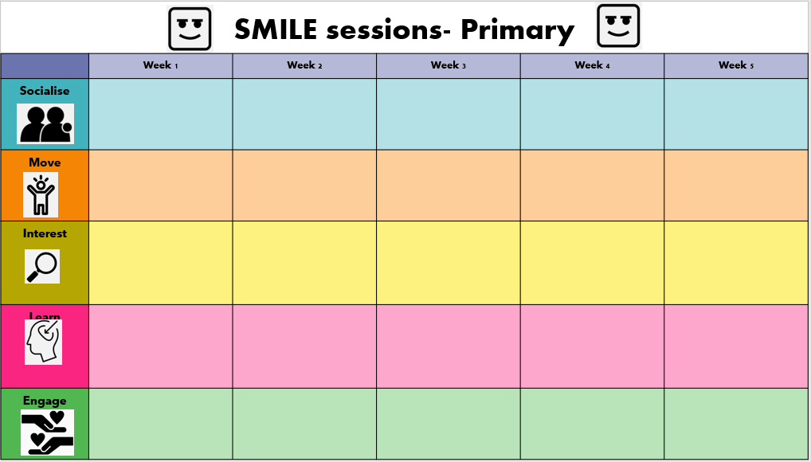
Other support and links
Education Resources | Council for Learning Outside the Classroom (lotc.org.uk)
Puffin- empathy day
The Munch Museum- contains nudity!
Tiny Toes Ballet- pre school
Andy’s Wild Workouts
The world’s best virtual school trips;
MM maori mindfulness
Cirque du soleil
Singing Hands- makaton
Empathy Day activities 2020
Barnardos Breathing- attachment sent
Picture books suitable for older children
Jacqueline Woodson Reads "The Day You Begin"
Alexis Deacon reads ‘Beegu’
Oprah Winfrey reads ‘Hula Hoopin’ Queen’
Sophie Helm reads ‘Super Duper You
Extracts from chapter books
Little Badman by Humza Arshad
The Secret Dragon | Ed Clarke
Build An Adventure Workshop | Jamie Littler
Notes:
I have made a couple of timetable templates so you can make your own and here are some links to additional resources; I have added some in response to feedback from the session

Slide 32

Getting information, advice and guidance
Getting information, advice and guidance
Welcome
User guide
Working with worry
Buana bunny’s worry story
Notes:
Individed is a great tool to equip pupils with the information that they need to make good decisions about their own emotional health and wellbeing
Through different activities their wellbeing is assessed and activities and resources provided to help them improve it. It is accessible at home and if teachers register their pupils they can track the assessments and also when resources are accessed.
It’s fully funded and the portal plus some support videos are linked here.

Slide 33

Getting information, advice and guidance
Notes:
I am sure you all know about our one stop shop; Just One Norfolk. This is the place to go to or to signpost parents and carers to if they need information, advice and guidance.

Slide 34
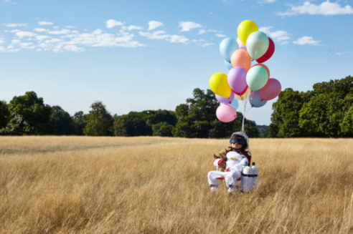
What is the key message you will take away from today?
What is the key message you will take away from today?
What have you identified as your next step as a result of this session?
Notes:
At the live webinar we collected these answers in chat; if you would like to share yours; please email me.

Slide 35





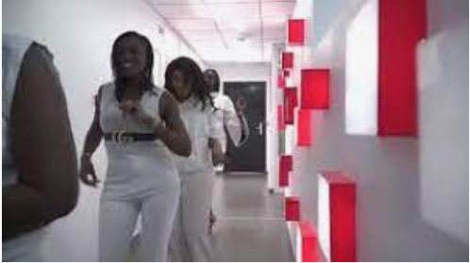
SMILE dance challenge
SMILE dance challenge
Nurturing Wellbeing
@SEL_Norfolk_Sch
Jerusalema Challenge - CTI Sénégal - YouTube
Notes:
So we are the last slide of the day. I hope you have enjoyed the session and I hope you and your pupils enjoy the activities and resources suggested.
I would love you to share anything you do in school and we have a Twitter account @sel_norfolk_sch
Within Move there was the suggestion of learning a class dance; one of these; let me see you, the easiest, You’re welcome and sunflower; probably the hardest.
It would be great to see these; maybe we could organise a zoom dance off in the summer term?
To inspire you I thought we could end with the Jerusalema dance challenge that boosted wellbeing globally last year. There is a compilation from around the world embedded in the picture and also one done in Senegal which I included to show that Africa is more that Handa’s surprise.
PLAY VIDEO

