Slide 1
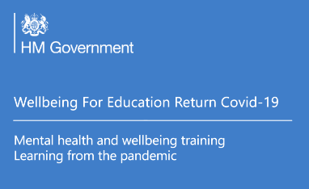

Nurturing Wellbeing
Practical support for developing wellbeing for pupils and families
Secondary and Colleges
23.03.21
anna.sims@norfolk.gov.uk
Notes:
Welcome to our session today focussing on nurturing wellbeing for secondary schools and giving practical support for developing wellbeing for both pupils and families. This is a follow up to the session delivered on 09.03.21 about the importance of social and emotional learning and a trauma informed approach. A link to the video of this will be sent to you as soon as it becomes available.
I will be leading the session today. I have been working promoting social and emotional learning in primary schools using the PATHS programme for 10 years and in the last 2 years have supported EHWB in secondary schools and colleges via my wellbeing newsletter. I also worked with Ormiston Families in setting up Mental Health Support Teams in Norfolk and Waveney.
I also lead on the Anna Freud Link Programme which involves facilitating schools and Mental Health Services to have discussion about the local issues affecting children and young people.
Your video is turned off and your microphone is muted. If you want to ask questions please use the chat function.

Slide 2
Aims of the Session
Aims of the Session
5 ways of wellbeing
Know how to deliver activities that support the 5 ways of wellbeing
Ensure provision supports equality, diversity and inclusion
Share and signpost to the guidance, advice and help that is available locally and nationally
Engage families
Pupils
Familes
Notes:
In this session we aim to offer practical support and ideas to nurture wellbeing
We are using the 5 ways of wellbeing as a structure to support pupil and have suggestions for tutor time activities that can be shared with families
We want to ensure that the provision supports equality, diversity and inclusion
Finally we want to share and signpost to the guidance, advice and help that is available locally and nationally

Slide 3
By the end of the session
By the end of the session
By the end of the session you will hopefully -
Understand the importance of equipping pupils with the information that they need to make good decisions about their own health and wellbeing.
Understand the importance of providing clear, planned curriculum opportunities to promote resilience, support social and emotional learning and opportunities for pupils to participate in activities to build their confidence and self-esteem
Understand that we all have mental health but when issues arise pupils know to seek support as early as possible from appropriate sources
After this session you will have
complete and fully editable timetables for daily wellbeing sessions
a resource bank of suggested sessions for use at home or in school to support wellbeing
a narrated PPT adaptation of the session to share with colleagues
Notes:
We have planned an hour of input for but at the end of the session there will be an opportunity to stay and ask questions or to leave if you want to.
A pdf of the powerpoint and resource list and planner will be emailed to you tomorrow and a narrated version of the powerpoint will be available so you can share with colleagues back at school.
-

Slide 4

Group Agreement:
Group Agreement:
Use of personal material/views – share with care (including the webinar message board)
Confidentiality – you can take the learning out of the session but don’t take or record any personal-identifying information out of the session
In order for this to be a safe space for us all to share our thoughts, opinions and experiences, it is important for us to respect and value difference and diversity in all of its forms
Notes:
We want this to be a safe space for people to share so here is a group agreement.
I want to reassure you that joining in with the activities is your choice. There is no pressure from us.
Does anyone have anything else they would like to add? Please put any ideas in the chat.

Slide 5
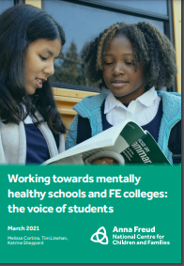
Views of young people
Views of young people
Schools are important places
To talk about mental health
To seek support for themselves and their friends
The most important topics to lean about should be
Depression and anxiety
Body image
Identity
Notes:
Wellbeing is being talked about a lot now but we want to ensure that it remains a priority. All of the time for everyone.
The pandemic has had an impact on all our lives and wellbeing. There is a lot of talk of catching up and missing out . However its not an either or. Well being supports attainment and is essential for our ability to be resilient and cope with life's challenges now and in the future.
We are not expecting staff within schools to become mental health experts, however you are role models and by modelling behaviours and discussing issues you can have a powerful influence on how well your pupils can adapt to this unique time in history.
In a recent study by Anna Freud young people said that schools are important places
To talk about mental health and to seek support for themselves and their friends

Slide 6

Learning growth and development needs secure foundations
Learning Growth And Development Needs Secure Foundations
Foundations are created when pupils, students and staff:
Grow and develop through learning
Experience relationships built on trust with each other
Are emotionally open, curious and interested
Feel safe
Feel welcome
Notes:
Pupils learn best when they have a sense of wellbeing. Wellbeing can be defined as “feeling good and functioning well”
We feel that life is in balance and that we can generally cope.
We feel motivated and engaged and able to show resilience and ‘bounce back’ from life’s challenges.
Resilience can be seen as a toolkit to help us deal with life’s challenges. The 3 components are:
A sense of self-esteem and confidence
A belief in one’s own self-efficacy or personal judgment of our ability to deal with change and adaptation.
A repertoire of social problem-solving approaches
Secure foundations are needed for learning, wellbeing and building of resilience.
It is important the everyone feel safe and welcome, have their emotions validated in order to grow ,develop to thrive and flourish.

Slide 7
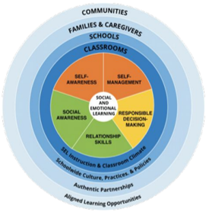
Social and Emotional Learning- SEL
Social and Emotional Learning- SEL
Understand how you are feeling, how others might be feeling
Putting feelings into words
The ability to calm oneself down when feeling highly emotionally aroused
Planning ahead and considering the effects of your behaviour on others
Developing greater empathy/compassion for others
“Treat Others the Way you Want to Be Treated”
Notes:
In the last session we recommended schools adopt Social and Emotional Learning as a tool to improve the emotional wellbeing and mental health of pupils and the whole school community; delivering lessons explicitly around mental health; ensuring pupils feel safe and have good role models, extending from the classroom throughout the school, the family and the community.
The ultimate goal of SEL is to support growth of empathy and compassion.
Understand theirs and others’ feelings.
Being able to talk about feelings and acknowledge them so they have a sense of control
We want them to have the tools to self regulate; calm down or energise and to effectively problem solve and make plans.
The SEL curriculum is based on the 5 competencies; ● Self-awareness ● Self-management ● Social awareness ● Relationship skills ● Responsible decision-making
Norfolk has supported primary schools to deliver SEL using the ‘PATHS’ programme and the programme is underpinned by the Golden Rule, “Treat Others the Way you Want to Be Treated” Kind words and kind actions.

Slide 8
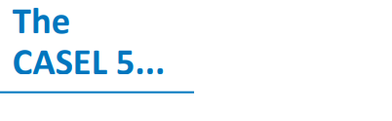
The CASEL 5
● Self-awareness
The abilities to understand one’s own emotions, thoughts, and values and how they influence behaviour across contexts.
● Self-management
The abilities to manage one’s emotions, thoughts, and behaviours effectively in different situations and to achieve goals and aspirations.
● Social awareness
The ability to understand the perspectives of and empathise with others, including those from diverse backgrounds, cultures, and contexts.
● Relationship skills
The ability to establish and maintain healthy and supportive relationships and to effectively navigate settings with diverse individuals and groups.
● Responsible decision-making
The ability to make caring and constructive choices about personal behaviour and social interactions across diverse situations.
Notes:
● Self-awareness
The abilities to understand one’s own emotions, thoughts, and values and how they influence behaviour across contexts. This includes capacities to recognise one’s strengths and limitations with a well-grounded sense of confidence and purpose.
● Self-management
The abilities to manage one’s emotions, thoughts, and behaviours effectively in different situations and to achieve goals and aspirations. This includes the capacities to delay gratification, manage stress, and feel motivation and agency to accomplish personal and collective goals.
● Social awareness
The ability to understand the perspectives of and empathise with others, including those from diverse backgrounds, cultures, and contexts. This includes the capacities to feel compassion for others, understand broader historical and social norms for behaviour in different settings, and recognise family, school, and community resources and supports.
● Relationship skills
The ability to establish and maintain healthy and supportive relationships and to effectively navigate settings with diverse individuals and groups. This includes the capacity to communicate clearly, listen actively, cooperate, work collaboratively to problem solve and negotiate conflict constructively, navigate settings with differing social and cultural demands and opportunities, provide leadership, and seek or offer help when needed.
● Responsible decision-making
The ability to make caring and constructive choices about personal behaviour and social interactions across diverse situations. This includes the capacity to consider ethical standards and safety concerns, and to evaluate the benefits and consequences of various actions for personal, social, and collective well-being.

Slide 9
Whole school college approach to wellbeing and mental health :
Whole School/College Approach To Wellbeing And Mental Health
on, anger
Curriculum,
teaching and
learning to promote
resilience and support
social and emotional
learning
An ethos and
environment that
Promotes respect
And values diversity
Targeted
support and
Appropriate
referral
Leadership and management
that supports and champions
efforts to promote emotional
health and wellbeing
Enabling
student voice
to influence
decisions
Staff
development
to support their own
wellbeing and that
of students
Working with
parents/carers
Identify need and
monitoring impact of
interventions
(Source Public Health England and Children and Young Peoples Mental Health Coalition, 2015)
Notes:
The CASEL SEL framework is most effective when delivered as a whole school approach – and here you can see the Public Health whole school approach model. There are 8 components.
Leadership and Management
Ethos and environment
Curriculum, teaching and learning to promote and support wellbeing
Identifies need and monitors impact
Targets support and appropriate referrals
Supports wellbeing and provides appropriate CPD
Enable student voice to influence decisions
Engagement and partnership with families and local communities
The whole school approach is a tried and tested method of school improvement and any work that will create long term cultural change needs to be top down; leadership and management and bottom up; teaching and learning.

Slide 10
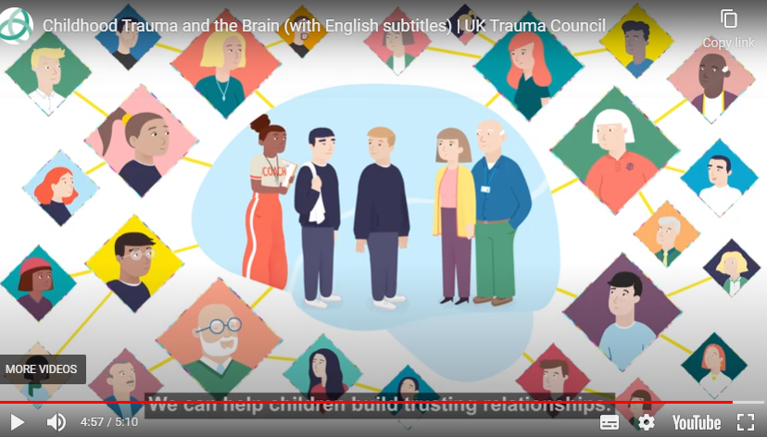
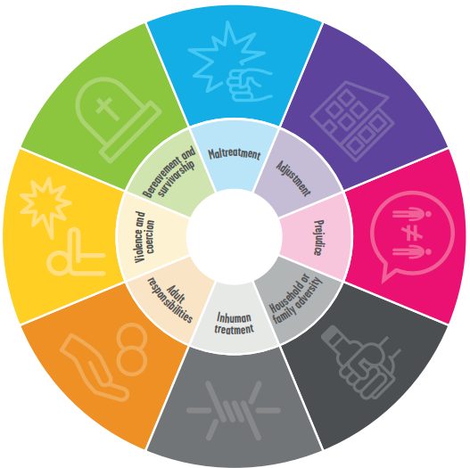
Trauma aware approach
Trauma aware approach
Household and family adversity
Inhuman treatment
Adult responsibilities
Violence and coercion
Bereavement and survivorship
Maltreatment
Adjustment
Prejudice
Trauma and the brain
Notes:
In the last session we talked about the need to take a trauma aware approach in our schools because of Adverse Childhood Experiences (ACES).
A link to a video produced by the UKTC (UK Trauma Council) and shared by the Anna Freud team is on the slide and explains clearly the effect of the following on brain development and consequently the potential to threaten wellbeing outcomes
Household and family adversity
Inhuman treatment
Adult responsibilities
Violence and coercion
Bereavement and survivorship
Maltreatment
Adjustment
Prejudice
.
ACEs are more common than you might think. Almost half of all adults living in the UK have experienced at least one form of adversity in their childhood or adolescence.
Relationships really do matter, and every contact with someone who has experienced adversity and trauma can be an opportunity for healing and growth.
This needs to be supported by providing a safe environment, validating feelings, having clear transparent boundaries but showing empathy,
•As professionals, we need to become adversity and trauma informed
Adversity and trauma informed practice guide. https://youngminds.org.uk/media/3091/adversity-and-trauma-informed-practice-guide-for-professionals.pdf
Is a collaboration from Young Minds, Anna Freud and Body and Soul, gives examples of how to put this into practice, and how to take care of ourselves as well as those we work with.

Slide 11
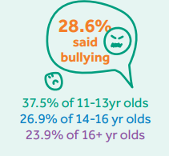
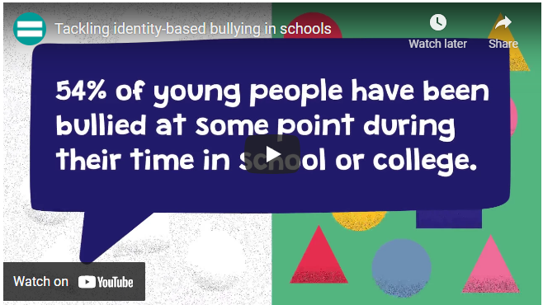
As educators it is our duty to ensure our schools are places where no one experiences prejudice
As educators it is our duty to ensure our schools are places where no one experiences prejudice
Notes:
Experiencing prejudice is an adverse childhood experience and can have short and long term effects of mental and physical health. As educators it is our duty to ensure our schools are places where no one experiences prejudice:
Study by Anna Freud of 3298 young people 11- 19 were interviewed. 28.6% said that bullying had a negative impact on their mental health. Illustrates the importance of making our schools safe places for all.
PLAY VIDEO please
There are statutory duties
Education and Inspections Act 2006
the Equality Act 2010
Ofsted framework
Keeping Children Safe In Education
Statutory RSHE

Slide 12
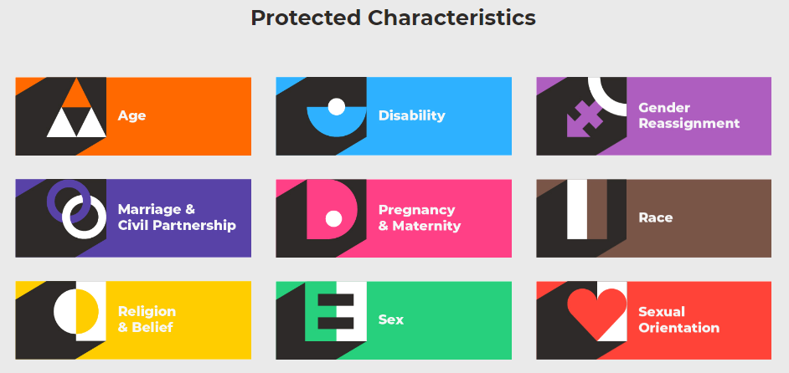

Protected characteristics
The Equality Act 2010 makes sure that people with particular characteristics are protected from discrimination. It is your right that you should not be treated differently based on a protected characteristic.
Discrimination means unfair treatment of somebody based on a particular characteristic
Your rights are things you are born with that belong to you that nobody can take away
While attending school there is no protection against age discrimination (unless you are in a 6th form, FE college or University) or marriage or civil partnerships discrimination
Notes:
There are 9 protected characteristics; age, disability, gender reassignment, marriage and civil partnership, pregnancy and maternity, race, religion and belief, sex and sexual orientation.
The Equality Act 2010 makes sure that people with particular characteristics are protected from discrimination. It is your right that you should not be treated differently based on a protected characteristic.
Discrimination means unfair treatment of somebody based on a particular characteristic
Your rights are things you are born with that belong to you that nobody can take away
While attending school there is no protection against age discrimination (unless you are in a 6th form, FE college or University) or marriage or civil partnerships discrimination

Slide 13
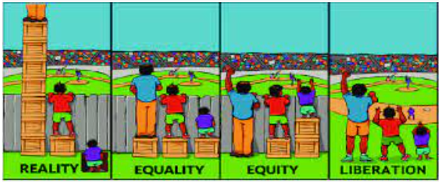
Equality and Equity
Notes:
This diagram illustrates the difference equality and equity.
Equality shows the fans at the match have been given equal support in the form of boxes but due to their height differences one now has a great view due to his existing height, the fan of average height has an okay view but the fan with the height disadvantage still can’t see.
Equity Fans have been given the support they need so they have an equal opportunity to enjoy watching the match.
Reality some fans have lots of boxes which allows them an amazing view while other have no boxes and are actually standing in a hole.
Liberation is where the fence/obstacles are taken away and there is no need for boxes.

Slide 14

Be where you are celebrated not tolerated
Notes:
An excellent place to learn about what it means to have a school that is equitable, diverse and inclusive is from DiverseEd. And their ambition is that all schools are where everyone is celebrated, not tolerated.

Slide 15
School culture and environment
School culture and environment
Create a safe, calm, controlled, and nurturing school environment for pupils and staff
Promote an ethos that fosters a culture of connection inclusion and respect so everyone feels safe and can safely express their feelings
Provide diverse and inspirational role models in staff and visitors
Ensure that the hidden curriculum, including SMSC and British Values, enables all pupils to engage, see themselves and their families reflected and supports and embeds the explicit PSHE curriculum
Notes:
Promoting wellbeing A safe calm predictable controlled environment is vital for pupils to learn but particularly for those vulnerable pupils
The importance of relationships and inclusion so everyone feels respected and safe.
The validation and normalising of feelings.
Having clear transparent boundaries but being understanding and empathetic to individual needs
As with all systemic changes; equality, diversity and inclusion need a whole school approach to be effective.
Children need to see themselves to be themselves.

Slide 16
Curriculum teaching and learning
Curriculum teaching and learning to promote resilience and support social and emotional learning
Provide a preventative approach to mental health through an explicit social and emotional learning curriculum to keep everyone thriving
Celebrate successes and achievements, compliment actions and qualities
Statutory Guidance RSHE curriculum including:
The benefits of physical exercise, time outdoors, community participation, voluntary and service-based activity on mental wellbeing and happiness.
Simple self-care techniques, including the importance of rest, time spent with friends and family and the benefits of hobbies and interests.
Notes:
Integrate mental health and wellbeing across the whole school or college curriculum
Provide a preventative approach to mental health through an explicit social and emotional learning curriculum to keep everyone thriving
Celebrate successes and achievements
Statutory Guidance RSHE curriculum including:
The benefits of physical exercise, time outdoors, community participation, voluntary and service-based activity on mental wellbeing and happiness.
92% of young people were asked how they would like to learn about mental health and wellbeing at school.
Designated lessons came out top followed by group activities
What would your pupils say?
Is having a wellbeing day once a year enough?

Slide 17
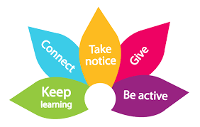
5 Ways to Wellbeing
5 Ways to Wellbeing
SMILE
Socialise
Move
Interest
Learn
Engage
Notes:
Here are the 5 ways of wellbeing which is the Public Health model that has been adopted by Norfolk and promoted to children, young people and families.
Connect – connect with the people around you
Be active – find an activity that you enjoy and make it a part of your life
Keep learning – learning new skills can give you a sense of achievement and a new confidence
Give– even the smallest act can count, whether it’s a smile, a thank you or a kind word
Take notice– be more aware of the present moment, including your thoughts and feelings, your body and the world around you.
Smile is a child friendly version of this. Socialise (connect), Move (Be active) Interest (Take notice), Learn, Engage (Give)
We have developed ideas both primary and secondary pupils.
Obviously this is best if it is done as a whole school approach.
Activities are prompted by video clip or activity that can be shown during assembly time/tutor group session and shared with families so they can get involved too.
The idea is to promote ways of self care and make this part of our everyday lives.

Slide 18
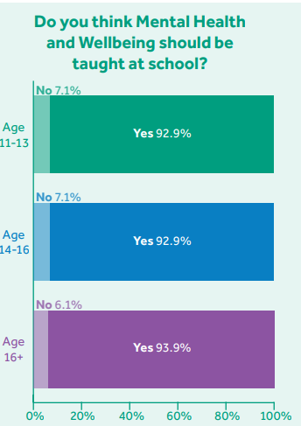
Learn
Learn
learning new skills can give you a sense of achievement and a new confidence
Recognise and understand how you are feeling
Strategies for coping with uncomfortable feelings
Self-care
Understand support that is available
Notes:
Learning throughout life enhances self-esteem and encourages social interaction and a more active life.
Anecdotal evidence suggests that the opportunity to engage in work or educational activities can help to lift people out of depression.
The practice of setting achievable and self set goals has been strongly associated with higher levels of wellbeing
Going forward it would be useful to consult with pupils to find out what they would like to learn about.
But my suggestion is that we focus on social and emotional skills. We think it is important for explicit teaching of skills as well as providing opportunities for pupils to reflect and share with others ( if they want)?
Recognise and understand how you are feeling
Strategies for coping with uncomfortable feelings
Self-care What helps you to feel good?
Understand support that is available Getting Help: Investigate digital support
. Take ownership of wellbeing. Devise a wellbeing plan for the next week

Slide 19

Normalising Feelings
Normalising Feelings
Everyone has feelings
All feelings are normal
Notes:
Acknowledging your Feelings
It is important for pupils and ourselves to understand that we all have feelings and that all feelings are ok.
Feelings change throughout the day and they provide critical information.
In PATHS we encourage pupils to think of feelings as comfortable and uncomfortable rather than good or bad, right or wrong or negative and positive.
So not making judgements about our feelings. We want pupils to understand that feelings are normal.
Evidence shows that if we are able to identify and recognise our feelings this helps us to have some control over them.
Just by acknowledging our feeling this helps to manage a situation more effectively.
By modelling/sharing our (appropriate) feelings with pupils we can expand their emotional vocabulary and help them to understand that all feelings are normal.
If you find this difficult. Think about when you were their age and share example. Or maybe a situation that we all have in common. I wonder what that could be?!!!

Slide 20
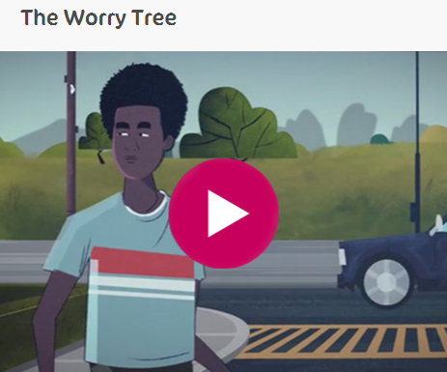
Feelings: Worried
Feelings: Worried
Everyone has feelings
All feelings are normal
Notes:
So I suggest that we start off looking at feeling worried.
The worry tree video comes from the every mind matters website.
So pupils are encouraged to acknowledge the feeling and the problem and to come up with a solution of how to deal with it.
By acknowledging the feeling and the problem pupils can start to decide what things they can control and things they can’t control. By focusing on things they can do it helps to help them cope with an uncomfortable feeling.

Slide 21
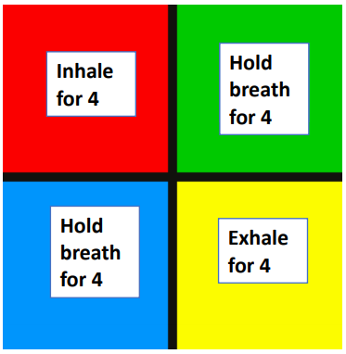
Self regulation: Calming down strategies
Self regulation: Calming down strategies
7/11
Breathe in for 7 and out for 11
5 finger breathing
Smell the strawberry and blow out the candle
Square breathing
Notes:
Calming down strategies to help self regulate .
If we don’t acknowledge feelings, our brains can become hijacked by strong feelings and then we are unable to think clearly and unable to respond in a positive way. It has an impact on our behaviour which may be unhelpful.
If we are able to self regulate then we are able to engage the thinking part of the brain and respond to a situation in a considered thoughtful way rather than responding emotionally. By calming down and considering our options we are able to make positive decisions which helps our ability to engage in learning/activities and our relationships with other people.
5 finger breathing : You start at the base of your thumb and breathe in until you reach the top of your thumb. You pause and then you breathe out as you trace the other side of the thumb. Continue breathing in as you go up, pause at the top and then breathe out as you to down the other side.
Smell the strawberry and blow out the candle Breathe in, pause, breathe out
Square breathing: Breathe in for 4, Pause for 4, breathe out for 4, pause for 4 and repeat.
Breathe in for 7 and out for 11

Slide 22
Problem Solving
Problem Solving
Stop and calm down
Identify the problem and the feeling
Identify solutions and make a plan
Choose a solution and evaluate
Notes:
So responsible decision making is helped or hindered by our emotions and our ability to have some kind of control over them.
The first step is to be calm and not be too hasty in making a behaviour choice.
If we are able to identify and acknowledge the feeling and the problem then we more able to make a decision which is helpful for us and our relationships.
So the next stage is to think of different solutions. It is important that we encourage pupils to take control over this and not come up with all the solutions ourselves. We want pupils to be independent problem solvers.
We need to recognise that some solutions may not work so need to think things though carefully and make a plan.
Once we have decided on our course of action then we can carry out the plan and then evaluate.
If things work out great but if they don’t then we need to calm down and see how we feel now. Is it the same feeling? Is it the same problem? Can we use another of our solutions this time?

Slide 23
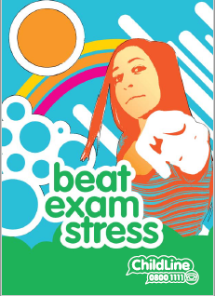
Make a plan
Make a plan
Plan ahead
Pamper yourself
Prepare for the big day
Pace yourself
Perform as well as you can
Phew! Relax
Notes:
Childline have this resource which helps to plan for a situation which involves exam stress.
So the importance of making a plan in advance
Being kind to yourself – have regular breaks. Pamper yourself
Prepare for the big day
Pace yourself
Perform as well as you can
Phew! Relax

Slide 24

Strengthening neural pathways
Strengthening Neural Pathways
Notes:
Acknowledging our feelings and self regulation can feel very strange if we are not used to doing this or we don’t see others around us doing this. In order to develop and strengthen the neural pathways between the emotional part of the brain (limbic system) to the thinking part of the brain (neo cortex) we need time and practise to strengthen those pathways. It is a bit like making a path through a wood which is overgrown. The first time we have to hack through and the pathway is not clear. The second time it is a bit easier but not much. The 5oth time it is getting easier. With repetition and practice it becomes our default option and this can really help in times of crisis.

Slide 25
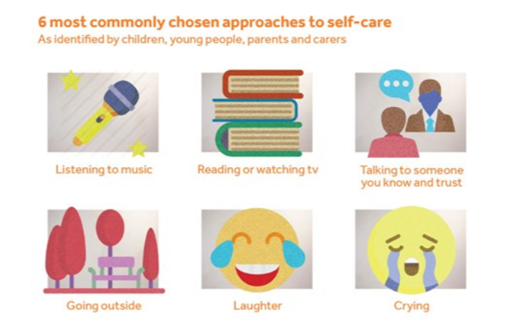
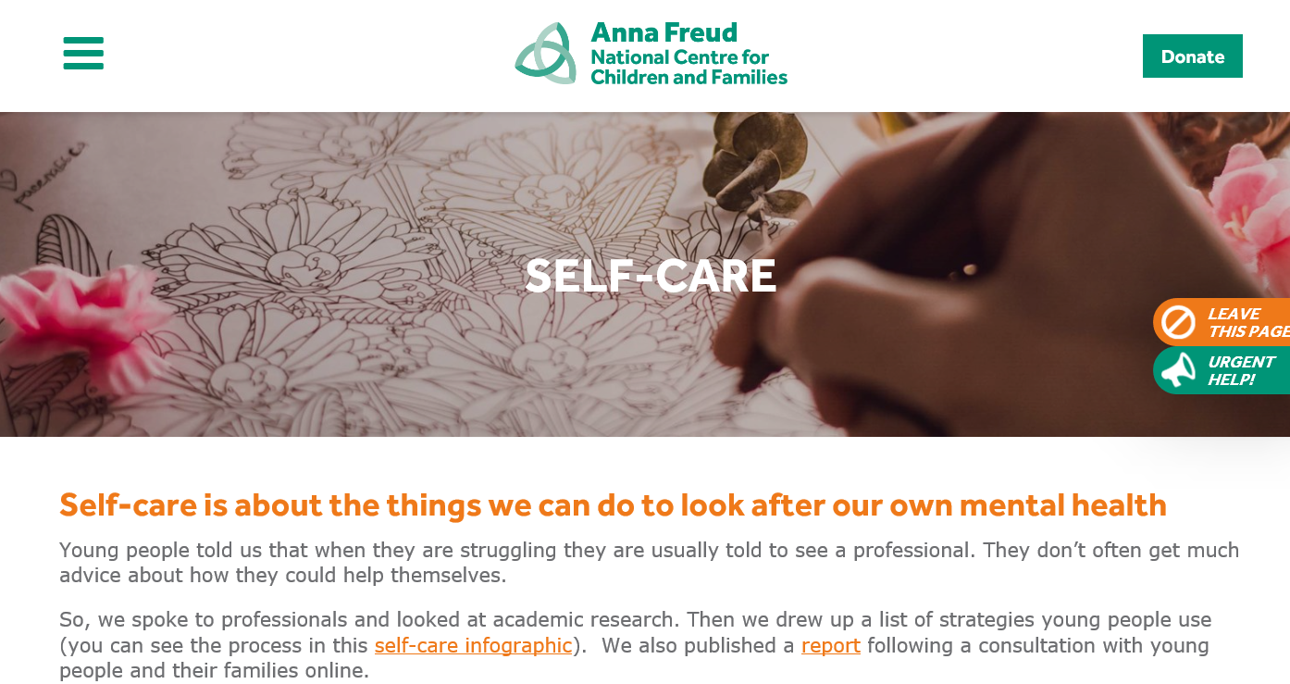
Self care
Self care
https://www.annafreud.org/on-my-mind/self-care/
Notes:
Anna Freud self care ideas. This is aimed at teenagers but is a useful resource for adults too.
The 5 most common chosen approaches to self care are:
Listening to music
Reading and watching tv
Talking to someone you know and trust
Getting outside
Laughing
Crying
Loads of ideas from photography, baking, drawing , tai chi, visualisations as well as very practical things like organising your day (having a routine) and
personal care and hygiene (washing your hair, dressing rather than spending the day in your pjs) can really help.
Breakout rooms :share self care idea that you would be willing to share with pupils, colleagues
Possibility of having a display to show all members of staff have strategies of dealing with difficult circumstances. Redcucign the stigma.

Slide 26

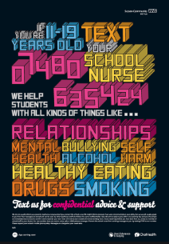
Kooth and Chat Health
Notes:
Anna The digital offer to pupils 11 and above includes Chat Health and Kooth
Chat health is a text service for young people 11 – 19 years. Pupils will get a response from a health professional regarding any health issue including emotional health. 07480 635060
Kooth is for 11 to 25 years. Young people are offered free safe and anonymous online counselling and support . There are also chat forums where they can share views and experiences on various themed topics. The site is monitored just to reassure you that 11 years olds won’t be able to view the content that 25 years olds can access..

Slide 27


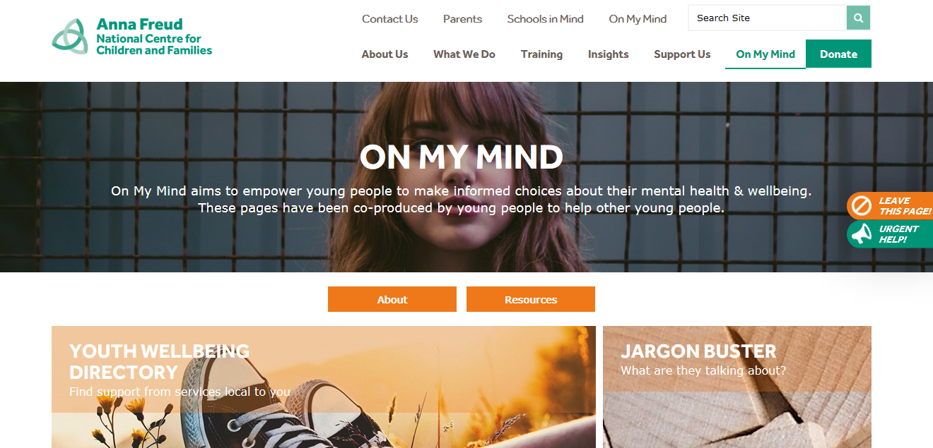
Curriculum teaching and learning
Curriculum teaching and learning to promote resilience and support social and emotional learning
Anna Freud Schools in Mind
On my mind
Mentally Healthy Schools
PSHE Association
Place 2Be
Young Minds : Academic Resilience
Every Mind Matters
Rise Above
No Outsiders
Just One Norfolk
Notes:
Resources
Anna Freud
Anna Freud resources are really useful to support pupils, families and staff.
Self care: with lots of ideas and support for wellbeing. This is designed for young people but is applicable to adults too.
Mentally healthy schools just extended to secondary.
On my mind for secondary pupils advice guidance – self care sources of support
Sign up to Schools in Mind to receive regular updates and training opportunities

Slide 28

Take Notice
Take Notice
Create opportunities to notice things in our lives including the world outside.
Express gratitude
Be in the moment: Mindfulness and visualisation activities
Notes:
Reminding yourself to ‘take notice’ can strengthen and broaden awareness.
Studies have shown that being aware of what is taking place in the present directly enhances your well-being and savouring ‘the moment’ can help to reaffirm your life priorities.
Heightened awareness also enhances your self-understanding and allows you to make positive choices based on your own values and motivations.
My suggestion is to
Create opportunities to notice things in our lives including the world outside.
Go outside and observe the world
Shared a video of a starling murmuration
Ask pupils to share photos and pictures of things they notice when they get outside
Pupils create display in form room. Ideas from Grayson Perry art club.
Express gratitude
Being grateful for things in our life. So we may have lost a lot during lockdown but it is focussing on the positive and recognising the good things in our life.
Think of one thing we are grateful for every night before we go to bed. Start a gratefulness journal and write things down.
I must admit I started this during lock down but gave up weeks ago!
Be in the moment: Mindfulness and visualisation activities
5,4,3,2,1 Think of 5 things you can see, 4 things you can hear 3 things you can touch 2 things you can smell and 1 deep breath
Video clips to try ideas out. Not everything will appeal to everyone.
Mindful grounding techniques from young minds

Slide 29
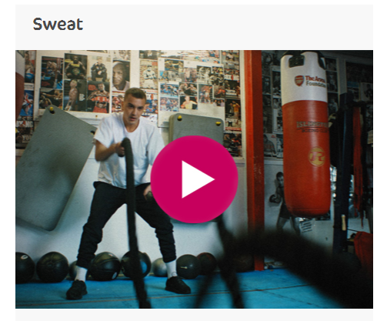
Be Active
Be Active
Aim to inspire pupils to try different activities at home and then feedback in tutor group sessions the next day. The aim is that pupils are active every day and the choose activities that become part of their daily routine. Getting outside and being active has a big impact on our mental wellbeing so it’s finding out what is right for each individual.
Notes:
Physical activity has a huge potential to enhance our wellbeing. Even a short burst of 10 minutes' brisk walking increases our mental alertness, energy and positive mood. Participation in regular physical activity can increase our self-esteem and can reduce stress and anxiety,
When we do physical exercise our body releases chemicals such as dopamine and endorphins in your brain that make you feel happy. Not only does your brain release these feel good chemicals but exercise helps your brain get rid of chemicals that make you feel stressed and anxious.
These video clips are designed to inspire pupils to try different actives at home and then feedback in tutor group sessions the next day. The aim is that pupils are active every day and the choose activities that become part of their daily routine. Getting outside and being active has a big impact on our mental wellbeing so it’s finding out what is right for each individual.
There are options so pupils are given a choice. Sit down yoga, low impact and activities can be adapted to suit individual needs.
These activities have been given to us by Active Norfolk
How exercise can help wellbeing mental health
Getting outside
Workouts
Yoga
Dance
Tai Chi and Qigong

Slide 30
Give
Give
Promote prosocial behaviours and kindness to others
Be kind to our self and practise positive self-talk
Random acts of kindness
Doing something nice everyday for a month
Volunteering
Be kind to your self
Notes:
Participation in social and community life has attracted a lot of attention in the field of wellbeing research.
Individuals who report a greater interest in helping others are more likely to rate themselves as happy.
Research into actions for promoting happiness has shown that committing an act of kindness once a week over a six-week period is associated with an increase in wellbeing.
Giving or doing things for others has a positive impact on our own wellbeing.
So the aim is to promote prosocial and kindness to others.
Kind words and kind actions.
Random acts of kindness
Send a kind message to someone you are not living with.
Say something nice to somone who has helped you.
Smile at everyone you meet today
Hold the door open
Action for happiness calendar Doing something nice everyday for a month
Volunteering Giving your time to help others. Investigating ways you could do this. Raising money for charity.
Start of a topic for the next 6 weeks.
Being kind to yourself. More tricky thing to do.

Slide 31

Positive Self Talk
Positive Self Talk
Positive affirmations
I am kind
I am a good listener
I can sing well
I am organised
Notes:
In order to be resilient we to need to feel positive about our self. We may receive positive comments from others but there is a need to take time to acknowledge what we are good at.
So we need to practise saying nice things about our self. It is tricky but with practise we get better. I am sure we are all very good at saying what we are not good at or what we haven’t done but we need to swing this round to focus on the positive.
Is what you are saying to yourself warm and supportive? If not why not and change it!
See my positive affirmations. Don’t worry I am not going to ask you to share now but maybe before you go to bed tonight then say something about yourself

Slide 32
Connect
Connect
Generate conversations and help pupils to connect with others. It is important that we promote an ethos that fosters a culture of connection, inclusion and respect so everyone feels safe and can safely express their feelings. Also provide diverse and inspirational role models to enable all pupils to engage and see themselves.
Ground rules
Interview with partner about lockdown
Covid keeps/lockdown loves
Who inspires you?
Challenges and motivation
Bouncing back from lockdown
Talking to others asking for help
Notes:
There is strong evidence that indicates that feeling close to, and valued by, other people is a fundamental human need and one that contributes to functioning well in the world.
On of the big challenged to our lives has been the disruption to relationships. So the aim of this strand is to generate conversations and help pupils to connect with others. It is important that we promote an ethos that fosters a culture of connection, inclusion and respect so everyone feels safe and can safely express their feelings.
You can disagree but do so respectfully.
We want to provide diverse and inspirational role models to enable all pupils to engage and see themselves.
The first step is to establish and agree ground rules. You could use the ground rules at the beginning of the session.
I suggest that pupils interview each other about impact of lockdown. What has been difficult? What have they learnt?
Next time look at positive things. Covid keeps/lockdown loves
Next I have included video clip from Arlo Parkes, Alfie Hewitt and Action Jackson.
Who inspires you?
Challenges and motivation
Bouncing back from lockdown
Finally video clip from Kooth about the need to talk and ask for help.
Talking to others asking for help
Breakout room Discussion about content of first few weeks. What do you pupils need? Want? Feedback from each group.

Slide 33
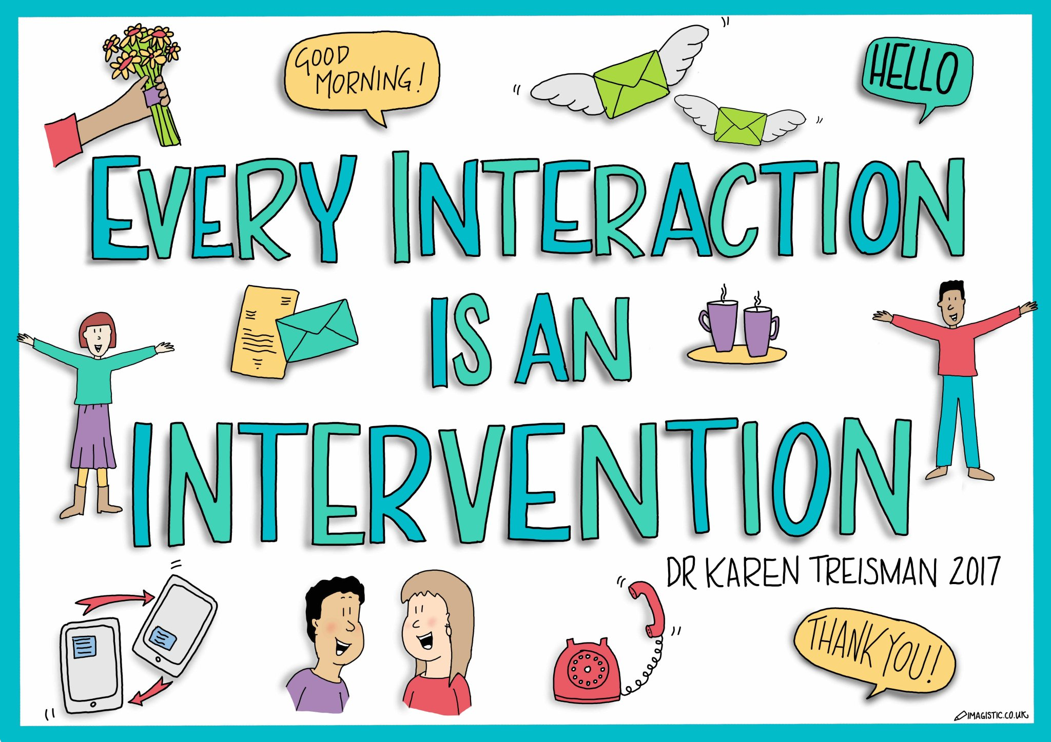
Relationships Are Pivotal Every Interaction Is An Opportunity To Grow… Resilience
Relationships Are Pivotal Every Interaction Is An Opportunity To Grow… Resilience
We learn through interactions and relationships
Repeated experiences become habits
These become wired in our brains
This cycle increases the chances of us repeating these habits
These habits and wiring can improve and support resilience and wellbeing
(Hebb 1949) (Whole School SEND 2020)
Notes:
Anna
This slide brings the neuroscience (Hebb 1949) into relationships and why they matter so much. It explains how our brains grow and develop through relationships.
This is where adult modelling can support and strengthen those neural pathways.
Neurons wiring together when repeatedly activated for example when learning something new.
We know from extensive research how protective in the longer term even one solid good relationship with a teacher or similar figure can be in the long-term outcomes of children or young people from such additionally vulnerable family backgrounds.
Identify a trusted person in schools. Trusted adult sticker
Pupil chooses a trusted adult they can talk to
Sticker in planner so families know who they can talk to
In addition to normal support e.g. head of year, pastoral support
Pupil choice – someone they feel comfortable talking to.

Slide 34
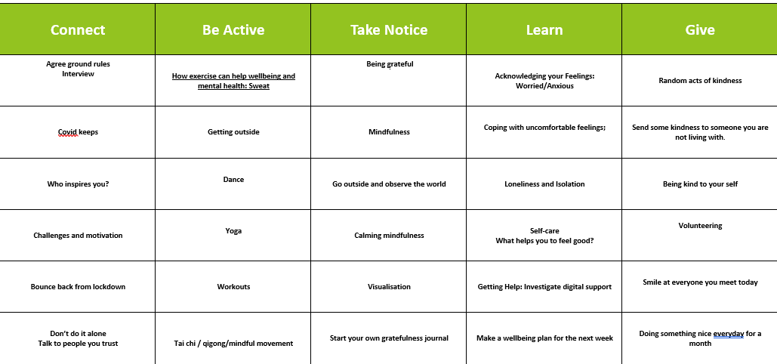
Tutor group sessions:
The 5 ways to wellbeing
Tutor group sessions:
The 5 ways to wellbeing
Notes:
Activities for next 6 weeks for each of the 5 ways of wellbeing. Encourage of sharing with families by promoting your website. Ask families to feedback and share.

Slide 35
Consult with pupils
Consult with pupils
What things in school support their wellbeing?
How they rate this support
How could the school better support their wellbeing?
What would they like to see?
Awareness of support systems in place
Notes:
Consulting with pupils What do they want to learn about ? Can send you a document to do this which you can adapt?
Possible ideas
What do pupils want to learn about?
Sleep
Social media and self-care
Unhelpful thoughts
Self -care and asking for help
Perfectionism
Competitiveness
Dealing with change

Slide 36
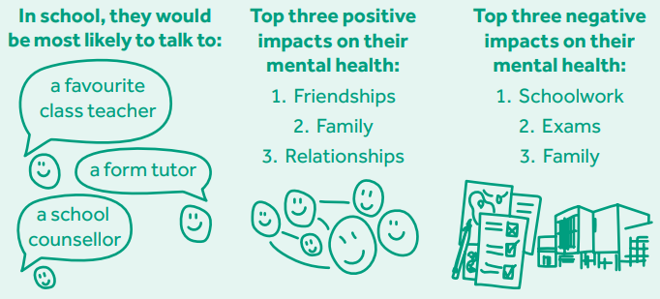
Views of young people
Views of young people
Notes:
Anna Freud study

Slide 37
Engaging families
Engaging families
Promote 5 ways for wellbeing on your website and encourage families to get involved
Self care for parents and carers from Anna Freud
Make families aware of services offered by the school
Challenge stigma We all have mental health like physical health
Promote Just One Norfolk for details of mental health services Norfolk, guidance and support for families including Parentline and Solihull training for families of teenagers.
Sign up to wellbeing newsletters for regular updates anna.sims@norfolk.gov.uk
Notes:
Promote 5 ways for wellbeing on your website and encourage families to get involved
Self care for parents and carers from Anna Freud
Make families aware of the services within and outside schools. Challenge stigma around mental health; ensure pupils and families feel confident to access the service/s
Promote Just One Norfolk for details of Mental Health services Norfolk, guidance and support for families including Parentline and Solihull training for families of teenagers.
Sign up to wellbeing newsletters for regular updates anna.sims@norfolk.gov.uk
Ensure mechanisms for engaging with and supporting families to manage and support their child’s emotional, behavioural or mental health difficulties are robust

Slide 38
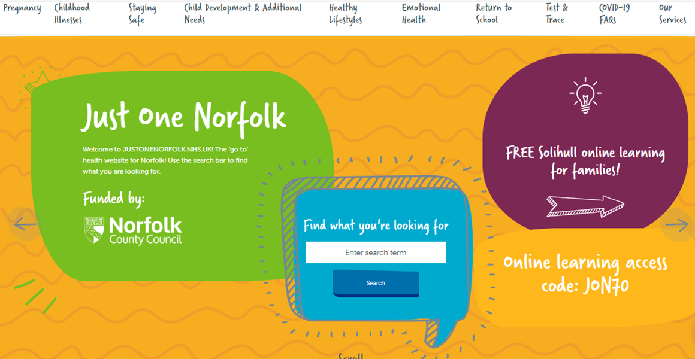
Just One Norfolk
Just One Norfolk
https://www.justonenorfolk.nhs.uk/emotional-health
Notes:
Just One Norfolk website for details of all mental heath services in Norfolk and Waveney
Just one number
Parent line
Chat health
Activities and guidance for families
Solihull training
Accessibility features really useful and inclusive eg. text can be translated or read if they are unable to understand English.

Slide 39


Individed
Getting information, advice and guidance
Welcome
User guide
Working with worry
Buana bunny’s worry story
Notes:
We are individed 4 – 16 years
Tailored advice and guidance and support for children and families.
Picture based quizzes to measure child’s mental health and wellbeing and indicators of their emotional health and wellbeing
Activities to support children’s needs.

Slide 40
Seeking additional or specialist support
Seeking additional or specialist support
Remember do the simple things first:
Implement your whole setting approach:
Include the family; try to ensure everyone works together
Be aware of the groups of children and young people who are at more risk of struggling with their mental health
Adhere to policies and procedures; equalities and safeguarding. Check your bias.
All schools, and all parents/carers can access the Healthy Child Programme’s Just One Number team on 0300 300 0123
Liaise with your SENDCO and the school lead for Wellbeing and Mental Health; this may be your Mental Health Champion.
If concerns persist refer to the Norfolk and Waveney Emotional Wellbeing and Mental Health Pathway. Click here to download.
Notes:
Remember do the simple things first:
Implement your whole setting approach:
Include the family; try to ensure everyone works together
Be aware of the groups of children and young people who are at more risk of struggling with their mental health
Adhere to policies and procedures; equalities and safeguarding. Check your bias.
All schools, and all parents/carers can access the Healthy Child Programme’s Just One Number team on 0300 300 0123
Liaise with your SENDCO and the school lead for Wellbeing and Mental Health; this may be your Mental Health Champion.
If concerns persist refer to the Norfolk and Waveney Emotional Wellbeing and Mental Health Pathway. Click here to download.

Slide 41
Additional or specialist support
Seeking additional or specialist support
Remember do the simple things first:
Norfolk and Suffolk NHS Foundation Trust Wellbeing (IAPT) Service also provide a range of support for people with common mental health and emotional issues, such as low mood, depression or stress. Services are free and are available to people aged 16 and over living in Norfolk & Waveney. If you are aged 16 and over you can access support through your GP, or you can self-refer using the form on this website, or by calling 0300 123 1503 - lines open 9am-5pm
Norfolk and Suffolk NHS Foundation Trust Wellbeing Service have also developed a range of resources to support people through the Coronavirus pandemic available at: https://www.wellbeingnands.co.uk/norfolk/

Slide 42

Anna Freud 5 Steps to Mental Health and Wellbeing Interactive Framework
Anna Freud 5 Steps to Mental Health and Wellbeing Interactive Framework
The 5 Steps Framework was developed by mental health experts and teachers, for teachers.
By registering, you can move through the steps at your own pace and
Update a personalised action plan that can be regularly reviewed.
Access resources, guidance and examples of good practice.
5 Steps to Mental Health and Wellbeing (annafreud.org)
Notes:
We suggest that you audit your school using the Anna Freud 5 steps to mental health and wellbeing interactive framework In order to access good practice resources and guidance. You need to register and then you can log in and complete the audit tool. Once you have completed the audit you will receive a personalised action plan that can be regularly reviewed. The 5 steps are
Leading change
Promoting wellbeing
Supporting staff
Understanding need
Working together
The 5 steps include the 8 whole school approach (WSA) principles from Public Health England
5 Steps to Mental Health and Wellbeing (annafreud.org)

Slide 43

Looking after our own wellbeing
Looking after our own wellbeing
Looking after our own wellbeing is of vital importance in looking after the wellbeing of others.
Notes:
We need to look after our self so that we can support others. The analogy that you need to put your oxygen mask first so you can help others is important point to make. It is vital that we practise self care and be kind to our self. Identify one action that you will take forward and schedule into your week to help improve your welbeing.
Going for a walk round the block, yoga with Adrienne, dance tracks from go noodle banana banana meatball is my personal favourite at the moment.
Having more fun!

Slide 44

What is the key message you will take away from today?
What have you identified as your next step as a result of this session?
Next steps
Notes:
So this is the end of the session and we have covered a huge amount of content. We hope you have found this useful.
To help us consolidate our thinking. I'd like you to capture in the CHAT column what next steps you are going to take as a result of todays webinar.
Check CHAT.
Also complete zoom poll before you leave.

