Slide 1




Attendance Network Meeting
Welcome, the session will start shortly.

Slide 2

Agenda
9.30am | Welcome! Term Headlines
9.40am | Termly Check up
10.00am | WTISA survey results
10.45am | Let’s share best practice guest speaker: Alice Blincow – West Earlham Junior
11.00am | Break
11.15am | Let’s share best practice guest speaker: Jane Price – Harleston Sancroft
11.30am | Spotlight session: Attendance register codes
12.20pm | Final comments & questions

Slide 3

Term Headlines
Letter sent to all schools from Minister for Schools regarding WTISA becoming statutory. Includes additional detail for schools about key changes.
WTISA – consultation with schools held and results compiled.
NCC Local code of conduct was revised in line with the national framework and consultation with schools held including webcast. Released the ‘Penalty Notice Fines for School Attendance are changing’ leaflet to support sharing the message about the new national framework.
New national attendance ambassador elected – Rob Tarn, founder of 1st attendance hub
Approx a further 300 TSMs were held during the Spring Term. With another 251 scheduled for Summer Term. We will be introducing a new Booking system for 2024-25
Temporary change to Attendance Duty Line open hours

Slide 4


Save the date!
Monday 24th June – Webcast on Support first approach and legal interventions
Wednesday 3rd July – Webcast on CME/Admissions changes
Next year's network dates TBC

Slide 5
Sharing daily attendance data with the DfE
The DfE recently hosted 2 webinars aimed at schools and LA’s regarding sharing daily attendance data. They shared that 91% of schools across England are currently participating and sharing their school data. With sharing data with the DfE to become mandatory for all schools from 19th August 2024 when Working together to improve school attendance becomes statutory it is the DfE’s hope that by having a real-time picture of attendance, schools, trusts, LAs and the DfE can identify and take appropriate action to improve attendance and outcomes for pupils. If you are already sharing your data and want to learn more about how to get the most out of the view your education data service (VYED) click here to access the monitor your school attendance: User guide.
If your school is yet to set up their connection with WONDE to share daily attendance data, you can access the DfE webinar recording via the DfE’s YouTube page entitled ‘Monitor your school attendance – May Webinar for schools and trust not yet sharing data’.

Slide 6

Attendance Network Directory
Staying connected
Are you signed up to the Attendance Network Directory?
By joining the directory, you gain access to contact details for other colleagues who also have responsibility for attendance. Enabling you to stay directly connected outside of the arranged network meetings.
If you would like to join the directory please add your name, setting and email address to the directory sign up sheet located near the refreshments.
Thanks!

Slide 7

Collaboration Opportunity
We are currently working on our revised versions of the model school policy and the FPN guidance letter (formerly known as the Warning Letter). We are specifically looking at enhancing and expanding on versions of the policy specifically for parents and pupils.
If you would like to support us with this piece of work, please speak to a member of the team during today's session or email us at csattendance@norfolk.gov.uk

Slide 8

Let’s begin with a termly check up
In your groups reflect, discuss and share the challenges you have faced/facing in your setting this term. What strategies have you put in place? Don’t forget to share your successes!

Slide 9


Working together to improve school attendance (2024) consultation
Survey ran from 16th April to 17th May 2024

Slide 10
Fun Quiz

Slide 11
1. is the name of the approach to be taken by all when addressing attendance?
2. What code has now become a statistical absence code?
3. What's the new national criteria for legal intervention?

Slide 12
4.What code will now denote the use of a part-time timetable?
5. True or false – to use the ‘B’ code the CYP needs to be physically supervised?
6. How long will you need to keep your admission register for?

Slide 13
7. What will parent contracts now be called?
8. What senior role will all schools need to have in post?
9. What becomes mandatory from August 2024 for all schools to submit?

Slide 14
10. What new absence return will school need to submit to the LA?
11. Under the new framework how much will a parent need to pay to discharge an FPN after 21days?
12. What must be added to all school's attendance policy?

Slide 15






2024 School Attendance Reforms
Revised, statutory version of Working together to improve school attendance guidance: Ensuring clearer roles for schools and local authorities & reflecting changes detailed below.
Regulations to mandate attendance data-sharing by all state-funded schools: Giving schools, LAs and DfE access to near-live high-quality data, allowing better, more targeted support to be put in place as early as possible.
Regulations to modernise school attendance and admission registers: Designed with schools & LAs, to improve consistency & accuracy of recording. Registers to be kept electronically. Schools must inform LA when pupil has/will miss 15 days due to illness.
New National Framework for Penalty Notices: Single national threshold will improve consistency and embed ‘support first’ approach by ensuring penalty notices are only considered where support is not engaged with, not working or not appropriate.
New National Attendance Ambassador: Key roles include acting as sector-facing lead for attendance hubs; disseminating effective practice to schools and trusts; and working with DfE’s regional teams to support strong attendance
New guidance effective from 19 August 2024
90% of schools already signed-up to share data
New code will track use of part-time timetables
Fine considered w. 5 days unauthorised absence
Rob Tarn, founder of 1st attendance hub

Slide 16
Working Together to Improve School Attendance
Overview
What is it?
Introduced in 2022, following Schools White Paper.
Based on existing best practice
Non-statutory, but most schools & LAs are already implementing key elements
Support First approach
EXPECT
MONITOR
LISTEN & UNDERSTAND
FACILITATE SUPPORT
FORMALISE SUPPORT
ENFORCE
What’s new?
Statutory guidance from 19th August
Increased clarity on link between attendance and wider school culture, including importance of working with families.
Reflect changes to the law on keeping school attendance and admission registers
Set out the new National Framework for penalty notices.
Change ‘parenting contracts’ to ‘attendance contracts’ to better reflect agreement between parents, schools and/or LAs.

Slide 17
Working Together to Improve School Attendance
What does it mean for schools?
Existing expectations of schools
Develop and maintain a school culture that promotes benefits of attendance
Have a clear attendance policy
Accurately complete admission & attendance registers
Monitor & analyse data to identify pupils/cohorts requiring support
Build relationships with families, & work with them to remove barriers
Share & collaborate with other schools/LAs/partners on persistent & severe absence
What’s new for schools?
Updated section on physical & mental ill health to be clear on schools’ role, & provide further clarification around medical evidence, additional support for pupils with SEND and part-time timetables.
Explain the new requirements on data sharing
Clarification of expectations of senior attendance champions.
Expectation to inform a pupil’s youth offending team worker of any unexplained absences.

Slide 18
Working Together to Improve School Attendance
What does it mean for local authorities?
Existing expectations of LAs
Rigorously track LA data to devise strategic approach
School Attendance Support Team
  Comms/advice
  Targeting Support Meetings
  Multi-disciplinary support for families (access to early help)
  Legal intervention where support has not been successful or engaged with
Monitor & improve attendance of children with a social worker (via Virtual School)
What’s new for LAs?
Increased clarity on additional attendance services that may be traded; LA responsibilities for cross-border pupils; and how to hold effective Targeting Support Meetings.
Flexibility in how LAs work with independent schools, to better suit local needs.
Further detail on cross partnership ownership of attendance improvement.

Slide 19
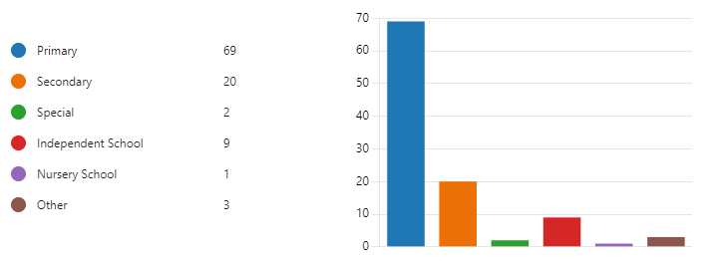
Key messages from the consultation so far
35% respondents indicated high level of confidence in their knowledge of the revised guidance
50% had high confidence in their setting’s ability to meet the requirements of the revised guidance
Notes:
As at 17May, 104 responses

Slide 20
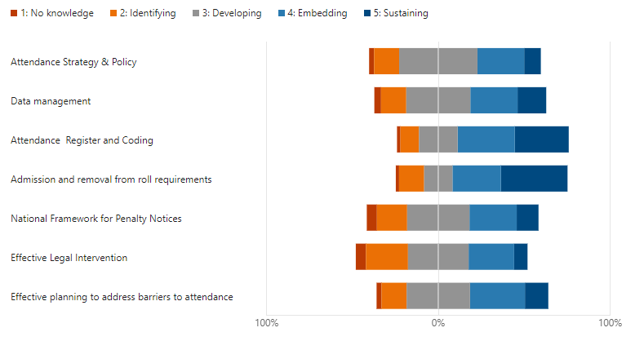
Please allocate a score to each of the following areas of practice as outlined in the revised guidance using the descriptors provided:

Slide 21
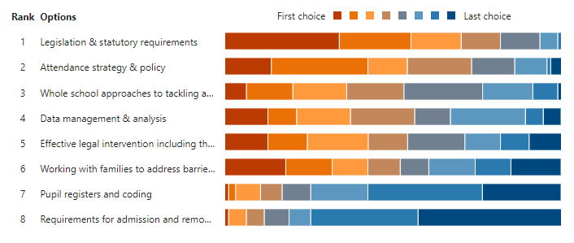

Further guidance & support
Notes:
DfE would like to hear from anyone who would be willing to talk about the experience of using the daily attendance reports. If you are willing to take part in this research, please complete the form using the link in the PP. The research is entirely voluntary, confidential and you are not committing to participate by leaving your details.

Slide 22
Penalty notices
Communication for parents
Mental health
Bite-sized information
Fast-track
Case studies
Term-time holidays
Severe absence
Legal processes
Too much to absorb at once

Slide 23

Do the initial findings resonate with you and your setting?
Are there any key points missing?​
What currently works well?​
What are the specific issues you would like guidance on?​
What is the most helpful way to receive additional guidance, advice and training? ​

Slide 24
Next steps
The strategic approach taken in Norfolk places schools and the LA in a strong position to respond to the changes to the national framework.
We will:
Analysis the responses to the consultation with schools
Revise our local code of conduct for penalty notices (consultation ended 17 May)
Refresh the Attendance Strategy (August 2024)
Provide tailored guidance and support based on identified need throughout the remainder of the Summer Term
Please use your planned TSMs to ask any questions and provide feedback on what additional guidance, training and support you feel you require.
Notes:
We appreciate there is a lot to think about, but we have time. We know that the strategic approach taken in the last two years places schools and the LA in a string position to respond to the changes to the national framework

Slide 25




West Earlham Junior School
Alice Blincow

Slide 26

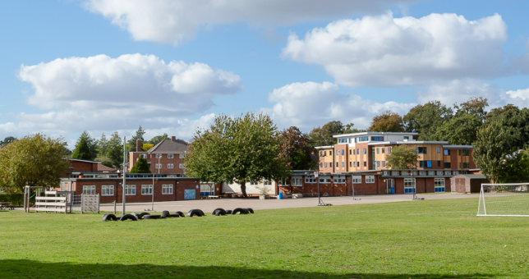
West Earlham Junior School
Attendance

Slide 27


West Earlham Junior School
Attendance
The Department for Education (DfE) has stated, 'persistent failure to send children to school is a clear sign of neglect'.
Knowing who is absent and why, is fundamental to effective safeguarding. Non-Attendance to school or unauthorised attendance, can result in safeguarding action.
A child missing from education is not in itself a child protection matter, and there may be an innocent explanation for this. However, regular school attendance is an important safeguard and unexplained non-attendance can be an early indicator of problems, risk and vulnerability.

Slide 28

Attendance challenges at WEJS
Overall attendance : 94%
Authorised absence due to illness: 3.16%
Significant rise in absence requests: 0.65%
Code C – 0.77% (reduced timetable and EBSA)

Slide 29
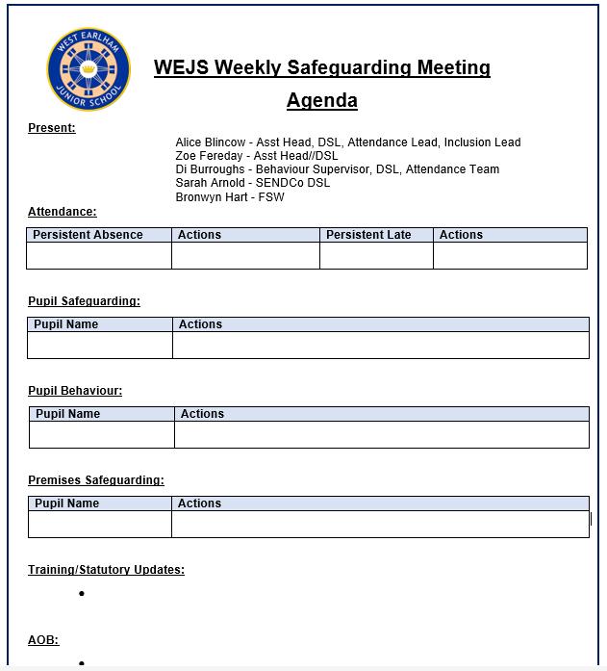





Alice Blincow
Assistant Head
Lead DSL
Attendance Lead
Inclusion Lead
Di Burroughs
Behaviour Supervisor
Attendance Lead
DSL
Zoe Fereday
Assistant Head
DSL
Safeguarding, Inclusion & Attendance Team
Bronwyn Hart
Family Support Worker
DSL
Sarah Arnold
SENDCo
DSL

Slide 30
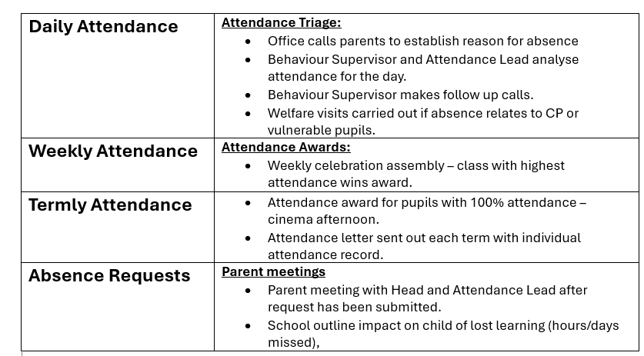
Attendance Systems at WEJS

Slide 31

15-minute comfort break,
See you back soon!

Slide 32

Today's contributors:
Alice Blincow –West Earlham Junior School
Jane Price – Harleston Sancroft (primary phase)
Let’s Share Best Practice
Notes:
Following the contributions – delegates to move tables to sit with others in that area/ setting to share best practice – feedback from evaluation
Start by sharing something positive, brag about something you do well!

Slide 33
Achieving a lower PA
Harleston Sancroft Academy

Slide 34
Clear protocol
Tracking Grid
PA went from 22.4% last year to 8.8% since the introduction of the protocol and the procedures that we follow.
PA
National - 14.9 East of England 14.2 Norfolk 15.2

Slide 35
Key Points
Clear protocol - create clarity around steps
Consistency - tracking/ weekly meetings/fairness
Relationships - creating/building and sustaining - supporting the child as well as the family

Slide 36

Spotlight on attendance register codes

Slide 37
School Attendance (Pupil Registration) (England) Regulations 2024
Every school must have an admission register and, unless all the pupils at the school are boarders, an attendance register.
The regulations set out:
  how the registers must be kept,
  what information must be in the registers,
  who can access the registers, and
  what information held in the registers must be shared.
The regulations also control the granting of leave of absence in schools maintained by the local authority and special schools not maintained by the local authority.
The 2024 regulations consolidate a number of amendments made to the 2006 regulations and make further changes to modernise the keeping of the admission and attendance register and the information recorded in the registers, they also ensure the right people have access to the information held at the appropriate time.

Slide 38
Data sharing
Registers must be kept electronically - to improve the ability to analyse and share data and improve the accuracy of recording.
Access to registers in all schools extended to LAs and the Department – to ensure the right people have access to the right information at the right time and to allow a national understanding of current attendance and absence rates to inform policy.
Preservation on registers increased to six years – to allow a pupil’s attendance to be looked at throughout their time at the school.
Sickness return introduced – to help the LA to fulfil any duty they may have under section 19 of the Education Act 1996.

Slide 39
Attendance register
Attendance to be recorded the same way for pupils of compulsory school age and non-compulsory school age – to enable schools to better track attendance and absence for all pupils.
Attendance register simplified into attendance and absence and mandate the use of a set of attendance and absence codes – to improve consistency and accuracy in recording across schools.
Supervision of approved educational activity clarified – to cease confusion and inappropriate recording.

Slide 40
Mandated the use of a set of absence and attendance codes - to improve consistency and accuracy in recording.
Set of codes simplified into attending and absent but how they are counted statistically remains the same.
Three codes cease to be used - J (replaced by J1), Y (broken down into individual causes) and H (leave of absence for a family holiday).
Twelve new codes created – mostly by breaking down existing codes.
Code C broken down into:
C – Leave of absence for exceptional circumstances
C1 – Leave of absence for the purpose of participating in a regulated performance
C2 – Leave of absence for compulsory school age pupil subject to a part-time timetable
There is an additional code for attending a place other than the school:
Code K – Attending education provision arranged by the LA
Code Y will be broken down into:
YI – Unable to attend due to transport normally provided not being available
Y2 – Unable to attend due to widespread disruption to travel
Y3 – Unable to attend due to part of the school premises being closed
Y4 –Unable to attend due to whole school being closed
Y5 – Unable to attend as pupil is in criminal justice detention
Y6 – Absent in accordance with public health guidance or law
Y7 – Unable to attend because of other unavoidable cause
Q – Unable to attend the school because of a lack of access arrangements
There is one change to statistical meanings:
Code J1 (attending an interview) will replace J and become an authorised absence

Slide 41
Let’s Network
Spotlight on attendance codes
Open to whole room discussion. Any questions regarding the changes?

Slide 42
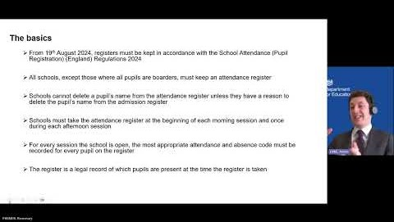

Slide 43
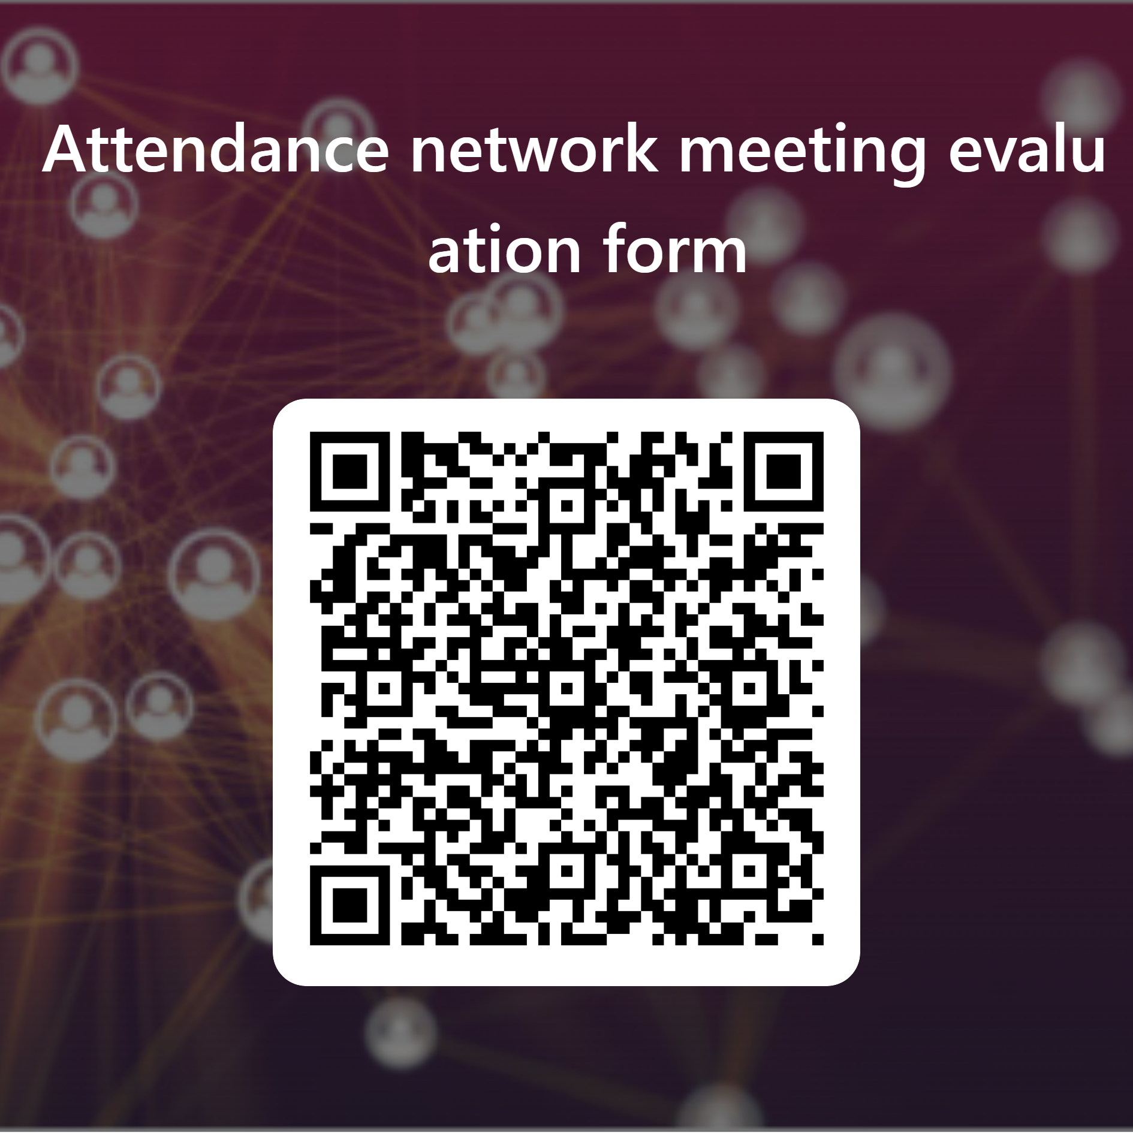
Evaluation
Please take 5 minutes now to complete our evaluation form

Slide 44

Further support and guidance can be found at:
School attendance - Schools (norfolk.gov.uk)
If you have any further questions that have not been answered today, then please contact the Attendance Team on 01603 233681 or at csattendance@norfolk.gov.uk

