Slide 1


The School Attendance (Pupil Registration) (England) Regulations 2024 (legislation.gov.uk)
Delivered by Eric Clarke, Admissions Manager & Shelley Horne, Senior Children Missing Education Officer

Slide 2



Netiquette
Raise your hand if you want to speak
Mute your mic
Use the CHAT facility to connect

Slide 3
Learning
outcomes
By the end of this session, you will:
Understand the responsibilities of schools in relation to the School Attendance (Pupil Registration) (England) Regulations 2024
Understand when it would be appropriate to add a child to the school roll and when to remove a child from the school roll
Understand the role of schools and the LA to ensure that all pupils are tracked

Slide 4

Changes to reforms
4 key aspects to the changes which will be statutory from 19 August 2024:
Publication of a revised version of ‘Working Together to Improve School Attendance’ and revised ‘Summary table of responsibilities for school attendance’.
Mandatory attendance data sharing by all state funded schools. The Education (Information About Individual Pupils) (England) (Amendment) Regulations 2024 come into force on 19th August 2024; they are the statutory instrument that provides for the new mandatory data-collection and replaces existing, voluntary collection.
Modernisation of school attendance and admission registers through laying the School Attendance (Pupil Registration) (England) Regulations 2024 which will revoke and replace the Education (Pupil Registration) (England) Regulations 2006.
Creation of a new National Framework of Penalty Notices through changes to legislation (see Chapter 6 of the revised guidance).

Slide 5
Working Together to Improve School Attendance (2024)
Expectations of schools
The law requires all schools including independent schools to have an admission register and, except for schools where all pupils are boarders, an attendance register. These registers must be kept electronically. All pupils (regardless of their age) must be placed on the admission register and have their attendance recorded in the attendance register. The proprietor of a school who fails to comply with these regulations is guilty of an offence and can be fined.

Slide 6
Admissions
Introduction
Role of the Local Authority
Admission Arrangements
Current activities of the team

Slide 7
In Year Admissions
Co-ordinated In Year Admissions Scheme
Immediate transfers
Deferred in year transfers
Application process

Slide 8
Expected first day of attendance
Most school admissions involve the school or admission authority offering a place to the parent of the prospective pupil. An offer of a place is not an agreement.
Before a pupil can be registered at a school the person with control of a pupil’s attendance must have accepted the offer, either by agreeing the starting day in advance or the pupil attending the school on that day.
A person with control of the pupil’s attendance is defined in regulation 3(2)
Schools must enter pupils’ names on the admission register on the first day that the school and a person with control of the pupil’s attendance have agreed that the pupil will attend the school.
In the normal admissions round, when the person with control of a pupil’s attendance has accepted the school place and starting day offered, the local authority can communicate that agreement to schools on behalf of the parent.

Slide 9
Expectations of schools once a place is offered and parent has agreed to accept
In the normal Admissions round, where parents have accepted the place, the Admissions team will provide this information to schools via SAM. The pupil should be placed on roll from the start of the academic year.
Where an applicant is offered a school place following an in-year application, and the offer is accepted, arrangements should be made for the pupil to start school as soon as possible, particularly where the child is out of school.
The pupil should be added to the school’s electronic Admission Register from the date agreed with parents.
All schools must make a return to the local authority within 5 days of adding a pupil’s name to the admission register (a New Pupil Return) and must provide the local authority with all the information held within the admission register about the pupil.
If a pupil fails to attend school on the agreed starting day, the school is expected to follow this up and try to establish the reason for absence. If they are unable to locate the pupil, schools should notify the local authority.

Slide 10
The School Attendance (Pupil Registration) (England) Regulations 2024
Contents of the admission register (‘the school roll’)
The school admission register, sometimes known as the ‘the school roll’, must be kept in accordance with the School Attendance (Pupil Registration) (England) Regulations 2024. Regulation 8 sets out the contents of the admission register.
The names of all pupils (both compulsory and non-compulsory school age) must be entered on the admission register.
Schools are expected to use an electronic management information system to keep their attendance and admission registers to improve accuracy, speed up the process of sharing and analysing information, and make returns to local authorities and DfE easier.
Registers are legal records, and all schools must preserve every entry in the attendance or admission register for 6 years from the date the data was entered.
It is vital that the admission register is kept up to date. Schools should encourage parents to inform them of any changes whenever they occur and must ensure the admission register is amended as soon as possible.

Slide 11
What happens if a parent does not accept the school place offered?
The Admissions Team and CME Team will work with parent to gain an understanding of why the parent does not want to accept the place.
If this is the only offer the LA can make, the parent will be made aware of their options. They can appeal the decision via appeals process or the LA will look to initiate the School Attendance Order process.
The school that has been offered will be named in a School Attendance Order. Parents could be prosecuted if they are found to be in breach of an order.

Slide 12
Deletion returns:
All schools must make a return to the local authority when a pupil’s name is deleted from the admission register (a Deletion Return).
A pupil’s name can only be deleted from the admission register for a reason set out in regulation 9 of the School Attendance (Pupil Registration) (England) Regulations 2024.
Schools cannot retrospectively delete a pupil’s name from the admission register or attendance register.

Slide 13
Changes to deletion of names from Admission Register effective from 19 August 2024
A | Pupil is registered at another school
B | Pupil was enrolled in Nursery but not enrolled into Year R
C | Ceasing of dual registration
D | A school attendance order relating to the pupil and formerly naming the school has been amended by the relevant local authority to substitute the name of the school with that of another school
E | A school attendance order relating to the pupil and naming the school has been revoked by the relevant local authority on the ground that arrangements have been made for the pupil to receive suitable education otherwise than at school
F | Elective home education
G | Pupil has moved ceased to attend and the new address is beyond reasonable distance from registered school

Slide 14
Changes to deletion of names from Admission Register effective from 19 August 2024
H | Pupil has failed to return within 10 days of expected return from agreed leave of absence
I | Pupil’s whereabouts are unknown
J | Pupil is in custody
K | Pupil is deceased
L | Pupil will cease to be of compulsory school age before start of next academic year
M | Pupil is a boarder, and fees remain outstanding at end of school term to which they apply
N | Pupil’s name has been removed from roll of independent school
O | Permanent exclusion and appeal process has complete
* | End of school phase and pupil is not transferring via NCC admissions arranged school place (Yr2 state funded infant schools Yr6 state funded junior and primary schools)

Slide 15
End of term reminders........
As we are now very close to the end of term the CME team would like to remind all schools of processes that need to be completed prior to the end of term and the start of the new academic year. Some of the following may not apply to your school;
Schools where a nursery is attached to the school
If you have a nursery attached to your school and any of the children are not transferring into your reception class, you need to complete a Deletion Return selecting regulation B
Pupils leaving school at the end of year 2 (Infant Schools) and year 6
Schools are not expected to notify Norfolk County Council of pupils’ leaving school at standard transition times (where the pupil has completed the final year of education normally provided by that school).
However, not all pupils transfer to their expected schools and some pupils may not have agreed transfer places at the end of the school year. Therefore, Norfolk schools are requested to complete an Off Roll Notification form/Deletion Return for pupils leaving Yr2 and Yr6 who are suspected to:
become electively home educated;
be moving away;
not have an identified school to transfer to;
transfer to an independent school;
transferring to a school outside of Norfolk.

Slide 16
Start of the new academic year reminders..........
Start of the academic year in September – Applies to all schools
Subject to any amendments to the Admissions allocation list over the coming months, children expected to join the school in the new academic year must be placed on roll from the first day of term. If a child does not attend as arranged, then all reasonable steps must be taken to determine the reason why this is the case before referring to the Attendance Service or Children Missing Education. If you have any queries about ‘reasonable steps’, please contact the CME team.
If you are contacted by a parent on or after the child has been placed on your roll to advise the child is doing something different you will need to obtain the relevant details and complete a Deletion Return and submit to the CME team, the child should not just be deleted from your MIS system. Effective information sharing between parents, schools and local authorities is critical to ensuring that all children of compulsory school age are safe and receiving suitable education

Slide 17
CME Activity this year so far.......
6182 Off Roll Notifications received and processed
1941 On Roll Notifications received and processed
2340 CME referrals received, and cases opened to CME Officers to track pupils back into education
346 PPME referrals received, and cases opened to CME Officers to conduct joint investigations with schools to establish whereabouts of pupils

Slide 18
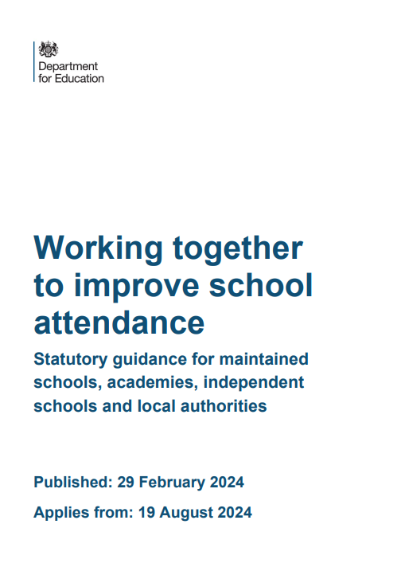
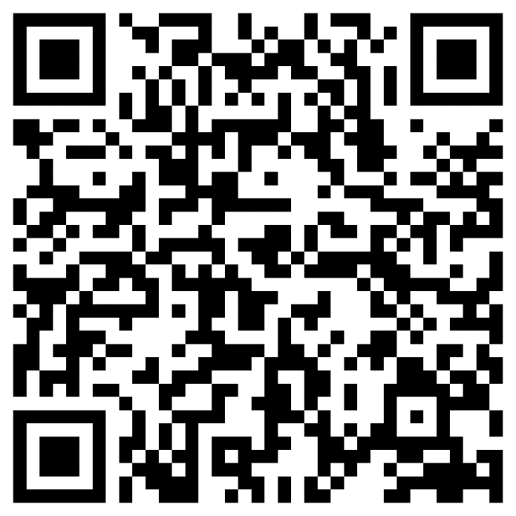

Slide 19

Next steps
What we are doing:
Updating process for parents when applying for in-year admission
Updating CME guidance
Revising on roll notification form to new pupil returns
Revising off roll notification to deletion return to reflect new pupil regulations

Slide 20

Questions?

Slide 21

Further support and guidance can be found at: School admissions - Norfolk County Council or
Children missing education
If you have any further questions that have not been answered today, then please contact the Admissions team at admissions@norfolk.gov.uk or the CME Team on 01603 307716 or at cme@norfolk.gov.uk
The DfE have a range of recorded webinars to support schools with implementing the requirements of the Working together to improve school attendance guidance and these can be accessed via their YouTube page.

