Slide 1
Bystander Intervention Programme
Tackling Sexual Harassment
and Abuse in our community

Slide 2
Intentions of this programme
Intentions of this programme:
Raise awareness of the links between sexist language, sexual harassment and sexual violence
Provide staff CPD on the importance of challenging sexist language and the impact of sexual harassment

Slide 3
CPD: Sexual Harassment and Sexism in our community. Challenging the use of language.
How our language can influence those around us.
Session Aims:
Acknowledge the need for a sociocultural change in the use of language
Understand the importance of challenging inappropriate language
Identify effective methods to successfully deal with sexist language
Recognise the long-term nature of this initiative to change sociocultural behaviours
Notes:
Session aims

Slide 4
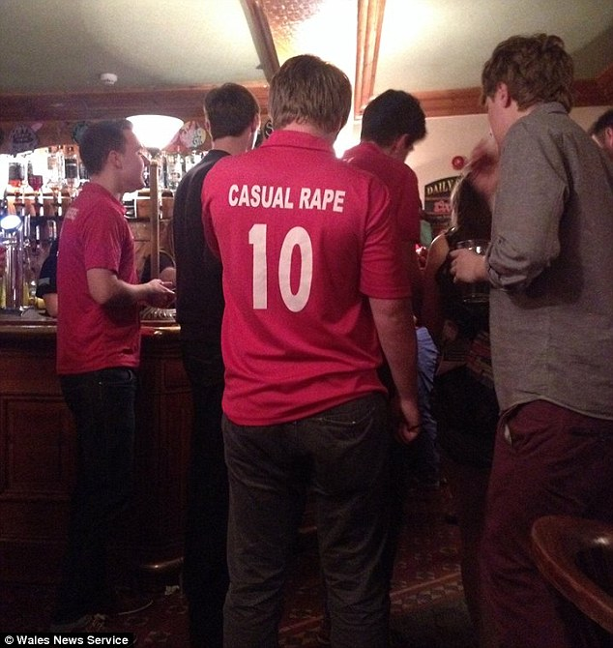
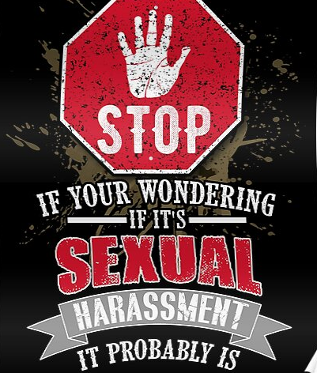
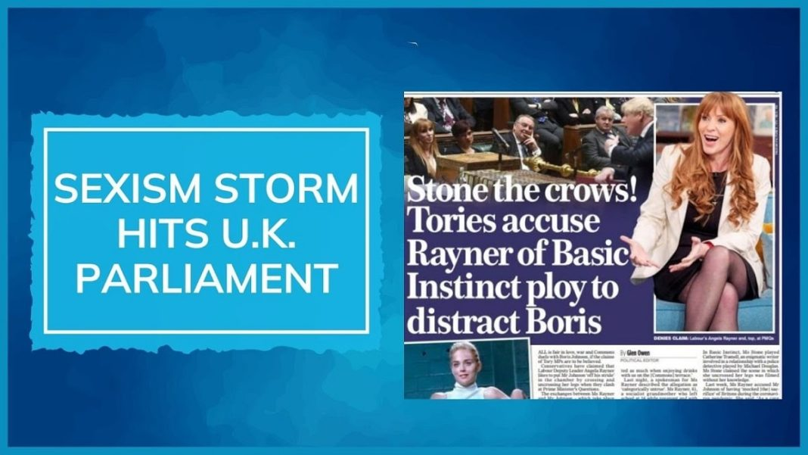
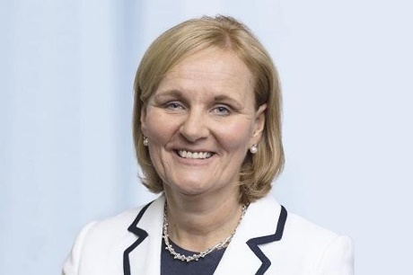
Examples of sexism in society
The Confederation of British Industry has admitted it hired “toxic” staff and failed to fire people who sexually harassed female colleagues.
We know that all genders are discriminated against; transphobia, homophobia etc. however this is about dealing with the omnipresent issue of sexism, sexual harassment and abuse, of which the victims are disproportionately female.
This is not a case of political correctness, and the intention is not to apportion blame.
The objective is to make a concerted long-term effort to eradicate sexism and misogyny throughout society AND in schools/colleges.
Research shows that sexist language denigrates women suggesting that they are inferior to men. It also shows a clear link between sexist language and sexual harassment and abuse.
A white paper: ‘Protection from Sex-based Harassment in Public’ was given Royal Assent on September 18th, 2023, and will shortly become law, punishable by 2 years imprisonment. This law makes sexual harassment in public, which causes harassment alarm or distress, a criminal offence. There is not an illustrative list, however examples of such behaviour include intrusive or persistent staring or questioning, following someone, sexual or obscene comments, propositions or gestures, flashing or exposing intimate body parts, non-consensual physical contact, and technology-enabled sexual behaviour.
Met Police: Institutionally misogynistic
Female armed police officer wins £1m pay out after enduring sexist 'boys club culture' at force where inspector shared snaps of topless women and gun instructor said women shouldn't be armed because they get periods.
Sexism and Sexual Harassment in our community
‘without one would the other exist?’.
Amanda Blanc CEO Aviva 2020 –present
AGM “you’re not man enough for this job” shareholder.
Zara Aleena – murdered,
walking home
Eilidh Barbour, TV presenter & journalist walks out of sport awards over sexism,.
UK Feminista: Sexism in schools is endemic
Notes:
Introductory slide clearly shows why this training is necessary – highlighting the issues in society around sexism and misogyny. Examples of such behaviour which will be covered in the new legislation include intrusive or persistent staring or questioning, following someone, sexual or obscene comments, propositions or gestures, flashing or exposing intimate body parts, non-consensual physical contact, and technology-enabled sexual behaviour. Recent legislation Protection form Sex based Harassment in Public. The young man wearing the ‘Casual Rape’ t-shirt was part of the Aberystwyth University cricket team on a night out.

Slide 5
Activity 1: definitions
Activity
In your groups
Create a definition for sexism
Create a definition for misogyny
…showing prejudice, stereotyping, or discrimination, typically (but not only) against women, on the basis of sex.
…dislike of, contempt for, or ingrained prejudice against women.
Misandry - dislike of, contempt for, or ingrained prejudice against men
Notes:
Ask staff to define the terms. Then ask what the male equivalent is to misogyny.

Slide 6
Attitudes and behaviours
Sexism includes any attitudes or behaviours which align with traditional gender stereotypes.
Gender stereotypes must always be challenged because they limit choice, opportunity and freedom.
Sexism also includes discrimination based on a person’s sex or gender in which one sex, usually female, is seen as inferior to another.
Sexism creates a disregard of women and misogyny acts on that disregard. Statements such as ‘boys will be boys’ and therefore a woman/girl should not wear certain clothes is sexism. However, to make comments such as ‘she had it coming’ in relation to rape, is misogyny.
An important part of professional development is acknowledging the influence adults have on students in education settings and therefore the importance of reflecting on when and how we use language.
Notes:
Developed explanation of sexism and misogyny, it could be argued that boys’ will be boys’ is sexist whereas rape comments such as ‘she had it coming’ are misogynistic

Slide 7
Activity 2: Sexism in society
Activity
Sexism in Society: Match the statistics to the relevant statement
of big budget British films (over £30 million) are directed by women
MPs are women in the UK
of senior roles in UK newspapers are held by women
Women are killed every week in the UK by a partner or ex-partner
of children are exposed to domestic violence in the UK at some point in their childhood
Women are raped in England and Wales every year
of children aged 11-13 reported they had seen pornography at some point
Notes:
Ask staff to match the statistic to the statement to get them thinking about sexism in society and how unequal it is. These statistics mainly come from ONS; rape statistics from Rape Crisis – reiterate that as many as half of all rapes committed go unreported; Pornography stats from Children’s Commissioner report 2023. There are 223/650 female MPs (June 2024); Children exposed to domestic violence stat is from Women's Aid and supported by the Children’s Commissioner in her report February 2023

Slide 8
The indisputable facts
The indisputable facts:
Sexual harassment, sexual assault and the use of sexist language is nothing new(historic testimonies on Everyone’s Invited etc.)
It’s not going away
It is prevalent throughout society including in schools and colleges
Anyone can be a victim of sexual harassment or abuse, but the evidence clearly shows that girls are disproportionately
affected
Why do some men/boys feel they can act in this way? Discuss with the person sitting next to you
Change of Culture required!
Street harassment - it’s not ok | Jess Leigh | TEDxExeter (youtube.com)
Notes:
Street harassment - it’s not ok | Jess Leigh | TEDxExeter (youtube.com) Show this video (11.44 mins) it gives examples of the many forms of sexual harassment women and girls are subjected to on a daily basis and the impact it can have on them. Pose the question ‘why do some men/boys think it is ok to act in this way’?

Slide 9
UK Feminista survey findings
Taken from “It’s just everywhere. A study on sexism in schools – and how we tackle it” by the NEU and UK Feminista who commissioned a report into sexist and misogynistic language in schools in 2017, 4 years before the Ofsted review. Over 1500 Students and 1600 staff were questioned
The use of sexist, misogynist language, which denigrates girls and femaleness, is commonplace in schools.
Both male and female students report the common use of language which associates negative characteristics with being female, “you throw like a girl”, “don’t be a pussy”, and more positive characteristics with being male, “man-up”. This language is more likely to be targeted at male students, while female students are more likely to be subjected to gendered sexual name-calling such as ‘slut’, ‘slag’ and ‘whore’.
The accepted and often casual use of language that denigrates girls/women/femaleness fuels harmful and narrow ideas about what it means to be a man or a woman in society today. It contributes to a conducive context for sexist attitudes and behaviours, including sexual harassment.
“I have [heard] a male member of staff saying to another member of staff ‘Don’t be such a girl’ in a derogative manner, which is particularly strange because we work in a girls’ school.” – Secondary school teacher
“Being called a slag just because I mostly had friends that were male and not many that were female in school. Told to “act like a girl” because I didn’t used to wear makeup in early years of secondary school.” – Female student
Notes:
This is a summary of the ‘It’s just everywhere’ study by UK Feminista into sexism in schools. There is a radio interview form Radio 4’s PM programme in which Evan Davis interviews Mary Boustead the General Secretary of the NEU, shortly after the launch of Everyone’s Invited website where ‘victims of sexual abuse, violence and harassment in schools were encouraged to post their testimonies (currently 51,000 testimonies). The interview is a few minutes in length and if you play it you could ask ‘who do you agree with Mary or Evan’ in terms of whether things have improved in relation to the treatment of women and girls.

Slide 10
Activity 3: Word and gender association
Activity
This activity is designed to help unpack the meaning of everyday sexism and challenge your own thinking.
In your groups or pairs have a look at the ‘everyday’ words and decide whether you associate them with males or females. For example, think about the word ‘aggressive’ do you associate the word with males or females. Explain your choices to each other.
Word and Gender Association
Male words Female words
Stupid Weak Frigid Rude Clever
Impulsive Emotional Calm Quiet Confident
Emotionless Provider Player Risk-taker
Rich Poor Disruptive Kind Strong Bossy
Aggressive Jealous Confident Shy
Notes:
This activity is designed to make people think about everyday words and how and to whom they are directed. It is preferable to do this spontaneously especially as we often use words in such a way. It should evoke discussion and understanding that sometimes, sub consciously we may use words depending on the gender we are speaking to

Slide 11
Don’t be that guy
What do you think is the message of this clip?
Don’t be that guy’: ‘Powerful’ anti-sexual violence video targets men (youtube.com)
Notes:
‘Don’t be that guy’: ‘Powerful’ anti-sexual violence video targets men (youtube.com) This short 1 minute clip is about how sexist language/attitudes/behaviour could/does lead to sexual assault and violence. However tenuous the link may be in terms of the use of sexist language to carrying out sexual assaults the link is real, research proves this, however, worth stressing that it is a very small minority of men who this applies to.

Slide 12
Examples of what sexist and gender stereotypical language and behaviour looks and sounds like
Abusive, insulting or sexualised language
Terms such as slag, sket, whore and bitch are used to demean girls and women. This includes use of words to describe women’s genitalia as terms of abuse. These terms should be treated as seriously as racist or homophobic language. This language along with sexist or sexualised insults about clothing, body shape or related to sexual activity should be treated as unacceptable within educational settings. As with other forms of prejudicial language, sexist language is not always intended to hurt, but it will still have a negative impact on all genders because of the unconscious bias or inequality it promotes.
Sexist assumptions and stereotypes
‘Only boys can...’ or ‘girls are better at’. This can include attitudes such as women being too easily offended, girls or women being bossy rather than assertive. This can be responded to by pointing out role models who counter these stereotypes or by asking where these ideas come from ‘Who says..?’ Care needs to be taken to challenge what is termed as banter or jokes at the expense of women or girls. Suggestions that females (or that any gender is inferior) are inferior to males or that they should have a subordinate role should always be challenged.
Gendered Language The English language appears to have evolved on the assumption that the world is male: ‘the man in the street’, ‘manning the phones’, the ‘tax man’ and so on. This language can make women and girls feel their contribution to society is invisible or useless. Counter this with appropriate alternatives such as police officer or fire fighter. It is important to remember that whilst many of the words used to describe men are positive, words used to describe women often have negative connotations. Examples here include bachelor and spinster; sir and madam. Some insults directed towards men make reference to women (e.g. ‘old woman’, ‘son-of-bitch. Challenge assumptions e.g. men/women don’t/can’t do that etc.
Notes:
This highlights the many reasons why sexist language must ALWAYS be challenged, the message sexist language gives if it goes unchallenged is incredibly damaging to girls and gives boys/males the idea of superiority in terms of genders.

Slide 13
Ways to respond to sexist language
Organisational response … does not/will not tolerate (sexist) language like that. The policy says we are all responsible for making this a safe place for everyone. That kind of language is sexist and makes others feel unsafe. That is inappropriate/sexist behaviour/language.
Questioning response What makes you think that? What do you mean by that? Let’s talk about why people think like that. How do you think that comment will make the women around you feel? What if it were aimed at your daughter/wife/sister/mother?
Confronting response Language like that is not acceptable. A lot of people would find that offensive. Sexist language is as insulting as racist or homophobic language.
Personal response I’m not happy with what you have said. I find the language offensive I don’t agree with that, because…
Notes:
These four options can be used when challenging sexist language (or any other issue that requires intervention). The organisational response can be especially effective for those who may be less confident in challenging behaviour

Slide 14
Activity 4: Responding to sexist language
Activity
Using the four possible responses to the use of sexist language decide which response you would use if you heard the
following:
That’s so
gay!
Your Mum’s a
slag
My football team
got absolutely raped
by the other team
You need to
man up
He’s just being a pussy
Pulling another
young person’s
bra strap
Hey sexy,
you look hot
in that top
Paul’s a paedo.
His girlfriend’s much younger than him
I can give you a
verb, ‘to rape’
Discuss on your tables which of the responses you would use to challenge this language
Organisation response Questioning response Confronting response Personal response
Notes:
In pairs or small groups staff discuss which of the four responses they may use if such statements as these are made to them or overheard by them.

Slide 15
Activity 5: How do the men feel?
Activity
How do you think the men in this clip feel?
'Get your arse out, mate': we turn the tables on everyday sexism (youtube.com)
If the roles were reversed, how do you think women might feel?
Notes:
'Get your arse out, mate': we turn the tables on everyday sexism (youtube.com) Watch this short video which essentially turns sexism on its head. Pose the question how the audience think the men in the clip feel. Provokes discussion on why it is different for men than women.

Slide 16
Summary
Sexism DOES suggest that one gender is inferior to the others.
Sexism against girls and women DOES cause intimidation, fear and worry.
Acceptance of sexist language DOES suggest it is ok.
It IS because some people think it is ok to verbally denigrate girls and women that it is ok to harass or abuse girls and women.
Without sexism and sexist language, sexual harassment and abuse WOULD BE less common.
If we CHALLENGE sexism and sexist language, we WILL make a difference for women and girls.
Notes:
Communities should now assume that incidents of sexual harassment/assault/online abuse are happening whether they are reported or not so must have a community approach.

