Slide 1
Settler
Learning Question: Why do we need to think about the language (words) we use?
Describe stereotypes and give examples
Understand the problems associated with gender stereotypes
Identify harmful words/phrases and explain why they are harmful
Keywords:
Stereotype -a widely held but fixed and
oversimplified image or idea of a particular
type of person or thing
Settler Activity: What do you think when you look at this poster?
Notes:
Settler: Ask students to look at the image and think about the question

Slide 2
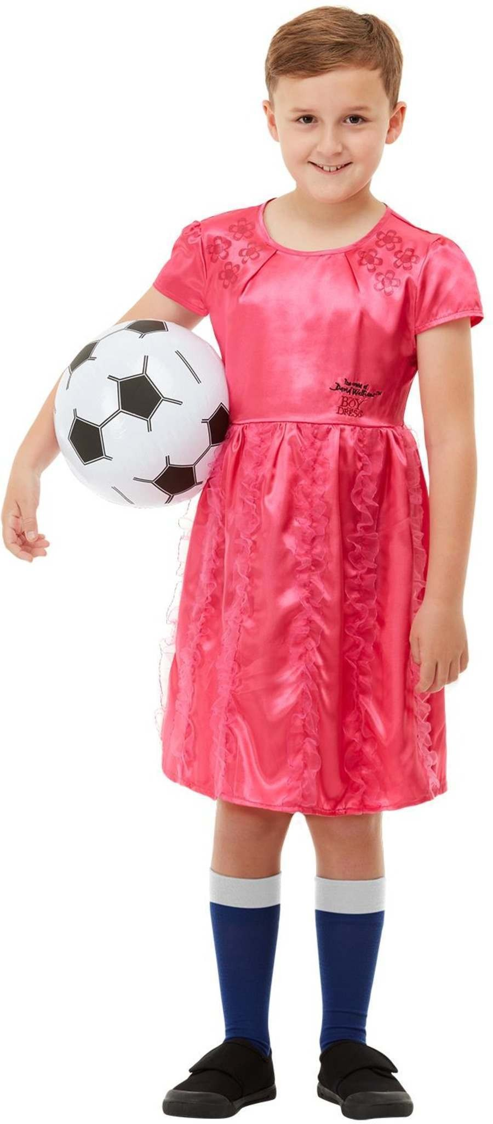
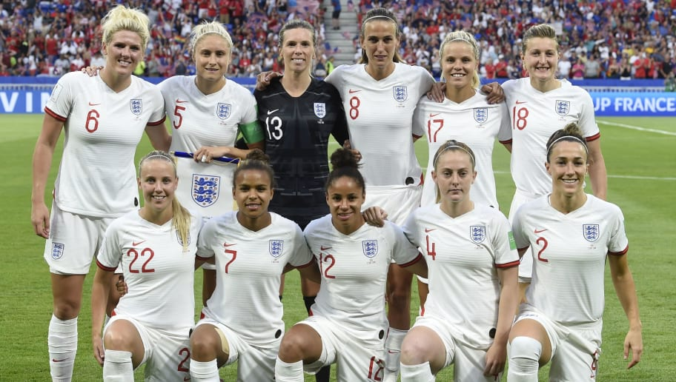
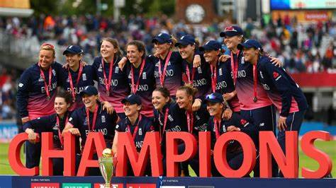
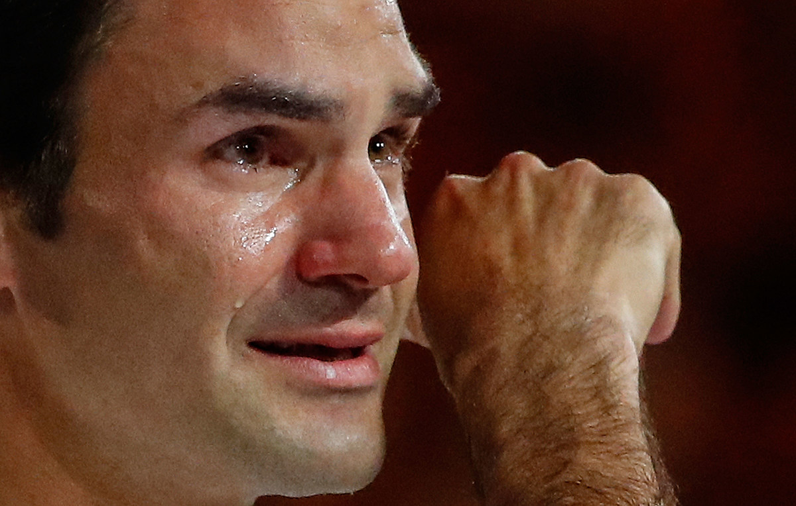
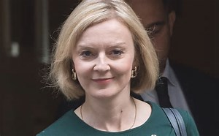
Starter activity
Learning Question: Why do we need to think about the language (words) we use?
Starter: You have 5 minutes to write on your whiteboard everything you remember and think about
the word ‘stereotype’
England Women’s
Football team. Euro
2022 champions
England Women’s
World Cup winning
Cricket team
A boy wearing a dress
Roger Federer, Tennis
Legend crying
Liz Truss, Britain’s
3rd female Prime Minister
What have all the people in these images achieved?
They have broken the gender stereotype
Notes:
This tests prior knowledge learning in line with KS1 & 2 RSE curriculum re stereotypes and lays the foundations for this lesson. Pictures animate in ask students what/who they think they are, answers animated in followed by a question and the answer. For a bonus point who was the only other, and first female British PM.

Slide 3
Assumption of gender roles
Learning Question: Why do we need to think about the language (words) we use?
Discuss in your pairs:
What reaction did the children
have when the professionals
entered the classroom?
Are there any problems with
having fixed stereotypes by the
age of 7? If so what are they?
A Class That Turned Around Kids' Assumptions of Gender Roles! - YouTube
Notes:
This well used video clip highlights gender stereotypes – important point is the question –what problems are there associated with forming fixed stereotypes regarding gender by the age of 7. A Class That Turned Around Kids' Assumptions of Gender Roles! - YouTube

Slide 4
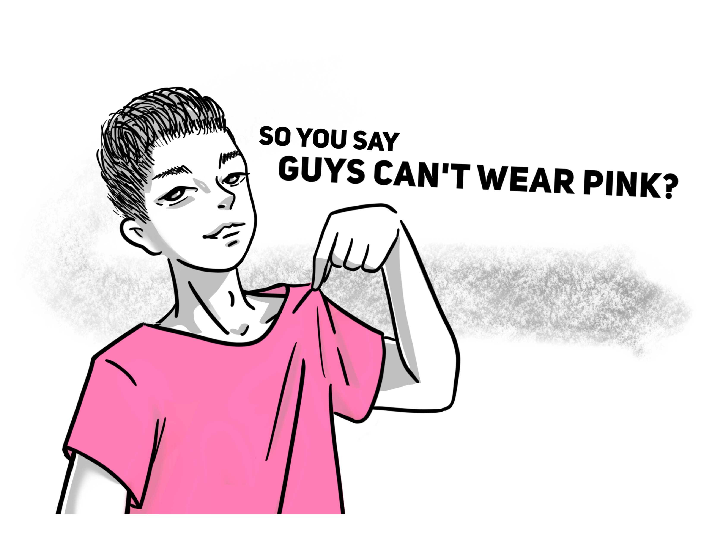
Harmful language
Learning Question: Why do we need to think about the language (words) we use?
Activity: Write down any words you have heard or used which are not nice things to call someone
Highlight each word in one colour if you associate it with boys/men
and another colour if you associate it with girls/women. For example:
if you have ever heard or used the word ‘bitch’ would you associate that
with boys or girls – highlight it.
When you have highlighted the words next to them write why you think they are boy/girl words
Challenge Activity: Can you list some reasons why it might be a problem to associate some words with different genders e.g. weak = girls
Notes:
Children should think about all the words used to name call. You may have to give them a few examples to start them off but they must be encouraged to tell you what words they have heard or used so that you can understand the types of language they are using. Helps students understand how they think about words and their language

Slide 5
Harmful or harmless?
Learning Question: Why do we need to think about the language (words) we use?
Harmful Harmless
Bitch I really like your hair That’s so gay Don’t be such a girl
You look nice today Wolf whistle You shouldn’t wear tops like that
You’re a pussy Only girls cry You smell good
You throw like a girl She’s a slag Nice trousers Boys don’t cry
Activities: Are the words harmful or are they harmless?
Draw the table in your books and place every word/statement into whichever column you
think they should go.
2. Using a separate coloured pen/pencil write a brief reason for your decision.
Notes:
Students work separately to put the words/statements where they think - most should be placed in the Harmful column but wherever they are placed students must justify then a discussion should take place. The activity should help students understand why these statements/words can be/are harmful. Highlight the ‘he’s a player/she’s a slag’ ask students what they think about those two statements etc.

Slide 6
Ignore, Report or Educate
Learning Question: Why do we need to think about the language (words) we use?
IGNORE REPORT EDUCATE
What can you do? What should you do?
Your best friend is sharing an image
of his girlfriend with your friendship group which was only meant to be seen by him..
You are on the field and one of your friends
shouts to you, ‘you run like a girl’.
A year 5 boy is arguing with a PE teacher
saying he doesn’t want to play netball as
it’s a girls game.
You are in the corridor when you hear girls
shouting ‘you’re so gay’ to a group of boys.
A year 6 girl is told by her male peers
she won’t be any good at football until she
grows a pair.
Girls in your year group tell you there’s no
point in saying anything about the sexist language
because boys just laugh at them
Year 6 boys are staring at a group of year 6
girls. One of the boys shouts, ‘Bunch of slags’.
A year 6 boy is crying and you hear one of
his peers tell him to ‘man up’.
On the school bus home a year 5 student
grabs a girl and pulls her onto his lap and
won’t let her go.
Nothing is meant by sexist jokes, its just
‘banter’, no one gets hurt.
Do these statements change your actions?:
The year 6 boy is your brother
His girlfriend is your sister
The year 6 girls are your friends
The year 6 boy is your cousin
The year 6 girl is the best player in the school
Notes:
Give the statements to students and ask them, for each one, to decide which of the 3 given options they would choose if they heard them and explain why. After the activity animate in the statements about who the recipients were and ask if this changes their mind and explain their decisions.

Slide 7
Plenary
Learning Question: Why do we need to think about the language (words) we use?
Answer TRUE or FALSE to the following statements:
Gender stereotypes are fine because they tell us what girls can do and boys can’t etc.
Statements like ‘boys don’t cry’ and ‘you run like a girl’ suggests that females are weaker than males.
Name calling based on someone’s gender is discrimination.
Boys and girls should always be treated the same as neither is better than the other.
Using words like ‘bitch’, ‘dickhead’ and ‘slag’ is ok because everyone else uses them.
It is dangerous to have fixed gender stereotypes because it can limit opportunities.
FALSE
TRUE
TRUE
TRUE
FALSE
TRUE

