Slide 1
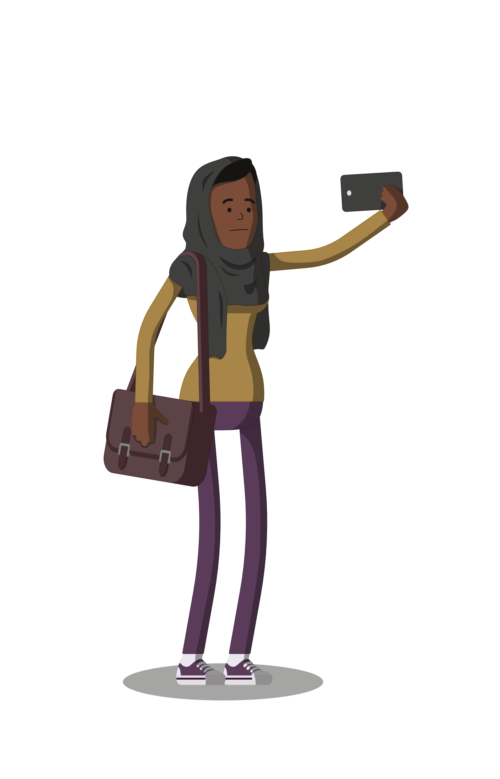
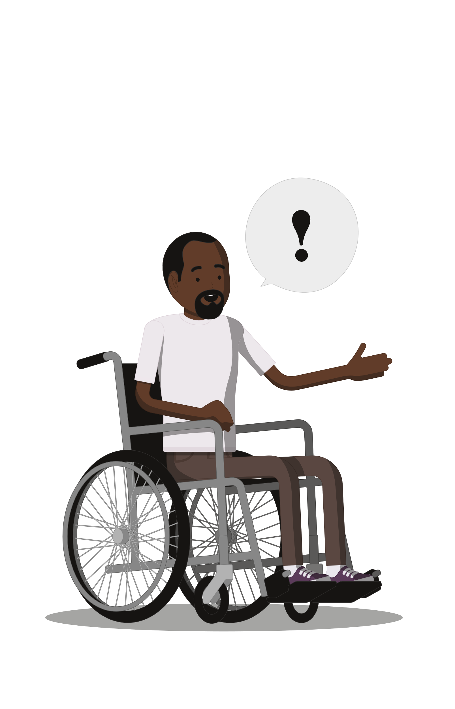
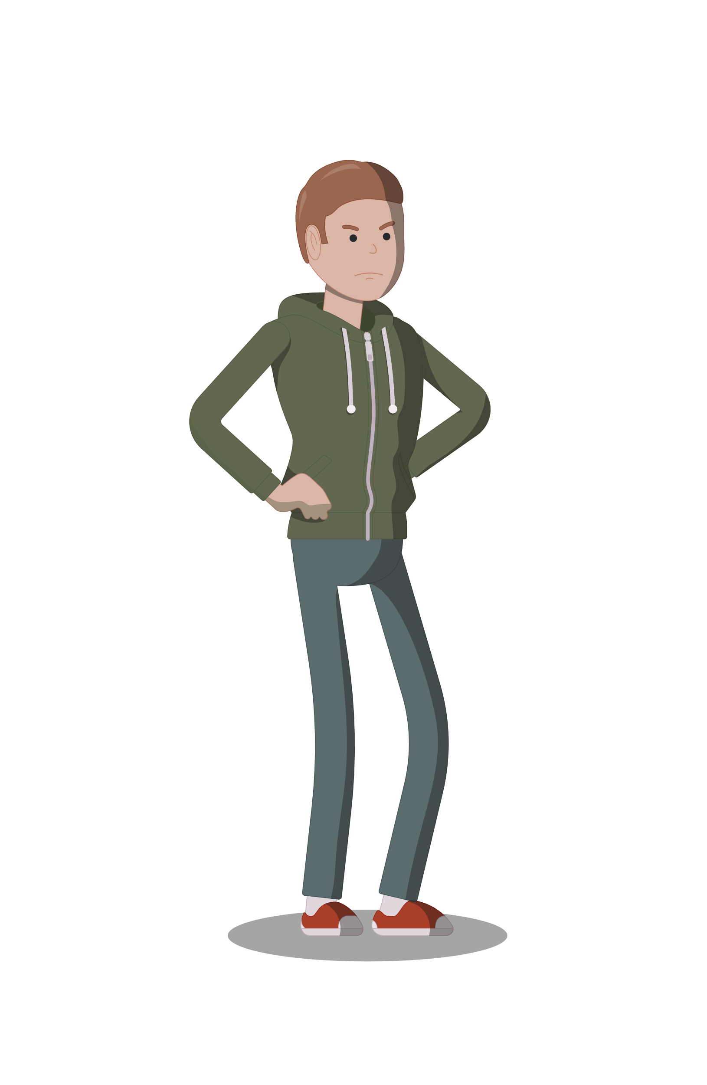
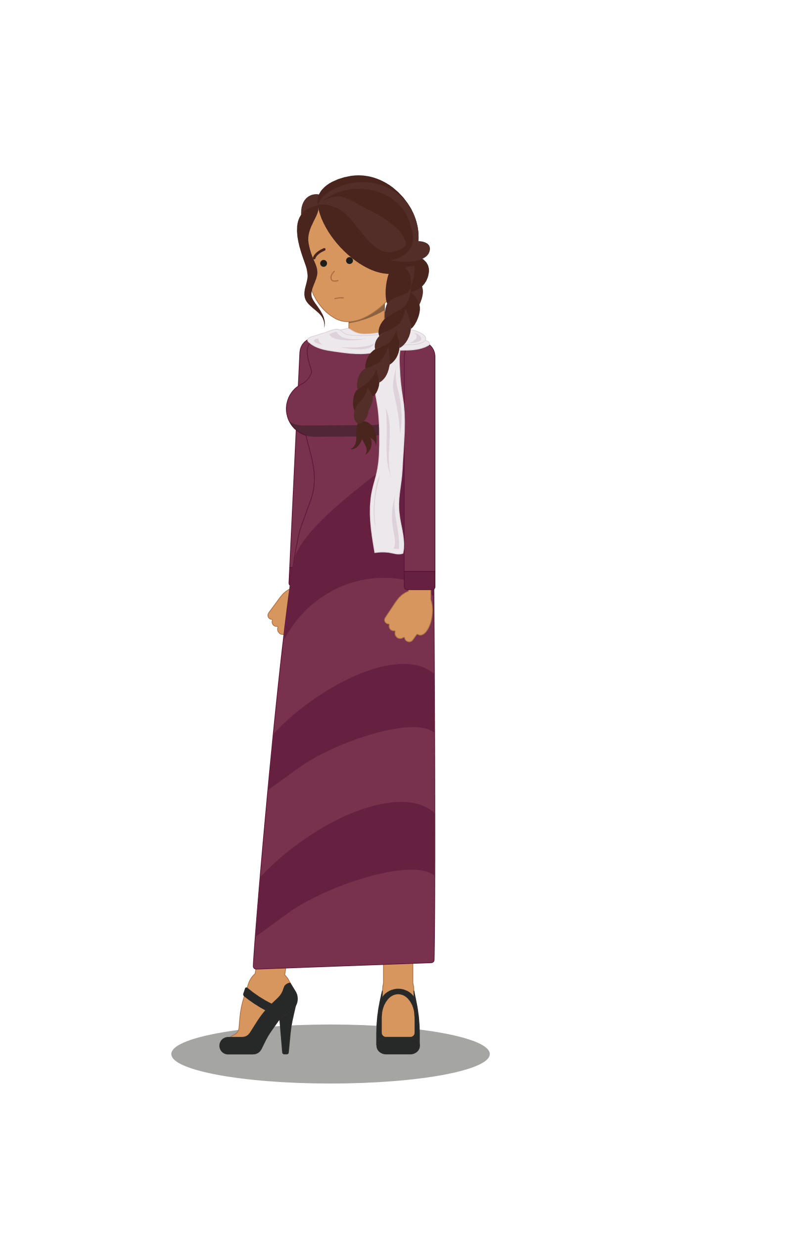
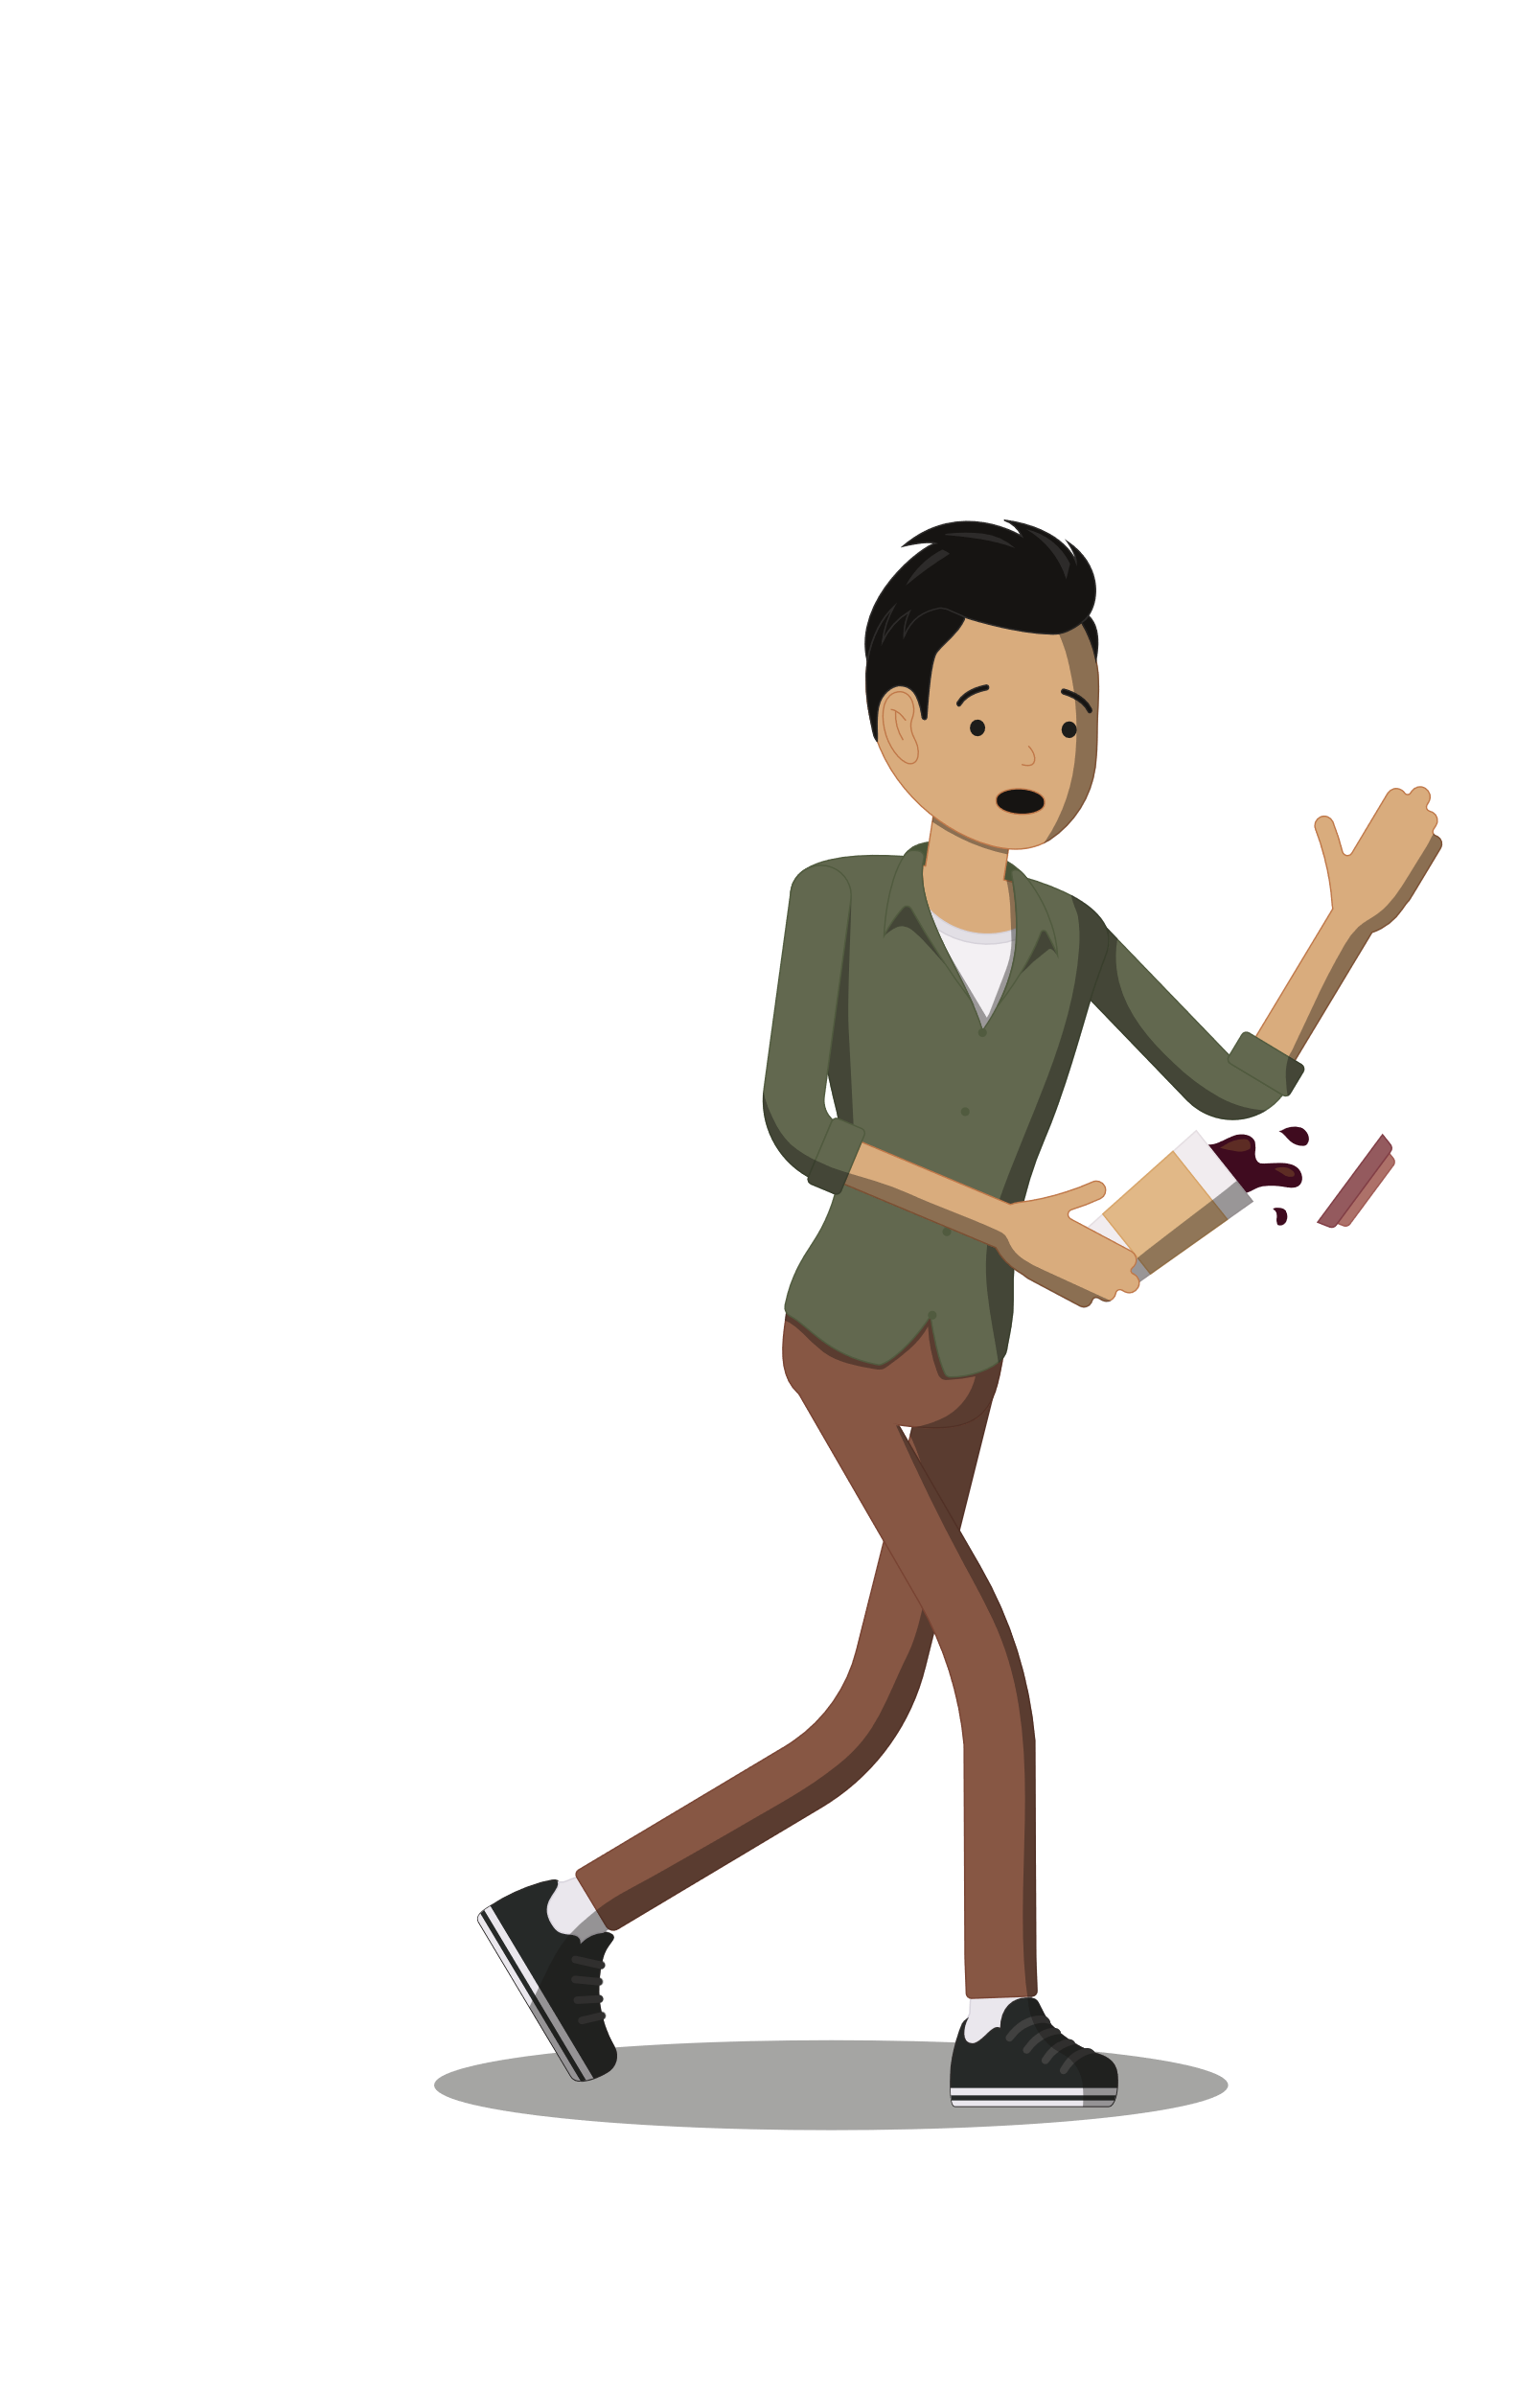
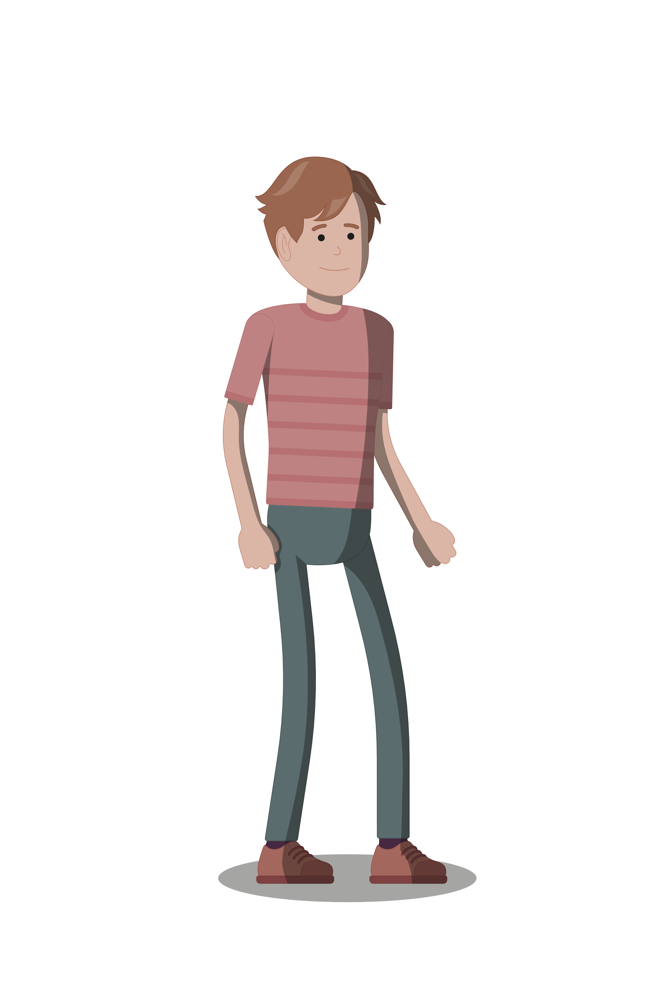
Learning Question: How can I help to end the use of harmful and inappropriate language in my school?
!
!
!
!
CALL
IT OUT
Understand the importance of challenging harmful/inappropriate language
Learn the 5Ds of being an Active Bystander
Use the skills to help reduce the amount of harmful/inappropriate language in your school
Keywords:
Perpetrator = someone who does something which is wrong; commits a crime; breaks rules etc.
Harassment = behaviour that causes distress, embarrassment or is intimidating
Delegate= Get someone else to help
Notes:
Introduce the lesson and the objectives explaining that by the end of the lesson students will have the skills to become active bystanders able to prevent incidents of sexual harassment and other intersocietal issues e.g. racist comments

Slide 2
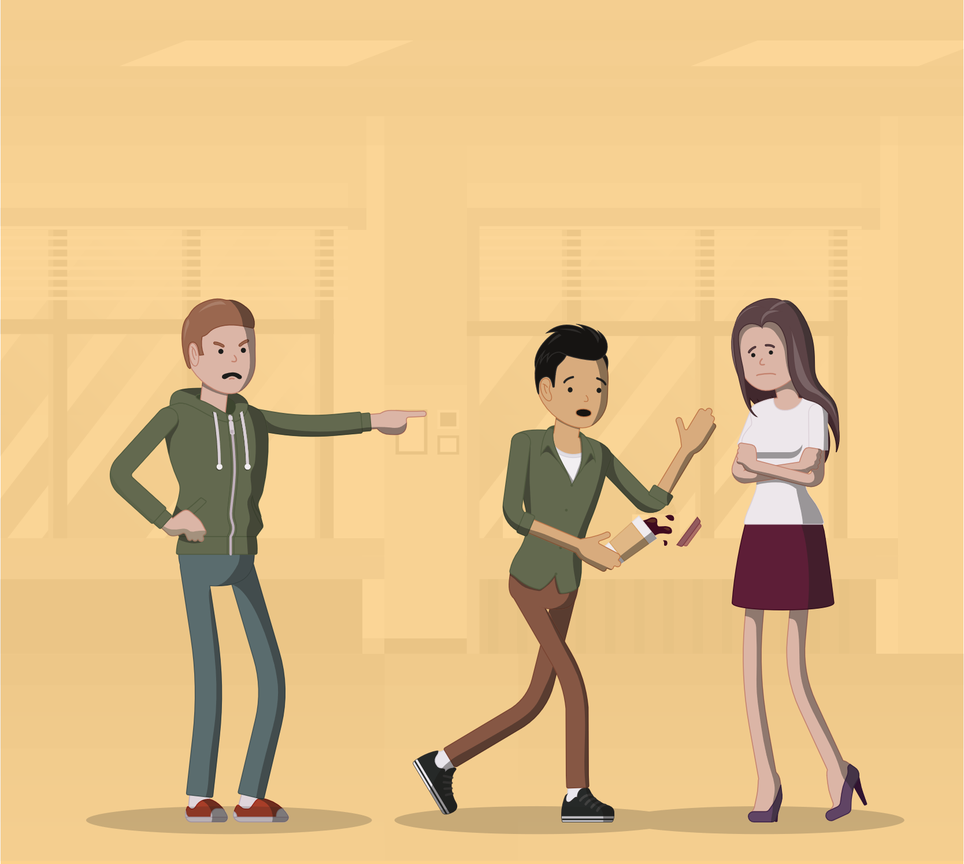
Active bystander
Learning Question: How can I help to end the use of harmful and inappropriate language in my school?
!
!
!
!
CALL
IT OUT
This lesson is about becoming an Active Bystander.
An Active Bystander is someone who recognises inappropriate, disrespectful or
threatening behaviour and chooses to do something about it.
Our school has a ‘zero tolerance’ approach to inappropriate and harmful
language and behaviour. Together we can help to get rid of it in our
school and community by becoming Active Bystanders.
CALL
IT OUT
Notes:
Introduce the lesson and the objectives explaining that by the end of the lesson students will have the skills to become active bystanders able to prevent incidents of sexual harassment and other intersocietal issues e.g. racist comments

Slide 3
Inappropriate language
Learning Question: How can I help to end the use of harmful and inappropriate language in my school?
!
!
!
!
CALL
IT OUT
In previous lessons we have learnt about what inappropriate language is and the danger
of stereotyping people.
In your groups/pairs discuss the sort of inappropriate language that you hear in school
What does your school say about the use of inappropriate language?
What could you do when you hear that sort of language?
Why do you think people don’t do anything when they hear inappropriate language?
Notes:
Introduce the lesson and the objectives explaining that by the end of the lesson students will have the skills to become active bystanders able to prevent incidents of sexual harassment and other intersocietal issues e.g. racist comments

Slide 4
Get involved
Learning Question: How can I help to end the use of harmful and inappropriate language in my school?
!
!
!
!
CALL
IT OUT
Some reasons why people don’t get involved to prevent inappropriate behaviour:
Fear that they might be wrong
They might have misunderstood the situation
They don’t know what to do
Thinking that someone else will probably do something (intervene)
Afraid of what other people will think if they get involved
Fear that the perpetrator may turn on them
HOWEVER, by working together, not waiting for someone else to get involved, by taking responsibility, trusting yourself and your instincts
YOU CAN MAKE A REAL DIFFERENCE
Notes:
Introduce the lesson and the objectives explaining that by the end of the lesson students will have the skills to become active bystanders able to prevent incidents of sexual harassment and other intersocietal issues e.g. racist comments

Slide 5
The 5Ds
Learning Question: How can I help to end the use of harmful and inappropriate language in my school?
!
!
!
!
CALL
IT OUT
REMEMBER
An Active Bystander sees/hears inappropriate behaviour or language and wants to do something to prevent it.
Active
Bystander
Here to Help
Active Bystanders use the 5Ds to help prevent incidents
escalating (getting worse). The 5Ds are:
DIRECT
DELAY
DISTRACT
DELEGATE
DOCUMENT
Using one or more of the 5Ds can help your peers and improve your school community
DIRECT DELAY DISTRACT DELEGATE DOCUMENT
Notes:
Introduce the lesson and the objectives explaining that by the end of the lesson students will have the skills to become active bystanders able to prevent incidents of sexual harassment and other intersocietal issues e.g. racist comments

Slide 6
Direct
Learning Question: How can I help to end the use of harmful and inappropriate language in my school?
!
!
!
!
DIRECT: This involves directly getting involved to prevent the incident.
CALL
IT OUT
Remember: The most important thing is your safety
Assess the Situation What to consider if I want to directly intervene | Action Speaking to the perpetrator
Is it safe to do so? | Keep it short and concise; state what you see happening
Is the person being harassed physically safe? | Condemn what they are doing e.g. Say “You cannot say that”
Does it appear unlikely that the situation will get worse? | Address the behaviour –avoid labelling the harasser e.g. Say “what you said is sexual harassment”, NOT “you are a sexual harasser”.
DIRECT DELAY DISTRACT DELEGATE DOCUMENT

Slide 7
Distract
Learning Question: How can I help to end the use of harmful and inappropriate language in my school?
!
!
!
!
CALL
IT OUT
DISTRACT: distract (put off) the perpetrator to prevent the incident.
Method:
Do something that disrupts the incident
Ignore the perpetrator and speak to the person being targeted
For example, if you heard someone shouting
at another person you might drop something
on the floor nearby and then speak to the person
being shouted at, or ask them if they could show
where the toilets were etc.
DIRECT DELAY DISTRACT DELEGATE DOCUMENT
Notes:
Introduce the lesson and the objectives explaining that by the end of the lesson students will have the skills to become active bystanders able to prevent incidents of sexual harassment and other intersocietal issues e.g. racist comments

Slide 8
Delegate
Learning Question: How can I help to end the use of harmful and inappropriate language in my school?
!
!
!
!
CALL
IT OUT
DELEGATE: This involves getting someone else to help you
If you witness an incident and want to use the DELGATE method of intervention you could:
Speak to someone near you who notices what is happening. Work together to intervene.
Speak to a teacher/member of staff about something you have seen.
Ask an older person for advice
DIRECT DELAY DISTRACT DELEGATE DOCUMENT
Notes:
Introduce the lesson and the objectives explaining that by the end of the lesson students will have the skills to become active bystanders able to prevent incidents of sexual harassment and other intersocietal issues e.g. racist comments

Slide 9
Delay
Learning Question: How can I help to end the use of harmful and inappropriate language in my school?
!
!
!
!
CALL
IT OUT
DELAY: This where you can’t intervene at the time but can do so later on
What reasons can you think of as to why you might have to delay intervention?
Incident is over very quickly
It is not safe to intervene
You are dealing with something else
Delayed intervention involves asking the person if they are ok.
Letting them know you are there for them, offering support.
Asking the if they need help to report it.
Making sure they know they don’t deserve to be spoken to or
treated like that.
DIRECT DELAY DISTRACT DELEGATE DOCUMENT
Notes:
Introduce the lesson and the objectives explaining that by the end of the lesson students will have the skills to become active bystanders able to prevent incidents of sexual harassment and other intersocietal issues e.g. racist comments

Slide 10
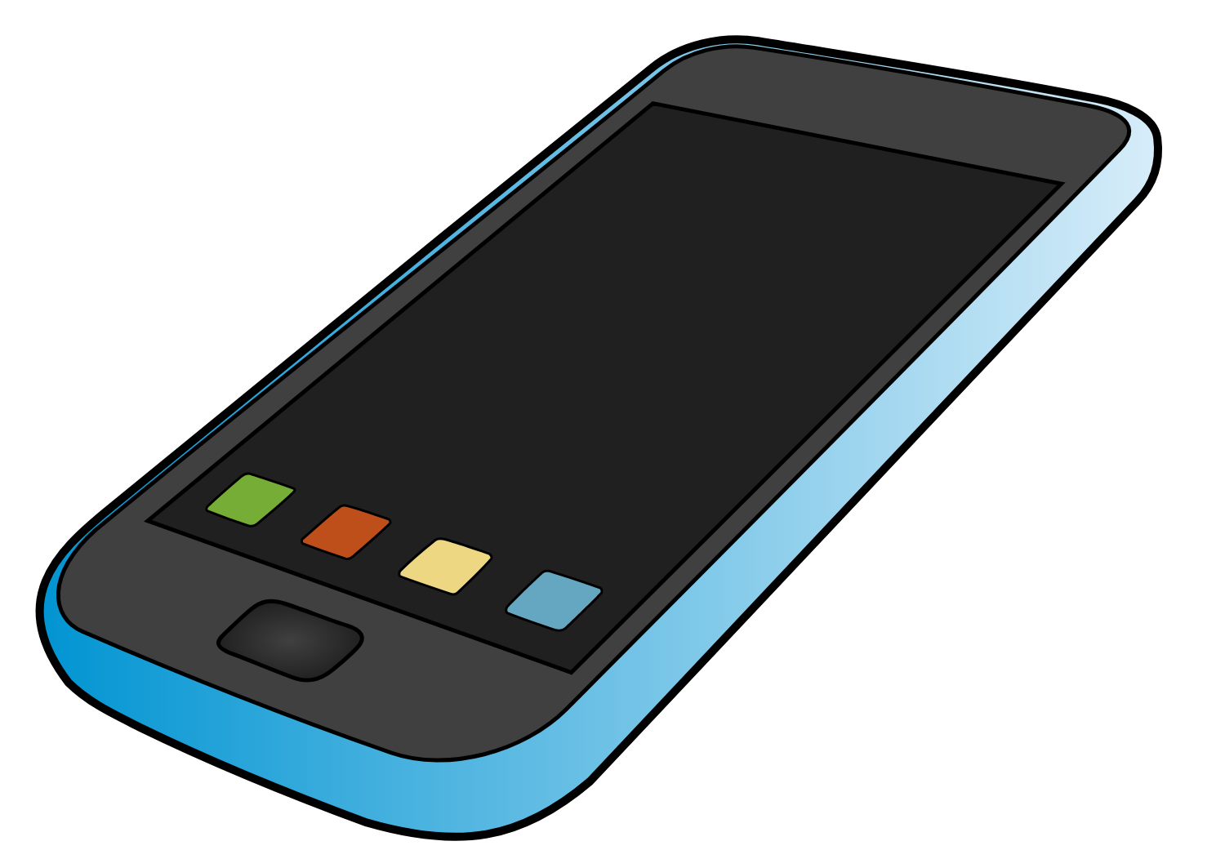
Document
Learning Question: How can I help to end the use of harmful and inappropriate language in my school?
!
!
!
!
CALL
IT OUT
DOCUMENT: This involves methods of recording the incident that you witness
If it is safe to do so it is always good to document/record an incident. However,
if no one else is helping out consider using one of the other Ds
You can record it on your phone – photos or video
You can write down what you have seen or heard
NEVER share the video or photos without the consent (permission) of the victim
DIRECT DELAY DISTRACT DELEGATE DOCUMENT
Notes:
Introduce the lesson and the objectives explaining that by the end of the lesson students will have the skills to become active bystanders able to prevent incidents of sexual harassment and other intersocietal issues e.g. racist comments

Slide 11
Scenarios
Learning Question: How can I help to end the use of harmful and inappropriate language in my school?
!
!
!
!
CALL
IT OUT
Read the four scenarios and decide in your groups which of the 5Ds you would use
in these situations.
When you have decided which method of intervention you would use explain within your
groups why the other methods would be inappropriate
DIRECT DELAY DISTRACT DELEGATE DOCUMENT
Notes:
Introduce the lesson and the objectives explaining that by the end of the lesson students will have the skills to become active bystanders able to prevent incidents of sexual harassment and other intersocietal issues e.g. racist comments

Slide 12
Scenario 1
Learning Question: How can I help to end the use of harmful and inappropriate language in my school?
!
!
!
!
CALL
IT OUT
Which of the 5Ds would you use if this happened?
You are walking down the corridor in school when you hear a boy in year 6 saying to a girl if you don’t give me a kiss I will tell all of my friends that you are a slag. The girl is crying and looking very anxious.
DIRECT DELAY DISTRACT DELEGATE DOCUMENT
REMEMBER your safety is the most important thing. Therefore, there might be some
scenarios where DIRECT intervention is not the best idea
Notes:
Introduce the lesson and the objectives explaining that by the end of the lesson students will have the skills to become active bystanders able to prevent incidents of sexual harassment and other intersocietal issues e.g. racist comments

Slide 13
Scenario 2
!
!
Learning Question: How can I help to end the use of harmful and inappropriate language in my school?
!
!
CALL
IT OUT
Which of the 5Ds would you use if this happened?
You are in the playground and you can see a large group of girls, they have surrounded a boy who you don’t recognise. You hear the girls calling him a ‘pussy’ and one of them says, “boys don’t cry”. All the girls are laughing and being very noisy. The boy is clearly upset and scared.
DIRECT DELAY DISTRACT DELEGATE DOCUMENT
REMEMBER your safety is the most important thing. Therefore, there might be some
scenarios where DIRECT intervention is not the best idea
Notes:
Introduce the lesson and the objectives explaining that by the end of the lesson students will have the skills to become active bystanders able to prevent incidents of sexual harassment and other intersocietal issues e.g. racist comments

Slide 14
Scenario 3
Learning Question: How can I help to end the use of harmful and inappropriate language in my school?
!
!
!
!
CALL
IT OUT
Which of the 5Ds would you use if this happened?
You are in line to go into class when you see a boy in front of you walk past everyone and as he does so he
slaps everyone on the back side. Everyone looks shocked but nobody does anything. You have to go into your classroom.
DIRECT DELAY DISTRACT DELEGATE DOCUMENT
REMEMBER your safety is the most important thing. Therefore, there might be some
scenarios where DIRECT intervention is not the best idea
Notes:
Introduce the lesson and the objectives explaining that by the end of the lesson students will have the skills to become active bystanders able to prevent incidents of sexual harassment and other intersocietal issues e.g. racist comments

Slide 15
Scenario 4
Learning Question: How can I help to end the use of harmful and inappropriate language in my school?
!
!
!
!
CALL
IT OUT
Which of the 5Ds would you use if this happened?
You are on the school bus when you notice a student with his arm around a girl. The girl looks very uncomfortable and keeps shrugging trying to get the student to remove his arm.
DIRECT DELAY DISTRACT DELEGATE DOCUMENT
REMEMBER your safety is the most important thing. Therefore, there might be some
scenarios where DIRECT intervention is not the best idea
Notes:
Introduce the lesson and the objectives explaining that by the end of the lesson students will have the skills to become active bystanders able to prevent incidents of sexual harassment and other intersocietal issues e.g. racist comments

Slide 16
Make a real difference
Learning Question: How can I help to end the use of harmful and inappropriate language in my school?
!
!
!
!
CALL
IT OUT
You can make a real difference by following the 5 Ds of intervention.
Benefits of becoming an Active Bystander:
Make life better for people
Help those in need
Create a happier atmosphere
Help to eradicate (get rid of) harassment & harmful language
Know that you are helping others
Active
Bystander
Here to Help

Slide 17
Report and support
Learning Question: How can I help to end the use of harmful and inappropriate language in my school?
!
!
!
!
CALL
IT OUT
Whichever of the 5Ds you chose to prevent incidents of sexual harassment
REMEMBER the most important thing is your SAFETY.
ALWAYS report what you have seen or heard
By becoming an Active Bystander you can and will
make a real difference to people’s lives.

Slide 18
5Ds for display
DELAY
DISTRACT
DELEGATE
DIRECT
DOCUMENT

Slide 19
All of the scenarios
Learning Question: How can I help to end the use of harmful and inappropriate language in my school?
!
!
!
!
Which of the 5Ds would you use if this happened?
You are walking down the corridor in school when you hear a boy in year 6 saying to a girl if you don’t give me a kiss I will tell all of my friends that you are a slag. The girl is crying and looking very anxious.
CALL
IT OUT
Which of the 5Ds would you use if this happened?
You are in the playground and you can see a large group of girls, they have surrounded a boy who you don’t recognise. You hear the girls calling him a ‘pussy’ and one of them says, “boys don’t cry”. All the girls are laughing and being very noisy. The boy is clearly upset and scared.
Which of the 5Ds would you use if this happened?
A boy walks towards you and your friends while you are standing in the canteen queue. As he approaches he slaps the backside of one of your friends and grins at her. You can see that she feels very uncomfortable.
Which of the 5Ds would you use if this happened?
On your way to school you see an older boy walking behind a pupil in your school. You notice that every time the pupil stops the older boy stops and looks the other way. The pupil starts walking faster and so does the older boy. You think something is wrong.
Notes:
Introduce the lesson and the objectives explaining that by the end of the lesson students will have the skills to become active bystanders able to prevent incidents of sexual harassment and other intersocietal issues e.g. racist comments

