Slide 1
Learning Question: What is sexist language and why is it harmful?
Learning Outcomes:
Define and understand the meaning of sexism
Recognise the problems with gender stereotypes
Understand the harm caused by sexist language
Keywords:
Prejudice = biased opinion that is not based on reason or actual experience.
e.g. prejudice against people from different backgrounds including gender
Rape culture: a society or environment whose usual social attitudes have the effect of
normalizing or trivializing sexual assault and abuse
Notes:
Introduce the lesson with the Learning Question (these can be changed to objectives depending on your schools learning strategy). Read out the aims of the lesson and the keywords; you may want students to write down the words and their meanings in their books or literacy /keyword books. Important to note that ‘rape culture’ encapsulates everything to do with sexual abuse including sexual harassment and sexist language

Slide 2
Define sexism
Learning Question: What is sexist language and why is it harmful?
These words, when put in the correct order, define sexism:
defined showing sexism prejudice as is women (but not only) the
typically basis discrimination stereotyping or sex of against on
Activity: Work out, in your groups what you think the correct order is and create a sentence which defines sexism.
Sexism is
defined as
showing prejudice
stereotyping, or
discrimination, typically
(but not only)
against women,
on the basis
of sex.
Challenge task: Now put the definition in your own words
Notes:
Sentence anagram. Students are given one word each and then they have to put themselves in a continuum in the correct order to define the word sexism. This can be done as a whole class or in pairs/small groups. Every student will now have an understanding of the meaning of sexism. Scaffold the activity by animating in parts of the correct order of words. Challenge: Ask the students to put the definition in their own words e.g. it means treating women differently because they are female

Slide 3
Sexist phrases
Learning Question: What is sexist language and why is it harmful?
On your post it notes write down one word or phrase that you regularly hear that you think is sexist
stick your post it onto the board
Activity: In pairs discuss:
Why people use these words
What do the words mean?
How would you feel if they were directed at you?
What is the potential harm in using such words?
Notes:
You may have to prompt a class by giving one or two examples e.g. ‘man up’ etc. Class discussion – why do people use these words; responses may include: name calling; banter; nothing meant by it etc. discussion should centre around the meaning of the words, how the person they are aimed may feel, why the person using the words has chosen them etc. Animate in other examples of sexist language. Encourage students to be as honest as they can in terms of the sexist language they hear/use

Slide 4
Gender stereotypes
Learning Question: What is sexist language and why is it harmful?
Girls don’t understand politics
Boys don’t cry
Girls should cover up
Boys are better at science and engineering
Women look after the children in the home
Men provide for their family
Activities:
In pairs decide what these statements are examples of.
Try to think of at least two further examples.
Discuss with your partner what you think of each
statement and why they are controversial
How would you change each statement to make them
acceptable to all genders?
Notes:
Students should recognise these as stereotypes, you could ask them to give you a couple more examples. The discussion should then centre around why these statements are problematical and how they may make specific genders feel about themselves.

Slide 5
Assumptions of gender roles
Learning Question: What is sexist language and why is it harmful?
Discuss in your pairs:
What reaction did the children
have when the professionals
entered the classroom?
Are there any problems with
having fixed stereotypes by the
age of 7? If so what are they?
A Class That Turned Around Kids' Assumptions of Gender Roles! (youtube.com)
Notes:
Students must understand that despite the fact that they may no longer look at professions as male/female (hopefully they don’t) they are examples of suggesting that women are not as capable/as good as men, weaker. The danger associated with forming gender stereotypes at such a young age is it creates barriers (I can’t/shouldn’t do that) and/or misconceptions. A Class That Turned Around Kids' Assumptions of Gender Roles! (youtube.com)

Slide 6
Harmful or Harmless words and phrases
Learning Question: What is sexist language and why is it harmful?
Harmful Harmless
Bitch I really like your hair That’s so gay Don’t be such a girl
You look nice today Wolf whistle Wearing that is asking for trouble
You’re a pussy Only girls cry You smell good
He’s a player She’s a slag Nice suit
Activities:
Draw the table in your books and place every word/statement into whichever column you
think they should go.
2. Using a separate coloured pen/pencil write a brief reason for your decision.
Notes:
Students work separately to put the words/statements where they think - most should be placed in the Harmful column but wherever they are placed students must justify then a discussion should take place. The activity should help students understand why these statements/words can be/are harmful. Highlight the ‘he’s a player/she’s a slag’ ask students what they think about those two statements etc.

Slide 7
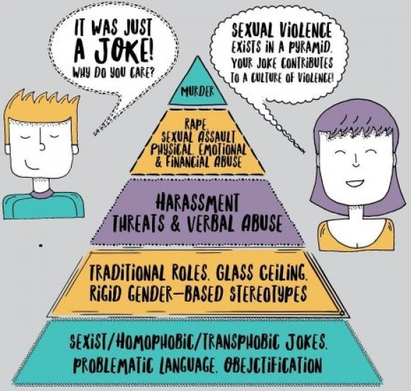
Inferences
Learning Question: What is sexist language and why is it harmful?
Discussion:
What can you infer about sexism and sexist language from this source?
From the source I can infer…
What do you think about the suggestion made by this?
Notes:
Students asked to make inferences about sexism/sexist language from the source e.g. I can infer that sexism can sometimes lead to more serious crimes etc.

Slide 8
Justifying your opinion
Learning Question: What is sexist language and why is it harmful?
Disagree
Agree
Sexist comments such as ‘man up’; ‘she’s a slag’ and ‘boys don’t cry’, are not ok because they suggest that one gender is better than the other.
Strongly
agree
Strongly
disagree
Activity: Go to whichever station best supports your opinion about this statement. Be prepared to justify your decision
Notes:
This statement should provoke discussion, what must be made clear by the end of the discussion is that the statement is true.

Slide 9
Plenary
Learning Question: What is sexist language and why is it harmful?
Write down at least 3 things that you have learnt in this lesson
Put them in order of what you think is most important by numbering – 1 being the most important
1.
2.
3. Anyone can be the victim of sexism
Notes:
AfL – expect to see an understanding of what sexism means; dangers of gender stereotypes and how restrictive they are; types of language

