Slide 1


Welcome, the webcast will start shortly.
Parental responsibility measures attendance census 2023/24
Delivered by the Attendance Team

Slide 2



Parental responsibility measures attendance census 2023/24
Webcast and Q&A
Notes:
Welcome!

Slide 3



What is the PRMA Census?
The data collection for attendance penalty notices (PNs), parenting contracts, parenting orders and attendance case management is an annual collection.
All LAs are asked to make this data return reporting on the provisions relating to the use of attendance penalty notices, attendance case management (fast track), parenting contracts, parenting orders and education supervision orders used within its authority during each academic year.
The data collection covers the school year from 1 September 2023 to 31 August 2024.
Notes:
So, what is the parental responsibility measures attendance census? It’s the collection of data relating to attendance penalty notices, parenting contracts (which moving forward will be known as attendance contracts), parenting orders and attendance case management which we have previously referred to as Fast Track here in Norfolk and from this year forward will refer to as Support First Approach. All LAs are asked to make this annual data return and it involves reporting on the provisions relating to managing and promoting regular school attendance.
The PRMA collection provides information at LA level to the DfE on the volumes of parenting contracts, parenting orders, education supervision orders and penalty notices issued to address poor attendance in school and enables them and us to analyse the effectiveness of these tools.
Its therefore important that the data we collect is both accurate and complete.

Slide 4
What do we need from you?
The census asks us several questions relating to Attendance case management, commonly referred to here in Norfolk as Fast Track. As this is a school led intervention, we do not hold the data required to complete the return and therefore need to collect it from you.
We must provide figures for the following questions:
Total number of cases entering Fast Track during the period
Total number of Fast Track cases prosecuted during the period
Total number of Fast Track cases withdrawn, before prosecution, during the period
They also require the reason for withdrawal broken down by the following:
Total number of Fast Track cases withdrawn because attendance improved following the support measures
Total number of Fast Track cases withdrawn for another reason*
*We are then required to specify the reason for those cases withdrawn for another reason
Notes:
What do we need from you?
The census asks us several questions relating to Attendance case management, commonly referred to here in Norfolk as Fast Track. However, as this is a school led intervention, we do not hold the data required to complete the return and therefore need to collect it from you.
We must provide figures for the following questions:
Total number of cases entering fast track during the period
Total number of Fast Track cases prosecuted during the period
Total number of Fast Track cases withdrawn, before prosecution, during the period
They also require the reason for withdrawal broken down by the following:
Total number of Fast Track cases withdrawn because attendance improved following the support measures
Total number of Fast Track cases withdrawn for another reason
Please specify the reason for those cases withdrawn for another reason

Slide 5

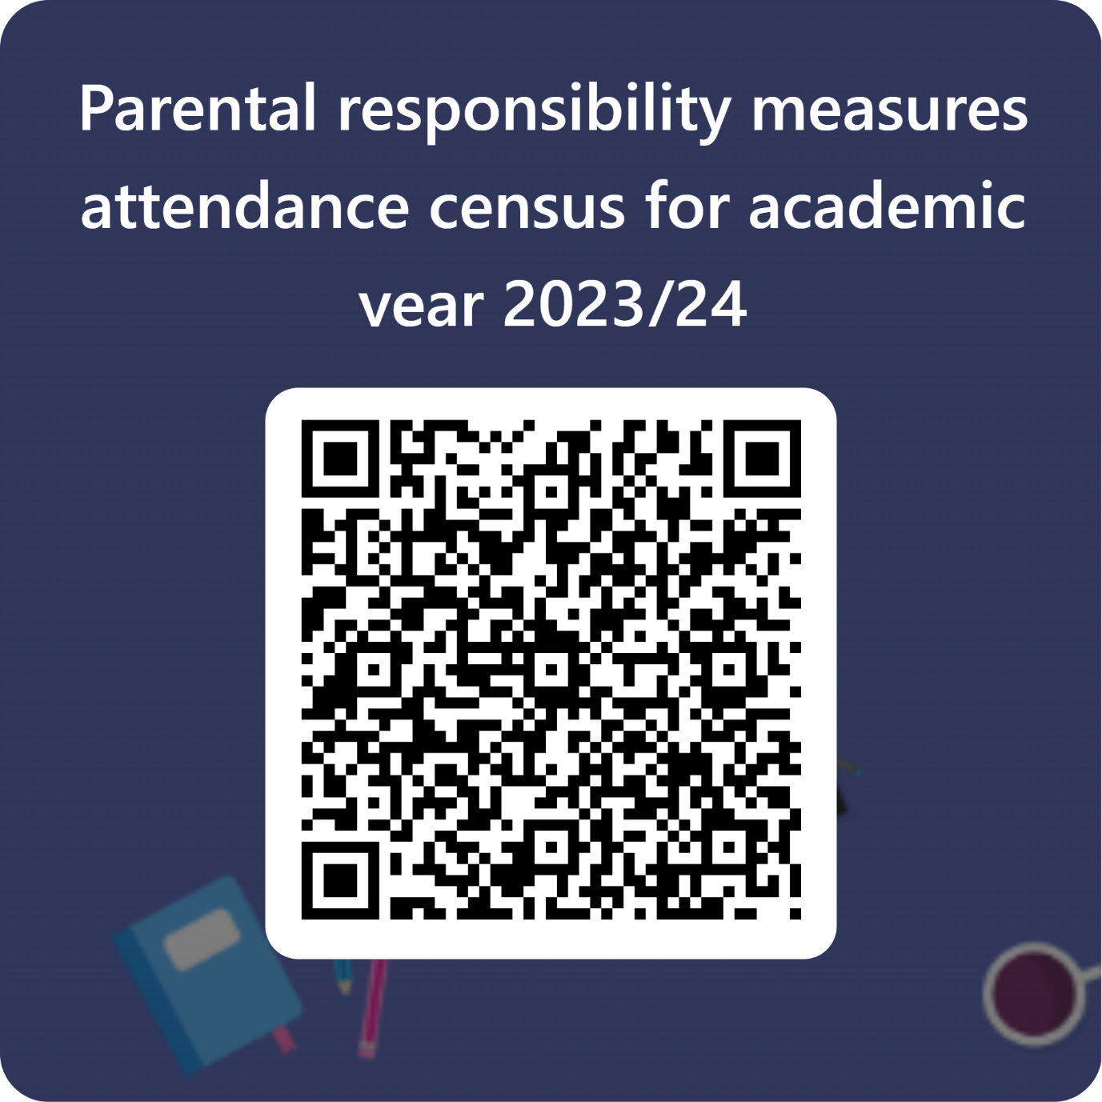
How will we collect this data from you?
We collect this data from you by using an MS form, it has been designed to capture the number of parenting contracts offered via Fast Track and does not collect personal information of pupils or parents.
Let’s take a look together!
Notes:
Demo form and output from form

Slide 6
Things to remember when completing the return
We ask that all schools complete the return even if they have not completed any Fast Track intervention this past academic year
It is possible to complete one submission for multiple schools if you wish – remember to state which schools it is in relation too
You must count the number of parents who have been subject to invention via Fast Track for the total number of cases entered
Each parent will have an outcome! So, if you have 10 parents entered you will have 10 outcomes accounted for on the form
Deadline for submission is Friday 11th October 2024

Slide 7

NORFOLK PRIMARY SCHOOL PRMA EXAMPLE
Total number of cases entered the Fast Track case management system for academic year 2023/24? | 15
For each of the cases you entered into the Fast Track case management system last year please confirm how many were agreed and accepted by parents? | 8
Outcomes:
Attendance Improved | 5
Closed due to medical defence | 2
Closed due to an issue with transport | 0
Closed due to a religious observance defence | 0
Closed due to authorised traveller absence | 0
Closed for other authorised circumstances | 0
Closed as pupil removed from roll to home educate | 1
Closed as pupil moved to another school in Norfolk and process discontinued | 0
Closed as pupil moved to another school our of Norfolk | 0
Closed as case was referred to the LA for consideration of prosecution | 5
Number of cases started in 2023/24 that remain open and have not yet been concluded | 2
Outcome Total: | 15
Number of agreed plans
Count in number of parents

Slide 8
Q&A

Slide 9


Save the date!
Attendance Spotlight Webinars
Will be held approximately on the last Thursday of each month. They will begin at 10.30am and can be accessed via the links in the Upcoming events section of Attendance news and events page. Autumn Term schedule:
Thursday 26th September
Thursday 24th October
Thursday 28th November
Thursday 19th December
Countywide Attendance Network Meetings
Autumn Network Meeting: Thursday 7th November
Spring Network Meeting: Thursday 27th February
Summer Network Meeting: Thursday 26th June
All held in person at The Inspiration Teaching Hub.
Keep up to date with Attendance news and events via:
Attendance news and events page
And by registering to receive weekly emails and updates from the News for Norfolk Education Providers.
Webpage for News for Norfolk Education Providers can be found here.

Slide 10
Targeting Support Meetings
Schools are expected to participate in these meetings in line with 'Working together to improve school attendance.' The number of meetings a school is expected to have is outlined within the DfE guidance and depends on the level of the attendance challenges in the school:
If your school's attendance levels were below the national average for your phase, it is expected that you book a TSM for each term
If your school's attendance levels were above national average for that phase, you may if you want only schedule one TSM for the academic year.
We would encourage all secondary schools in Norfolk to book a TSM for each term, whether above or below national average. If your setting's attendance rates are above the national average for your phase and you wish to meet with us termly, you are welcome and invited to do so.
Booking your TSM
To book your TSMs for the academic year:
Visit the following page: NCC Targeting Support Meeting Bookings
Select the meeting type that applies to your school setting.
Select the date you wish to book in the calendar.
Select a time from the available options.
Add your details into the required fields, ensuring to include the name of your school.
Select book and you will receive an email confirmation of your booking.
Please note:
If you wish other colleagues to attend, you can forward the meeting invitation.
When booking a meeting for each term, you will need to repeat this process for each booking.
If a date or time is unavailable that is because the slot is already booked, or the date falls outside of term-time based on the Norfolk calendar.
Notes:
Targeting Support Meetings (TSMs) are essential for early identification and support of pupils with habitual attendance issues, requiring collaboration between schools, local authorities, and partners. Local authorities are expected to organise these meetings regularly with each school to build strong relationships, discuss overall trends and emerging trends in the school's attendance data, identify and agree on action plans for severely absent pupils, and discuss approaches for persistently absent pupils needing multi-agency responses.

Slide 11
Data sharing & absence returns
In line with The Education (Information About Individual Pupils) (England) (Amendment) Regulations 2024 and the requirements of 'Working together to improve school attendance', all schools are now legally required to share information from their registers with the DfE and the local authority.
Sharing data with the DfE:
From the start of the 2024-25 academic year, schools have a duty to provide attendance information to the Department for Education (DfE) on request. Data indicates that as of 6th September, over 380 have already signed up to share their daily attendance data with the DfE in line with statutory requirements.
Action: It is important that all schools ensure that they have completed this process and for those schools who have not, further guidance on how to share your data is available via this link: Share your daily school attendance data - GOV.UK (www.gov.uk)
Once you are sharing data with the DfE you will have access to a range of tools that will support you to analyse your data. The DfE has published guidance for schools, academy trusts and local authorities on using the monitor your school attendance tool.
Sharing data with the LA:
Further, to facilitate timely collaborative working across partners, all schools are also required to share information from their registers with the local authority. As a minimum this includes:
New Pupil and Deletion returns
Attendance returns
Sickness returns
If your school is not currently sharing data as part of the local arrangements, you will receive an e-mail from attendancedatacollection@norfolk.gov.uk within the next two weeks providing guidance on what you need to do next.
If you already provide attendance data to the LA via the local arrangements, please also contact attendancedatacollection@norfolk.gov.uk if:
You have changed Management Information System provider over the Summer as this will impact on data collection.
You are unsure of who we hold as your contact for the local data feed and/or would like to make a change to the contact.
Notes:
As an LA, we want to reduce the administrative burden placed on schools as well as support them to meet with national requirements. As a result, we need schools to engage with both our local attendance data arrangements as well as the DfE collection of attendance data. This is because the DfE does not currently provide the facility to export data relating to sessional attendance codes which are required for the purpose of the sickness and attendance returns. As the DfE systems develop, we envisage that we will be able to cease the local collection of data and are providing feedback on proposed future development of the national system. Engaging with both systems simultaneously will not add to schools workloads nor compromise information security.

Slide 12

If you have any further questions that have not been answered today, then please contact the Attendance Team on 01603 223 681 or at: csattendance@norfolk.gov.uk

