Slide 1




Attendance Network Meeting
Welcome, the session will start shortly.

Slide 2

Agenda
9.30am | Welcome! Term Headlines
9.40am | Termly Check up
10.00am | Getting attendance right: Eight things' schools can do this term
11.45am | Break
11.00am | Guest Speaker: Andrew Siddy from Virtual School to speak about Kinship
11.30am | Spotlight session: Support First Approach, let's build a road map
12.15pm | Final comments & questions

Slide 3

Term Headlines
Working together to improve school attendance guidance became statutory from 19th August 2024.
The Education Hub – Top tips on how to keep your child healthy at school guidance that can be shared with parents and link to the NHS published guidance supporting parents to decide – Is my child too ill for school?
Parental Responsibility Census completed, thank you to those who responded promptly.
  11,791 FPNs issued in 23/24
  1387 parents entered fast track, 519 closed due to improvement, 304 closed for other reasons
School inspection handbook re-published September 2024, recording of webinar explaining changes available.
Supporting students at key secondary school transition points webinar hosted by SecEd, in partnership with GL Assessment available.
SEND and Inclusion Support Line is now live – 0333 313 7165
Norfolk’s attendance rates are on the rise!
Notes:
The phoneline is staffed by experienced Early Help Advisors, who will assist families and professionals to navigate our SEND & Inclusion support, there will also be a duty Inclusion Adviser, SEND Adviser and an Attendance Officer as part of the new phoneline to ensure calls are dealt with in a swift way and urgent exclusion cases are supported immediately.
The phone line will be open weekdays between 9am and 5pm, seeking to provide holistic and personalised support with the aim of reducing exclusions and guiding families through the SEND offer.

Slide 4
Norfolk Attendance Data
Phase | Display Name | Attendance % | Absence % | Authorised Absence % | Unauthorised Absence %
Primary | National | 95.67 | 4.33 | 3.00 | 1.33
Primary | Norfolk | 95.72 | 4.28 | 3.14 | 1.14
Primary | Regional | 95.78 | 4.22 | 3.10 | 1.12
Secondary | National | 92.96 | 7.04 | 4.43 | 2.61
Secondary | Norfolk | 92.46 | 7.54 | 5.46 | 2.08
Secondary | Regional | 93.06 | 6.94 | 4.72 | 2.22
Special | National | 88.34 | 11.66 | 8.65 | 3.01
Special | Norfolk | 89.30 | 10.70 | 8.18 | 2.52
Special | Regional | 88.92 | 11.08 | 8.75 | 2.32

Slide 5
Sharing daily attendance data with the DfE
The DfE recently hosted 2 webinars aimed at schools and LA’s regarding sharing daily attendance data. They shared that 91% of schools across England are currently participating and sharing their school data. Sharing data with the DfE is mandatory for all schools and has been now since Working together to improve school attendance became statutory guidance on the 19th August 2024. It is the DfE’s hope that by having a real-time picture of attendance, schools, trusts, LAs and the DfE can identify and take appropriate action to improve attendance and outcomes for pupils. If you are already sharing your data and want to learn more about how to get the most out of the view your education data service (VYED) click here to access the monitor your school attendance: User guide.
If your school is yet to set up their connection with WONDE to share daily attendance data, you can access the DfE webinar recording via the DfE’s YouTube page entitled ‘Monitor your school attendance – May Webinar for schools and trust not yet sharing data’.

Slide 6


Save the date!
Attendance Spotlight Webinars
Will be held approximately on the last Thursday of each month. They will begin at 10.30am and can be accessed via the links in the Upcoming events section of Attendance news and events page. Autumn Term schedule:
Thursday 28th November
Thursday 19th December
Countywide Attendance Network Meetings
Spring Network Meeting: Thursday 27th February
Summer Network Meeting: Thursday 26th June
All held in person at The Inspiration Teaching Hub.
SEND and Inclusion Network
Keep up to date with Attendance news and events via:
Attendance news and events page
And by registering to receive weekly emails and updates from the News for Norfolk Education Providers.
Webpage for News for Norfolk Education Providers can be found here.
Notes:
The Inclusion and SEND team are holding termly network meetings organised by NCC Partnerships, Schools and Communities (PSC) and Children and Young People’s Mental Health Services (CYPMHS). This is a great opportunity to expand your network, learn from others, and discover new possibilities for collaboration. You will also get to hear from some of the most influential and inspiring speakers in the county, who will share their stories and insights on how to leverage system collaboration for greater impact and value. The Autumn Network meeting has already taken place, future Network meetings will take place on:
30.01.25 at 11.00 – 12.30 online via Microsoft TEAMS.
08.05.25 at 11.00 – 12.30 online via Microsoft TEAMS.
The meetings are free to attend, but you need to register in advance to secure your spot. You can register by contacting sendandinclusiontraining@norfolk.gov.uk.

Slide 7

Norfolk Steps
Universally free training and resources for schools to support early intervention and prevention through a whole-school approach including managing behaviours that challenge or may risk harm.
Gypsy Roma Traveller (GRT) graduated offer of support
The offer is based on three levels of support: universal, targeted, and enhanced. Each level corresponds to the degree of need and intervention required for GRT CYP, from initial assessment and induction to more intensive and specialist support, within a whole-school approach.
Notes:
Norfolk Steps provides training and resources to schools and settings to support early intervention and prevention through a whole-school or setting approach, including managing behaviours that challenge or may risk harm. Its now fully funded for all mainstream and specialist schools in Norfolk.
The Steps Graduated Offer of support is a comprehensive and flexible programme, providing schools and settings with the guidance and tools to meet the needs of children and young people (CYP) to promote positive behaviours. The offer is based on three levels of support: universal, targeted, and enhanced. Each level corresponds to the degree of need and intervention required for CYP, from whole-school positive, preventative approaches that draw upon trauma aware approaches to evidence-informed tracking and planning for children and young people with behaviours that challenge and specialist support for children and young people with behaviours that may harm.
The Gypsy Roma Traveller graduated offer of fully-funded support is a comprehensive and flexible programme, providing schools and settings with the guidance and tools to meet the needs of GRT children and young people (CYP). The offer is based on three levels of support: universal, targeted, and enhanced. Each level corresponds to the degree of need and intervention required for GRT CYP, from initial assessment and induction to more intensive and specialist support, within a whole-school approach.

Slide 8

Attendance Network Directory
Staying connected
Are you signed up to the Attendance Network Directory?
By joining the directory, you gain access to contact details for other colleagues who also have responsibility for attendance. Enabling you to stay directly connected outside of the arranged network meetings.
If you would like to join the directory please add your name, setting and email address to the directory sign up sheet located near the refreshments.
Thanks!

Slide 9

Let’s begin with a termly check up
In your groups reflect, discuss and share the challenges you have faced/facing in your setting this term. What strategies have you put in place? Don’t forget to share your successes!

Slide 10

Getting attendance right: Eight things' schools can do this term
Very few schools can say that the attendance of their students is back to pre-pandemic levels.
Attendance is clearly linked to a student’s attainment at GCSE. DfE data evidences that at key stage 4, students not achieving grade 9 to 4 in English and maths had an overall absence rate of 8.8%, compared to 5.2% among those achieving grade 4 and 3.7% of those achieving grade 5 and above.
Last year, 57% of year 7 to 11 students who missed school at the start of the year went on to miss at least 10% of sessions across the whole academic year.
And for vulnerable students, we know that attendance is an important protective factor.

Slide 11

1. Complete your attendance (and admissions) registers accurately and report daily
New codes for logging reasons for absence in your attendance register. Sections 282-411 of the WTISA set out clear code definitions.
Schools must now share daily attendance data with the DfE.
Robust day to day processes to track and follow up absence and poor punctuality which are rigorously applied across the school.
Discuss: Are you confidant that your settings registers are accurate? What measures do you have in place to ensure accuracy?

Slide 12

2. Ensure you have identified a member of your senior leadership as your Attendance Champion
All schools must have a named Senior Attendance Champion. They must be named in the school attendance policy and oversee your attendance strategy. Responsibility for attendance should be detailed in their job description. Depending on your school attendance data it may well be that improving school attendance is an area of focus in their appraisal targets for this year.
Who is your settings named Senior Attendance Champion?

Slide 13

3. Put a meeting in the diary this term with your School Attendance Support Team
Book your termly targeting support meeting with the Attendance Team.
Action: book your termly TSMs, ensure the correct staff are available to attend and participate to get the most out of them!

Slide 14
4. Schedule training for your staff
All school staff need to understand the common language used when discussing attendance.
Discuss: How will each member of school staff contribute towards creating the culture and expectations of high attendance?

Slide 15
5. Establish what attendance patterns look like in your school
Have a systematic process in place for identifying individuals and cohorts who fall into the different absence categories.
Regularly analyse the data and use it to inform your practice.
Discuss: Have you identified any patterns from last year’s data? How have you used your analysis to inform your practice this year so far?

Slide 16
6. Communicate with parents
Communicating with parents should start from the beginning of the year.
Clarifying for parents what good attendance looks like and how it links to attainment over time.
Celebrate high attendance and engagement as soon as you have the opportunity.
Action: There are templates available for messages to parents, including suggested letters from the DfE, but you are best placed to decide how you reach parents in your school. Newsletters, settling in evenings, parents’ evenings are all forums for setting the culture and nudging families. Consider how you approach this in your setting.

Slide 17
7. Review your attendance policy
Attendance Policy should have been reviewed and republished.
Action: Check that your setting has reviewed and republished its school attendance policy. Does it meet the requirements set out in WTISA?

Slide 18
8. Decide how you will report attendance data to your governing body and other stakeholders
Governors and relevant stakeholders will seek assurances around attendance with us. If you want to monitor patterns in attendance a dashboard that can be shared with senior leadership, governors, and trust leaders is often a way of doing this that is time-efficient and easy to digest.
What, when and how is data being shared? Not just with governors and trust leaders but within school too?

Slide 19

15-minute comfort break,
See you back soon!

Slide 20





Virtual School response to the expansion of the Virtual School Head role to include championing the educational attendance, attainment and progress of children in kinship care

Slide 21

Who are we?
We are not a school, but we are a service which offers advice and guidance. We support early years settings, schools, post-16 settings and other professionals to ensure that children in care, previously in care, children with a social worker & children in kinship care (from September 2024) get the very best from their education.

Slide 22
What is kinship care?
Kinship care is when a child lives full-time or most of the time with a relative or close family friend, usually because their parents are not able to care for them. The arrangement may be temporary or longer term. In the UK, there are more than 180,000 children in kinship care.
Grandparents are the most common kinship carers, but older siblings, aunts, uncles, and people who know the child well can also take on the role. This list is not exhaustive.
You might see kinship carers referred to as ‘family and friend’s carers’ or ‘connected people’ by local authorities and in some documents.

Slide 23
The following are all types of kinship care arrangement; however, this list is not exhaustive:
Informal kinship care arrangements
A private fostering arrangement in which some who is not a close relative of the child looks after the child for 28 days or more
Where a ‘lives with’ Child Arrangements Order has been granted in favour of someone who is a friend or family member but is not the child’s parent
Where a Special Guardianship Order has been granted appointing a friend or family member as the child’s special guardian
Where a child is a ‘looked after child’ and each of the following apply:
- the child is being cared for by a friend or family member who is not their parent, and
- the friend or family member is approved as a local authority foster carer on either a temporary basis or following full assessment.
Where an Adoption Order has been granted in respect of the child and, prior to making the order, the adopter was a friend or family member.
Championing kinship care: the national kinship care strategy (publishing.service.gov.uk)

Slide 24


Slide 25
Why do children need kinship care?
Most children are in kinship care because their parents are not able to look after them.
Research shows that around half of children are in kinship care because their parents have had problems with drugs or alcohol. Children may also need kinship care if their parents die, go to prison, or they are abusive, neglectful or unwell.
Many children in kinship care will have experienced trauma. A kinship carer provides a stable home life where they can grow and develop in a safe, positive environment. They also get to stay in their existing family network, which helps maintain them maintain their sense of identity and family relationships.
Source: Forgotten: Support for Kinship Children’s Education and Mental Health, Aug 2024.

Slide 26
What challenges are children in kinship care facing?
Too many kinship children aren’t getting the educational support they need.
There is a high prevalence of special educational needs amongst children in kinship care, but many are missing out on a diagnosis and formalised support in school.
Many children in kinship care are struggling with their mental health, and emotional and therapeutic support for this group is lacking.
Some kinship children need additional support to manage contact and navigate their family relationships and identity.
Educational support for these children does not always recognise their specific circumstances & needs.
Kinship carers can find it difficult to navigate the education system as it can be unclear what support this group are entitled to in order to thrive at school.
Source: Championing Kinship Care: The National Kinship Care Strategy, Dec 2023 & Forgotten: Support for Kinship Children’s Education and Mental Health, Aug 2024.

Slide 27
What are the new duties for kinship?
From September 2024, the Virtual School Head strategic role will include:
a) Raising the visibility of the distinct needs of children in different types of kinship
care arrangements and the disadvantage that they can experience.
b) Promoting practice that supports attendance and engagement in education.
c) Promoting practice that improves children in kinship care’s outcomes to narrow
the attainment gap, so that every child has the opportunity to reach their full
potential.
Furthermore, we will extend Virtual School Heads’ provision of advice and information, on request, to all kinship carers with Special Guardianship and Child Arrangements Orders as part of their non-statutory role. This will be an important step in helping more kinship carers to navigate the education system, in turn helping them to advocate for the educational achievement of their children. More children in kinship care will receive the help they need to thrive at school.
Championing kinship care: the national kinship care strategy (publishing.service.gov.uk)

Slide 28
What is not within the scope of the new duties?
All children in kinship care, regardless of legal status, will benefit from the adaptation of the strategic Virtual School Head’s role. Although this does not involve direct intervention with children in kinship care, all children will benefit from this system wide approach.
• Virtual School Heads are not expected to provide information and advice to kinship carers with informal arrangements.
Championing kinship care: the national kinship care strategy (publishing.service.gov.uk)

Slide 29
How has the Norfolk Virtual School responded?
Appointment of a new adviser with responsibility for kinship and previously in care children.
From September 2024, Kinship families with a Special Guardianship or Child Arrangements Order, regardless of whether children were previously looked after, will benefit from advice and information from the Virtual School Head to help them navigate the education system. This will be reflected in our Virtual School offer published for 2024/25.
Delivered a webinar for Norfolk Designated Safeguarding Leads on kinship
Created & shared a One Minute Guide to kinship
Highlighted the new duties to SLT/Designated Teacher’s & SENCOs at breakfast briefings
Consultation period/offer being prepared.
Extension of all participation events for previously in care to be inclusive of kinship families 2024/25. Families can be signposted to ask for further information by emailing virtual.schoolsPIC@norfolk.gov.uk

Slide 30
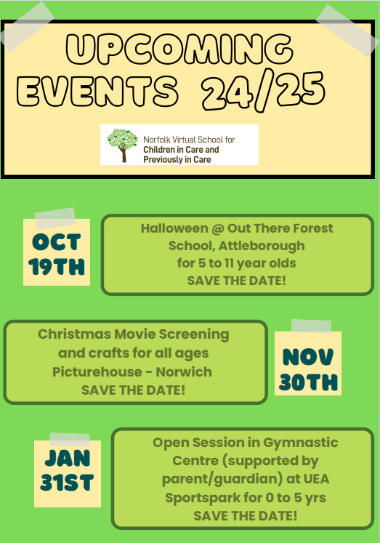
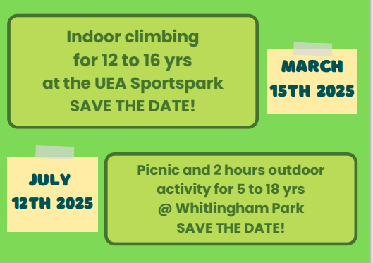

Participation event for Previously in Care and Kinship
All events will be free to access
The activities are open to children and young people who were previously in care or are living in kinship arrangements. Families can register their interest in the events by going to this link:
https://forms.office.com/e/WwdBPx77D9

Slide 31
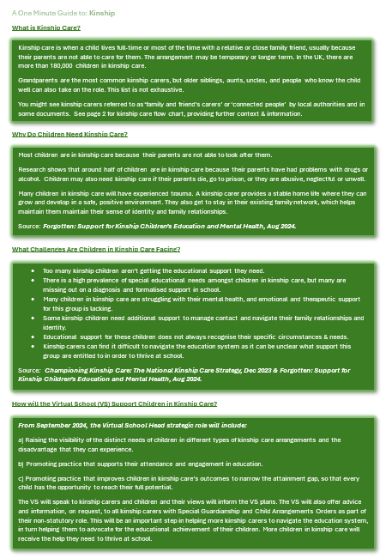
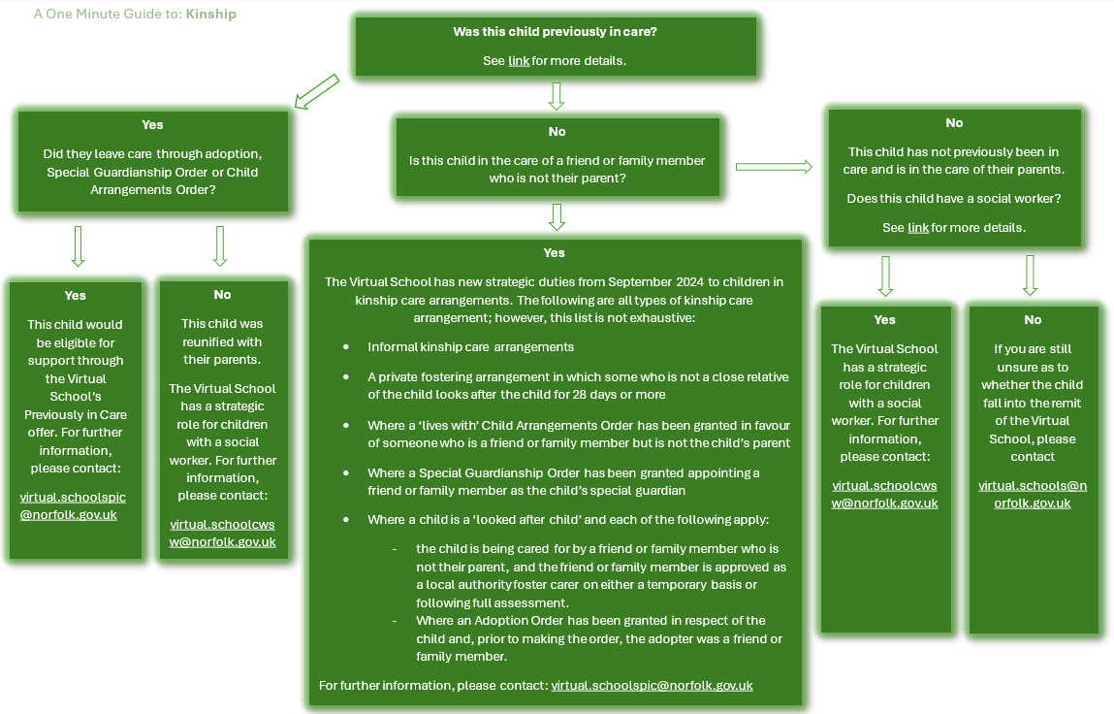
The OMG to Kinship can be found on the virtual school’s Padlet - Norfolk Virtual School for Children in Care, Previously in Care, Children with a Social Worker and Kinship

Slide 33

Consultations
We have been working with the charity, Kinship, as part of our consultation.
They have advised that 2 major education concerns raised by kinship families are:
Behaviour, trauma and school engagement​
​
2. Lack of support with SEND & questions about how to get a diagnosis (if applicable)​
We are currently meeting with local kinship groups to hear their experiences/thoughts about these areas & any other feedback they can offer.

Slide 34
Support available to kinship carers
Kinship Compass is a new interactive tool which helps kinship carers to navigate and find independent information, it is a gateway to support and advice, guiding you in your caring role, at a local and national level.
www.kinship.org.uk/support-and-advice/kinship-compass/
Kinship carers can enter their location or postcode and access:
workshops and roadshows running online and in person
peer support groups and 1-2-1 volunteer support (Someone Like Me)
online advice guides and information
our Kinship Community for up-to-date news and stories

Slide 35


Slide 36
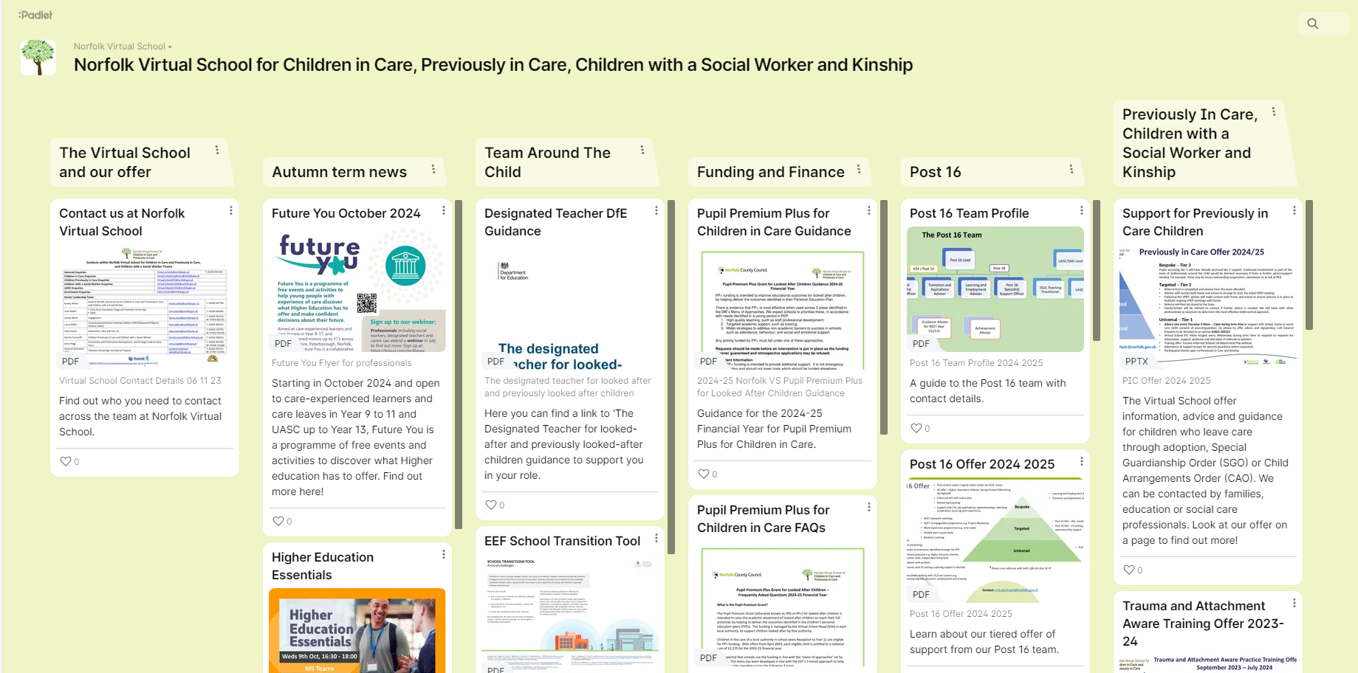
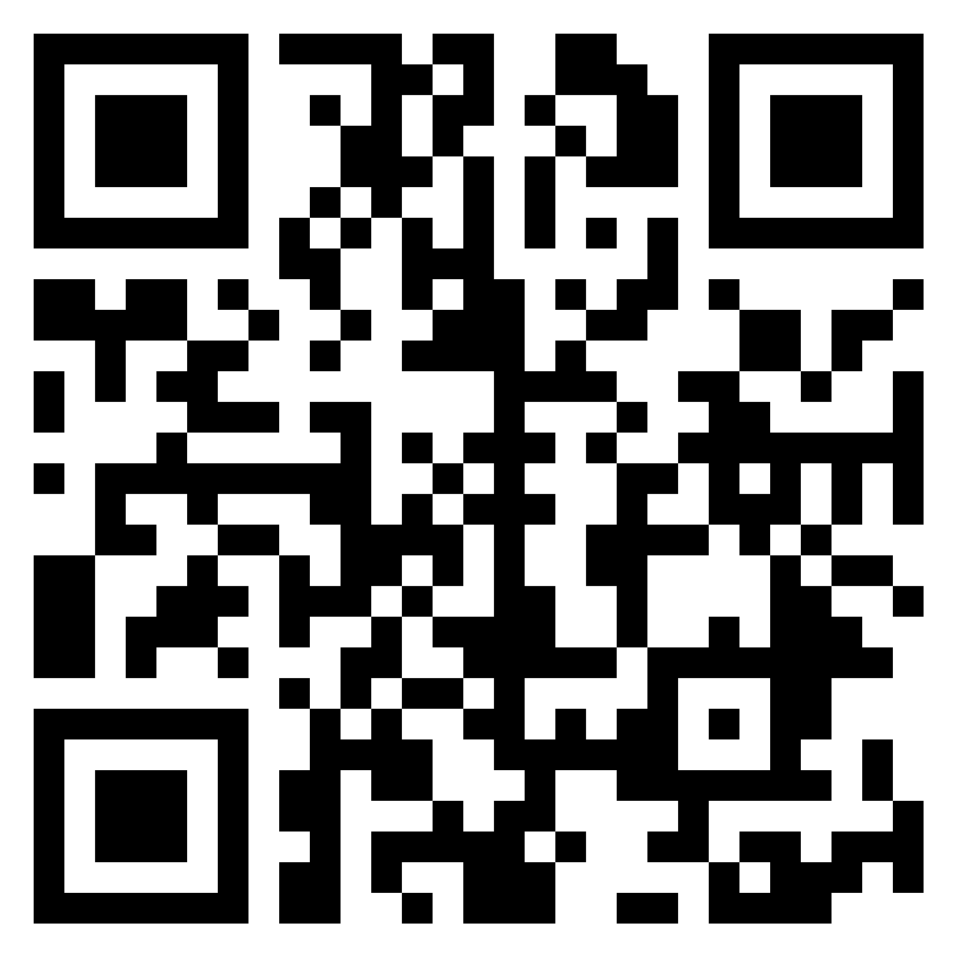
PADLET – Find resources from today including the kinship OMG, our offers of support and professional development calendar:
Scan the QR code or follow the link below
https://padlet.com/norfolkvirtualschool/norfolk-virtual-school-for-children-in-care-previously-in-ca-4wsjfcrprcdjhnxt

Slide 37



How can you contact the Virtual School?
01603 303323
@SchoolCic
www.schools.norfolk.gov.uk/virtualschoolcic
virtual.schools@norfolk.gov.uk Enquiries
virtual.schoolsPIC@norfolk.gov.uk Previously in Care/kinship
01603 303323 – Every Thursday morning, an adviser from the Previously in Care/Kinship team is available for general enquiries or signposting to support children’s education.
PADLET:

Slide 38

Let’s Network
Spotlight on Support First Approach
Let's create a roadmap that incorporates all your best practice

Slide 39
Requirements of the Support First Approach
ensuring a first-day response to any absence
communicating with the child’s parents to understand the barriers to school attendance (steps need to be taken to ensure that each “parent” is included and receives correspondence)
completing wishes and feelings work with the child to understand their views on why they are absent from school
offering a minimum of 3 meetings with child’s parents before considering possible legal intervention
agreeing an effective plan with parents to support improvement in attendance - which could lead to the creation of an attendance contract with parents,
referrals to wider support services where appropriate
confirming that parents are aware of their legal responsibilities regarding ensuring their child’s regular attendance at school by issuing a Notice to Improve
where safeguarding concerns are identified for a pupil/family, appropriate liaison between relevant agencies including social care, police, health, other educational establishments, etc.

Slide 40

Want to improve Attendance? Be a bit kinder!
By Luke Bowers, The Excellence Hub
Where were you yesterday?
Why were you late?
Oh, nice of you to show up
We missed you; it wasn’t the same without you.
Good morning, are you ok?
Have you had anything to eat yet today?
We’re really glad you're here, is there anything we can do so you can be successful today?
It’s really nice to see you.
We’re so glad you’re back.
How did you sleep last night?
Notes:
WANT TO IMPROVE ATTENDANCE? BE A BIT KINDER! Short article by Luke Bowers who works for The Excellence Hub
He says-
“Let me start by saying two things for clarity: 1. If your work has anything to do with trying to reduce pupil absence you are an absolute hero. 2. If your work has anything to do with trying to reduce pupil absence it is one of the hardest jobs in education right now (hence you're an absolute hero!). None of the comments below are in any way a criticism, merely an observation.
Over a number of years I have had the privilege of overseeing attendance across a region of schools and across a multi-academy trust. The Excellence Hub has been inundated with requests since the start of term from schools struggling with attendance. Attendance is now rightly being seen the responsibility of the many and not the few across the sector. The new DFE guidance (mandatory from August 24) and likely development of Ofsted scorecards has further raised the accountability stakes. I have not been to any school where staff are not trying their hardest and where they are not diligently following their policies. However, diligent and professional compliance don't necessarily translate into a positive culture of attendance.
I want you to think about the first interaction staff in your school or trust has with a pupil when they arrive late or when they return from an absence. This first interaction is essential as a potential conflict point. Far too often the first comment a child hears is "why were you late?", or "where were you yesterday?" or even a sarcastic/attempt at humour "oh, nice of you to show up". Here's the truth. You may have absolutely no idea how many challenges that young person has gone through just to get to the threshold of your building at that time. They may be an unidentified young carer, they may have had no food and their clothes may be dirty. They may be suffering with high levels of anxiety. They have however just arrived at your school; an oasis, a safe, calm and welcoming haven. Wouldn't it be awesome if the first things the child heard when they arrived late were things such as: Good morning, are you ok? Have you had anything to eat yet today? How did you sleep last night? We're really glad you're here, is there anything we can do so you can be successful today? Additionally if a child returns after an absence (short or long) imagine if they heard: We're so glad you're back. It's really nice to see you. We missed you, it wasn't the same without you. If you're reading this as a school or trust leader and you know that every member of staff speaks to your children like this every time, then well done. If not then think about clear scripts to follow. Is this going to improve attendance by 10%? You already know the answer to that. Will this approach mean that children know that if they're running late they won't be judged or criticised and possibly prevent future absence? Maybe.

Slide 41
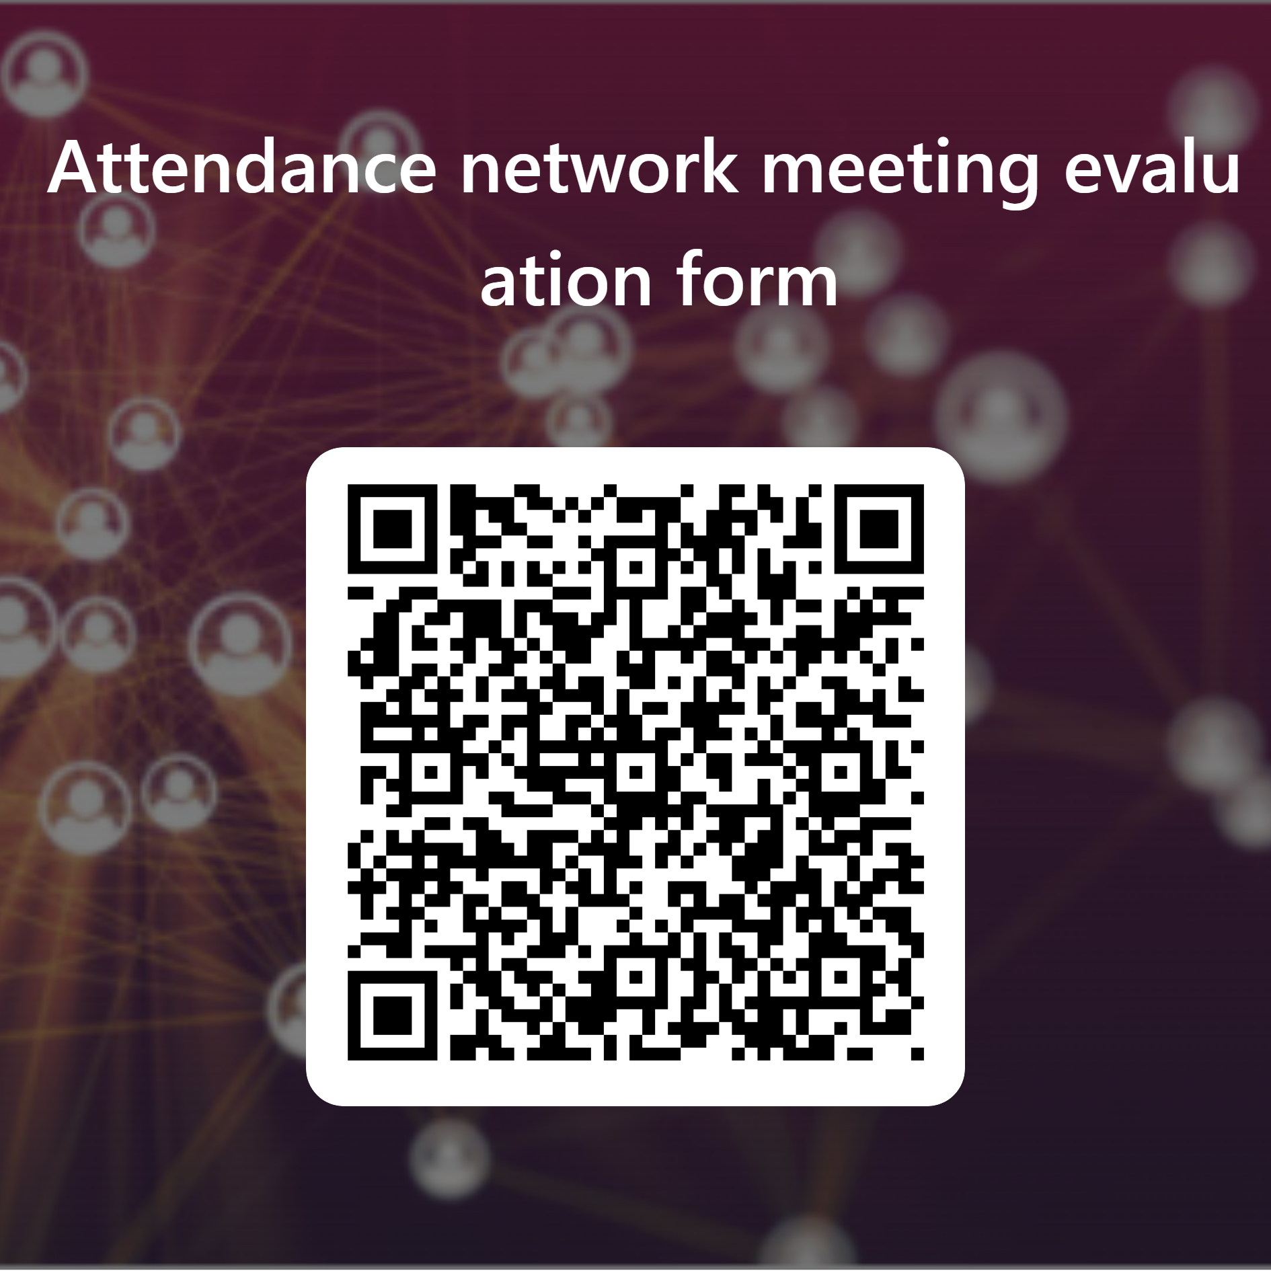
Evaluation
Please take 5 minutes now to complete our evaluation form

Slide 42

Further support and guidance can be found at:
School attendance - Schools (norfolk.gov.uk)
If you have any further questions that have not been answered today, then please contact the Attendance Team on 01603 233681 or at csattendance@norfolk.gov.uk

