Slide 1
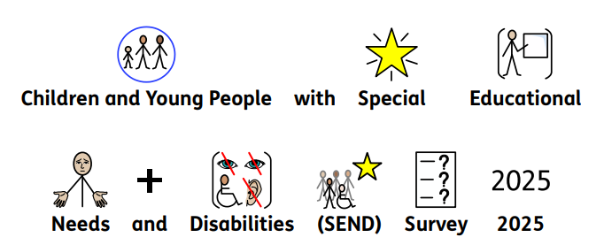
Children and Young people with special educational needs and disabilities (SEND) survey 2025.

Slide 2
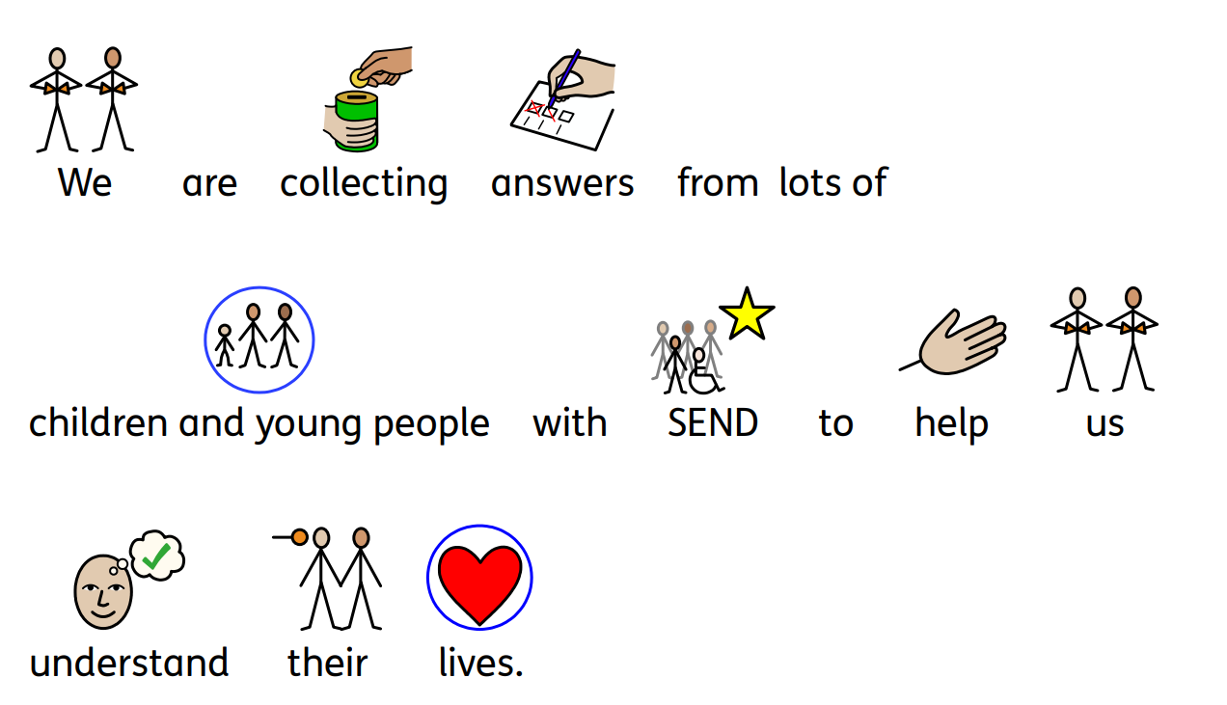
Why we are collecting answers

Slide 3
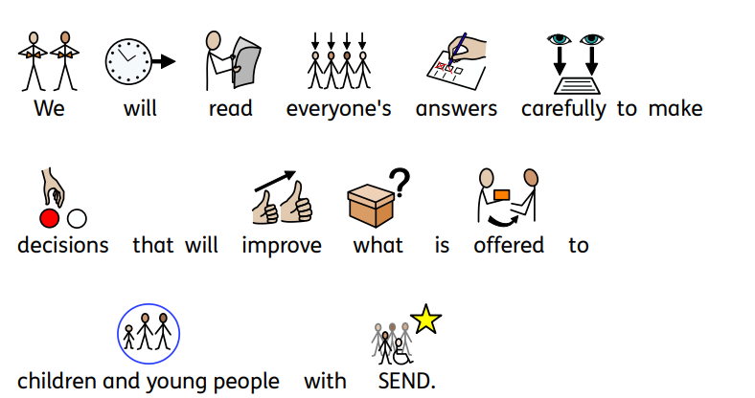
What we will do with your answers

Slide 4
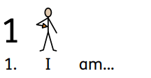
Your age range

Slide 5
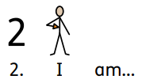
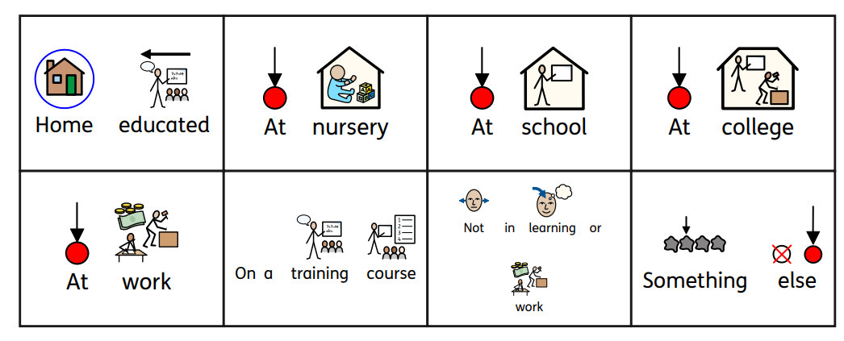
What you are doing

Slide 6
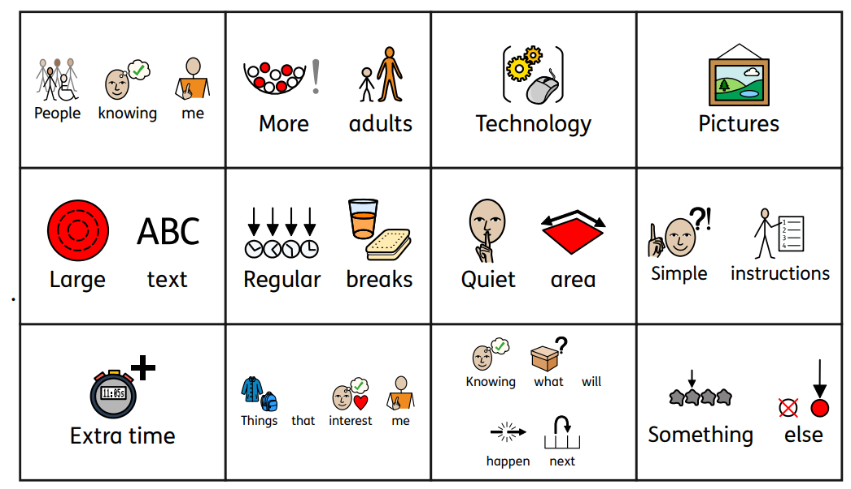
What helps you to learn

Slide 7
Making choices

Slide 8
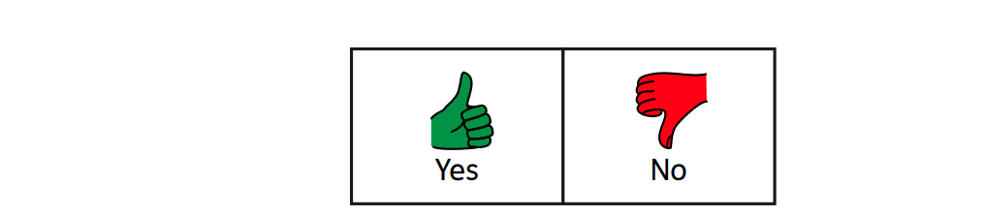
Help to learn

Slide 9
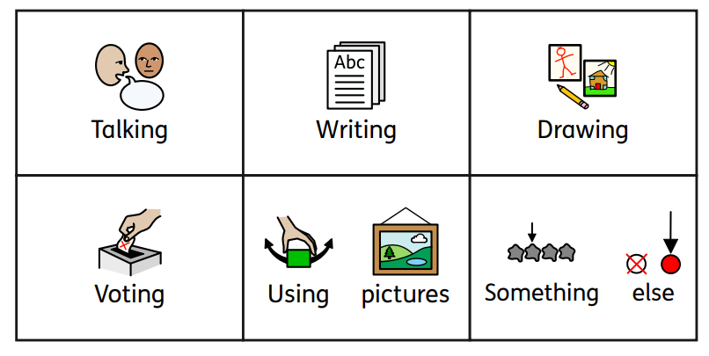
Sharing your views

Slide 10
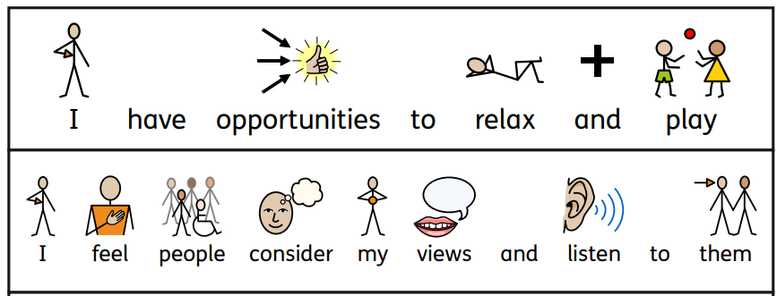
Children and young people’s rights 1

Slide 11
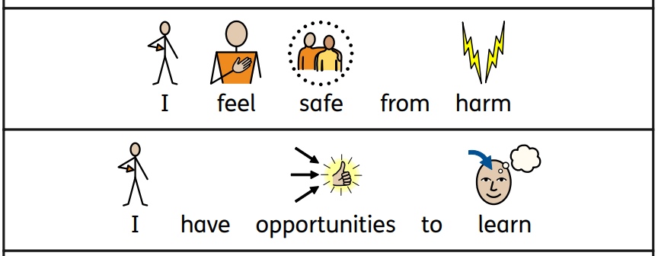
Children and young people’s rights 2

Slide 12
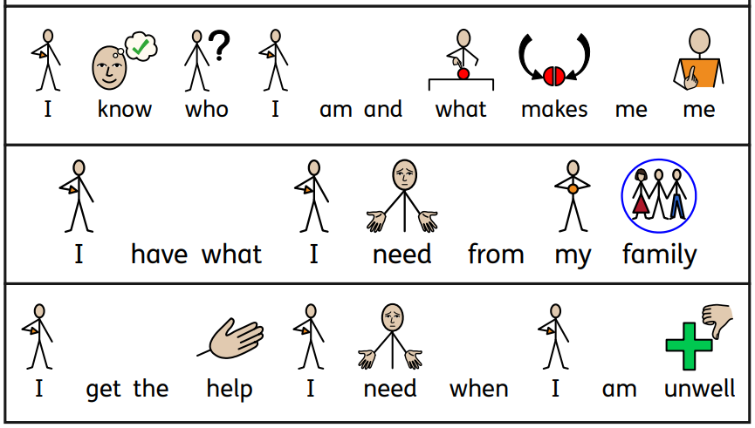
Children and young people’s rights 3

Slide 13
Choices for your free time

Slide 14
Activities in your free time

Slide 15
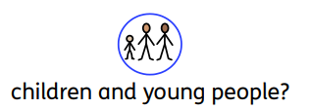
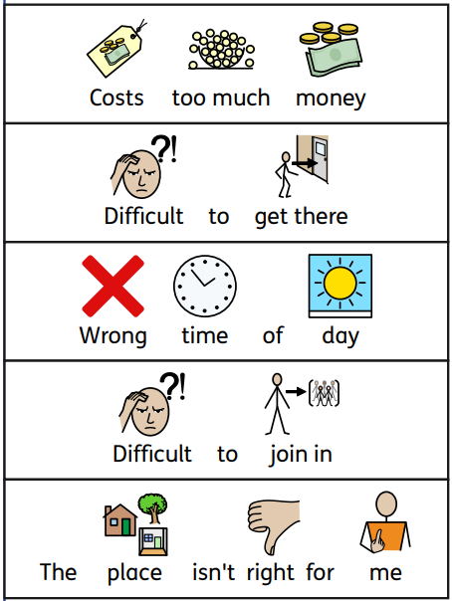
What stops you doing activities

Slide 16
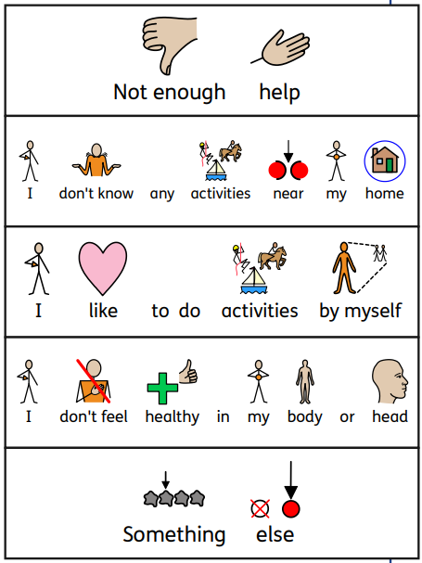
What stops your doing activities with others

Slide 17
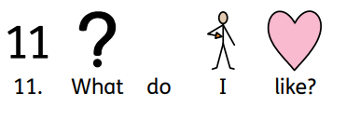
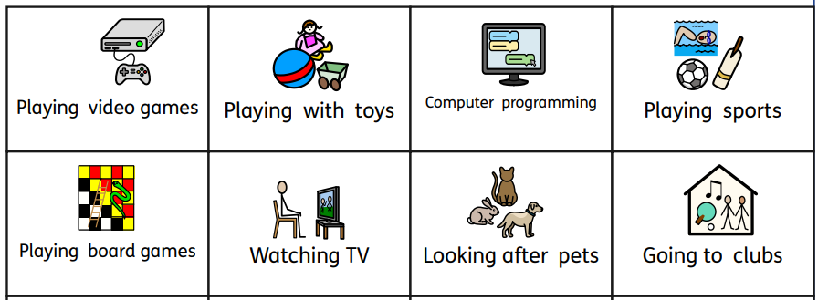
What activities do you like

Slide 18
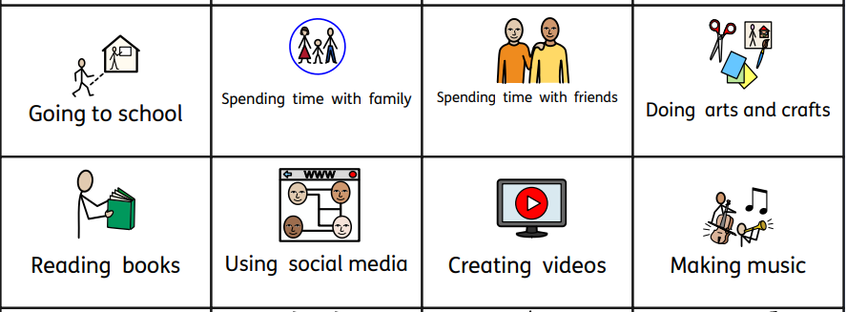
What do you like 1

Slide 19
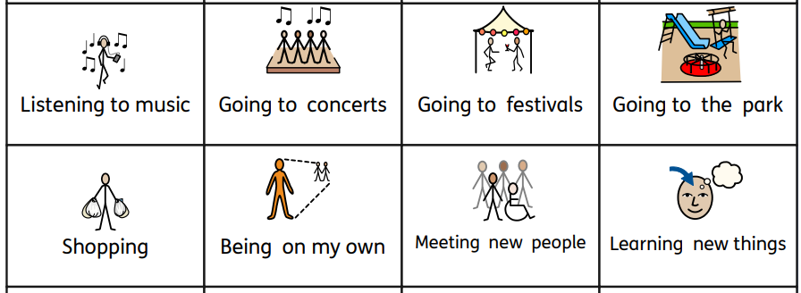
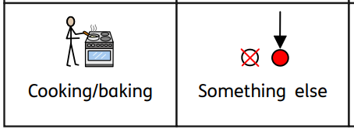
What do you like 2

Slide 20
If you are bullied

Slide 21
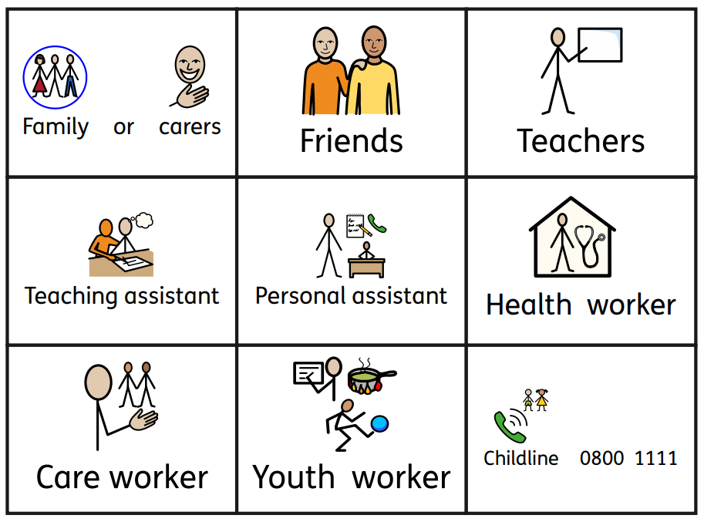
Who do you tell if you are bullied

Slide 22
Feeling healthy in your body

Slide 23
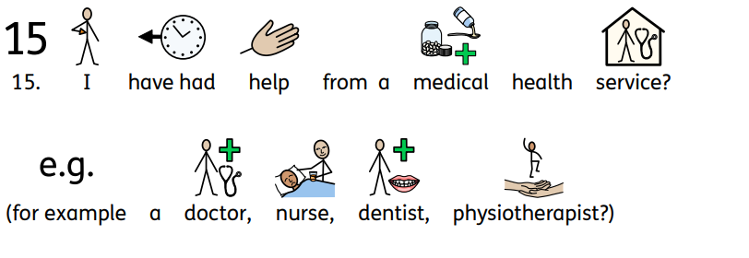
Help from a medical health service

Slide 24
Feeling healthy in your head

Slide 25
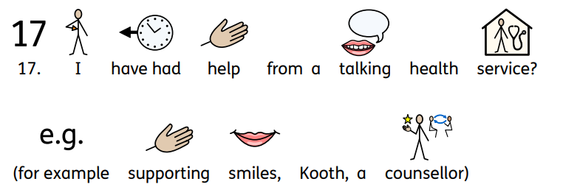
Help from a talking health service

Slide 26
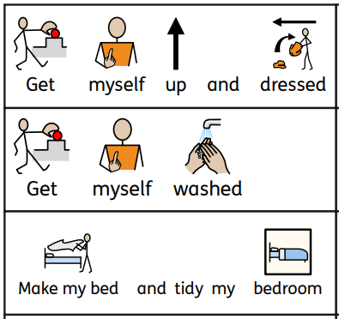
What you can do 1

Slide 27
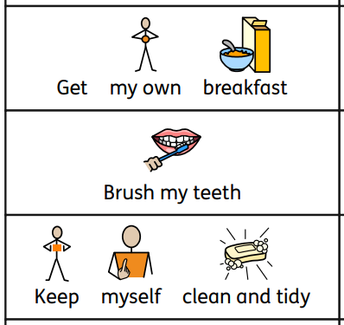
What can you do 2

Slide 28
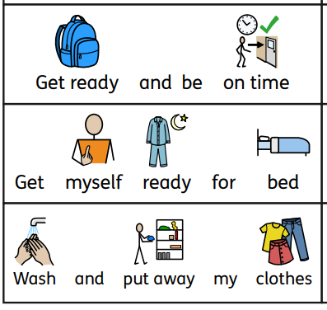
What can you do 3

Slide 29
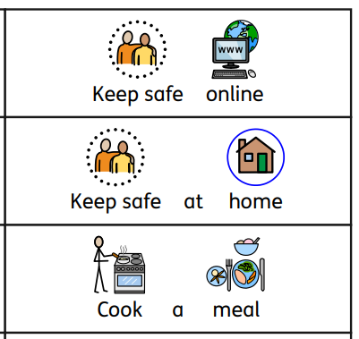
What can you do 4

Slide 30
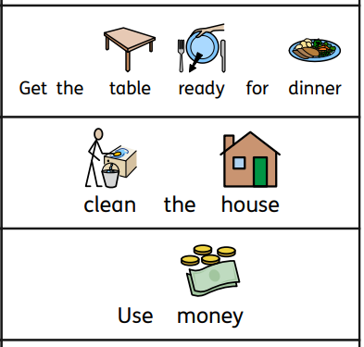
What can you do 5

Slide 31
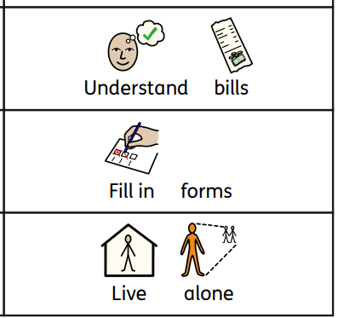
What can you do 6

Slide 32
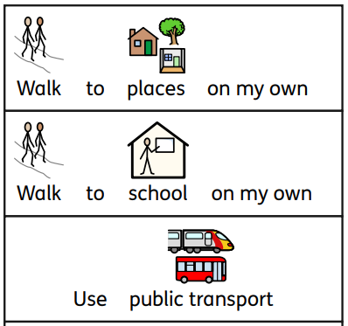
What can you do 7

Slide 33
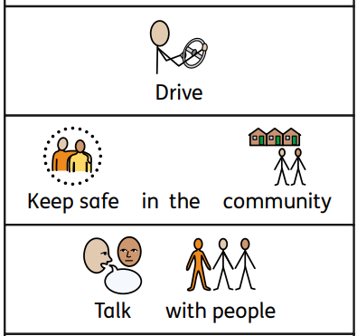
What can you do 8

Slide 34
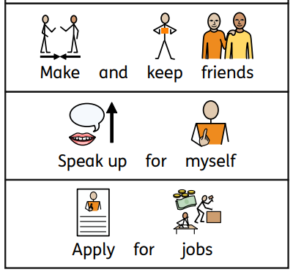
What can you do 9

Slide 35
Making choices in the future

Slide 36
Help needed to prepare for adult life 1

Slide 37
Help needed to prepare for adult life 2

Slide 38
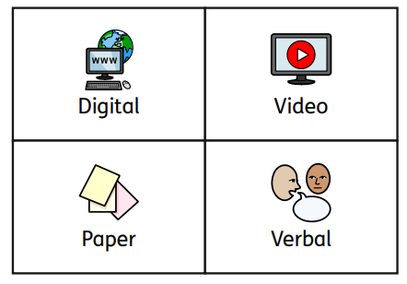
The type of information you prefer

Slide 39
Are words easy to read and understand

Slide 40
Are you happy most of the time

Slide 41
What would make your life better

