Slide 1


Welcome, the webinar will start shortly.
Attendance Spotlight Webinar
Delivered by the Attendance Team

Slide 2

Attendance Spotlight Webinar
Enforce - Sentencing Guidelines

Slide 3
Working together to improve attendance
Expect
Monitor
Listen and understand
Facilitate support
Formalise support
Enforce
Support First Approach

Slide 4

ENFORCE
Where all other avenues have been exhausted and support is not working or not being engaged with, enforce attendance through statutory intervention or prosecution to protect the pupils right to an education.

Slide 5


School Attendance S444 Education Act 1996
Section 444 (1): Parent fails to secure regular attendance at school.
Section 444 (1A): Parent knowingly fails to secure regular attendance at school.
“Knowingly Fails” Definition:
The parent is aware that their child is not attending school regularly and fails to take reasonable steps to ensure attendance.
This includes situations where the parent is informed by the school or authorities about the child’s non-attendance and still does not act to rectify the situation.
School attendance offences are criminal offences, and the Local Authority must prove the case using the ‘beyond reasonable doubt’ threshold based on the evidence provided by the school

Slide 6



Section 444 – The child shall not be taken to have failed to attend regularly at the school by reason of his absence from the school if:
The absences were authorised by the Head teacher
The absences were due to the child’s illness (sufficient medical evidence is required)
The absences relate to religious observance for the faith that the family belong to
The child lives more than 2/3 miles from the local school and the local authority has failed to provide transport
If a parent is charged with the more serious S444 (1a) offence, they have an additional defence if they can prove that they had reasonable justification for their failure to cause the child to attend regularly. This is for the parent to prove but it is crucial that the Local Authority have evidence to show parental failure to secure attendance as well as knowledge of the absence.

Slide 7
Sentencing Guidelines for Section 444 of the Education Act 1996
Offences:
S.444(1): Parent fails to secure regular attendance at school.
S.444(1A): Parent knowingly fails to secure regular attendance at school.
Maximum Penalties:
S.444(1): Level 3 fine (£1000).
S.444(1A): Level 4 fine (£2,500) and/or 3 months imprisonment.
Sentencing Ranges:
S.444(1):
Category 1: Band B fine – Band C fine
Category 2: Band A fine – Band B fine
Category 3: Conditional discharge – Band B fine
S.444(1A):
Category 1: Low level community order – High level community order
Category 2: Band C fine – Low level community order
Category 3: Band A fine – Band C fine
Notes:
Sentencing Ranges:
s.444(1):
Category 1: Band B fine (75-125% of weekly income) – Band C fine (125-175% of weekly income)
Category 2: Band A fine (25-75% of weekly income) – Band B fine (75-125% of weekly income)
Category 3: Conditional discharge – Band B fine (75-125% of weekly income)
s.444(1A):
Category 1: Low level community order – High level community order
Category 2: Band C fine (125-175% of weekly income) – Low level community order
Category 3: Band A fine (25-75% of weekly income) – Band C fine (125-175% of weekly income)

Slide 8
Practical implications of sentencing ranges:
Band A Fine: Typically, 50% of the offender’s weekly income.
Band B Fine: Typically, 100% of the offender’s weekly income.
Band C Fine: Typically, 150% of the offender’s weekly income.
Conditional Discharge: No immediate punishment, but if another offence is committed within a specified period, the offender can be sentenced for both the original and the new offence.
Community Orders: Can include requirements such as unpaid work, curfew, or attendance at rehabilitation programs.
  Low Level Community Order: Up to 40 hours of unpaid work.
  Medium Level Community Order: 40-80 hours of unpaid work.
  High Level Community Order: 80-300 hours of unpaid work.

Slide 9
“culpability refers to the degree of responsibility or blame attributed to the offender for committing the offence”
Factors influencing sentencing:
“Understanding harm helps the court assess the severity of the offence and tailor the sentence to reflect the impact on the child’s education and overall well-being”
Higher culpability:
  Refusal or failure to engage with guidance
  and support offered.
  Threats to teachers and/or officials.
  Parent encouraging non-attendance.
Lower culpability:
  Genuine efforts to ensure attendance.
  Parent concerned by child’s allegations of bullying.
  Parent put in fear of violence an/or threats from the child.
Greater harm:
  Significant period of missed education.
  Adverse influence on other children.
Lesser harm:
  All other cases.
Offence Categories:
Higher culpability and greater harm
Higher culpability and lesser harm or lower culpability and greater harm
Lower culpability and lesser harm
Notes:
In the context of sentencing guidelines, culpability refers to the degree of responsibility or blame attributed to the offender for committing the offence. It helps determine how serious the offence is and influences the severity of the sentence.
Culpability Factors:
Higher Culpability:
Refusal or Failure to Engage: The parent refuses or fails to engage with guidance and support offered by the school or authorities.
Threats to Teachers and/or Officials: The parent makes threats to school staff or officials.
Encouraging Non-Attendance: The parent actively encourages or supports the child's non-attendance at school.
Lower Culpability:
Genuine Efforts to Ensure Attendance: The parent makes genuine efforts to ensure the child attends school but faces obstacles.
Concerns About Bullying: The parent is concerned about the child's allegations of bullying at school.
Fear of Violence or Threats: The parent is put in fear of violence or threats from the child, making it difficult to ensure attendance.
In the context of sentencing guidelines, harm refers to the impact or consequences of the offence. For Section 444 of the Education Act 1996, harm is assessed based on the effect of the child's non-attendance at school. Here's a breakdown of what harm means and the factors that indicate greater or lesser harm:
Harm Factors:
Greater Harm:
Significant and Lengthy Period of Missed Education:
The child has missed a substantial amount of school, leading to gaps in their education and potential long-term effects on their academic progress.
Evidence: Attendance records showing prolonged absences, academic reports indicating a decline in performance.
Adverse Influence on Other Children:
The child's non-attendance negatively affects other children, such as siblings or peers, by setting a poor example or causing disruptions.
Evidence: Statements from teachers or other parents, behavioral reports from the school.

Slide 10
How do we evidence higher culpability and greater harm?
Evidence of Greater Harm:
Significant and lengthy period of missed education:
  Attendance records showing a prolonged absences.
  Academic reports indicating a decline in performance. Reports from teachers indicating how the absences have affected the child’s learning and progress and overall wellbeing.
Adverse influence on other children:
  Statements from teachers or other parents. How has the child’s non-attendance negatively affected other children, such as siblings or peers, by setting a poor example or causing disruptions.
  Behavioural reports from the school.
Evidence for Higher culpability:
Refusal or failure to engage with guidance and support offered:
  Records of missed meetings with school.
  Documentation of ignored communications from the school.
Threats to teachers and/or officials:
  Witness statements from school staff.
  Incident reports filed with the school or authorities.
Parent encouraging non-attendance:
  Testimonies from the child or other witnesses.
  Evidence of the parent’s actions or statements promoting truancy. How have they actively encouraged or supported the child’s non-attendance at school.

Slide 11

What happens next?
Your referral will be allocated to an AEO to review and ensure that there is enough evidence to pursue a prosecution; they will consider the following-
All records you have attached, chronologies, reports, communication with parent, meeting minutes
They will check our records and LCS for historic and current involvement that we may need to consider
They will check siblings and parent details
They will consider the evidential stage test
Then they will support you with putting together the prosecution pack
Evidential Stage Test:
On the balance of probability’s is their sufficient evidence to provide a realistic prospect of conviction against each suspect on each charge? Satisfied all evidence is admissible? Is the evidence:
Reliable
Accurate
Integrity
Notes:
The evidential stage test is the first part of the decision-making process. We have to consider-
Sufficient Evidence:
The CPS must decide if there is enough evidence to provide a "realistic prospect of conviction." This means that the evidence should be strong enough that a jury or magistrates, properly directed in accordance with the law, would be more likely than not to convict the defendant
Usable and Reliable Evidence:
The evidence must be admissible in court and reliable. This means it should be legally obtained and credible. The CPS will consider whether the evidence can be used in court and if it is likely to be believed by the court
Consideration of the Defence:
The CPS must also think about what the defence might say and how that could affect the prosecution's case. They need to consider any potential weaknesses in the evidence and how the defence might challenge it
Key Points:
If the case does not pass the evidential stage, it will not proceed to prosecution, no matter how serious the offence might be.
Only if the case passes the evidential stage will it move on to the next stage, which is the public interest stage

Slide 12
How we make our decision
Once the AEO has reviewed the referral they will list to discuss the case with the AEM at an ATP panel, we will then consider the following-
Based on the information available including consideration of any previous offences, history of intervention and safeguarding concerns, is it in the Public interest to proceed with legal action?
  We will consider if the parent has been prosecuted before, what the charge was previously what was the sentence imposed by court
  We will consider the age of the pupil
  If the pupil has any siblings? Is there attendance being impacted or could there be an impact in the future?
  Has the parent(s) engaged
  We will consider the level of absence
Level of prosecution proposed
  In order to secure a S1(a) conviction we must consider how the evidence demonstrates that the knowledge and reasonable justification elements have been secured
Education Supervision Order consideration
  All cases that we proceed with prosecution must be considered whether an ESO should be sought
Notes:
We have to abide by The code for Crown prosecutors as already mention there are ‘tests’ we have to consider the first being the Evidential stage test and then the Public interest test.
will only proceed with prosecution if the factors in favor clearly outweigh those against. This ensures that prosecutions are fair, just, and in the best interest of the public.

Slide 13
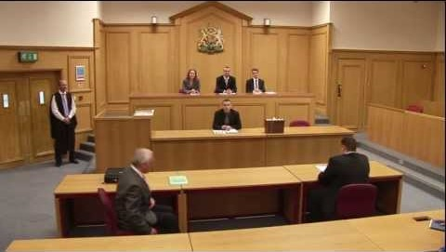
The Magistrates’ court

Slide 14

First hearing in court
Guilty plea:
Prosecution outlines case
Defence solicitor/defendant give mitigation
Magistrates decide sentence
Not guilty plea
Defence arguments set out
Trial fixed
Required witness agreed
Agree any additional evidence and timescales
School informed of court outcome
Case closed due to improved attendance
New intervention agreed if no improvement
School witnesses informed
Additional evidence gathered and served
Trial
Magistrates hear live evidence from defence and prosecution
Magistrates decide if defendant guilty or not guilty
If found guilty, Magistrates impose sentencing

Slide 15

What happens after court?
We will always share the court outcome with schools once the matter has concluded in court
The AEO who has been the LA prosecutor in court will often call you to discuss outcome and any agreed actions or provide advice about how to move forward following the court outcome
The parents being charged and listed for prosecution will not stop the requirement for ongoing support and intervention. It can be several months before a case is even heard let alone concluded in court. Schools must be mindful about new interventions ensuring that we are effectively planning and offering continuing support to pupils and their families
If an ESO’s has been considered appropriate at panel the AEO assigned will be in touch to discuss how this will progress. An ESO can run alongside a court prosecution

Slide 16
Attendance News & Current Events

Slide 17

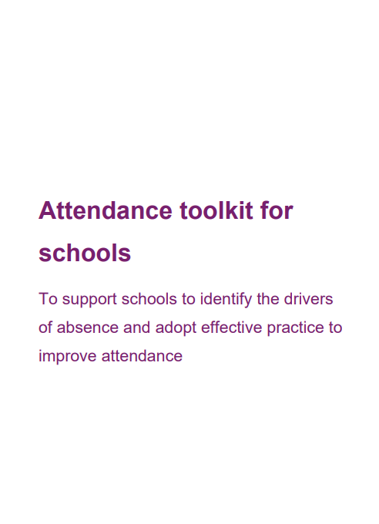
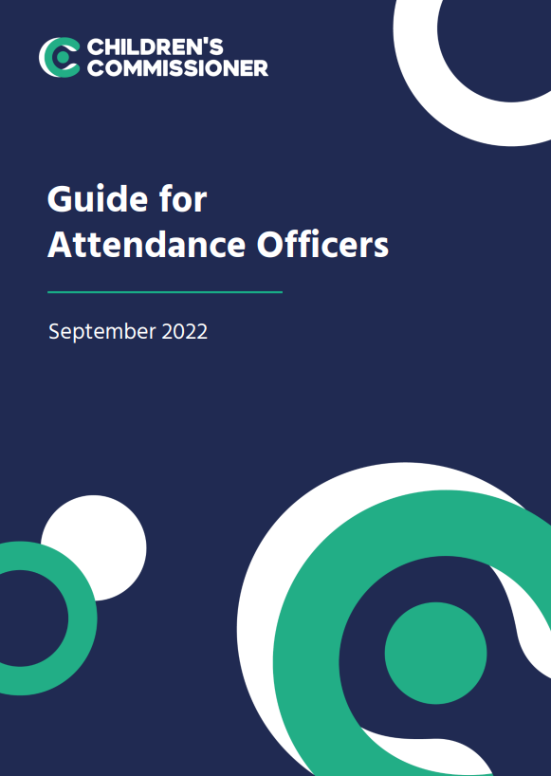
The importance of the first week back at school – a guide for attendance officers | Children's Commissioner for England
Attendance toolkit for schools.pdf

Slide 18


Implementing the National Framework for Attendance – November 2024
We consulted with schools at the beginning of the Summer Term 2024 to inform our response to the introduction of the new national framework for school attendance. We received 104 responses which indicated that, in general, schools felt confident about implementing the requirements of the reforms and we used the results inform the development of guidance and support for schools. Now that the reforms are statutory, we would like to take this opportunity to understand how confident schools feel and identify any additional support needs they may have.
Link to survey – Implementing the National Framework for Attendance

Slide 19
Data sharing & absence returns
In line with The Education (Information About Individual Pupils) (England) (Amendment) Regulations 2024 and the requirements of 'Working together to improve school attendance', all schools are now legally required to share information from their registers with the DfE and the local authority.
Sharing data with the DfE:
From the start of the 2024-25 academic year, schools have a duty to provide attendance information to the Department for Education (DfE) on request. Data indicates that as of 6th September, over 380 have already signed up to share their daily attendance data with the DfE in line with statutory requirements.
Action: It is important that all schools ensure that they have completed this process and for those schools who have not, further guidance on how to share your data is available via this link: Share your daily school attendance data - GOV.UK (www.gov.uk)
Once you are sharing data with the DfE you will have access to a range of tools that will support you to analyse your data. The DfE has published guidance for schools, academy trusts and local authorities on using the monitor your school attendance tool.
Sharing data with the LA:
Further, to facilitate timely collaborative working across partners, all schools are also required to share information from their registers with the local authority. As a minimum this includes:
New Pupil and Deletion returns
Attendance returns
Sickness returns
If your school is not currently sharing data as part of the local arrangements, you will receive an e-mail from attendancedatacollection@norfolk.gov.uk within the next two weeks providing guidance on what you need to do next.
If you already provide attendance data to the LA via the local arrangements, please also contact attendancedatacollection@norfolk.gov.uk if:
You have changed Management Information System provider over the Summer as this will impact on data collection.
You are unsure of who we hold as your contact for the local data feed and/or would like to make a change to the contact.
Notes:
As an LA, we want to reduce the administrative burden placed on schools as well as support them to meet with national requirements. As a result, we need schools to engage with both our local attendance data arrangements as well as the DfE collection of attendance data. This is because the DfE does not currently provide the facility to export data relating to sessional attendance codes which are required for the purpose of the sickness and attendance returns. As the DfE systems develop, we envisage that we will be able to cease the local collection of data and are providing feedback on proposed future development of the national system. Engaging with both systems simultaneously will not add to schools workloads nor compromise information security.

Slide 20
Targeting Support Meetings
Schools are expected to participate in these meetings in line with 'Working together to improve school attendance.' The number of meetings a school is expected to have is outlined within the DfE guidance and depends on the level of the attendance challenges in the school:
If your school's attendance levels were below the national average for your phase, it is expected that you book a TSM for each term
If your school's attendance levels were above national average for that phase, you may if you want only schedule one TSM for the academic year.
We would encourage all secondary schools in Norfolk to book a TSM for each term, whether above or below national average. If your setting's attendance rates are above the national average for your phase and you wish to meet with us termly, you are welcome and invited to do so.
Booking your TSM
To book your TSMs for the academic year:
Visit the following page: NCC Targeting Support Meeting Bookings
Select the meeting type that applies to your school setting.
Select the date you wish to book in the calendar.
Select a time from the available options.
Add your details into the required fields, ensuring to include the name of your school.
Select book and you will receive an email confirmation of your booking.
Please note:
If you wish other colleagues to attend, you can forward the meeting invitation.
When booking a meeting for each term, you will need to repeat this process for each booking.
If a date or time is unavailable that is because the slot is already booked, or the date falls outside of term-time based on the Norfolk calendar.
Notes:
Targeting Support Meetings (TSMs) are essential for early identification and support of pupils with habitual attendance issues, requiring collaboration between schools, local authorities, and partners. Local authorities are expected to organise these meetings regularly with each school to build strong relationships, discuss overall trends and emerging trends in the school's attendance data, identify and agree on action plans for severely absent pupils, and discuss approaches for persistently absent pupils needing multi-agency responses.

Slide 21


Save the date!
Attendance Spotlight Webinars
Will be held approximately on the last Thursday of each month. They will begin at 10.30am and can be accessed via the links in the Upcoming events section of Attendance news and events page. Autumn Term schedule:
27th March 205
24th April 2025
22nd May 2025
3rd July 2025
Countywide Attendance Network Meetings
Spring Network Meeting: Thursday 27th February
Summer Network Meeting: Thursday 26th June
All held in person at The Inspiration Teaching Hub.
Click here to book
Keep up to date with Attendance news and events via:
Attendance news and events page
And by registering to receive weekly emails and updates from the News for Norfolk Education Providers.
Webpage for News for Norfolk Education Providers can be found here.

Slide 22

Further support and guidance can be found at:
School attendance - Schools (norfolk.gov.uk)
If you have any further questions that have not been answered today, then please contact the Attendance Team on 01603 233681 or at csattendance@norfolk.gov.uk

