Slide 1




Attendance Network Meeting
Welcome, the session will start shortly.

Slide 2

Agenda
9.30am | Welcome! Term Headlines
9.40am | Termly Check up
10.00am | Norfolk STEPs – Victoria Marley
11.00am | Sharing best practice: Charis Prevett, Kings Lynn Academy
11.20am | Break and networking
11.45am | Spotlight session: Support First Approach, let's build a road map
12.20pm | Final comments & questions

Slide 3

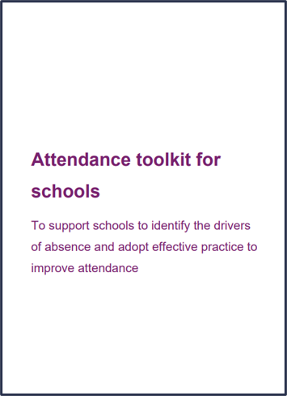
Term Headlines
Childrens Wellbeing and Schools Bill 2024 is currently in the house of Lords and has been through the first 2 readings.
DfE hosting a conference for secondary schools on ‘Breaking Down Barriers to Opportunity: Transforming Attendance’ on Monday 17th March 2025
Norwich Priority Area Partnership Attendance Conference, Friday 28 March 2025, all secondary heads are invited to participate
3086 FPNs have been issued under the new framework since September 2024, with a total of 5298 being issued in total
Have you seen the Attendance toolkit for schools shared by the DfE?
Attendance toolkit for schools.pdf
Notes:
This will see a range of changes for schools and council services. There is a very handy Schools Week summary of the changes and the DFE policy summary adds some more context. There are some changes in terms of the Out of School Register, changes to Elective Home Education and also changes to the hours that children can work part-time. Some of the changes will have additional statutory guidance issued over the coming months. The bill had it second reading last week and is moving to the committee stage. Starts dates of when changes will begin are still to be decided.

Slide 4
Data sharing & absence returns
In line with The Education (Information About Individual Pupils) (England) (Amendment) Regulations 2024 and the requirements of 'Working together to improve school attendance', all schools are now legally required to share information from their registers with the DfE and the local authority.
Sharing data with the DfE:
From the start of the 2024-25 academic year, schools have a duty to provide attendance information to the Department for Education (DfE) on request. Data indicates that as of 6th September, over 380 have already signed up to share their daily attendance data with the DfE in line with statutory requirements.
Action: It is important that all schools ensure that they have completed this process and for those schools who have not, further guidance on how to share your data is available via this link: Share your daily school attendance data - GOV.UK (www.gov.uk)
Once you are sharing data with the DfE you will have access to a range of tools that will support you to analyse your data. The DfE has published guidance for schools, academy trusts and local authorities on using the monitor your school attendance tool.
Sharing data with the LA:
Further, to facilitate timely collaborative working across partners, all schools are also required to share information from their registers with the local authority. As a minimum this includes:
New Pupil and Deletion returns
Attendance returns
Sickness returns
If your school is not currently sharing data as part of the local arrangements, you will receive an e-mail from attendancedatacollection@norfolk.gov.uk within the next two weeks providing guidance on what you need to do next.
If you already provide attendance data to the LA via the local arrangements, please also contact attendancedatacollection@norfolk.gov.uk if:
You have changed Management Information System provider over the Summer as this will impact on data collection.
You are unsure of who we hold as your contact for the local data feed and/or would like to make a change to the contact.
Notes:
As an LA, we want to reduce the administrative burden placed on schools as well as support them to meet with national requirements. As a result, we need schools to engage with both our local attendance data arrangements as well as the DfE collection of attendance data. This is because the DfE does not currently provide the facility to export data relating to sessional attendance codes which are required for the purpose of the sickness and attendance returns. As the DfE systems develop, we envisage that we will be able to cease the local collection of data and are providing feedback on proposed future development of the national system. Engaging with both systems simultaneously will not add to schools workloads nor compromise information security.

Slide 5
Targeting Support Meetings
Schools are expected to participate in these meetings in line with 'Working together to improve school attendance.' The number of meetings a school is expected to have is outlined within the DfE guidance and depends on the level of the attendance challenges in the school:
If your school's attendance levels were below the national average for your phase, it is expected that you book a TSM for each term
If your school's attendance levels were above national average for that phase, you may if you want only schedule one TSM for the academic year.
We would encourage all secondary schools in Norfolk to book a TSM for each term, whether above or below national average. If your setting's attendance rates are above the national average for your phase and you wish to meet with us termly, you are welcome and invited to do so.
Booking your TSM
To book your TSMs for the academic year:
Visit the following page: NCC Targeting Support Meeting Bookings
Select the meeting type that applies to your school setting.
Select the date you wish to book in the calendar.
Select a time from the available options.
Add your details into the required fields, ensuring to include the name of your school.
Select book and you will receive an email confirmation of your booking.
Please note:
If you wish other colleagues to attend, you can forward the meeting invitation.
When booking a meeting for each term, you will need to repeat this process for each booking.
If a date or time is unavailable that is because the slot is already booked, or the date falls outside of term-time based on the Norfolk calendar.
Notes:
Targeting Support Meetings (TSMs) are essential for early identification and support of pupils with habitual attendance issues, requiring collaboration between schools, local authorities, and partners. Local authorities are expected to organise these meetings regularly with each school to build strong relationships, discuss overall trends and emerging trends in the school's attendance data, identify and agree on action plans for severely absent pupils, and discuss approaches for persistently absent pupils needing multi-agency responses.

Slide 6


Save the date!
Attendance Spotlight Webinars
Will be held approximately on the last Thursday of each month. They will begin at 10.30am and can be accessed via the links in the Upcoming events section of Attendance news and events page. Autumn Term schedule:
27th March 2025
24th April 2025
22nd May 2025
3rd July 2025
Previous spotlight topics covered:
WTISA overview and Q&A, Online referral form,
Support First Approach, Attendance Coding
Children Missing Education, Norfolk Steps
Alternative Provisions, Sentencing Guidelines
Countywide Attendance Network Meetings
Summer Network Meeting: Thursday 26th June
All held in person at The Inspiration Teaching Hub.
Click here to book
Keep up to date with Attendance news and events via:
Attendance news and events page
And by registering to receive weekly emails and updates from the News for Norfolk Education Providers.
Webpage for News for Norfolk Education Providers can be found here.

Slide 7

Attendance Network Directory
Staying connected
Are you signed up to the Attendance Network Directory?
By joining the directory, you gain access to contact details for other colleagues who also have responsibility for attendance. Enabling you to stay directly connected outside of the arranged network meetings.
If you would like to join the directory please add your name, setting and email address to the directory sign up sheet located near the refreshments.
Thanks!

Slide 8

Let’s begin with a termly check up
In your groups reflect, discuss and share the challenges you have faced/facing in your setting this term. What strategies have you put in place? Don’t forget to share your successes!

Slide 9




Norfolk Steps
Victoria Marley

Slide 10
What is Norfolk Steps?

Slide 11
Our Steps Core Values
All behaviours are communicative.
Understanding the needs, experiences, feelings, and what makes the CYP an individual can shape consistent, inclusive support plans.
Staff and CYP relationships, underpinned by positive interactions and trust, are pivotal for positive outcomes.
Staff must use proactive responses whenever they can and reactive responses only when reasonable, proportionate and necessary.
All responses must be supportive including those that manage behaviours that challenge or harm.
All actions taken to manage behaviours that challenge or harm must be in the best interests of the CYP, considering their individual needs.

Slide 12

Flourish and Norfolk Steps
Steps Principles:
Consistency is key
Everyone is responsible for promoting positive behaviours
Positive language is prioritised
Positive relationships are vital
Behaviours are communication
Family and friends
Access to learning
The opportunity to lead a good life
Being understood
Building resilience
Respect for their individuality
Feeling safe
Being healthy

Slide 13
Step On
Promoting positive behaviours through:
Whole school culture and ethos
Consistency
Planning
Exploring functions of behaviour
Meeting unmet need
Building relationships

Slide 14
Step On
Can be self directed digital learning for modules 1-7.
Module 8 – physical intervention must be led by a Step On Lead Professional.
Can also be trained as a whole group by the school’s Lead Professional using the digital modules and the additional learning gained through Step On LP training.
The LP training is 2 days and covers content in the digital modules and Module 8.

Slide 15
Module | Aims | Module length | Approx activity time​ | Approx total time
Module 1 – Getting to Grips with the Guidance | Understand key guidance and legislation, including how this relates to our roles in schools | 25 minutes​ | 20 minutes​ | 45 minutes​
Module 2 – Whole School Culture and Ethos | Understand the importance of a positive whole school culture and ethos in relation to wellbeing and behaviour Know how to use the Steps principles to promote a positive whole school culture and ethos | 25 minutes​ | 10 minutes​ | 35 minutes​
Module 3 – Identifying what Underpins Behaviour | Recognise responses to behaviours Explore factors which may underpin behaviours Understand pupil needs | 25 minutes​ | 20 minutes​ | 45 minutes ​
Module 4 – Planning for Positive Behaviour | Explore the concept of inclusion Understand behaviour analysis and planning tools Recognise the importance of consistency between home and school | 30 minutes​ | 45 minutes​ | 1 hour 15 minutes​
Module 5 – Crisis Cycle: Introduction | Explore the link between the brain and behaviour Consider how behaviours can be understood through the crisis cycle | 10 minutes​ | 0​ | 10 minutes​
Module 6 – Crisis Cycle: Baseline, Escalation and Crisis Point | Identify how to support behaviour at different stages of escalation Continue to develop a positive behaviour support plan | 30 minutes​ | 45 minutes​ | 1 hour 15 minutes​
Module 7 – Crisis Cycle: De-escalation and Debrief | Identify how to support behaviour at different stages of de-escalation Understand the importance of reflection, reparation, and restoration Confidently complete a positive behaviour support plan Explore how to make the plans more accessible to staff | 30 minutes​ | 25 minutes​ | 55 minutes​
Module 8 – An Introduction to Physical Intervention | Understand legislation and guidance relevant to physical intervention Recognise safe Step On physical intervention techniques Consider the continuum of physical intervention techniques and when they are appropriate to use Know what actions to take following the use of physical intervention | 35 minutes​ | 1 hour 30 minutes​ | 2 hours 5 minutes​ (dependent on prior experience and number of colleagues)
Total: 7 hours 45 mins
Securing Successful Steps Strategies in School (only SLP) | Understand the Step On e-learning content and flexible approaches to delivery Review current practice in your school to identify areas of strength and priority areas for development Understand how to support your school to consistently embed Steps approaches | 15 minutes | 0 | 15 minutes

Slide 16
Functions of Behaviour
All behaviour is communication. The behaviour itself can be positive, negative or apathetic. Our role as professionals when understanding behaviour that challenges us, is to decipher what the CYP is trying to tell us.
We need to know the function of their behaviour.
Sensory | Tangible | Escape | Attention / Connection
Hyper or hypo arousal can lead to people engaging in behaviour to help them manage sensory input from their environments. This can be closely linked to ‘escape’ behaviours. May also include hunger, thirst etc | To gain a desired object, activity or experience. | To avoid an overwhelming activity, experience or sensory trigger. This also covers avoiding demands and managing accumulated stress. | To gain attention from, or connection with, another person or people. This attention could be positive or negative and be from someone specific or anyone available.
*

Slide 17

Functions of Behaviour
ESCAPE | ATTENTION / CONNECTION
Refusal to engage in work Pushing work away or destroying books and resources Avoiding sitting at desk or workstation by walking around Hiding (in classroom or elsewhere) Exiting lessons or presenting in a way that is reinforced by this Absconding / running away (not looking to see if they are followed) Hands over ears, eyes closed, head down on desk Reluctant to go to a specific place Reluctance to return to an environment (lateness, truancy) | Need to seek out support from staff often – won’t attempt a task without an adult present Talking to peers, including at inappropriate times e.g. during teacher input Low-level disruptive behaviours e.g. tapping, fidgeting, calling out Disengagement with learning – struggles to overcome challenges and gives up easily Appears defiant, hard to motivate, requires lots of engagement from staff to focus Makes eye contact with staff when running away Persistently seeking physical touch and being overly close Frequently reporting perceived or actual injuries and/or illness (if actual it can also be linked to a need to escape the ‘pain’ whether physical or psychological)

Slide 18
Functions of Behaviour
SENSORY | TANGIBLE
Unable to sit still – often walking around the room at inappropriate times Fidgety whilst sitting; changing position Tapping, doodling, fiddling with objects on the table Rocking back and forth on a chair Covering ears and closing eyes – attempting to shut out sensory input Chewing, spitting and dribbling | Attempts to gain access to a specific object or activity Shouting demands Frustration; shown by swearing, throwing objects or damaging own or others’ items Hurting others to gain access to an item / object Difficulties around sharing Perceived or actual lack of having objects at home (taking items home)

Slide 19
Proactive Strategies
More examples of supportive strategies can be found on the padlet
The functions of behaviour tell us about the CYP unmet needs.
Once you have identified the function of the behaviour, you are better able to support the CYP proactively to meet these needs in a positive way to avoid escalating low-level challenges into a crisis.
Sensory | Tangible | Escape | Attention / Connection
Sensory Diet Allow the CYP regular, planned opportunities to meet their sensory needs (some may also need ad-hoc opportunities). | Positive, reward-based behaviour strategies Using a reward-based system may motivate CYP when they are not intrinsically driven. Rewards must be regular and achievable. | Allow safe and structured opportunities to exit overwhelming situations E.g. ‘break out’ card for use in lessons, adjust timetable if appropriate, quiet / safe spaces for meals and unstructured times. | Avoid ‘planned ignoring’ Notice the low-level behaviour early and meet the need e.g. by asking them to help you with a job, distraction / redirection.

Slide 20
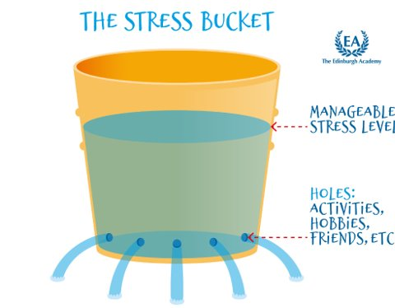
Stress Bucket
Notes:
The stress bucket can be useful to help understand how some children may become overwhelmed by a build up of stressors. CYP who have had traumatic experiences may have smaller buckets, which can lead to their buckets ‘over-flowing’ much more quickly. We can help alleviate these stressors through planning and providing positive experiences.

Slide 21


Roots and fruits
behaviour
feelings
experiences
*
Notes:
This diagram emphasises the link between experiences, feelings and behaviour.

Slide 22
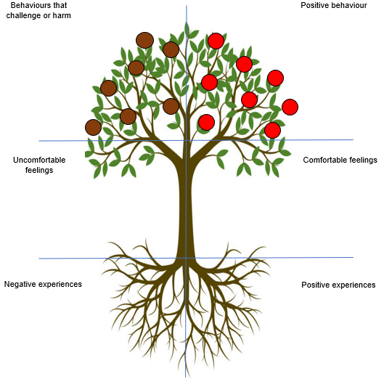
Roots and fruits
Think of a CYP who is currently struggling with their behaviour and complete the ‘roots & fruits’ analysis.
Notes:
This can be presented as a generic version – colleagues can discuss and complete
You may wish to present this as an activity around specific children. Staff can be grouped to do this. Ensure you have a copy of a blank plan available for ech of the CYP being discussed.

Slide 23
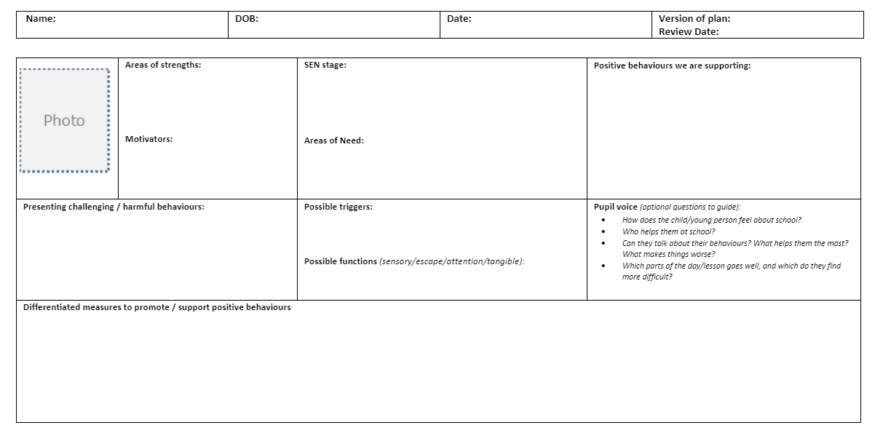
What we need to know:
Notes:
RA

Slide 24
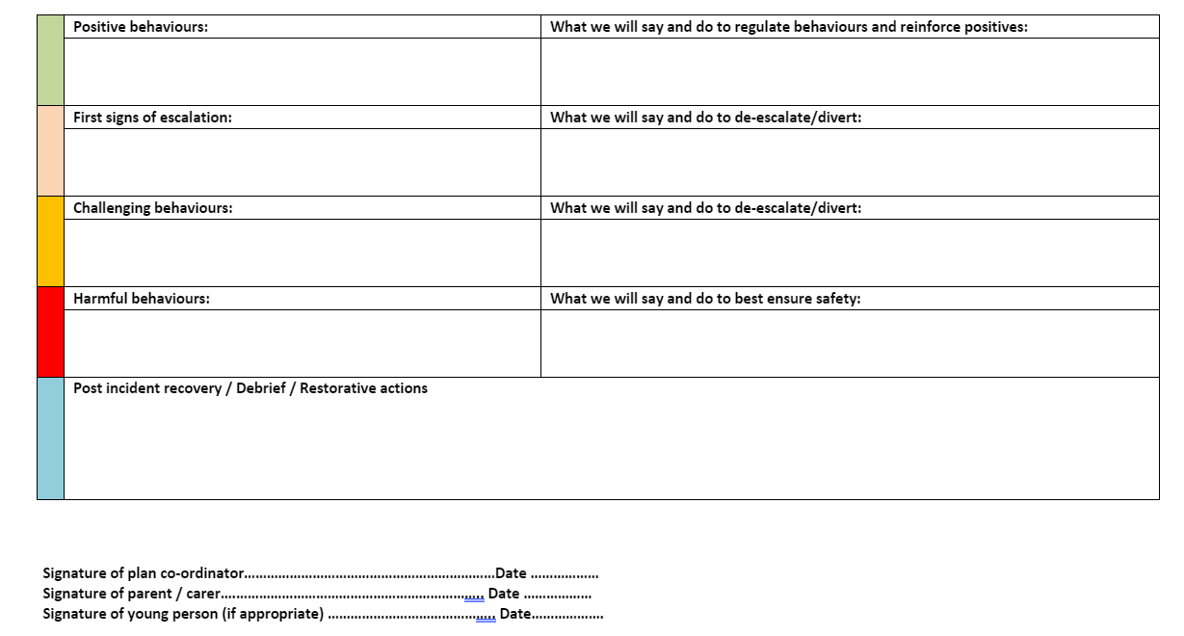

Slide 25
Step Up
Training in restrictive physical intervention (restraint).
All techniques have been risk assessed for physical/psychological risk.
This can be trained by Step Up Lead Professionals in schools/settings.
Step Up Lead Professional training takes 1.5 days.
Step Up LPs MUST have already be Step On LPs.
There must be 2 Step Up Lead Professionals leading training with a maximum of 12 staff who have completed modules 1-8.

Slide 26
Restrictive physical intervention should only be trained where there is an audited need.
Any RPI must be:
Last resort
Only in response to foreseeable or actual harm
Least intrusive (use of minimal force necessary)
For the least amount of time
Reasonable, proportionate and necessary

Slide 27
Norfolk Steps: The local picture
Currently we have:
268 Lead Professionals within primary schools.
36 Lead Professionals within secondary schools.
30 Lead Professionals within Early Years settings.
84 Lead Professionals within special schools.
129 Lead Professionals within non-mainstream services.

Slide 28
The Norfolk Steps Offer
Digital Learning
Norfolk Steps is currently fully funded for all mainstream and specialist schools.
Schools have access to Steps Lead Professional training for up to 2 members of staff alongside the digital e-learning.
Primary schools can access Step On and Step Up Lead Professional training. Secondary schools can access Step On Lead Professional training only.
Non-mainstream settings and specialist services can access adapted Step On and Step Up Lead Professional training.
Step on & Step up Lead Professional training
Ongoing supervision and Next Steps

Slide 29
How to access training?
All schools can sign up to Norfolk Steps training through S4S

Slide 30
Norfolk Steps Timescales
Step On should be refreshed every two years
Step Up should be refreshed annually
Step On and Step Up Lead Professionals attend annual refreshers (Next Steps) to maintain accreditation.

Slide 31
Role of Steps Lead Professional
Deeper understanding of the Step On digital content, the evidence base behind it and how to support staff engagement with their learning
Impact whole-school change
Offer practical support in the classroom, inc. Step Up as needed
Reduce incidents of RPI
Increase inclusive practice, decrease exclusions.
Build staff confidence / resilience
Guide staff who are having difficulties with CYP behaviour and need more intensive support
Improve lifelong outcomes for CYP

Slide 32
What we do:
Train Lead Professionals
Provide supervision for Lead Professionals- this may be
looking at planning,
discussing specific behaviours,
advising on training
practising physical/restrictive physical interventions
Constantly update training materials and padlets
Provide some Step Up training where schools currently have no Step Up LP (this is charged)
Deliver Lead Professional training to other counties (inc. Suffolk, Buckinghamshire, London)

Slide 33

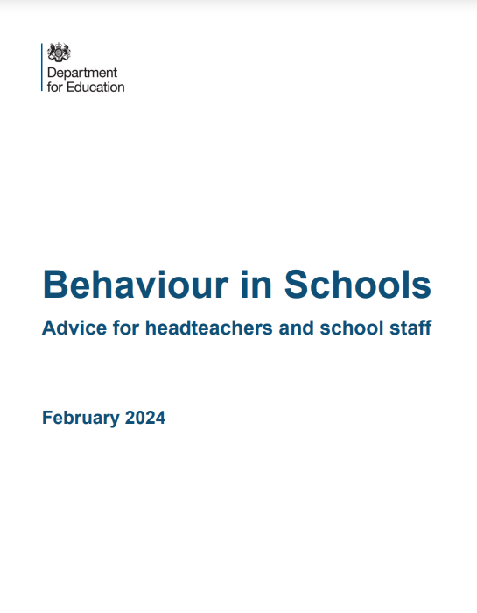

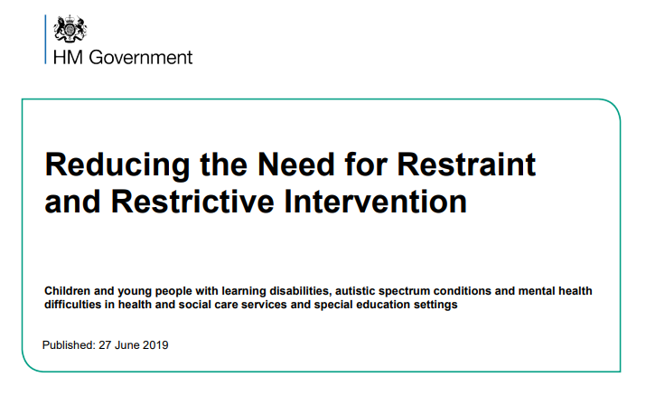

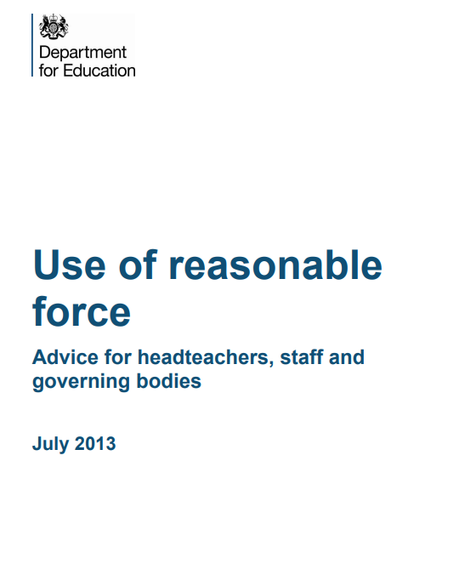
Relevant guidance to support positive behaviour
Mental health and behaviour in schools
SEND Code of practice
Teachers’ Standards
Behaviour in Schools
Use of reasonable force
Reducing the Need for Restraint and restrictive Intervention
*
Notes:
These documents are important guidance - SOLPs need to ensure that guidance relevant to their school/setting is also presented and discussed as necessary.
SOLPs may decide to remove some of the examples given above and insert images of the guidance they wish/need to include.

Slide 34
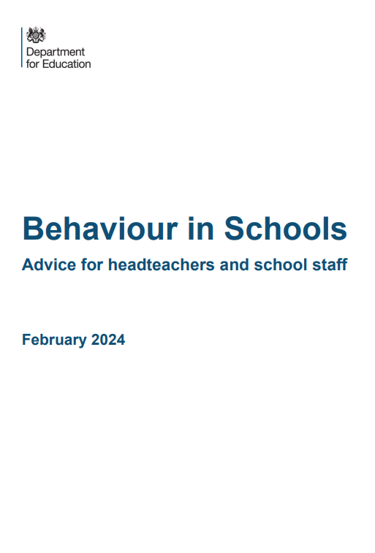
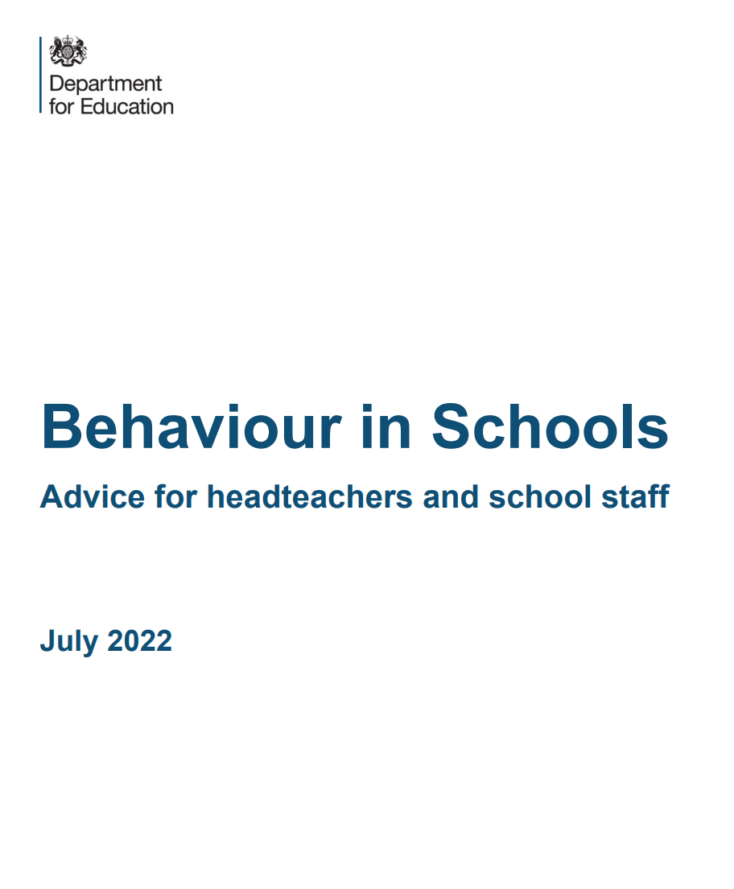
Behaviour in Schools
Schools should anticipate likely triggers of misbehaviour and implement preventative support.
The priority to ensure safety and to restore a calm environment.
Taking disciplinary action and providing appropriate support should occur at the same time if necessary.
Contributing factors should be considered and alternative arrangements can be considered where this would be more effective for a particular pupil.

Slide 35

Keeping Children Safe in Education:
Safeguarding and promoting the welfare of children is defined for the purposes of this guidance as:
• protecting children from maltreatment
• preventing the impairment of children’s mental and physical health or development
• ensuring that children grow up in circumstances consistent with the provision of safe and effective care, and
• taking action to enable all children to have the best outcomes.

Slide 36
Use of Reasonable Force
Reasonable force can be used to prevent pupils from hurting themselves or others, from damaging property, or from causing disorder.
Schools should NOT have a ‘no contact’ policy.
Use of physical intervention must be reasonable, proportionate and necessary.

Slide 37
Reducing the Need for Restraint and Restrictive Intervention
Proactive, preventative, non-restrictive approaches.
Any restrictive intervention must be based on an assessment that intervention is likely to cause less harm than not intervening.

Slide 38

Human Rights Act
Use effective measures to prevent harmful behaviours and protect the rights of others.
If physical intervention, or restrictive intervention is used when it is not reasonable, proportionate and necessary, this might be breaching the pupil’s human rights.

Slide 39

Ofsted: Positive environments where children can flourish
Staff should find the least intrusive way possible to support and empower pupils and keep them safe whilst balancing physical safety with the impact on emotional well-being.

Slide 40
Legally defensible position
Legal defence for the use of force is based on evidence that the action taken was justified and that it was:
Reasonable
Proportionate
Necessary
‘No more than absolutely necessary’ (Human Rights Act 1998)
‘In the best interests of the child’ (Children Act 1989 and 2004)
“What would you want someone to do in similar circumstances if this was your child or other loved one?” (HSW Act 1974/1999)
Notes:
Must be shown in all training/refreshers

Slide 41

Attendance at King's Lynn Academy
Charis Griffiths-Pugh
Assistant Principal

Slide 42


About me
Who am I?
Who am I not?
Assistant Principal for SEN and Attendance
15 years at KLA
SENCO
DSL
Student Voice
Persistent and stubborn!
The oracle!

Slide 43
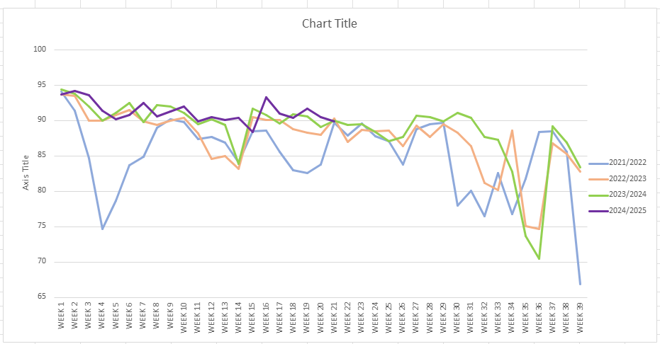
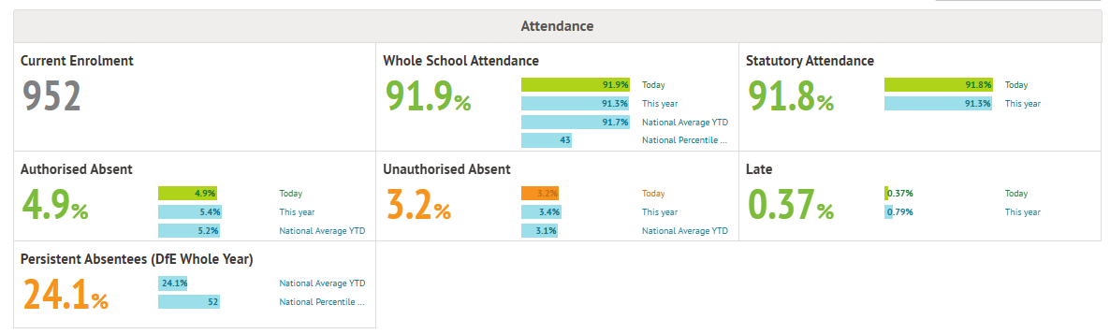
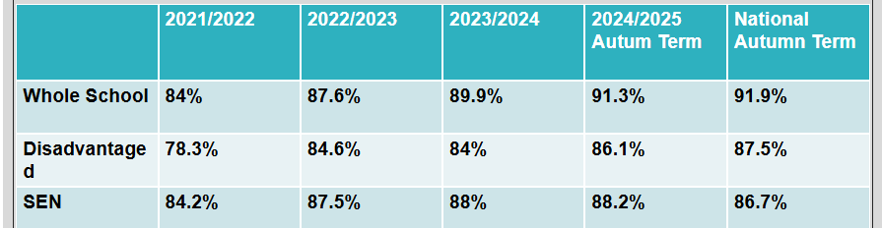
About KLA
91.3% attendance this year
24.1% Persistent Absence
Journey of improvement
Approximately 1/3 PP
Approximately ¼ SEN (6% EHCP)
Still battling COVID legacy??

Slide 44


KLA's systems, processes and support structures
No attendance officer – Attendance belongs to us all!
Various roles who play a hand in attendance
    Admin support – text messages and absence line.
    Non-teaching Heads of Year
    Family Support Workers
    SG/SEN/Pastoral Teams
    Teaching staff
Pastoral/Wellbeing/SEN/Behaviour support
    Make a Change (MAC)
    Catch-Up Base (CUB)
    Forward Step
    Heads of Year

Slide 45

To court or not to court... Does Legal Action make a difference?
FPNs used for term-time holidays
Court Action is rare
The process is what is important – the meeting with the parents and making plans with them and the students has far more impact.
Relationships are key!

Slide 46


IN SUMMARY – What has worked for us(so far)
We cannot work in islands – everyone has a role in attendance improvement! No one person can make the difference on their own!
Pastoral Teams play a huge role in attendance
Legal action isn't a cure for the problem in the majority of cases
However, the process is!
Relationships and persistence make the difference. It’s a step-by-step, day-by-day process.

Slide 47

20-minute comfort break,
See you back soon!

Slide 48

Support First Approach
New resources
Roadmap poster for parents
SFA chronology template
SFA process for schools

Slide 49
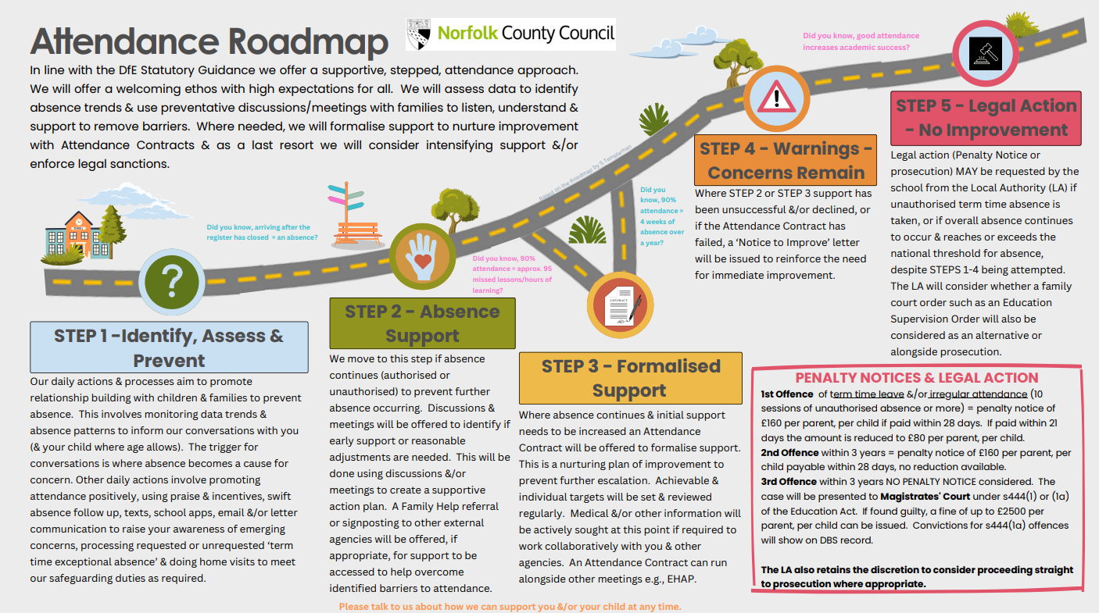

Slide 51
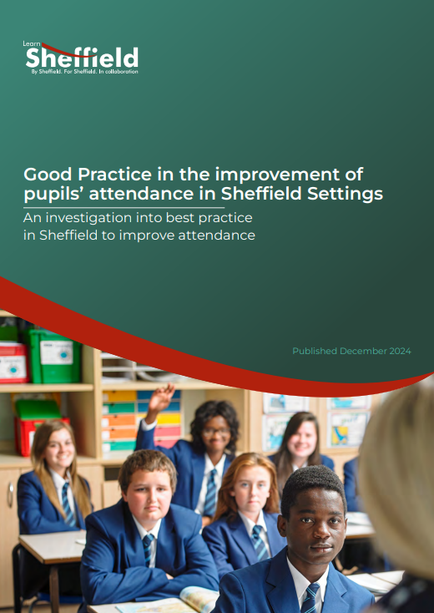
Let’s Network
Sharing best practice from another LA
Good Practice in the improvement of pupils’ attendance in Sheffield Settings – An investigation into best practice in Sheffield to improve attendance

Slide 52

Learn Sheffield committed to undertake a piece of work to look at strong practice in the city and produce a report on the learning from this to share with there partnership settings and more widely. They used a range of contextual data to identify a group of schools who appeared to be outperforming their context with regards to pupils' attendance.
Conclusions from the study:
Work on attendance is never done!
Attendance must be a focus with every member of staff, every parent and every pupil
There is no magic wand
Recommendation from the study include:
Senior Attendance Champions network
Notes:
Learn Sheffield committed to undertake a piece of work to look at strong practice in the city and produce a report on the learning from this to share with there partnership settings and more widely. They used a range of contextual data to identify a group of schools who appeared to be outperforming their context with regards to pupils' attendance. At the setting visits a set of key questions about the attendance processes and practice which has enabled schools to maintain strong attendance were discussed with leaders. In addition they looked at schools responses to the latest changes resulting from WTISA. The schools recognised that many agencies are often working under pressure and that resources are low. Schools made thoughtful comments about the impact of too much paperwork. They were concerned about the lack of action when they reported educational neglect. Some conclusions from the study were that

Slide 53
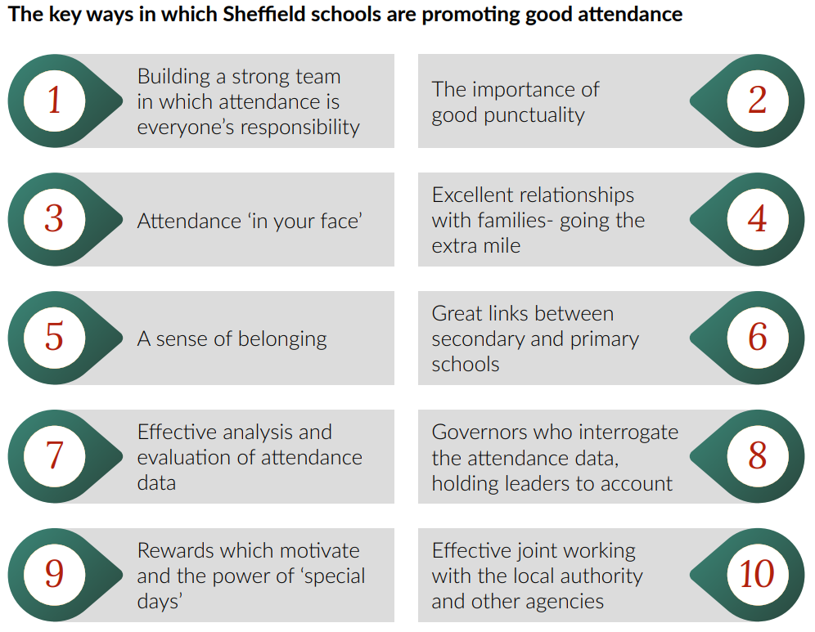

Slide 54

Building a strong team in which attendance is everyone’s responsibility
“Attendance is not only the responsibility of the pastoral or inclusion staff”
Discuss: what does ‘attendance is everyone’s responsibility’ look like/work in your setting?
Notes:
The report states that schools interviewed typically have a senior leader who is their Senior Attendance Champion as well as an attendance team who manage phone calls, the administration of registers, paperwork for fines and penalty notices, and knock on doors. Several schools where attendance is strong given their context have allocated financial resource to increasing the number of staff in their attendance team. For example, employing an additional admin assistant to complete the administration of attendance, including first day calls, can allow other members of the team to spend more time knocking on doors and meeting with families. One setting has extended the number of working weeks of the admin team to give more time to manage legal work.
Most schools talk about pastoral or inclusion team involvement, as well as engagement of form tutors or class teachers in promoting good attendance. This works better in some schools than others. Where attendance is genuinely everyone’s business and every team contributes to meetings in which attendance takes centre stage on the agenda, there is greater impact. Schools speak of weekly inclusion/pastoral/year group meetings in which attendance of individual pupils is discussed and methods to reduce barriers to attendance are agreed and monitored. In primary schools, attendance is a focus at pupil progress meetings when the attendance lead, class teacher, pastoral care and the SENDCo work together to discuss how they can best support each pupil. The impact of actions taken to improve a child’s attendance is then reviewed at the next pupil progress meeting. Attendance is not only the responsibility of the pastoral or inclusion staff. Attendance can form a focus of line management meetings between senior and curriculum leaders. For example, where an agenda item focusses on Key Stage 4 attendance and concerns leading to missed lessons and incomplete coursework. One setting has a WhatsApp group which informs all senior, pastoral and admin staff of who is away on each day. The names are written on a whiteboard and photographed. All staff are invested in good attendance.
The engagement of the SENDCo alongside the Senior Attendance Champion is important in monitoring and encouraging the strong attendance of pupils with SEND. The attendance of pupils with SEND, especially those with an EHCP, is an area of concern. Where the SENDCo helps families and pupils to understand the barriers to good attendance and identifies ways of mitigating against these barriers, attendance can improve. In some schools this has involved the use of the school’s additional provision for vulnerable pupils or specific rewards for attendance over a set period, say 20 days. In secondary schools, form tutors are typically involved in discussing attendance with their pupils. Where this discussion focuses on lessons or days missed or the impact on future outcomes it is likely to have more impact than the use of percentages. The greatest impact is where form tutors are consistent in following the school’s expectations in these discussions. Pupils often record their own attendance in planners or booklets. In some schools, form tutors record on a tracker that they have had conversations with their pupils about attendance. Schools do not assume consistency – rather there is quality assurance of the impact of the work in tutor time, including the work on attendance. Class teachers in primary schools know well which pupils are persistently absent or might have severe absence. Staff are expected to welcome pupils back straight away following a period of absence. One setting found that it helped if the teacher rings home if a child has more than one day off; talking about what they were doing in classsaying, ‘it will be great to see your child tomorrow, we will be doing….’ One to one intervention works well with individuals who need additional support to have good attendance. Pupils are matched up with an adult that knows them best so they feel they have someone to turn to if they are worried. Many schools say it is more important to make sure pupils feel ‘important and special,’ than giving ‘massive gestures and big prizes.’ For example, a boy with 44% attendance in Year 10 has almost full attendance in Year 11, as a result of intensive work with a pastoral staff member. In one setting, all (upper pay scale) UPS staff become mentors for a persistently absent (PA) pupil. The PA pupils have a £100 raffle every half term. They receive a raffle ticket each time they meet their mentor. This has engendered a culture of friendliness and belonging between staff and pupils and has impacted positively on attendance. Staff receive training about the importance of attendance and the attendance of different groups. Attendance is referred to in staff meetings and briefings. One setting has even quizzed staff on attendance matters. Many staff are trained in Emotional Based School Avoidance (EBSA). One school refuser’s attendance improved from 4% to 85% using these techniques

Slide 55
The importance of good punctuality
“telling pupils ‘its great to see you’ when they return to school, rather than ‘where were you yesterday?”
Discuss: what does your setting do to encourage good punctuality? What is the role of each member of the school?
Notes:
A feature of the schools visited was their insistence on good punctuality. Schools recognise the negative impact of U codes on overall attendance. Senior leaders maintain a high profile at the start and end of each day. Every setting focuses on positively encouraging and reinforcing good attendance – telling pupils ‘it’s great to see you’ when they return to school following an absence, rather than ‘where were you yesterday?’ Schools are typically very strict about closing gates and doors at the start of the school day. In secondary schools, poor punctuality is likely to result in a same day or next day detention (with some pupils exempt for extenuating circumstances). Leaders’ analysis shows that this is impacting on improved punctuality. In primary schools, the policy is often to be supportive in the first instance, but then to give parents and pupils a clear time limit for improvement. Most schools have a policy of always asking the parents why children are late, when they bring their child to school. Several schools use social media and seesaw messaging to thank parents for being on time, but also to highlight how many children were ‘late for their learning.’ Schools take great pains to develop a personalised approach to improving punctuality. For example, one pupil was motivated to arrive at school on time when they were allowed to join the school football club as a reward. Free breakfast clubs are a common feature of the schools visited. Some schools find that giving pupils jobs in school, such as delivering milk to each class, is helping to improve punctuality. Analysing punctuality allows schools to open the dialogue about routines in the morning. Ringing families with poor punctuality at 8am helps pupils to arrive on time. In one secondary setting, year leaders and teaching assistants call ten pupils each at 8am. This has improved punctuality and attendance.

Slide 56
Attendance ‘in your face’
“In one school the attendance team have moved offices to be front facing for parents and pupils”
Discuss: what have you implemented in your setting so that attendance is ‘in your face’
Notes:
The report reads:
It is interesting when arriving at a setting to walk the route of a parent visiting into a meeting room and similarly the route of the pupils to their first destination. In some schools the importance of good attendance can be seen everywhere: on the gate, on the fence, in the reception or entrance, in the waiting room, in the meeting room, on classroom doors, on classroom walls, on the staff room noticeboard. One note about percentage attendance of classes or form groups on the door of rooms- some classes will never reach the highest attendance because of the absence of one or two pupils in that group. This therefore needs to be done in a thoughtful way.
Schools make good use of pop-up banners, plasma screens and projected noticeboards to reinforce the messages about good attendance and where appropriate identify those who have strong attendance. One school’s pop-up banner in the entrance hall linked the percentage absence to the number of days off, the number of lessons missed and the consequent life chances.
In a setting where pupils line up at the start of the day and after break and lunch the leader overseeing the lines tells the story of attendance –for example, which class has improving attendance. In one setting the attendance team have moved offices to be front facing for parents and pupils. This has successfully raised the profile of the attendance team and their work. It is important that school staff, parents and pupils know who the attendance team are and what work they do.

Slide 57
Great links between secondary and primary settings
“All schools should work with local communities to help remove the barriers to attendance that families experience”
Discuss: how do you work with your feeder schools?
Notes:
Some secondary settings have effective links with their feeder primary schools. This enables information to be shared when Year 6 pupils move up to secondary school. Some secondary settings use the data about those pupils with poor attendance to plan early induction and interventions. This may include meetings with parents and pupils before they start school to develop relationships and set standards or additional activities in school pre- September to help pupils to feel safe and settled in their new environment. The benefit of such interventions is that pupils know adults who will work with them in Year 7. This helps pupils to feel that they belong. The pupils may enjoy activities which encourage them to come to school at the start of Year 7. Data from primary settings means that attendance teams in secondary settings can be ready to intervene rapidly when any pupil with previous poor attendance show signs of repeating that pattern.
One setting has identified the 26 pupils in Year 7 who were PA in primary school. Their names were circulated to staff so that staff could encourage these pupils’ good attendance. On the second day of absence in Year 7, the first letter is sent parents and parental meetings follow. Effective links between primary and secondary settings looking at shared families can mean that tactics for working with families can be agreed across schools to help families overcome barriers to good attendance. If the relationships between schools work especially well it is possible that the workload of attendance teams can be shared. Links between safeguarding leads across primary and secondary settings also supports important knowledge sharing.
Some links between primary and secondary settings are in their infancy. Paragraph 48 of Working together to improve attendance sets clear expectations for information sharing between schools and other agencies: ‘All schools should work with local communities (including voluntary and community groups) to help remove the barriers to attendance that families experience. In some cases, families will experience the same or similar barriers to attendance for multiple children who attend different schools in the area. As such, it is of mutual benefit for such schools to work together where possible. This will be particularly beneficial in supporting transition between feeder schools

Slide 58
Rewards which motivate and the power of ‘special days’
“where settings use rewards successfully… find out what reward pupils want”
Discuss: what do you do in your setting to reward and motivate? Is there something you have heard today that you might try?
Notes:
Leaders have different approaches to the use of rewards for good attendance. One setting regards good attendance as an expectation and does not reward pupils for their attendance- however, they do make sure that pupils are recognised by staff when they return from absence or when their attendance improves. ‘Staff noticing shows pupils you care.’ The setting does in common with some others, reset attendance to 100% at the start of every half term. After October half term, every pupil is given a 100% attendance badge- because at that point everyone’s attendance is 100%. Pupils must return badges to the head teacher if they are absent for a day. Some settings regularly consult pupils about what rewards they would like. For example, this resulted in the relaunch of the online rewards shop and merits for attendance. Other examples include:
• A vending machine is extremely popular at one setting. Pupils receive a set number of tokens to put into the machine for good attendance and greatly enjoy choosing a prize from the vending machine.
• A free visit to Yorkshire Wildlife park for all pupils with 97% and above attendance. • Each week pupils with 100% attendance in each class have the opportunity to take home a cake to share with their family.
• Most improved attendance awards; celebrate whole class awards first, second and third. Top attendance per class is celebrated on Dojo. Half termly awards for the most improved and 100% pupils.
• At one school pupils respond well to initiatives such as: HERO (Here, every day, ready, on time) certificates: Every week the class with the most improved attendance are celebrated, and raffle tickets – try to make sure every child has a chance to win.
• One setting previously had an 100% attendance rewards/special events – but parents did not feel it was fair and it did not have much impact. The setting now focuses more on improving the attendance of 91-93% attenders. The setting finds a points system is helping attendance improve. Pupils are given points when they attend school for a full week and can use their points to save up for a range of prizes (chosen through pupil voice), such as a family trip to a local soft play area, Disney on Ice tickets and Sheffield Steelers tickets.
Pupils and parents value positive phone calls home.
• Reward for 20 days attendance in a row (improving attender).
• Big end of year prizes for good attendance and behaviour such as a bouncy castle, funfair, seaside visit, cinema day.
Where settings use rewards successfully to improve attendance the common approach is to find out what rewards pupils want and also to ensure equality of opportunity so that rewards are accessible to all. Settings have recognised that pupils attend better when specific events are taking place. For example, one setting ran a ‘heart start’ day for Year 7. 98% of the year group attended on that day. Similarly, attendance at Key Stage 4 improves during mock exams. Whilst it is not possible to have ‘special days’ all the time, it would be possible to place individual special days at times where absence was typically high. Training days can also be planned strategically, although it is important that all staff have the opportunity to attend the training day, if for example it is calendared to match a religious festival

Slide 59
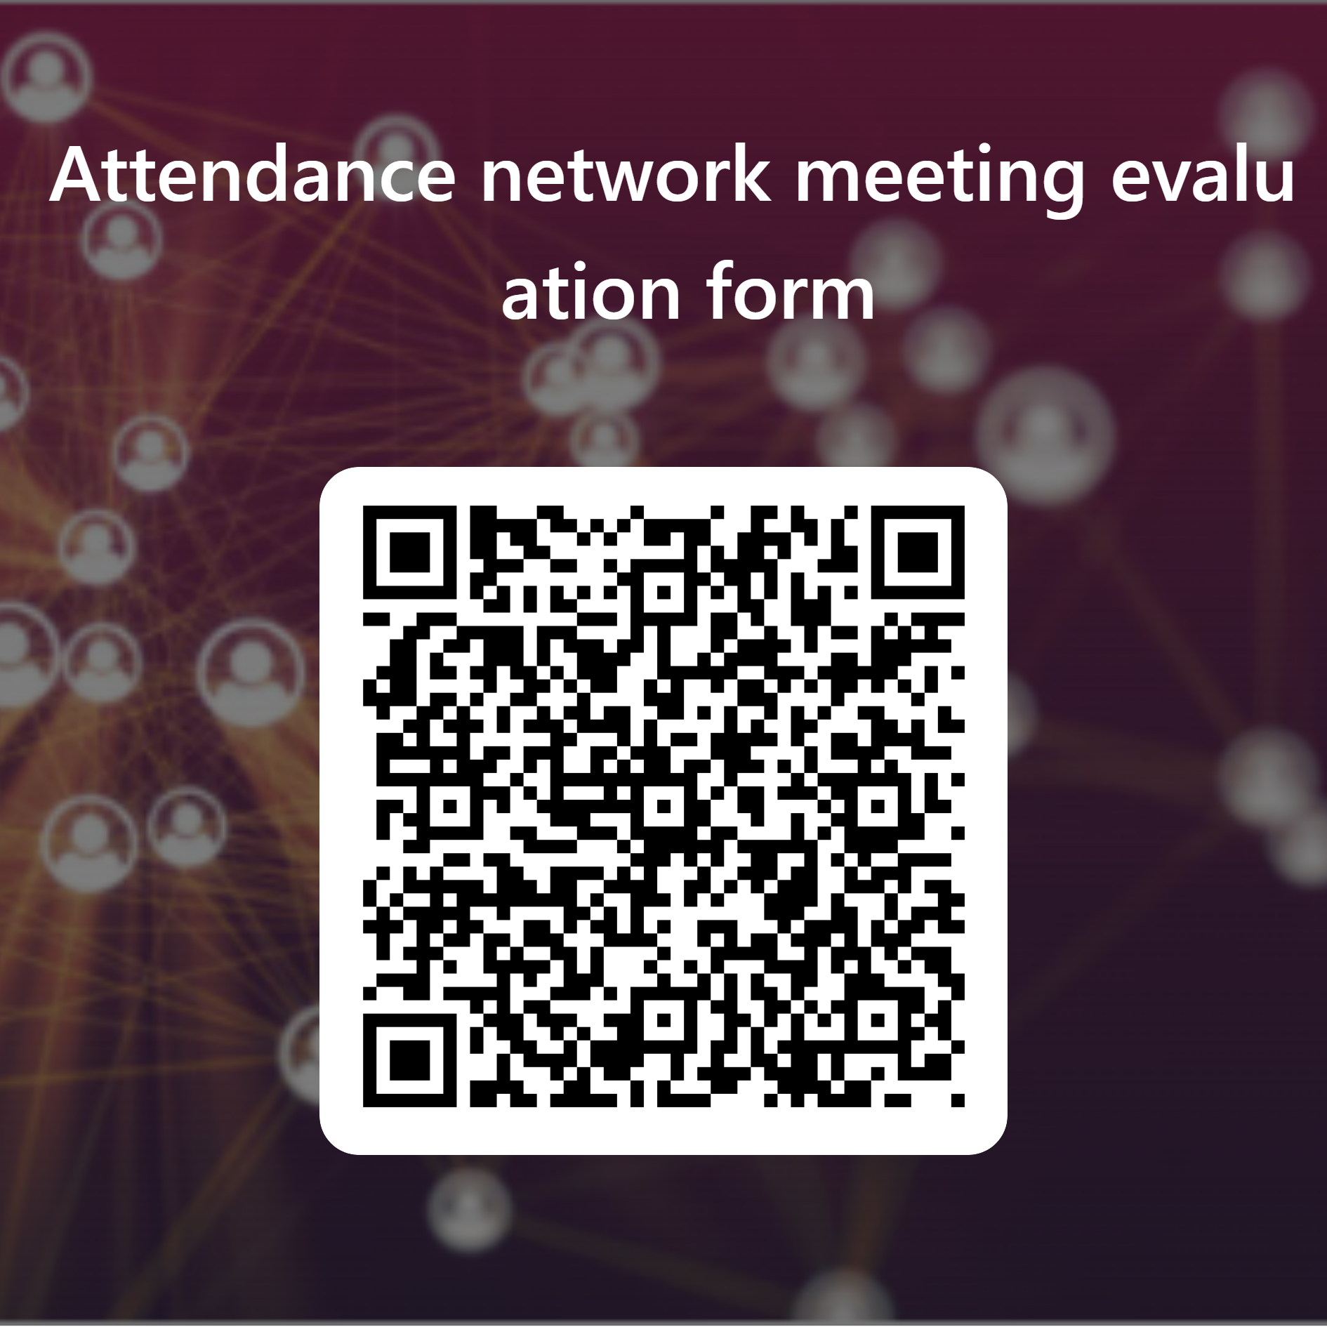
Evaluation
Please take 5 minutes now to complete our evaluation form

Slide 60

Further support and guidance can be found at:
School attendance - Schools (norfolk.gov.uk)
If you have any further questions that have not been answered today, then please contact the Attendance Team on 01603 233681 or at csattendance@norfolk.gov.uk

