Slide 1

Notes:
Please customise, add or remove slides and information to reflect how the Summer Reading Challenge is run locally.

Slide 2


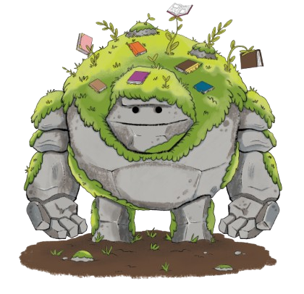
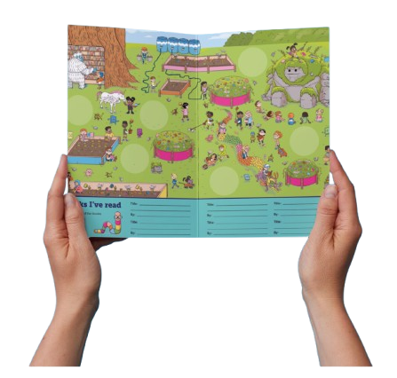
Take on the Challenge!
Go to your library this summer to sign up and get your Story Garden sticker booklet…
Read ANYTHING you like
Collect stickers from your library and add them to the magical garden as you read more
Rewards for meeting your goal!
Notes:
You set your reading goal, choose anything you like to read (can be a book, comic, magazine, audiobook, eBook, fact book etc.) and collect rewards for your reading. You can sign up at the library or online and it’s FREE to take part. When you join the Summer Reading Challenge at the library, you’ll get your very own collector’s sticker booklet where you can record your reading and add your stickers.

Slide 3
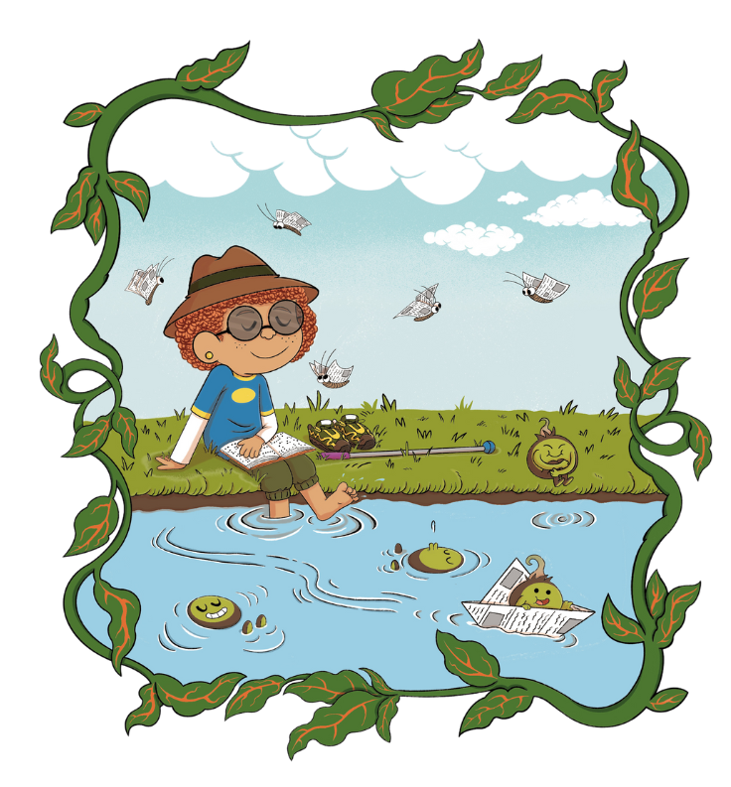
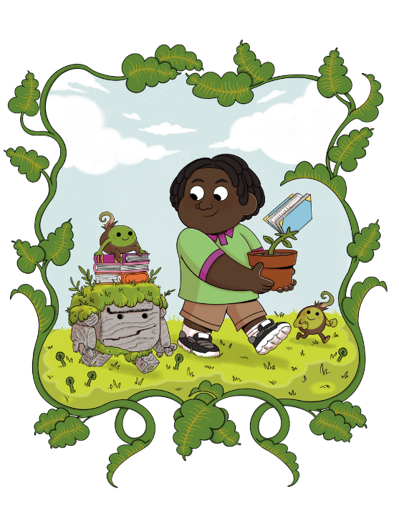
Magical Nature Theme
Notes:
This year’s Challenge is called Story Garden, and it’s all about nature, exploring the outdoors, exploring magical spaces, storytelling - and reading! Your library can help you find new books to enjoy and we’ll be hosting lots of events and activities connected to nature and wildlife, that will be sure to inspire your next story adventure.
Explore the magical connection between nature and reading with our Story Garden characters! You'll meet them inside your collector’s sticker booklet and spot amazing fantastical creatures and plants dotted around the garden – all illustrated by this year’s special guest award-winning illustrator, Dapo Adeola. Come along to your library for sign up day to collect your own sticker booklet and start reading!

Slide 4
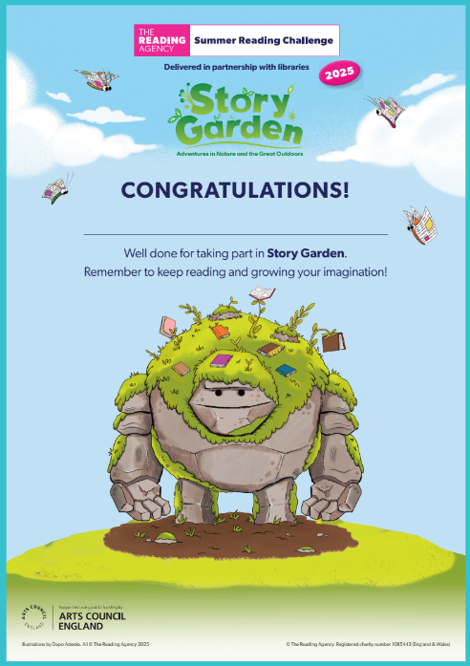
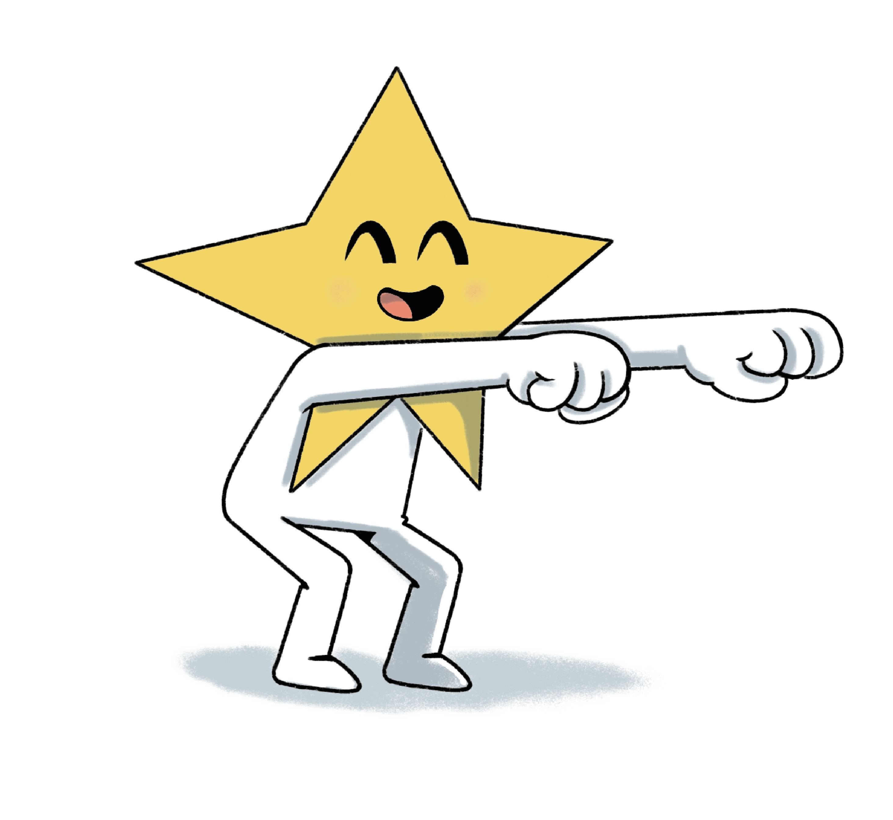
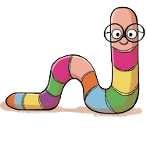
Complete the Challenge to be awarded your certificate of achievement!
Why not challenge your friends to take part too and compare your fave books?
Notes:
Most library authorities will also give medals to children who complete the Challenge, but not all. Please check with your local library service. ​
Please feel free to talk about other incentives offered by your local library service. [Please ensure this slide reflects the rewards/incentives offered by your local library service in 2025]

Slide 5

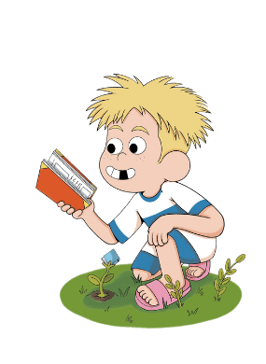
When does it start?
Insert date the Challenge begins at the library​
Insert date the Challenge ends at the library
Insert local library address​
Insert opening hours ​
Notes:
[Please edit to reflect your local start/finish dates and include any information on launch events and summer activities]

Slide 6
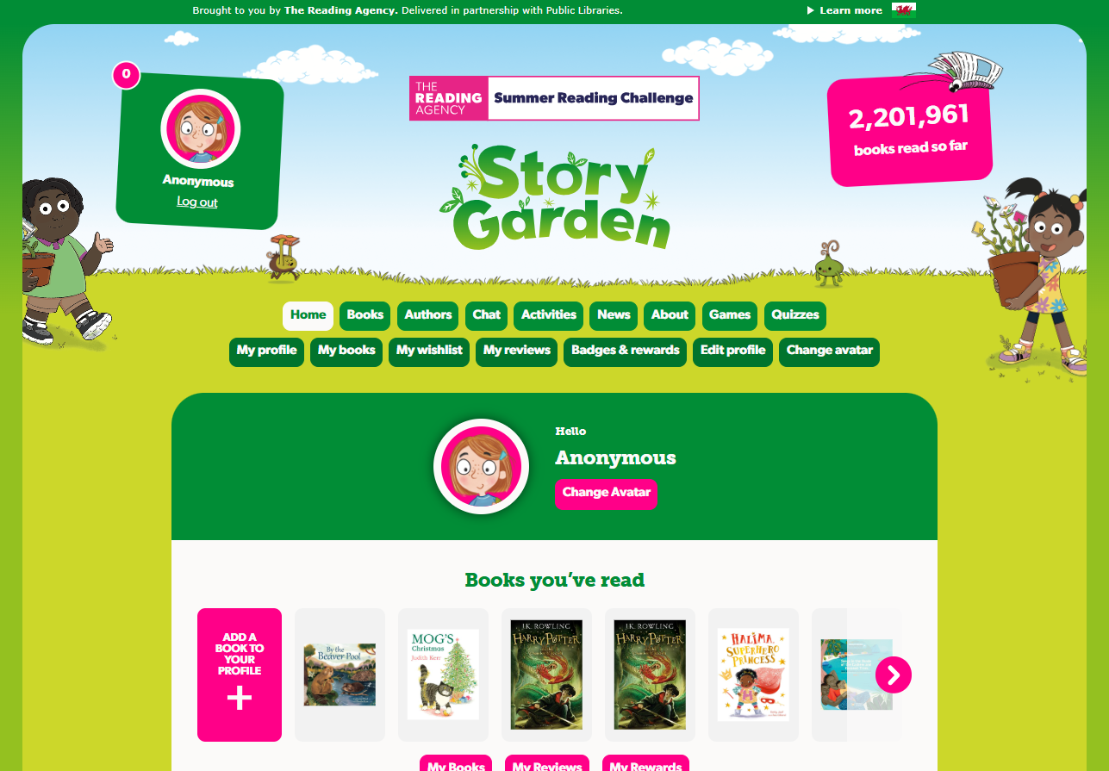



You can take part online!
✰ Set your own summer reading goal
✰ Rate and review your books to unlock badges
✰ Play games and enter competitions
✰ Use the Book Sorter to find books recommended by other children
summerreadingchallenge.org.uk
Notes:
The fun continues at home too! Visit the Summer Reading Challenge website to play games, review your latest reads and enter competitions.
You can share your favourite books with other children taking part in the Challenge and unlock extra rewards for your reading and reviewing!

Slide 7
Fun events & activities coming up
Add any activities your library wants to highlight here
Notes:
[Feel free to edit/remove this slide to reflect your local offer and the audience you're presenting to.]
The Reading Agency is an Approved Activity Provider for the Duke of Edinburgh's Award, which means volunteering to help with the Summer Reading Challenge counts towards the volunteering section of your Award!

Slide 8
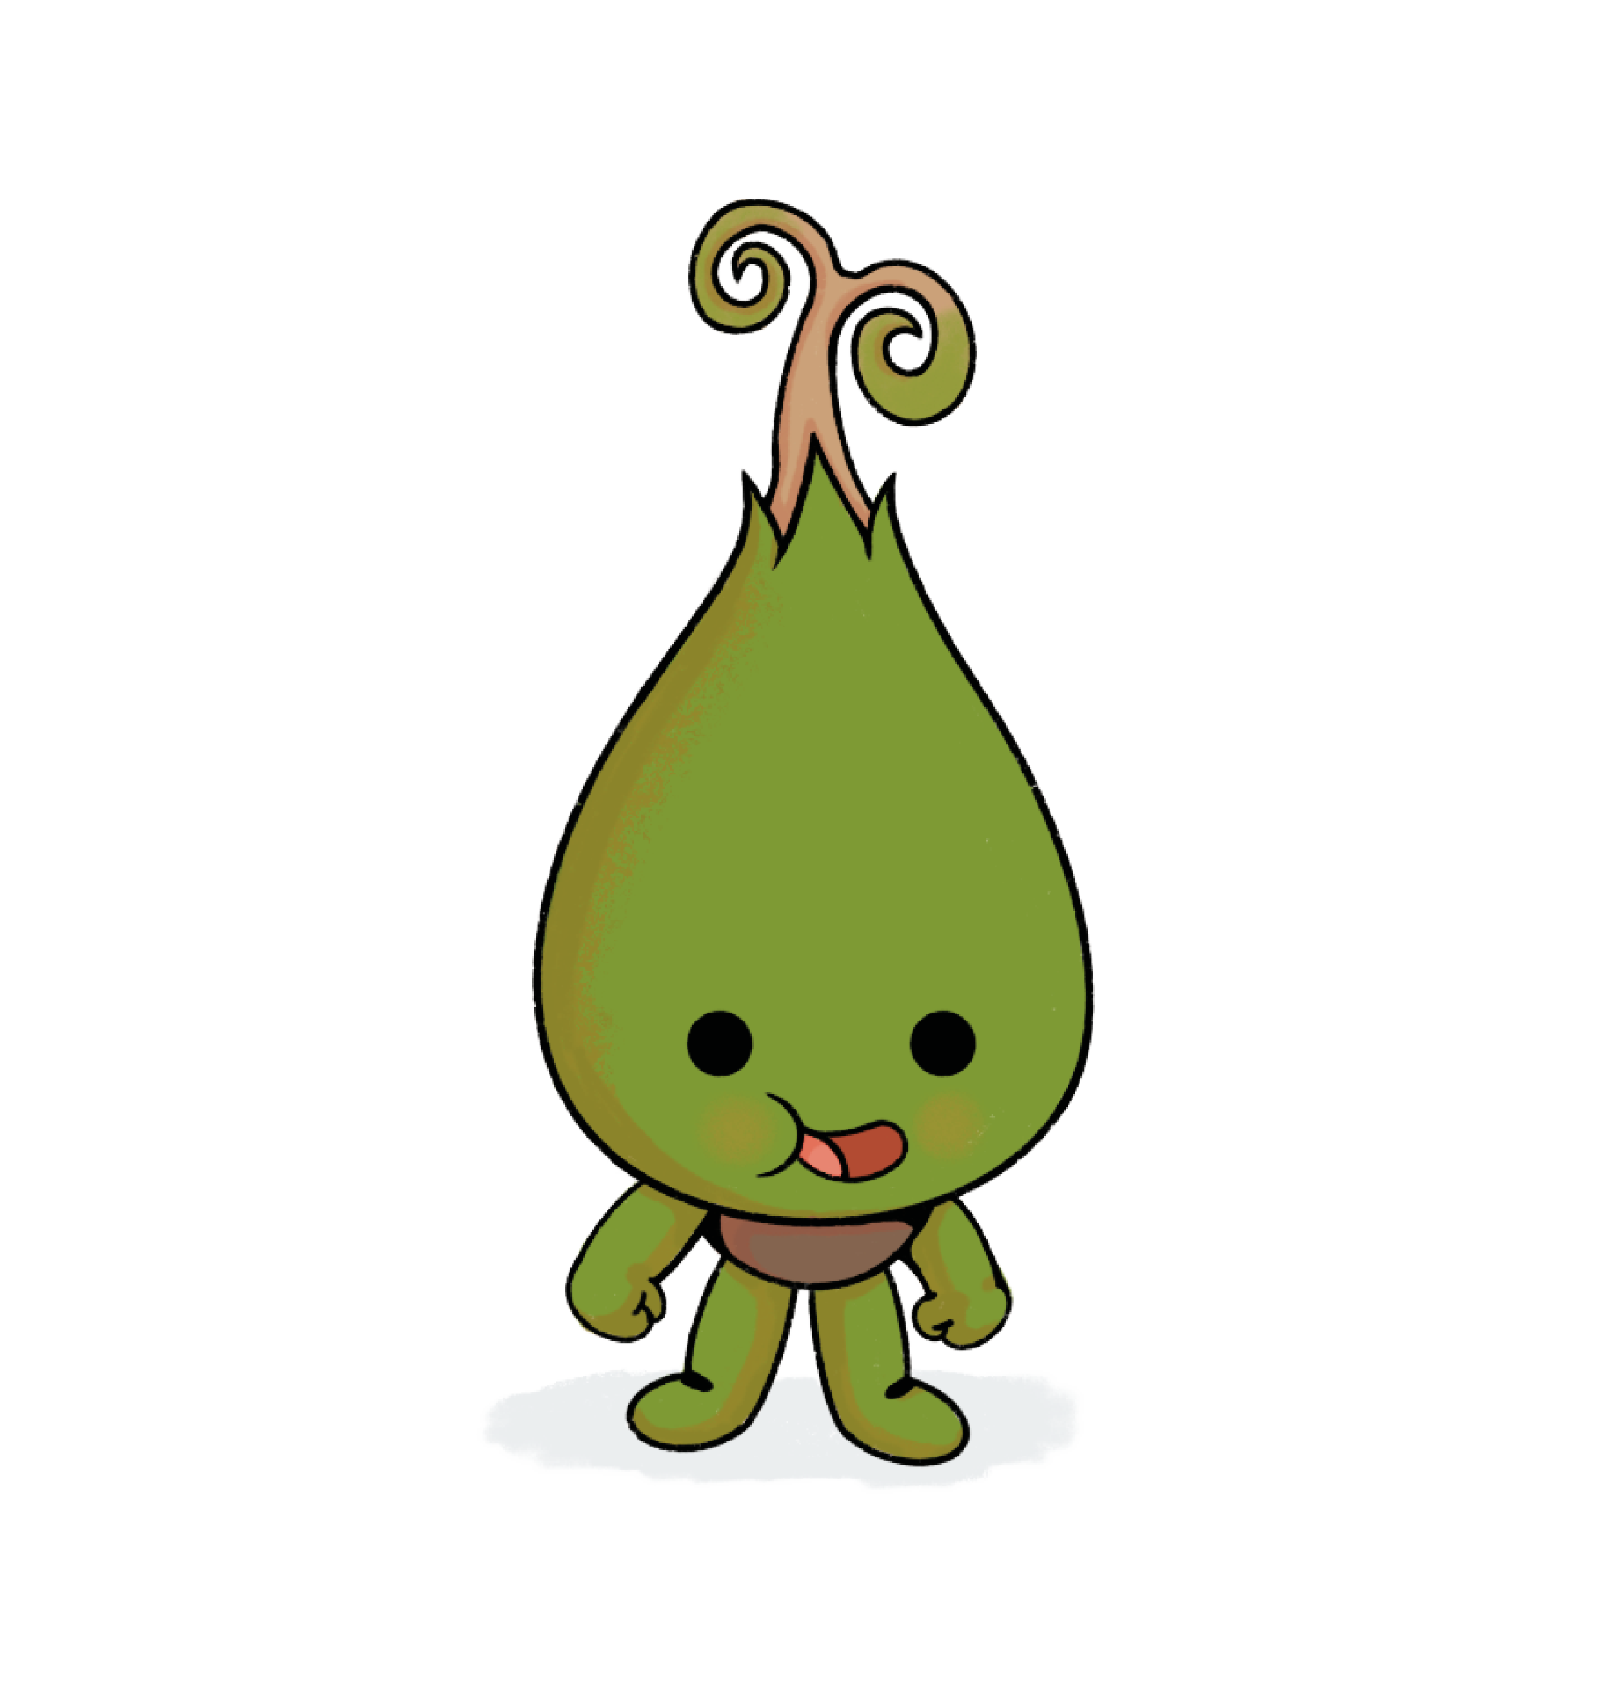

The Duke of Edinburgh's Award: Volunteering opportunities
Help us spread the joy of reading!
Young people aged 14+ can volunteer at the library to support the Summer Reading Challenge.
This can count towards the volunteering section of the Duke of Edinburgh’s Award!
Ask your local library about opportunities.
Notes:
[Feel free to edit/remove this slide to reflect your local offer and the audience you're presenting to.]
The Reading Agency is an Approved Activity Provider for the Duke of Edinburgh's Award, which means volunteering to help with the Summer Reading Challenge counts towards the volunteering section of your Award!

Slide 9

See you at the library!

